Slide 1
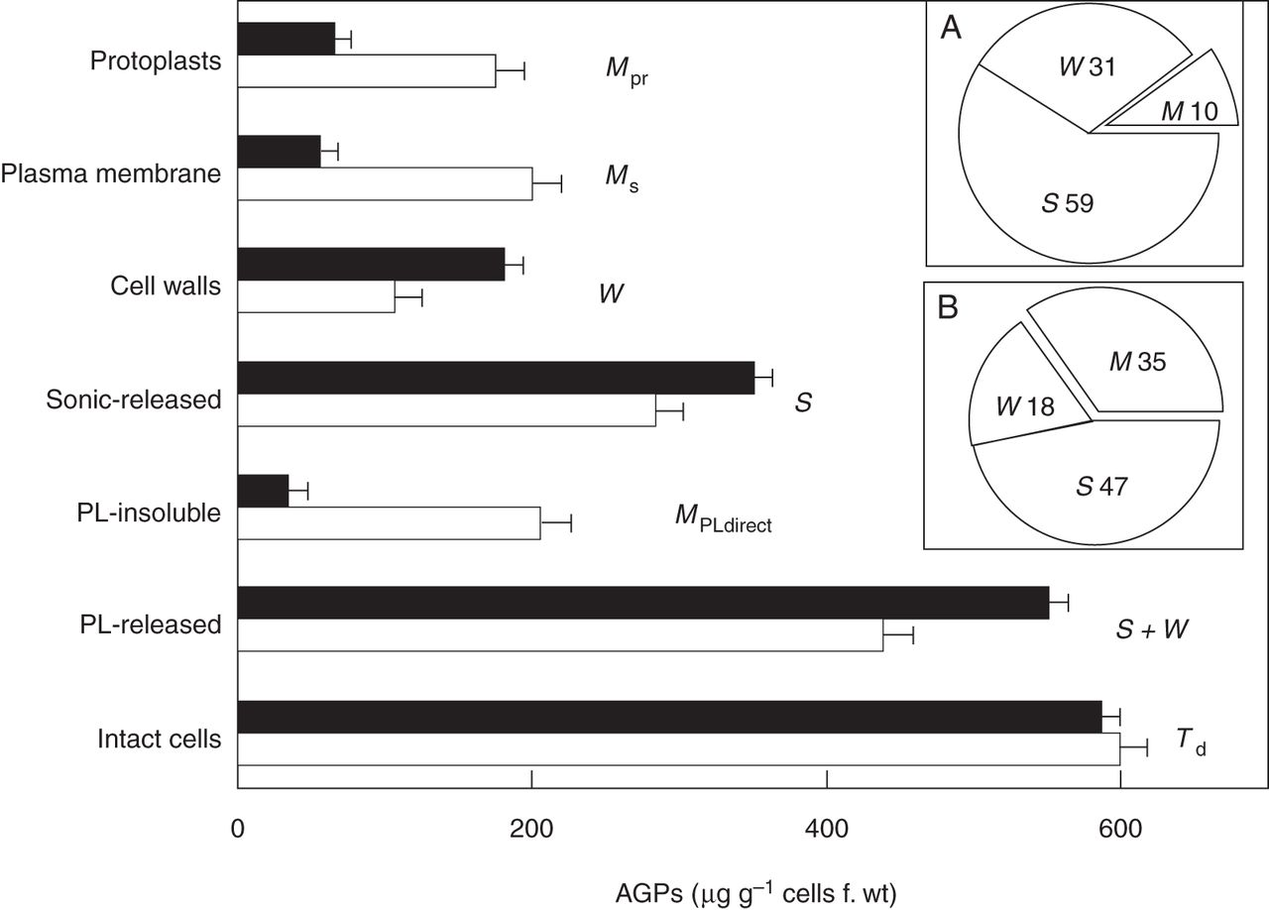
Fig. 1. Yariv reagent assay of AGP distribution in tobacco BY-2 cells adapted to growth in 2 % NaCl versus ...
Notes:
Fig. 1. Yariv reagent assay of AGP distribution in tobacco BY-2 cells adapted to growth in 2 % NaCl versus non-adapted controls. Solid columns, salt-adapted; empty columns, non-adapted controls. Protoplasts (Mpr), AGPs remaining bound after approx. 2 h treatment with cellulase/pectolyase. Plasma membrane (Ms), PM-bound AGPs calculated from the relation M = Td − ( S + W). Cell walls (W), AGPs assayed in the isolated wall fraction. Sonic-released (S), soluble AGPs released by ultrasonic cell disruption. PL-insoluble, AGPs remaining bound to cells after treatment with pectolyase also reflect PM-bound AGPs, hence MPLdirect. PL-released, soluble AGPs released by pectolyase treatment of intact cells reflect soluble periplasmic AGPs plus AGPs in muro (S + W). Intact cells (Td), AGPs that remain bound to washed cells. Error bars, 1 s.e. Each data point represents a minimum of five separate experiments using 7-d cultures of salt-adapted cells and 7-d cultures for controls. Note similar values for AGPs in protoplasts, plasma membrane and the pectolyase-insoluble residue of non-adapted control cells, but significantly lower values for plasma membrane-associated AGPs in 2 % salt-adapted cells (340 mm NaCl). Insets: Ms, S and W as a percentage of Td: (A) salt-adapted; (B) control cells. [Reprinted from Lamport et al. (2006).]
Unless provided in the caption above, the following copyright applies to the content of this slide: © The Author 2014. Published by Oxford University Press on behalf of the Annals of Botany Company. All rights reserved. For Permissions, please email: journals.permissions@oup.com

Slide 2
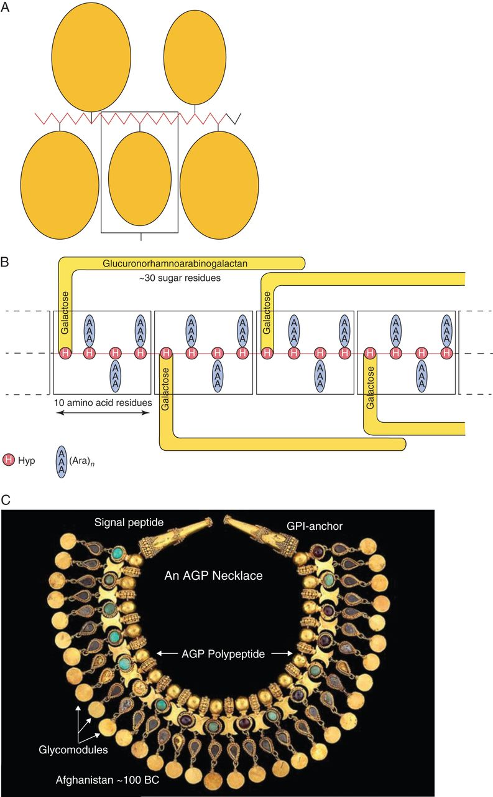
Fig. 2. AGP models: wattle blossom, hairy rope, necklace. (A) The ‘wattle-blossom’ model. Each Hyp residue of about ...
Notes:
Fig. 2. AGP models: wattle blossom, hairy rope, necklace. (A) The ‘wattle-blossom’ model. Each Hyp residue of about 24 is attached to an arabinogalactan chain that contains from one to 15 repeats of a β-(l-3)-linked galactose (Gal) oligosaccharide with a degree of polymerization (d.p.) of 12. The ‘wattle-blossom’ model depicts ‘the AGP as a whole is spheroidal’: GlcA, glucuronic acid; Rha, rhamnose; Gal, galactose; Ara, arabinose; p, pyranose; f, furanose. [Reprinted from Du et al. (1996a).] (B) The ‘twisted hairy rope’ model of an AGP. Hypothetical block size of 7 kDa contains 10 amino acid residues (1 kDa), 30 sugar residues (4·4 kDa) and 3 hydroxyproline (Hyp)-triarabinosides (1·32 kDa). The glucuronorhamnoarabinogalactan probably has a galactan backbone with glucuronic acid (GlcA), rhamnose (Rha) and arabinose (Ara) side chains. [Reprinted from Qi et al. (1991) as adapted by Du et al. (1996a).] (C) AGP modelled as a necklace. An elaborate robe decoration in the form of a necklace, (Tillya Tepe), 100 BC – 100 AD; National Museum of Afghanistan; Photograph Thierry Ollivier, Musée Guimet (reproduced with permission).
Unless provided in the caption above, the following copyright applies to the content of this slide: © The Author 2014. Published by Oxford University Press on behalf of the Annals of Botany Company. All rights reserved. For Permissions, please email: journals.permissions@oup.com

Slide 3
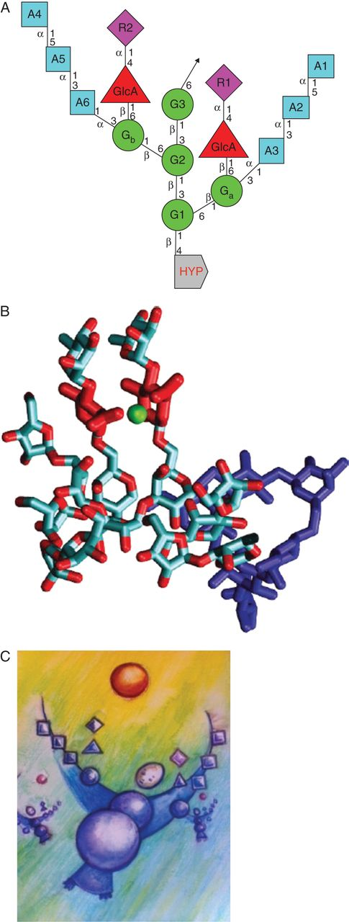
Fig. 3. Hyp-arabinogalactan (Hyp–AG) subunits. (A) The linkage connectivity of sugars involved in the repetitive ...
Notes:
Fig. 3. Hyp-arabinogalactan (Hyp–AG) subunits. (A) The linkage connectivity of sugars involved in the repetitive 15-residue consensus Hyp–AG, a conserved structure that accounts for Ca2+ binding by classical AGPs (Lamport and Varnai, 2013). A1–6 arabinose residues; G1–3 galactose mainchain residues; Ga and Gb, galactose sidedechain residues; R1 and R2, rhamnose sidechain residues; GlcA, glucuronic acid sidechain residues; Hyp, hydroxyproline. (B) Three-dimensional molecular model simulating an Hyp–AG with bound Ca2+. Hyp–AG interferon Hyp-polysaccharide-1 (IFNHP1) with Ca2+ ions (green) bound by two glucuronic acid (GlcA) sidechains (red); the galactan backbone is in dark blue and sidechains in light blue. [Reprinted from Lamport and Varnai (2013).] (C) ‘Molly Cool’ cartoon of an arabinogalactan subunit. Two hands are needed to catch a divalent Ca2+ ion. Credits: Amanda Dean and Freyja Dean.
Unless provided in the caption above, the following copyright applies to the content of this slide: © The Author 2014. Published by Oxford University Press on behalf of the Annals of Botany Company. All rights reserved. For Permissions, please email: journals.permissions@oup.com

Slide 4
Table 2. Content (mol %) of 6-linked galactose in AGPs * Identified as 2,3,4-trimethyl galactose. Fig. 4.AGP ...
Notes:
Table 2. Content (mol %) of 6-linked galactose in AGPs * Identified as 2,3,4-trimethyl galactose. Fig. 4.AGP Ca2+ binding: titration of Ca2+-depleted gum arabic with Ca2+ at pH 5. (A) Saturation binding data (black squares) with theoretical curve (line). (B) Scatchard analysis of binding data with best-fit line giving a Kd of 6·5 μm. YGlcA is the fraction of glucuronic acid bound. (C) pH-dependent cation release from Ca2+-saturated gum arabic: Ca2+ (dashed line) and Mg2+ (solid line). (D) Release of Ca2+ from gum arabic (dashed line) compared with pectin (solid line). [Reprinted from Lamport and Varnai (2013).]
Unless provided in the caption above, the following copyright applies to the content of this slide: © The Author 2014. Published by Oxford University Press on behalf of the Annals of Botany Company. All rights reserved. For Permissions, please email: journals.permissions@oup.com

Slide 5
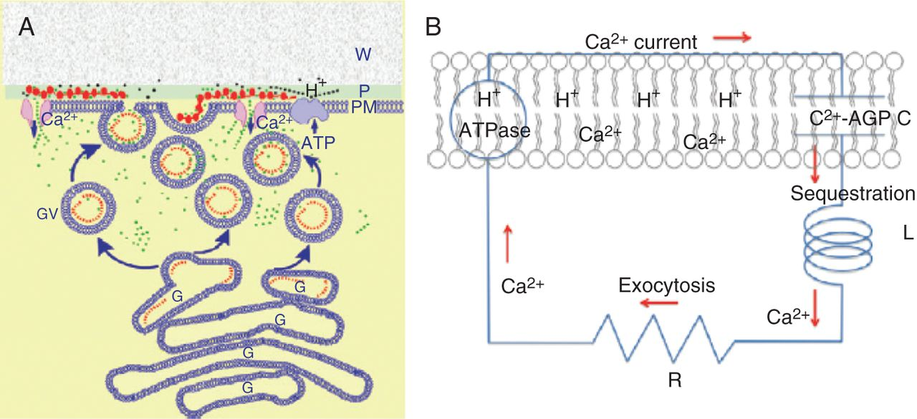
Fig. 5. The AGP–calcium oscillator. (A) Ca²⁺ release from periplasmic AGPs. The oscillator generates ...
Notes:
Fig. 5. The AGP–calcium oscillator. (A) Ca2+ release from periplasmic AGPs. The oscillator generates pulses of Ca2+ (green dots) whose influx coordinates exocytosis and rapid tip growth. This involves a pulse of H+ (black dots) releasing Ca2+ from periplasmic AGPs (red beads) via stretch-activated Ca2+ channels into the cytosol, and then sequestration by exocytotic Golgi vesicles containing AGPs (red dots). Diffusion of the initial H+ pulse to the wall domain restores the periplasmic pH. Ca2+ is recycled by fusion of vesicles with the plasma membrane. Ca2+ bound to periplasmic AGPs is now ready for the next oscillation. W, wall; P, periplasm; PM, plasma membrane; G, Golgi; GV, Golgi exocytotic vesicles. (B) Ca2+ current as a molecular clock: analogous to an electronic series RLC circuit where R is resistance, L is inductance and C is capacitance, with membrane-bound AGPs as the capacitor, C; Ca2+ sequestration as the inductance, L; vesicle exocytosis as the resistor, R, which limits the recycling rate. Hypothetically, C and L largely determine the oscillator frequency and amplitude of the Ca2+ current, ICa. Note the reported high efflux of Cl– as a counterion may maintain electrical neutrality (Cosgrove and Hedrich, 1991; Zonia et al., 2002). [Reprinted from Lamport and Varnai (2013).]
Unless provided in the caption above, the following copyright applies to the content of this slide: © The Author 2014. Published by Oxford University Press on behalf of the Annals of Botany Company. All rights reserved. For Permissions, please email: journals.permissions@oup.com

Slide 6
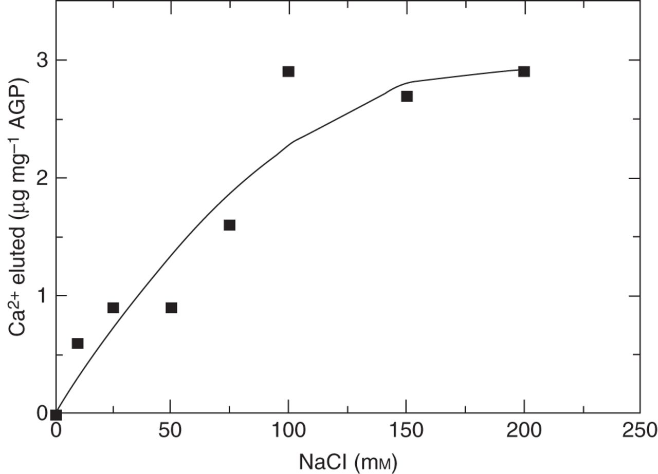
Fig. 6. High levels of Na⁺ compete with AGP-bound Ca²⁺. An experiment illustrating that ...
Notes:
Fig. 6. High levels of Na+ compete with AGP-bound Ca2+. An experiment illustrating that competition by 75 mm Na+ removed approx. 50 % of the Ca2+ from a carrot AGP–Ca2+ isolated from a carrot suspension culture. DTAL, unpublished data.
Unless provided in the caption above, the following copyright applies to the content of this slide: © The Author 2014. Published by Oxford University Press on behalf of the Annals of Botany Company. All rights reserved. For Permissions, please email: journals.permissions@oup.com

Slide 7
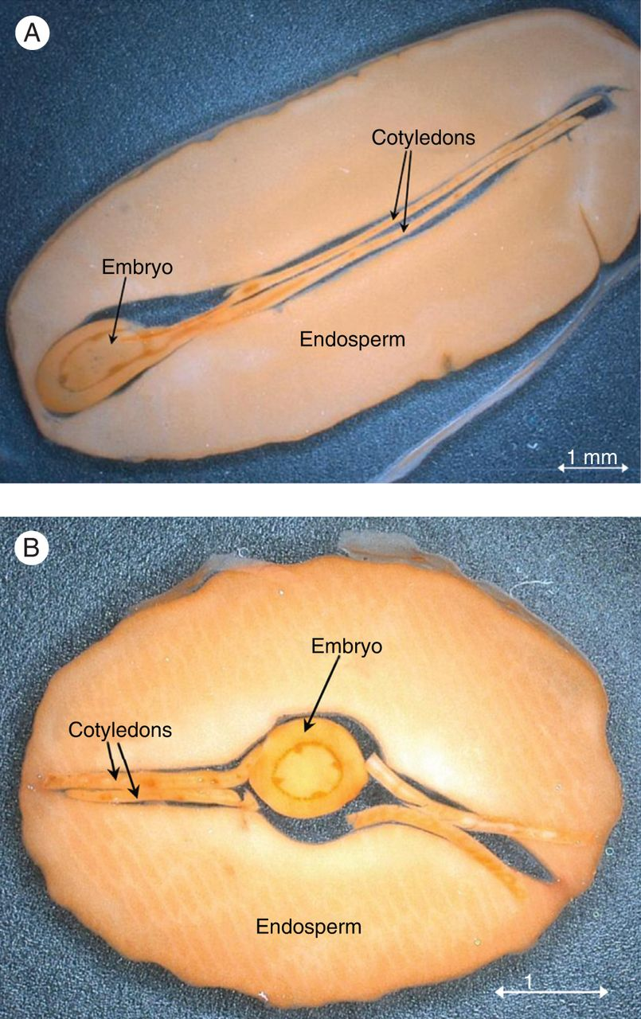
Fig. 7. Jatropha curcas staining with Yariv. J. curcas seed sections after staining with β-d-glucosyl Yariv: (A) ...
Notes:
Fig. 7. Jatropha curcas staining with Yariv. J. curcas seed sections after staining with β-d-glucosyl Yariv: (A) sagittal and (B) transverse section. [Reprinted from Sehlbach et al. (2013).]
Unless provided in the caption above, the following copyright applies to the content of this slide: © The Author 2014. Published by Oxford University Press on behalf of the Annals of Botany Company. All rights reserved. For Permissions, please email: journals.permissions@oup.com

