Slide 1
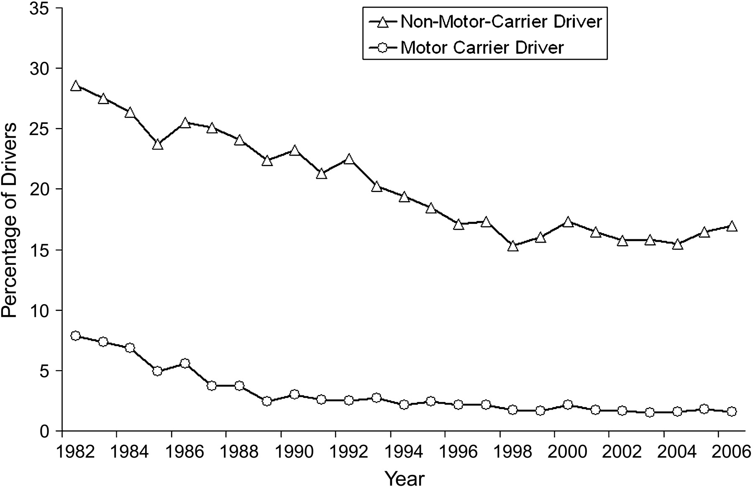
Figure 1. Percentage of drivers involved in fatal multivehicle motor carrier crashes with imputed blood alcohol ...
Notes:
Figure 1. Percentage of drivers involved in fatal multivehicle motor carrier crashes with imputed blood alcohol concentrations ≥0.01 g/dL, by year and driver type, United States, Fatality Analysis Reporting System, 1982–2006.
Unless provided in the caption above, the following copyright applies to the content of this slide: American Journal of Epidemiology © The Author 2009. Published by the Johns Hopkins Bloomberg School of Public Health. All rights reserved. For permissions, please e-mail: journals.permissions@oxfordjournals.org.

