Slide 1
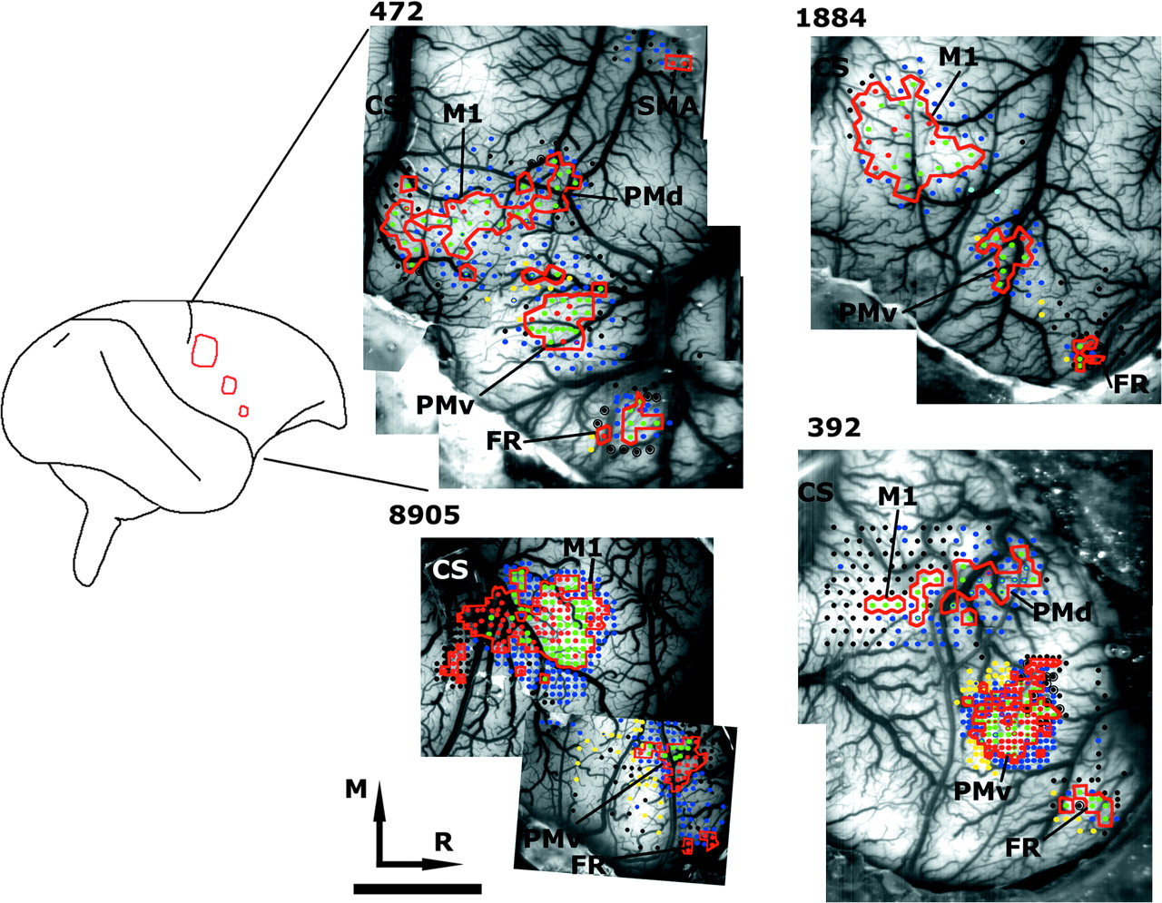
Figure 1. Reconstruction of ICMS movement maps. Digit and wrist/forearm movements comprised the DFL, indicated with a ...
Notes:
Figure 1. Reconstruction of ICMS movement maps. Digit and wrist/forearm movements comprised the DFL, indicated with a red contour. Each dot represents a microelectrode penetration site. The location of the ICMS-defined motor fields in each case is identified. Case 392 recovered from an experimental lesion in M1 prior to ICMS mapping explaining the small M1 DFL representation. Black dots = nonresponsive; black dots with large ring = site that was tested twice and still did not evoke response; dark blue = proximal movements; light blue = neck/back; green = wrist/forearm; red = digit; yellow = orofacial; R = rostral; M = medial; CS = central sulcus; scale bar = 5 mm.
Unless provided in the caption above, the following copyright applies to the content of this slide: © 2008 The AuthorsThis is an Open Access article distributed under the terms of the Creative Commons Attribution Non-Commercial License (http://creativecommons.org/licenses/by-nc/2.0/uk/) which permits unrestricted non-commercial use, distribution, and reproduction in any medium, provided the original work is properly cited.

Slide 2
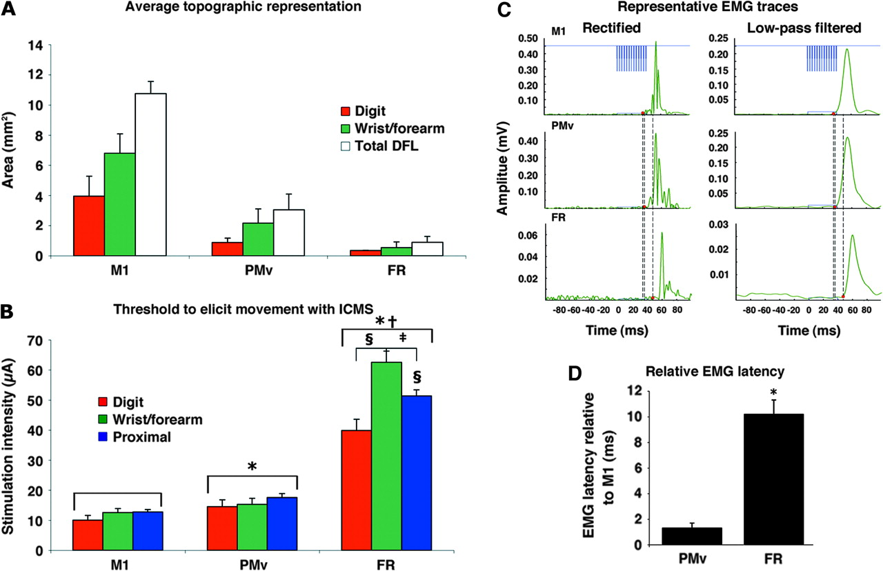
Figure 2. Area, threshold and latency for ICMS-defined representations in M1, PMv, and FR. (A) ICMS-evoked movement ...
Notes:
Figure 2. Area, threshold and latency for ICMS-defined representations in M1, PMv, and FR. (A) ICMS-evoked movement representations within the DFL of 3 motor fields: M1, PMv and FR (mean area ± SEM). The cortical surface area devoted to component movements is depicted. M1 DFL was more than 3 times larger than PMv, whereas PMv DFL was more than 3 times larger than FR. However, the proportion of component movements within each of these fields was similar. Monkey 392 was excluded from quantitative analysis because this subject had been given an M1 lesion. (B) Thresholds at which movements could be evoked using ICMS in M1, PMv, and FR (mean intensity ± SEM). Again this analysis excluded monkey 392. Statistical analysis revealed that movement thresholds in M1 were significantly lower than PMv and FR (*) and that thresholds in PMv were lower than FR (†). Within FR, digit movement thresholds were significantly lower than proximal and wrist/forearm (§). In addition, wrist/forearm movement thresholds were significantly higher than proximal movements thresholds (‡). (C) Representative ICMS-evoked EMG traces from each cortical area (M1, PMv and FR) recorded from the forearm extensors in case 472. On the left, the rectified traces are unfiltered. On the right, the same traces are shown following low-pass filtering, which were subsequently used for defining EMG onset. The train of stimulation is shown in blue (top). For each inset, the EMG trace is in green and the duration of the stimulation is in blue. A double dotted line identifies the onset of evoked EMG activity from M1 and PMv stimulation and the single dotted line identifies the onset of evoked EMG activity from FR stimulation. The y-axis is auto-scaled for the maximum amplitude of each trace. (D) Average latencies to evoke EMG activity with ICMS in PMv and FR relative to latencies in M1 (mean latency ± SEM). Within each monkey, the PMv and FR latencies were normalized by arithmetic subtraction from M1 latencies so that the data from both animals could then be combined (case 472, 2 PMv sites and 2 FR sites; case 1884 1 PMv site and 1 FR site). Normalized latencies to evoke EMG from FR were significantly longer than from PMv (*indicates statistically significant difference at P < 0.05).
Unless provided in the caption above, the following copyright applies to the content of this slide: © 2008 The AuthorsThis is an Open Access article distributed under the terms of the Creative Commons Attribution Non-Commercial License (http://creativecommons.org/licenses/by-nc/2.0/uk/) which permits unrestricted non-commercial use, distribution, and reproduction in any medium, provided the original work is properly cited.

Slide 3
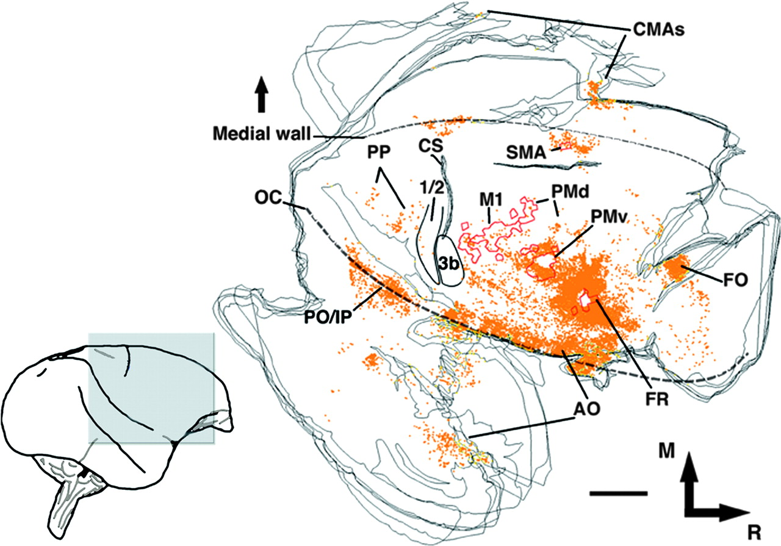
Figure 3. Pattern of connections of FR DFL in the ipsilateral hemisphere. Distribution of voxels with labeled terminals ...
Notes:
Figure 3. Pattern of connections of FR DFL in the ipsilateral hemisphere. Distribution of voxels with labeled terminals after injection of BDA into FR DFL (case 472; large injection; approximate depth of section = 1750 μm). This animal had the largest BDA injection in our 2 FR injected animals, which was of comparable size to the PMv injection in case 1934 (see Fig. 4A). Each orange dot represents a voxel (100 × 100 μm resolution; approximate depth 1500 μm) in which at least 2 labeled varicocities (terminal boutons) were identified. ICMS-defined DFLs are outlined with red contours and histochemically defined sensory areas (3b and area 1/2) in black contours. Additional dotted lines indicate the junction between the lateral and medial wall and the convexity of the lateral sulcus (operculum; OC). 1/2: primary somatosensory areas 1 and 2; 3b: primary somatosensory area 3b; CS: central sulcus; FO: frontal (others); M1: primary motor cortex; M = medial; R = rostral. Scale bar = 5 mm.
Unless provided in the caption above, the following copyright applies to the content of this slide: © 2008 The AuthorsThis is an Open Access article distributed under the terms of the Creative Commons Attribution Non-Commercial License (http://creativecommons.org/licenses/by-nc/2.0/uk/) which permits unrestricted non-commercial use, distribution, and reproduction in any medium, provided the original work is properly cited.

Slide 4
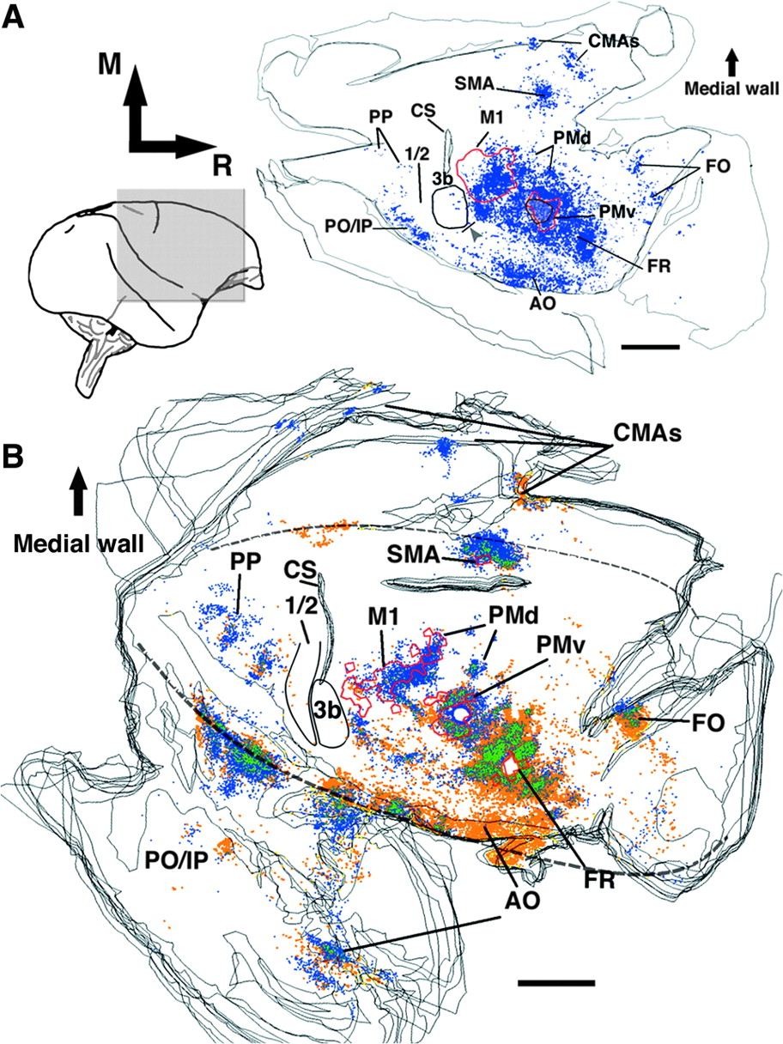
Figure 4. Comparison of the pattern of connections of PMv and FR DFL in the ipsilateral hemisphere. (A) Pattern of ...
Notes:
Figure 4. Comparison of the pattern of connections of PMv and FR DFL in the ipsilateral hemisphere. (A) Pattern of connections of PMv DFL in the ipsilateral hemisphere. Reconstruction of the typical distribution of voxels with labeled terminals observed in flattened, tangential sections through the fronto-parietal cortex in a case with a BDA injection in the PMv DFL (case 1934; Dancause, Barbay, Frost, Plautz, Stowe, et al. 2006). This injection was of comparable size and depth as the FR injection in case 472 (Fig. 3). As this animal received the largest BDA injection of any in that study, and displayed the most extensive and densest distribution of terminals, it provides a reasonable estimate of the limits of normal PMv connectivity. Each blue dot represents a voxel (100 × 100 μm resolution; approximate depth 1500 μm) in which at least 2 labeled varicocities (terminal boutons) were identified. ICMS-defined DFLs are outlined with red contours and histochemically defined sensory areas (3b and area 1/2) in black contours. In particular, note the intense BDA labeling found in M1 and the sparse labeling found in FO. In addition, BDA labeling in AO is less intense and more caudal than what was found following BDA injection in FR. (B) Within-case comparison of the pattern of connections of PMv and FR DFL in the ipsilateral hemisphere. Distribution of labeled terminals following injection of BDA into FR DFL (orange dots; see Fig. 3) and labeled cell bodies after injection of FB into PMv DFL (blue dots). One orange dot represents a voxel with labeled terminals and 1 blue dot represents a cell body. When both Fast Blue and BDA were colocalized, green is used. Abbreviations as in Figure 3. Scale bar = 5 mm.
Unless provided in the caption above, the following copyright applies to the content of this slide: © 2008 The AuthorsThis is an Open Access article distributed under the terms of the Creative Commons Attribution Non-Commercial License (http://creativecommons.org/licenses/by-nc/2.0/uk/) which permits unrestricted non-commercial use, distribution, and reproduction in any medium, provided the original work is properly cited.

Slide 5
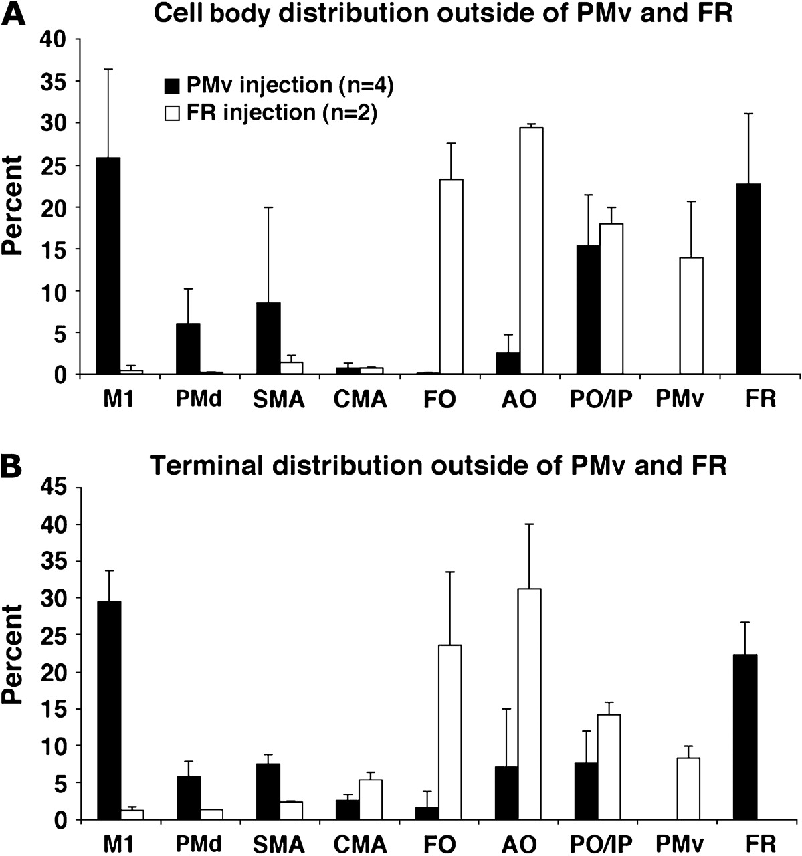
Figure 5. Quantitative distribution of labeling in the ipsilateral hemisphere. (A) Cell body distribution and (B) ...
Notes:
Figure 5. Quantitative distribution of labeling in the ipsilateral hemisphere. (A) Cell body distribution and (B) voxels with labeled terminals distribution following BDA injection in FR (n = 2) is compared with the distribution following injection in PMv (n = 4; from Dancause, Barbay, Frost, Plautz, Stowe, et al. 2006). Extrinsic connections with PMv are only available for the group of animals that had injection in FR and vice versa. Consequently, in these cases, to obtain the percentages, the denominator was the gross total − FR or PMv. It should be noted that the FR group is composed of only 2 animals and that the error bars simply show the variance between these 2 cases. See Figure 3 for abbreviations.
Unless provided in the caption above, the following copyright applies to the content of this slide: © 2008 The AuthorsThis is an Open Access article distributed under the terms of the Creative Commons Attribution Non-Commercial License (http://creativecommons.org/licenses/by-nc/2.0/uk/) which permits unrestricted non-commercial use, distribution, and reproduction in any medium, provided the original work is properly cited.

