Slide 1
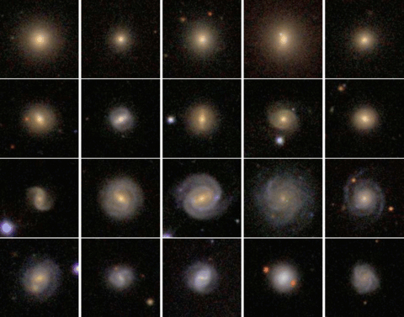
Figure 3 Examples of galaxies in our sample. The four rows show from top to bottom panel, respectively, elliptical ...
Notes:
Figure 3 Examples of galaxies in our sample. The four rows show from top to bottom panel, respectively, elliptical galaxies, galaxies with classical bulges, galaxies with pseudo-bulges and bulgeless galaxies. For the three last rows, the first three columns from left show barred galaxies. This grouping is based on the results from our parametric image decompositions.
Unless provided in the caption above, the following copyright applies to the content of this slide: © 2009 The Author. Journal compilation © 2009 RAS

Slide 2
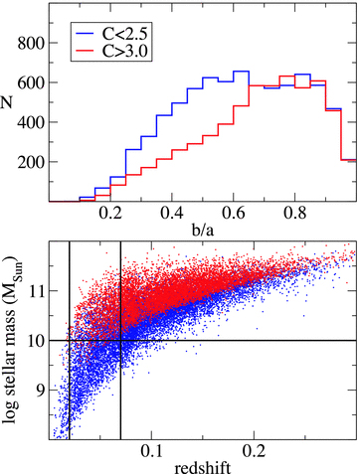
Figure 2 Top panel: distribution of isophotal axial ratios for galaxies in the parent sample with a concentration ...
Notes:
Figure 2 Top panel: distribution of isophotal axial ratios for galaxies in the parent sample with a concentration index below 2.5 (blue line) and above 3 (red line). Bottom panel: stellar mass plotted against redshift for all spectroscopically classified galaxies in SDSS DR2. Black lines indicate our cuts in mass and redshift. Blue and red dots correspond to galaxies with low and high dust-corrected z-band mass-to-light ratios, respectively.
Unless provided in the caption above, the following copyright applies to the content of this slide: © 2009 The Author. Journal compilation © 2009 RAS

Slide 3
Figure 1 Distributions of galaxy properties for the parent sample (top panels) and the final sample (bottom panels). ...
Notes:
Figure 1 Distributions of galaxy properties for the parent sample (top panels) and the final sample (bottom panels). From left- to right-hand panel: dust-corrected stellar mass, k-corrected z-band absolute magnitude, Dn4000 (corrected for [Ne iii] contamination), extinction-corrected [O iii] 5007 Å luminosity for AGN and the Petrosian concentration index. The first three parameters were taken from Kauffmann et al. (2003b), [O iii] luminosities from Kauffmann et al. (2003a) and concentration from the SDSS data base. The [O iii] luminosity has been used in previous work as an indicator of the accretion rate on to the central black hole (Heckman et al. 2004).
Unless provided in the caption above, the following copyright applies to the content of this slide: © 2009 The Author. Journal compilation © 2009 RAS

Slide 4
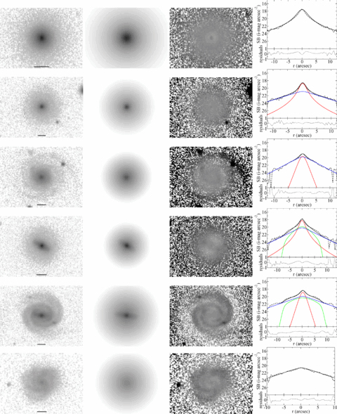
Figure 4 Examples of fits obtained. Each row refers to a single galaxy, showing, from left- to right-hand panel: the ...
Notes:
Figure 4 Examples of fits obtained. Each row refers to a single galaxy, showing, from left- to right-hand panel: the original i-band galaxy image, the model image obtained with budda, the residual image and surface brightness profiles. Horizontal lines in the galaxy images mark a length of 5 kpc at the galaxy distance. The first two images have intensities transformed to magnitudes per square arcsec, and are displayed with the same levels in all rows. The residual images are obtained by subtracting the model image from the original image, and are displayed with a much narrower range in intensity, which is also the same in all rows, in order to enhance residual substructures. In the residual images, darker pixels indicate where the galaxy is brighter than the model, whereas whiter pixels indicate where the model is brighter than the galaxy. The surface brightness profiles were obtained from cuts along the galaxy major axis, or along the bar major axis when there is a bar. The dashed line corresponds to the original galaxy image, whereas the black solid line corresponds to the model. When there is more than a single component, red, blue and green lines refer, respectively, to bulge, disc and bar. The dotted line in the bottom panel shows the residuals (galaxy − model). These results correspond to, from top to bottom panel, respectively, an elliptical galaxy, a galaxy with a classical bulge, a galaxy with a pseudo-bulge, a barred galaxy with a classical bulge, a barred galaxy with a pseudo-bulge and a bulgeless galaxy.
Unless provided in the caption above, the following copyright applies to the content of this slide: © 2009 The Author. Journal compilation © 2009 RAS

Slide 5
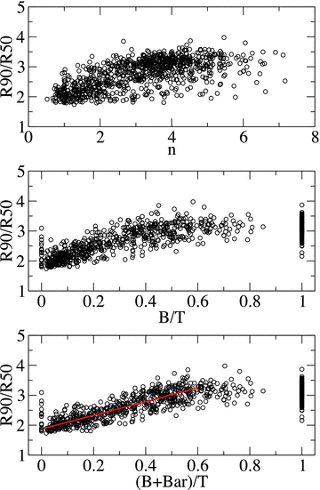
Figure 5 The concentration index (R90/R50) plotted against the bulge Sérsic index n (top panel), the bulge-to-total ...
Notes:
Figure 5 The concentration index (R90/R50) plotted against the bulge Sérsic index n (top panel), the bulge-to-total ratio B/T (middle panel) and the added contributions of bulge and bar to the total galaxy luminosity (B+ Bar)/T (bottom panel). The correlation between concentration and n is remarkably poorer than that with B/T. Interestingly, the latter correlation is improved when the bar contribution is taken into account. Elliptical galaxies and bulgeless galaxies can be readily identified in the middle panel at B/T= 1 and 0, respectively. The red line in the bottom panel is a linear fit to the data points with 0 < (B+ Bar)/T≤ 0.6. For galaxies with B/T, or (B+ Bar)/T, greater than ≈0.6, R90/R50 is roughly constant at ≈3.
Unless provided in the caption above, the following copyright applies to the content of this slide: © 2009 The Author. Journal compilation © 2009 RAS

Slide 6
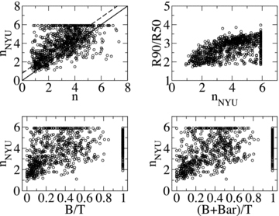
Figure 6 Top left-hand panel: the galaxy Sérsic index from Blanton et al. (2005a) plotted against our measurements of ...
Notes:
Figure 6 Top left-hand panel: the galaxy Sérsic index from Blanton et al. (2005a) plotted against our measurements of the bulge Sérsic index; top right-hand panel: the concentration index plotted against the galaxy Sérsic index; bottom left-hand panel: the galaxy Sérsic index plotted against B/T and bottom right-hand panel: the galaxy Sérsic index plotted against (B+ Bar)/T. The solid line in the top left-hand panel depicts a perfect correspondence. The dashed line is a linear fit to all data points, fixing the slope of the fit to 1. Although there is a very large spread, it is clear that the galaxy Sérsic index is systematically higher than the bulge Sérsic index by, on average, ≈0.8.
Unless provided in the caption above, the following copyright applies to the content of this slide: © 2009 The Author. Journal compilation © 2009 RAS

Slide 7
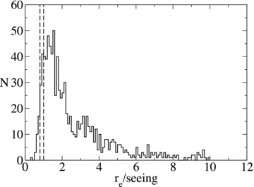
Figure 7 Distribution of the ratio between bulge effective radius and PSF HWHM for all galaxies in the sample ...
Notes:
Figure 7 Distribution of the ratio between bulge effective radius and PSF HWHM for all galaxies in the sample (excluding bulgeless galaxies). The two vertical dashed lines mark the positions where this ratio is 0.8 and 1. Only 3 per cent (10 per cent) of the bulges have effective radii below 0.8 (1) times the PSF HWHM.
Unless provided in the caption above, the following copyright applies to the content of this slide: © 2009 The Author. Journal compilation © 2009 RAS

Slide 8
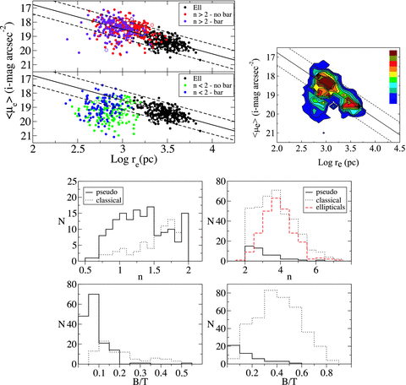
Figure 8 The graphical representation of our criterion to distinguish classical and pseudo-bulges. The two contiguous ...
Notes:
Figure 8 The graphical representation of our criterion to distinguish classical and pseudo-bulges. The two contiguous panels at the top show the mean effective surface brightness within the effective radius plotted against the logarithm of the effective radius. The two panels display elliptical galaxies and, separately, bulges with the Sérsic index above and below 2. Barred and unbarred galaxies are also indicated. The solid line is a fit to the elliptical galaxies and the two dashed lines point out its ±3σ boundaries. Bulges that lie below the lower dashed line are classified as pseudo-bulges, independently of their Sérsic index. Bigger, white-filled circles represent systems with 0.5 < b/a < 0.7, with similar colour coding. They do not show any clear distinct patterns. The separate panel at the top shows a density plot with all data points taken altogether. It shows that ellipticals, classical and pseudo-bulges indeed appear as independent groups in the Kormendy relation. The four histograms at the bottom show the distributions of the Sérsic index n and bulge-to-total luminosity ratio B/T for classical bulges and pseudo-bulges with n < 2 (left-hand panel) and n≥ 2 (right-hand panel). While the threshold in the Sérsic index can be considered as an approximation to identify pseudo-bulges, it is clear that it can generate many misclassifications. Our criterion can recognize more precisely pseudo-bulges, as those which are structurally different from classical bulges and ellipticals (also shown in the top right histogram).
Unless provided in the caption above, the following copyright applies to the content of this slide: © 2009 The Author. Journal compilation © 2009 RAS

Slide 9
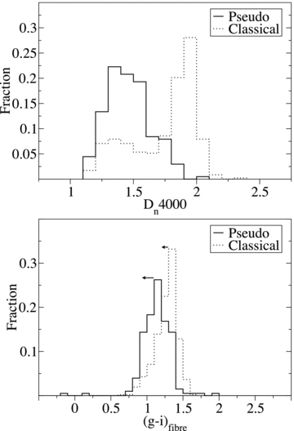
Figure 9 Distributions of D_{n}(4000) (top panel) and fibre g−i colour (bottom panel) for pseudo-bulges and ...
Notes:
Figure 9 Distributions of Dn(4000) (top panel) and fibre g−i colour (bottom panel) for pseudo-bulges and classical bulges. The arrows in the bottom panel indicate an upper limit on how dust reddening could affect the colours of each bulge category, on average.
Unless provided in the caption above, the following copyright applies to the content of this slide: © 2009 The Author. Journal compilation © 2009 RAS

Slide 10
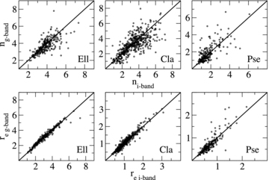
Figure 10 Comparison between structural parameters of elliptical galaxies and bulges obtained in the g and i bands. Top ...
Notes:
Figure 10 Comparison between structural parameters of elliptical galaxies and bulges obtained in the g and i bands. Top panel: the Sérsic index and bottom panel: effective radius. The solid lines depict a one-to-one correspondence. Bulges are separated according to our classification between classical and pseudo-bulges. The absence of systematic effects indicates that dust does not play a significant role in the overall results of the decompositions.
Unless provided in the caption above, the following copyright applies to the content of this slide: © 2009 The Author. Journal compilation © 2009 RAS

Slide 11
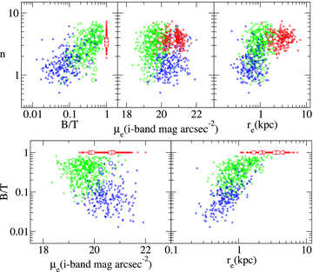
Figure 11 The bulge Sérsic index plotted against the bulge-to-total luminosity ratio (top left-hand panel), bulge ...
Notes:
Figure 11 The bulge Sérsic index plotted against the bulge-to-total luminosity ratio (top left-hand panel), bulge effective surface brightness (top centre panel) and bulge effective radius (top right-hand panel). And the bulge-to-total luminosity ratio plotted against bulge effective surface brightness (bottom left-hand panel) and effective radius (bottom right-hand panel). Blue, green and red circles represent, respectively, pseudo-bulges, classical bulges and ellipticals, with b/a≥ 0.9. Bigger, white-filled circles with similar colour coding represent systems with 0.5 < b/a < 0.7. They follow similar patterns.
Unless provided in the caption above, the following copyright applies to the content of this slide: © 2009 The Author. Journal compilation © 2009 RAS

Slide 12
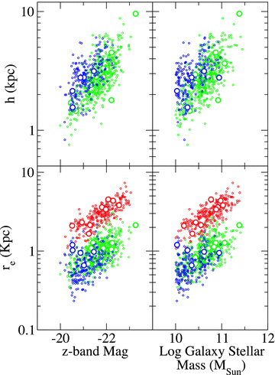
Figure 12 Disc scalelength and bulge effective radius plotted against galaxy z band absolute magnitude (k-corrected to ...
Notes:
Figure 12 Disc scalelength and bulge effective radius plotted against galaxy z band absolute magnitude (k-corrected to z= 0.1) and dust-corrected stellar mass from Kauffmann et al. (2003b). Blue, green and red circles represent, respectively, galaxies with pseudo-bulges, galaxies with classical bulges and ellipticals, with b/a≥ 0.9. Bigger, white-filled circles with similar colour coding represent systems with 0.5 < b/a < 0.7. They follow similar patterns.
Unless provided in the caption above, the following copyright applies to the content of this slide: © 2009 The Author. Journal compilation © 2009 RAS

Slide 13
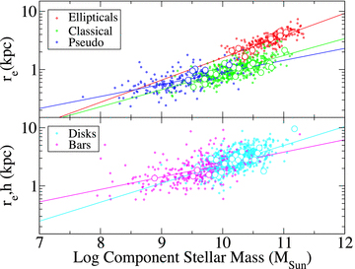
Figure 13 The scalelengths of elliptical galaxies, classical bulges, pseudo-bulges, discs and bars, plotted against the ...
Notes:
Figure 13 The scalelengths of elliptical galaxies, classical bulges, pseudo-bulges, discs and bars, plotted against the corresponding component stellar mass, as indicated. The solid lines are fits to the data. Bigger, white-filled circles represent systems with 0.5 < b/a < 0.7, with similar colour coding. They show a similar behaviour.
Unless provided in the caption above, the following copyright applies to the content of this slide: © 2009 The Author. Journal compilation © 2009 RAS

Slide 14
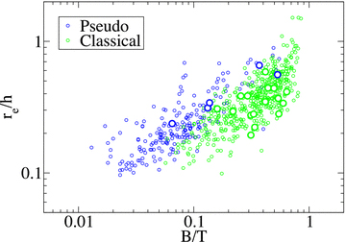
Figure 14 Ratio between the scalelengths of bulges and discs r_{e}/h plotted against B/T for pseudo-bulges and ...
Notes:
Figure 14 Ratio between the scalelengths of bulges and discs re/h plotted against B/T for pseudo-bulges and classical bulges. Although there is some scatter, it is evident that both quantities are correlated, which rules out the concept of a scale-free Hubble sequence. Interestingly, pseudo-bulges and classical bulges seem to follow offset relations. For the same B/T, pseudo-bulges have on average higher values of re/h. Bigger, white-filled circles with similar colour coding are pseudo-bulges and classical bulges in galaxies with 0.5 < b/a < 0.7, and portray similar patterns.
Unless provided in the caption above, the following copyright applies to the content of this slide: © 2009 The Author. Journal compilation © 2009 RAS

Slide 15
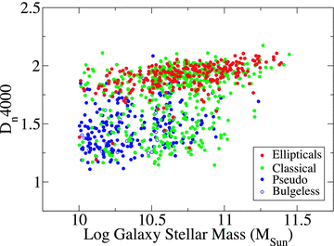
Figure 15 The 4000 Å break index plotted against galaxy dust-corrected stellar mass. Virtually all elliptical galaxies ...
Notes:
Figure 15 The 4000 Å break index plotted against galaxy dust-corrected stellar mass. Virtually all elliptical galaxies are found in the red sequence, while practically all galaxies with pseudo-bulges, and bulgeless galaxies, are found in the blue cloud. Galaxies with classical bulges can be found in both the red sequence and the blue cloud, although the majority of them occupy the red sequence.
Unless provided in the caption above, the following copyright applies to the content of this slide: © 2009 The Author. Journal compilation © 2009 RAS

Slide 16
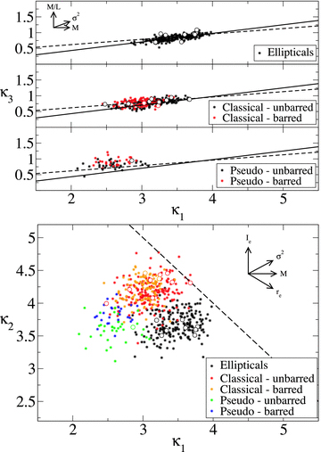
Figure 16 Elliptical galaxies, classical bulges and pseudo-bulges in the κ-space formulation of the fundamental plane ...
Notes:
Figure 16 Elliptical galaxies, classical bulges and pseudo-bulges in the κ-space formulation of the fundamental plane (FP). The top three panels show the edge-on view of the FP, κ3 plotted against κ1, while the bottom panel shows its nearly face-on view, κ2 plotted against κ1. Barred and unbarred galaxies are also indicated. In the top panels, the solid line is a fit to our ellipticals, while the dashed line is the fit obtained by Bernardi et al. (2003b) for nearly 9000 early-type galaxies. The dashed line in the bottom panel shows the limit of the zone of avoidance. The arrows indicate how some important physical parameters vary across the FP. Bigger, white-filled circles represent systems with 0.5 < b/a < 0.7, with similar colour coding.
Unless provided in the caption above, the following copyright applies to the content of this slide: © 2009 The Author. Journal compilation © 2009 RAS

Slide 17
Figure 17 Distributions of μ₀, h and D/T for all disc galaxies in the sample. The first two panels also show ...
Notes:
Figure 17 Distributions of μ0, h and D/T for all disc galaxies in the sample. The first two panels also show the values of the median and standard deviation of each distribution, as well as the mean 1σ uncertainty in individual measurements. Bin sizes are ≈2σ.
Unless provided in the caption above, the following copyright applies to the content of this slide: © 2009 The Author. Journal compilation © 2009 RAS

Slide 18
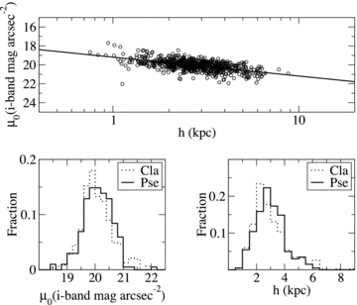
Figure 18 Scaling relation between disc scalelength and central surface brightness. The histograms at the bottom show ...
Notes:
Figure 18 Scaling relation between disc scalelength and central surface brightness. The histograms at the bottom show that galaxies with pseudo-bulges have more extended discs, with fainter central surface brightness, on average, as compared with galaxies hosting classical bulges, albeit with significant overlap. A Kolmogorov–Smirnov test rejects the null hypothesis of no difference between such distributions at a 92 per cent confidence level.
Unless provided in the caption above, the following copyright applies to the content of this slide: © 2009 The Author. Journal compilation © 2009 RAS

Slide 19
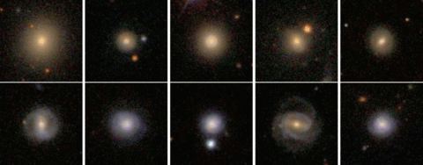
Figure 19 Examples of galaxies hosting classical bulges with D_{n}(4000) ≥ 1.7 (top panel) and ...
Notes:
Figure 19 Examples of galaxies hosting classical bulges with Dn(4000) ≥ 1.7 (top panel) and Dn(4000) < 1.7 (bottom panel). It is evident that the latter shows more often spiral structure and blue discs.
Unless provided in the caption above, the following copyright applies to the content of this slide: © 2009 The Author. Journal compilation © 2009 RAS

Slide 20
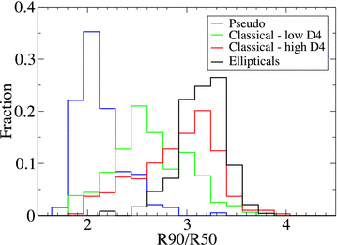
Figure 20 Distribution of concentration (R90/R50) for pseudo-bulges, classical bulges with D_{n}(4000) < 1.7, ...
Notes:
Figure 20 Distribution of concentration (R90/R50) for pseudo-bulges, classical bulges with Dn(4000) < 1.7, classical bulges with Dn(4000) ≥ 1.7 and elliptical galaxies.
Unless provided in the caption above, the following copyright applies to the content of this slide: © 2009 The Author. Journal compilation © 2009 RAS

Slide 21
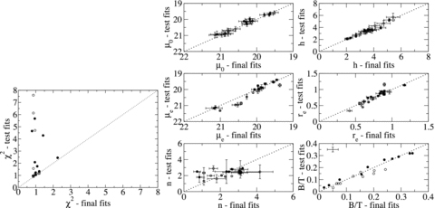
Figure A1 Comparison between the results from test and final fits in 20 barred galaxies. Filled circles refer to tests ...
Notes:
Figure A1 Comparison between the results from test and final fits in 20 barred galaxies. Filled circles refer to tests where the input parameters were multiplied by two, while empty circles refer to tests where the input parameters were divided by two. Error bars are 1σ uncertainties estimated by the fitting code. For B/T, typical error bars are shown, calculated through error propagation using the uncertainties in μe, re and n.
Unless provided in the caption above, the following copyright applies to the content of this slide: © 2009 The Author. Journal compilation © 2009 RAS

