Slide 1
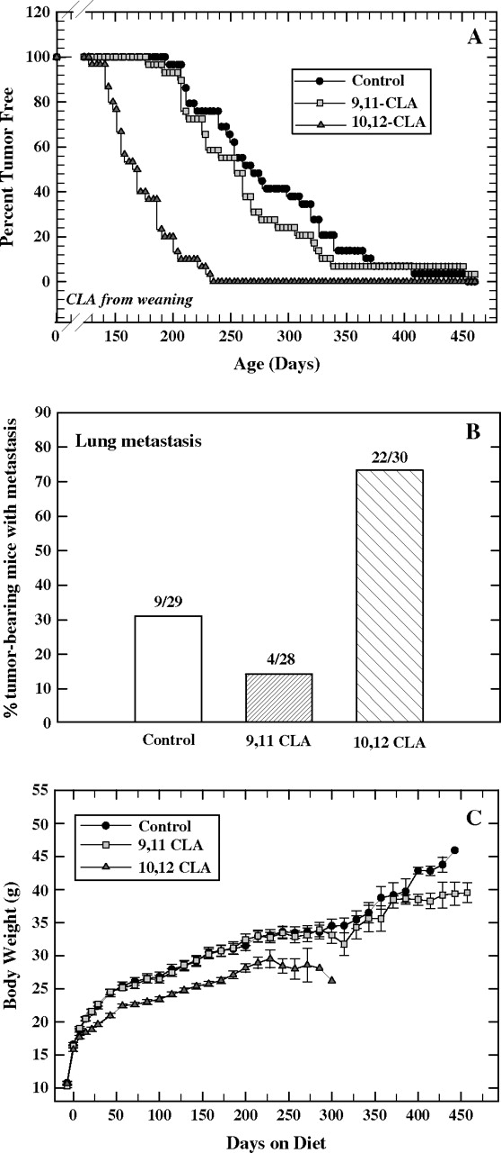
Fig. 1. Mammary tumorigenesis, lung metastasis and body weight of erbB2 transgenic mice fed control, c9,t11-CLA- or ...
Notes:
Fig. 1. Mammary tumorigenesis, lung metastasis and body weight of erbB2 transgenic mice fed control, c9,t11-CLA- or t10,c12-CLA-supplemented diets from 24 days of age until being killed. ( A ) Kaplan–Meier plot showing percentage of tumor-free mice in each group at various ages. Of the initial 30 mice in each group, one mouse in the control group and one in the c9,t11-CLA group were killed early due to causes unrelated to the experimental protocol. These mice are not included in the figure. The remaining mice in the control group (29 mice) and all mice in the t10,c12-CLA group (30 mice) were killed with tumor. One mouse in the c9,t11-CLA group was killed without tumor at the end of the experiment; 28 mice in the c9,t11-CLA group were killed with tumor. The control and the c9,t11-CLA groups are each significantly different from the t10,c12-CLA group; there is no statistically significant difference between the control and c9,t11-CLA groups. ( B ) Percentage of tumor-bearing mice with lung metastasis. The numbers above each bar indicate the number of tumor-bearing mice (denominator) with lung metastasis (numerator) in each group. The control and c9,t11-CLA groups are each statistically different from the t10,c12-CLA group. ( C ) Body weights of erbB2 transgenic mice in the three dietary groups. Each point represents the mean ± SEM.
Unless provided in the caption above, the following copyright applies to the content of this slide: © The Author 2007. Published by Oxford University Press. All rights reserved. For Permissions, please email: journals.permissions@oxfordjournals.org

Slide 2
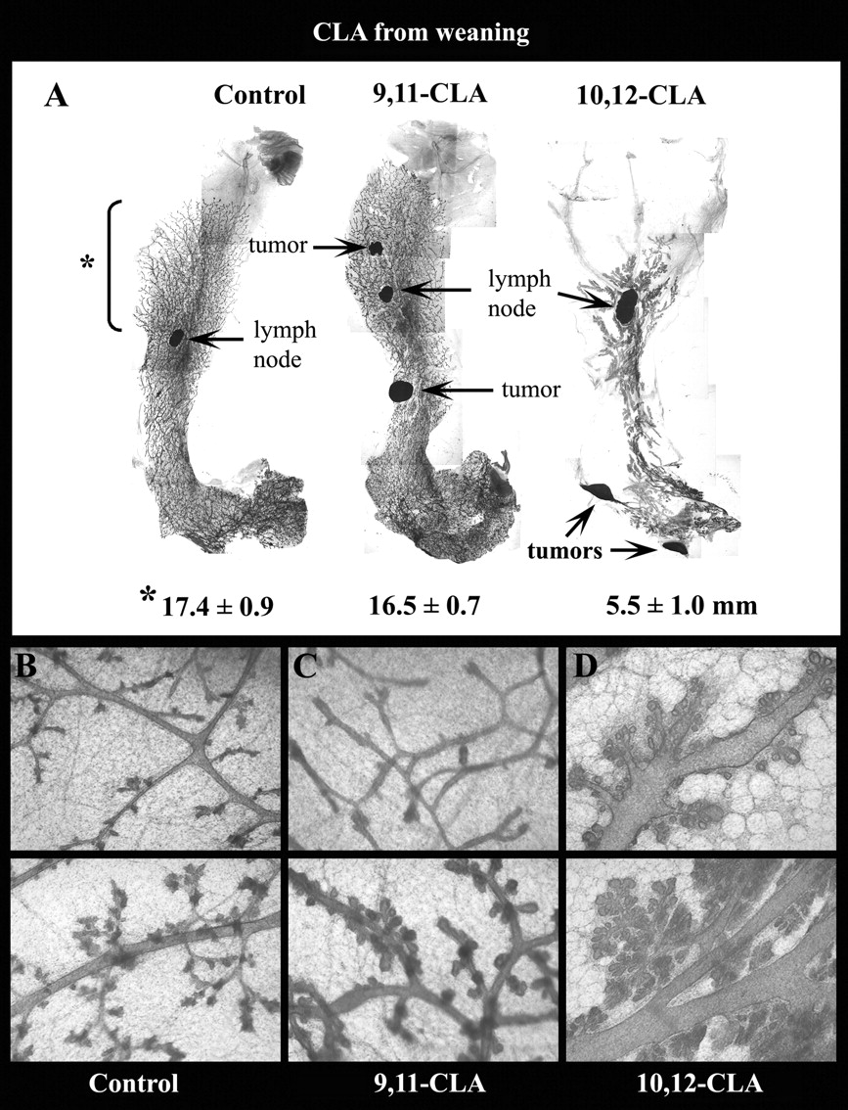
Fig. 2. Mammary gland whole mounts from erbB2 transgenic mice demonstrate a marked inhibition of epithelial ductal ...
Notes:
Fig. 2. Mammary gland whole mounts from erbB2 transgenic mice demonstrate a marked inhibition of epithelial ductal elongation concurrent with lobular hyperplasia in mice fed t10,c12-CLA- but not in mice fed c9,t11-CLA-supplemented diets from weaning to time of kill. In all the t10,c12-CLA-fed mice, the epithelium failed to grow to the end of the fat pad, but did undergo significant hyperplasia and lobular differentiation. The numbers under the whole-mount photos are the mean ± SEM ( n = 16–17) of the epithelial length from the mammary lymph node, as indicated by the asterisk beside the control whole mount. Whole-mount photos ( A ) were taken under the ×1 objective. Magnifications of the whole mounts ( B , C and D , both upper and lower panels) were each taken under the ×4 objective and show normal ducts with some budding in the control (B) and c9,t11-CLA (C) groups, and dilated ducts with extensive lobular hyperplasia in the t10,c12-CLA group (D).
Unless provided in the caption above, the following copyright applies to the content of this slide: © The Author 2007. Published by Oxford University Press. All rights reserved. For Permissions, please email: journals.permissions@oxfordjournals.org

Slide 3
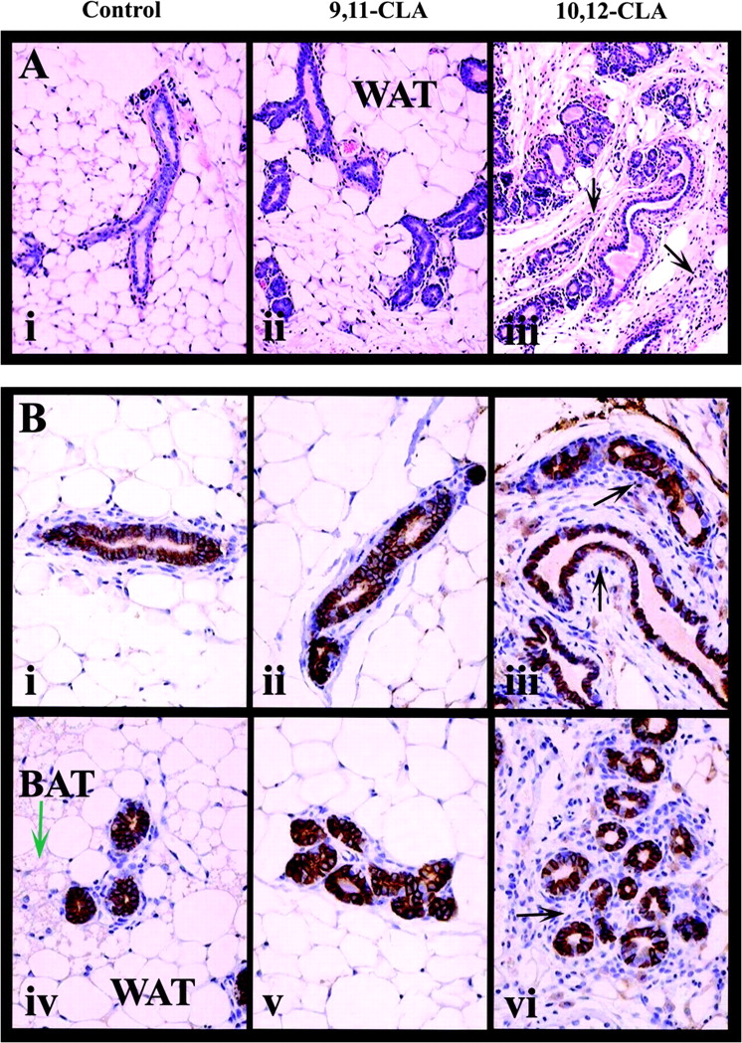
Fig. 3. Mammary gland histology is dramatically altered in erbB2 transgenic mice fed t10,c12-CLA, but neither CLA ...
Notes:
Fig. 3. Mammary gland histology is dramatically altered in erbB2 transgenic mice fed t10,c12-CLA, but neither CLA isomer alters expression or localization of erbB2 protein within the mammary epithelium. ( A ) H and E staining of mammary glands from mice fed control (i) or CLA-supplemented (ii, c9,t11-CLA; iii, t10,c12-CLA) diets from weaning to time of kill. Photos are representative of 19–20 H and E sections per group, and were taken under the ×10 objective. ( B ) Immunohistochemical detection of erbB2 (brown staining) in ducts (i–iii) and lobules (iv–vi) of mice fed control (i and iv), c9,t11-CLA- (ii and v) or t10,c12-CLA- (iii and vi) supplemented diets. Immunohistochemistry was performed on mammary glands of seven mice per group and the photos shown are representative of all fields on each of the seven slides per group. All slides were counterstained with hematoxylin (blue staining). Photos were taken under the ×20 objective. WAT, white adipose tissue; BAT, brown adipose tissue. The black arrows in the t10,c12-CLA group point to fibroblastic stroma. The green arrow in the control group points to BAT.
Unless provided in the caption above, the following copyright applies to the content of this slide: © The Author 2007. Published by Oxford University Press. All rights reserved. For Permissions, please email: journals.permissions@oxfordjournals.org

Slide 4
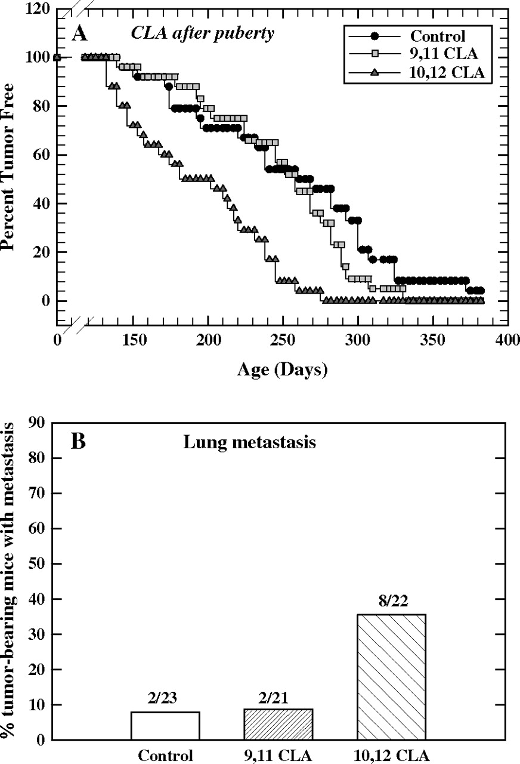
Fig. 4. Diets supplemented with t10,c12-CLA after puberty, but not with c9,t11-CLA, accelerate mammary tumor ...
Notes:
Fig. 4. Diets supplemented with t10,c12-CLA after puberty, but not with c9,t11-CLA, accelerate mammary tumor development and increase lung metastasis of erbB2 transgenic mice. Diets were initiated at 68–72 days of age, and fed continuously. ( A ) Kaplan–Meier plot showing percentage of tumor-free mice in each group at various ages. Of the initial 25 mice in each group, one mouse in the control group, four in the c9,t11-CLA group and two in the t10,c12-CLA group were killed early due to causes unrelated to the experimental protocol. These mice are not included in the figure. The remaining mice in the control (24 mice), c9,t11-CLA (21 mice) and t10,c12-CLA (23 mice) groups were killed with tumor. The control and the c9,t11-CLA groups are each significantly different from the t10,c12-CLA group; there is no statistically significant difference between the control and c9,t11-CLA groups. ( B ) Percentage of tumor-bearing mice with lung metastasis. The numbers above each bar indicate the number of tumor-bearing mice (denominator) with lung metastasis (numerator) in each group. Evaluation of metastasis could not be performed in one control mouse and one t10,c12-CLA mouse. The control and c9,t11-CLA groups are each statistically different from the t10,c12-CLA group.
Unless provided in the caption above, the following copyright applies to the content of this slide: © The Author 2007. Published by Oxford University Press. All rights reserved. For Permissions, please email: journals.permissions@oxfordjournals.org

Slide 5
Fig. 5. Mammary gland whole mounts from erbB2 transgenic mice fed the control, c9,t11-CLA- and ...
Notes:
Fig. 5. Mammary gland whole mounts from erbB2 transgenic mice fed the control, c9,t11-CLA- and t10,c12-CLA-supplemented diets. Diets were initiated at 68–72 days of age, and fed continuously (same experiment as shown in Figure 4 ). Note the extensive budding and alveolar hyperplasia from the ducts in the t10,c12-CLA group. The arrows point to vacuole-like structures within the ducts from the t10,c12-CLA group, and the arrowhead to an alveolar lumen. Photos were taken from mammary whole mounts using the ×1 (left side) or ×4 (right side) microscope objectives.
Unless provided in the caption above, the following copyright applies to the content of this slide: © The Author 2007. Published by Oxford University Press. All rights reserved. For Permissions, please email: journals.permissions@oxfordjournals.org

Slide 6
Fig. 6. Mammary gland whole mounts from FVB wild-type mice fed the control, c9,t11-CLA- and t10,c12-CLA-supplemented ...
Notes:
Fig. 6. Mammary gland whole mounts from FVB wild-type mice fed the control, c9,t11-CLA- and t10,c12-CLA-supplemented diets for 10 days starting at 70 days of age. Extensive budding and dilated ducts can be seen in the t10,c12-CLA group. The numbers in each panel refer to the number of terminal end buds (mean ± SEM of seven mice per group). Each photo in the left panels of the three dietary groups was taken under the ×1 objective. Each photo in the right panels of the three dietary groups was taken under the ×4 objective.
Unless provided in the caption above, the following copyright applies to the content of this slide: © The Author 2007. Published by Oxford University Press. All rights reserved. For Permissions, please email: journals.permissions@oxfordjournals.org

