Slide 1
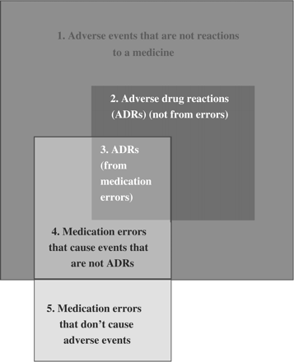
Figure 1. A Venn diagram showing the relation among adverse events, ADRs and medication errors; the sizes of the boxes ...
Notes:
Figure 1. A Venn diagram showing the relation among adverse events, ADRs and medication errors; the sizes of the boxes do not reflect the relative frequencies of the events illustrated (Reproduced from reference 8, with permission from Wolters Kluwer Health/Adis ©; Adis Data Information BV (2006); all rights reserved).
Unless provided in the caption above, the following copyright applies to the content of this slide: © The Author 2009. Published by Oxford University Press on behalf of the Association of Physicians. All rights reserved. For Permissions, please email: journals.permissions@oxfordjournals.org

Slide 2
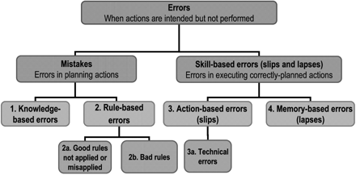
Figure 2. A classification of types of medication errors based on psychological principles. For examples of ...
Notes:
Figure 2. A classification of types of medication errors based on psychological principles. For examples of prescription errors in each category see the text and Table 1 (Reproduced from reference 8, with permission from Wolters Kluwer Health/Adis ©; Adis Data Information BV (2006); all rights reserved). Rule-based errors (using a bad rule or misapplying a good rule)—for example, injecting diclofenac into the lateral thigh rather than the buttock. Proper rules and education help to avoid these types of error, as do computerized prescribing systems. Action-based errors (called slips)—for example, picking up a bottle containing diazepam from the pharmacy shelf when intending to take one containing diltiazem. In the Australian study mentioned above most errors were due to slips in attention that occurred during routine prescribing, dispensing or drug administration. These can be minimized by creating conditions in which they are unlikely (for example, by avoiding distractions, by cross-checking, by labelling medicines clearly and by using identifiers, such as bar-codes);22 so-called ‘Tall Man’ lettering (mixing upper- and lower-case letters in the same word) has been proposed as a way to avoid misreading of labels,23 but this method has not been tested in real conditions. A subset of action-based errors is the technical error—for example, putting the wrong amount of potassium chloride into an infusion bottle. This type of error can be prevented by the use of checklists, fail-safe systems and computerized reminders. Memory-based errors (called lapses)—for example, giving penicillin, knowing the patient to be allergic, but forgetting. These are hard to avoid; they can be intercepted by computerized prescribing systems and by cross-checking.
Unless provided in the caption above, the following copyright applies to the content of this slide: © The Author 2009. Published by Oxford University Press on behalf of the Association of Physicians. All rights reserved. For Permissions, please email: journals.permissions@oxfordjournals.org

