Slide 1
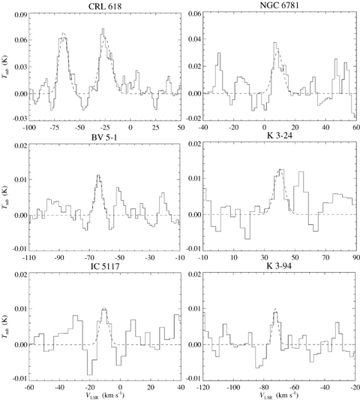
Figure 1 Spectra of the CO⁺N= 2 → 1, J= 5/2 → 3/2 line observed in the sample of PNe, with fits to the line ...
Notes:
Figure 1 Spectra of the CO+N= 2 → 1, J= 5/2 → 3/2 line observed in the sample of PNe, with fits to the line profiles overlaid (dashed lines). Brightness temperatures are given in main beam (Tmb) scale and velocities are quoted with respect to the local standard of rest (LSR). Some of the spectra have been binned to a lower velocity resolution to reduce the noise.
Unless provided in the caption above, the following copyright applies to the content of this slide: © 2007 The Authors. Journal compilation © 2007 RAS

Slide 2
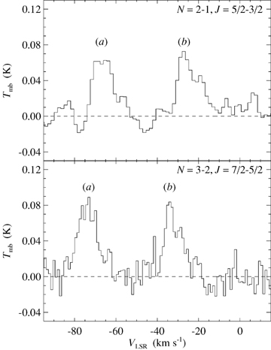
Figure 2 Spectra of the CO⁺ N= 2 → 1, J= 5/2 → 3/2 and N= 3 → 2, J= 7/2 → 5/2 lines observed in CRL 618. ...
Notes:
Figure 2 Spectra of the CO+ N= 2 → 1, J= 5/2 → 3/2 and N= 3 → 2, J= 7/2 → 5/2 lines observed in CRL 618. Brightness temperatures are given in main beam (Tmb) scale and velocities are quoted with respect to the LSR. The two velocity components appearing in each of the lines are labelled a and b on the spectra.
Unless provided in the caption above, the following copyright applies to the content of this slide: © 2007 The Authors. Journal compilation © 2007 RAS

Slide 3
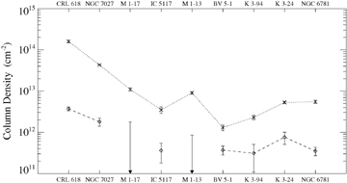
Figure 3 Column densities (with error bars) of CO⁺ (diamonds) and HCO⁺ (crosses, from the ...
Notes:
Figure 3 Column densities (with error bars) of CO+ (diamonds) and HCO+ (crosses, from the literature) for the sample of PNe. The sources span a range of evolutionary stages from PPN (left-hand side) through to evolved PN (right-hand side). Only an upper limit was obtained for the column density of CO+ for M 1–17 and M 1–13.
Unless provided in the caption above, the following copyright applies to the content of this slide: © 2007 The Authors. Journal compilation © 2007 RAS

Slide 4
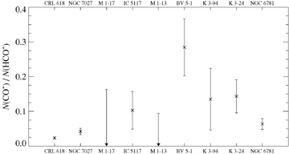
Figure 4 Ratios of CO⁺ to HCO⁺ column density (with error bars) for the sample of PNe. The ...
Notes:
Figure 4 Ratios of CO+ to HCO+ column density (with error bars) for the sample of PNe. The sources span a range of evolutionary stages from PPN (left-hand side) through to evolved PN (right-hand side). Only an upper limit was obtained for the column density of CO+ for M 1–17 and M 1–13.
Unless provided in the caption above, the following copyright applies to the content of this slide: © 2007 The Authors. Journal compilation © 2007 RAS

