Slide 1
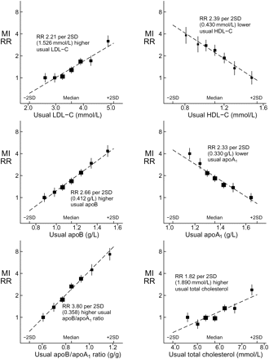
Figure 1 Relative risk of myocardial infarction at different usual levels of LDL-C, HDL-C, apoB, apoA_{1,} ...
Notes:
Figure 1 Relative risk of myocardial infarction at different usual levels of LDL-C, HDL-C, apoB, apoA1, their ratio (apoB/apoA1) and total cholesterol based on 3510 cases vs. 9805 controls, all without prior vascular disease. Relative risks and 95% CIs, adjusted for age, sex, smoking, and body mass index, are plotted against the mean usual value (i.e. the medium-term average value after allowance for measurement error). The seven groups are based on deciles or, for the middle three groups, quintiles of the values among cases. Horizontal scales are defined similarly in all graphs, with the marked points 2SD above and below the median (in the middle group) at the same positions. MI, myocardial infarction; RR, relative risk; SD, standard deviation of usual value in cases.
Unless provided in the caption above, the following copyright applies to the content of this slide: Published on behalf of the European Society of Cardiology. All rights reserved. © The Author 2009. For permissions please email: journals.permissions@oxfordjournals.orgThe online version of this article has been published under an open access model. Users are entitled to use, reproduce, disseminate, or display the open access version of this article for non-commercial purposes provided that the original authorship is properly and fully attributed; the Journal, Learned Society and Oxford University Press are attributed as the original place of publication with correct citation details given; if an article is subsequently reproduced or disseminated not in its entirety but only in part or as a derivative work this must be clearly indicated. For commercial re-use, please contact journals.permissions@oxfordjournals.org

Slide 2
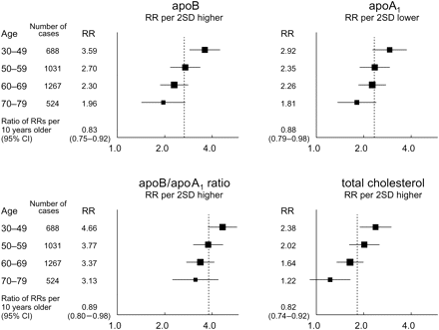
Figure 2 Effect of age on relative risk per 2SD difference in the usual levels of apolipoproteins and total ...
Notes:
Figure 2 Effect of age on relative risk per 2SD difference in the usual levels of apolipoproteins and total cholesterol. Relative risks and 95% confidence intervals (for 3510 cases and 9805 controls) are adjusted for sex, smoking, and body mass index. RR, relative risk; SD, standard deviation of usual value in cases.
Unless provided in the caption above, the following copyright applies to the content of this slide: Published on behalf of the European Society of Cardiology. All rights reserved. © The Author 2009. For permissions please email: journals.permissions@oxfordjournals.orgThe online version of this article has been published under an open access model. Users are entitled to use, reproduce, disseminate, or display the open access version of this article for non-commercial purposes provided that the original authorship is properly and fully attributed; the Journal, Learned Society and Oxford University Press are attributed as the original place of publication with correct citation details given; if an article is subsequently reproduced or disseminated not in its entirety but only in part or as a derivative work this must be clearly indicated. For commercial re-use, please contact journals.permissions@oxfordjournals.org

Slide 3
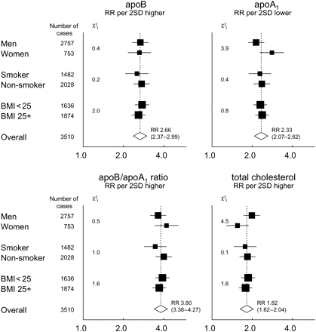
Figure 3 Effects of sex, smoking, and body mass index on relative risk per 2SD difference in the usual levels of ...
Notes:
Figure 3 Effects of sex, smoking, and body mass index on relative risk per 2SD difference in the usual levels of apolipoproteins and total cholesterol. Relative risks, with 95% confidence intervals and χ2 tests for heterogeneity, for 3510 cases and 9805 controls. Analyses of each factor are adjusted for age and the two other factors. RR, relative risk; SD, standard deviation of usual value in cases; BMI, body mass index.
Unless provided in the caption above, the following copyright applies to the content of this slide: Published on behalf of the European Society of Cardiology. All rights reserved. © The Author 2009. For permissions please email: journals.permissions@oxfordjournals.orgThe online version of this article has been published under an open access model. Users are entitled to use, reproduce, disseminate, or display the open access version of this article for non-commercial purposes provided that the original authorship is properly and fully attributed; the Journal, Learned Society and Oxford University Press are attributed as the original place of publication with correct citation details given; if an article is subsequently reproduced or disseminated not in its entirety but only in part or as a derivative work this must be clearly indicated. For commercial re-use, please contact journals.permissions@oxfordjournals.org

