Slide 1
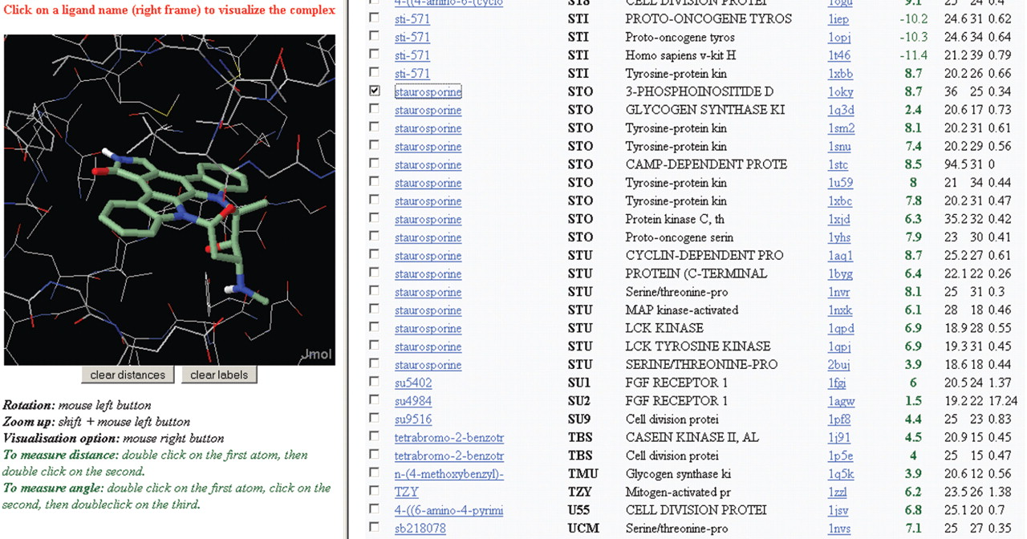
Figure 1 Example of kinDOCK output. The cAMP-dependent protein kinase (PDB1STC) has been submitted to kinDOCK. The ...
Notes:
Figure 1 Example of kinDOCK output. The cAMP-dependent protein kinase (PDB1STC) has been submitted to kinDOCK. The results were sorted by ligand name to highlight the scores and a binding mode obtained for staurosporine.
Unless provided in the caption above, the following copyright applies to the content of this slide: © The Author 2006. Published by Oxford University Press. All rights reserved The online version of this article has been published under an open access model. Users are entitled to use, reproduce, disseminate, or display the open access version of this article for non-commercial purposes provided that: the original authorship is properly and fully attributed; the Journal and Oxford University Press are attributed as the original place of publication with the correct citation details given; if an article is subsequently reproduced or disseminated not in its entirety but only in part or as a derivative work this must be clearly indicated. For commercial re-use, please contact journals.permissions@oxfordjournals.org

Slide 2
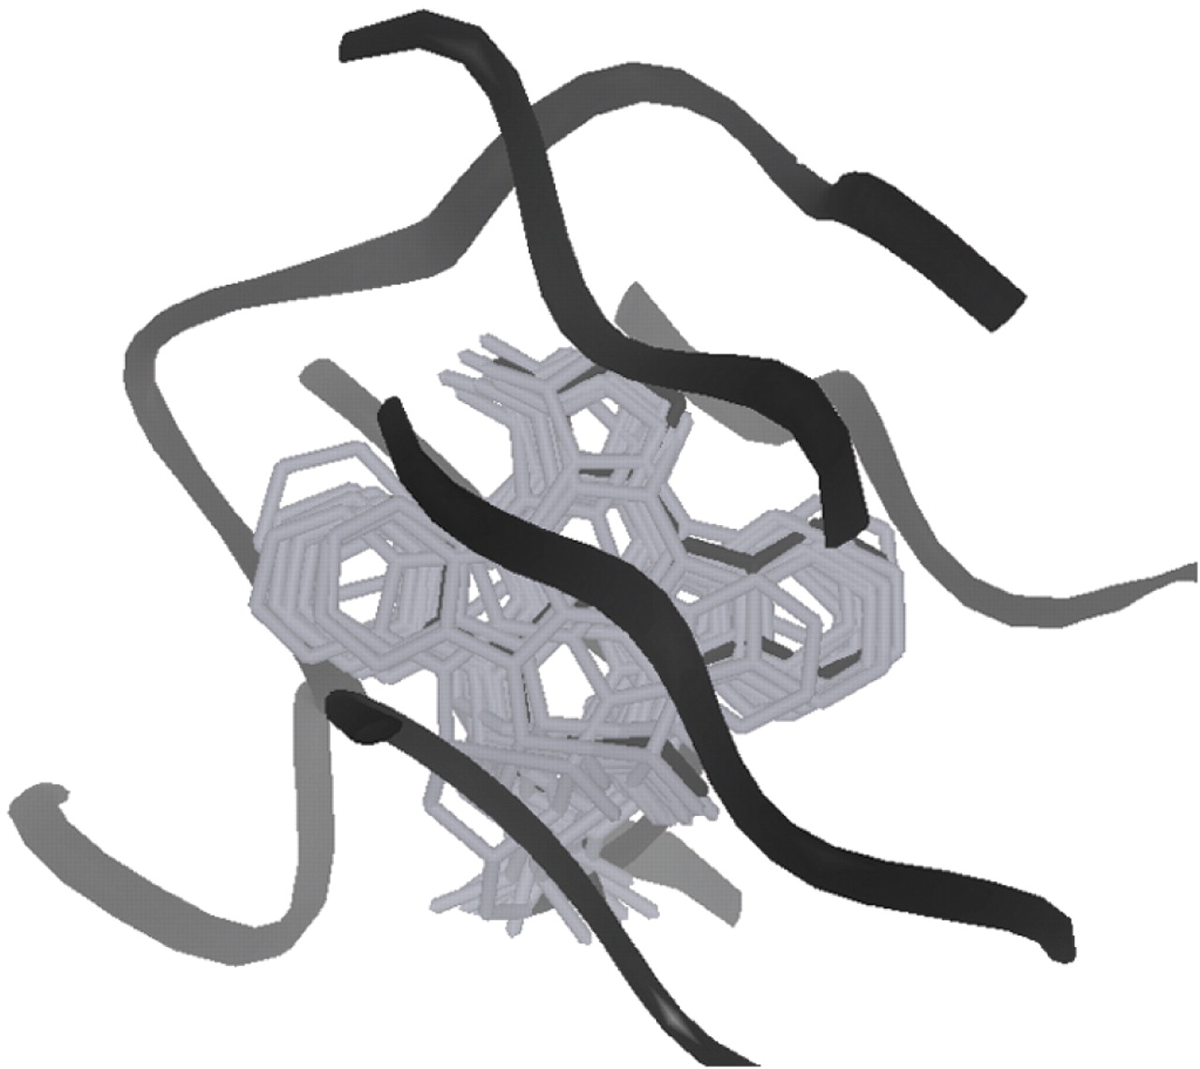
Figure 2 Example of superposition by kinDOCK. All stauroporines—protein kinase complexes present in the PDB (16 in ...
Notes:
Figure 2 Example of superposition by kinDOCK. All stauroporines—protein kinase complexes present in the PDB (16 in the current database; listed in Figure 1 ) were used to transfer the common ligand into the cAMP-dependent protein kinase (PDB1STC). The active site of cAMP-dependent protein kinase is drawn as a black ribbon. The experimental orientation of staurosporine (PDB1STC) is in black wireframe while the staurosporines docked by similarity are in grey wireframe.
Unless provided in the caption above, the following copyright applies to the content of this slide: © The Author 2006. Published by Oxford University Press. All rights reserved The online version of this article has been published under an open access model. Users are entitled to use, reproduce, disseminate, or display the open access version of this article for non-commercial purposes provided that: the original authorship is properly and fully attributed; the Journal and Oxford University Press are attributed as the original place of publication with the correct citation details given; if an article is subsequently reproduced or disseminated not in its entirety but only in part or as a derivative work this must be clearly indicated. For commercial re-use, please contact journals.permissions@oxfordjournals.org

Slide 3
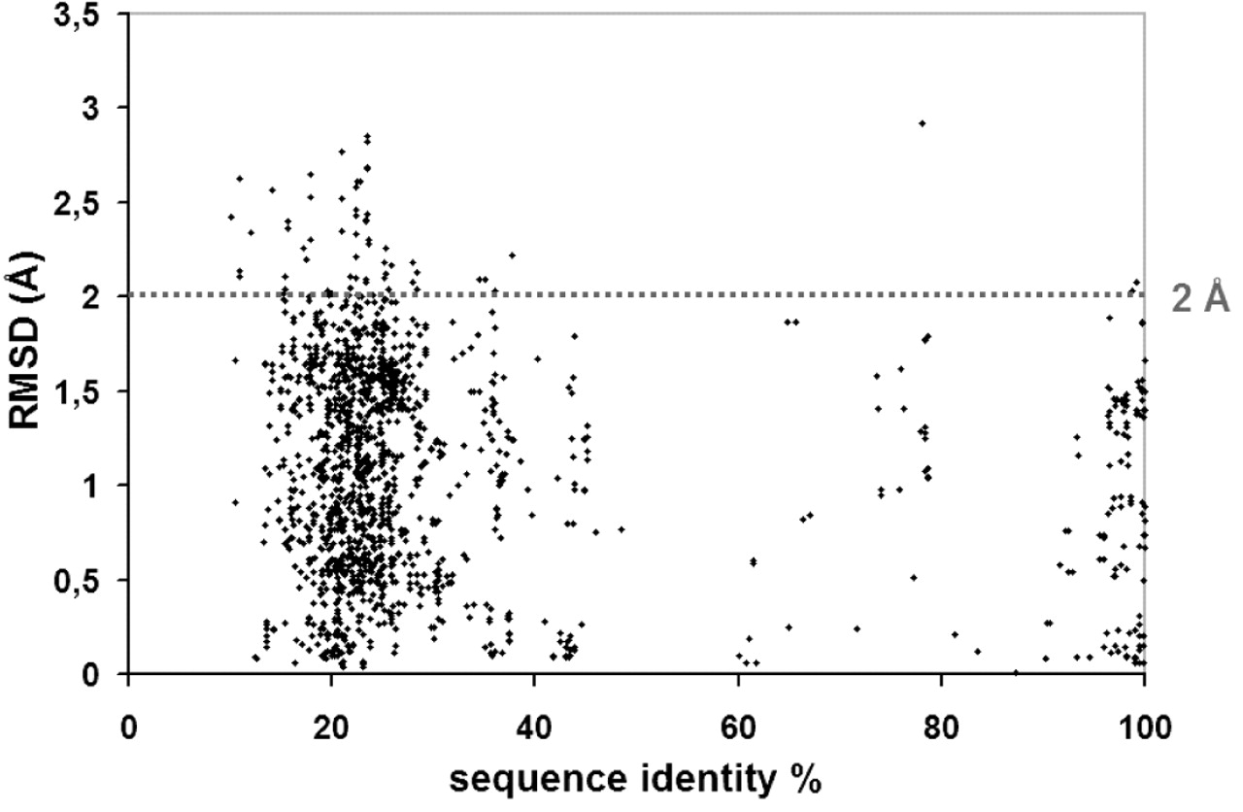
Figure 3 RMSD between the ligand poses as deduced by kinDOCK and the ligand in the template PDB structure.
Notes:
Figure 3 RMSD between the ligand poses as deduced by kinDOCK and the ligand in the template PDB structure.
Unless provided in the caption above, the following copyright applies to the content of this slide: © The Author 2006. Published by Oxford University Press. All rights reserved The online version of this article has been published under an open access model. Users are entitled to use, reproduce, disseminate, or display the open access version of this article for non-commercial purposes provided that: the original authorship is properly and fully attributed; the Journal and Oxford University Press are attributed as the original place of publication with the correct citation details given; if an article is subsequently reproduced or disseminated not in its entirety but only in part or as a derivative work this must be clearly indicated. For commercial re-use, please contact journals.permissions@oxfordjournals.org

Slide 4
Figure 4 Structures of the compound PD166326, PD173955 and their analog PP58.
Notes:
Figure 4 Structures of the compound PD166326, PD173955 and their analog PP58.
Unless provided in the caption above, the following copyright applies to the content of this slide: © The Author 2006. Published by Oxford University Press. All rights reserved The online version of this article has been published under an open access model. Users are entitled to use, reproduce, disseminate, or display the open access version of this article for non-commercial purposes provided that: the original authorship is properly and fully attributed; the Journal and Oxford University Press are attributed as the original place of publication with the correct citation details given; if an article is subsequently reproduced or disseminated not in its entirety but only in part or as a derivative work this must be clearly indicated. For commercial re-use, please contact journals.permissions@oxfordjournals.org

