Slide 1
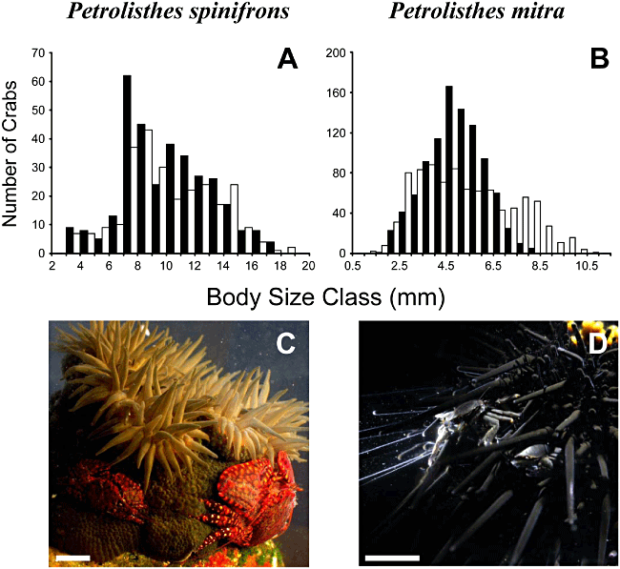
Figure 1. Size frequency distribution (A, B, respectively) of Petrolishes spinifrons and Petrolishes mitra (C, D, ...
Notes:
Figure 1. Size frequency distribution (A, B, respectively) of Petrolishes spinifrons and Petrolishes mitra (C, D, respectively). In the images, the two porcelain crabs are observed on their respective hosts: the sea anemone Phymactis papillosa and the sea urchin Tetrapygus niger (photo credits: Ivan Hinojosa). White and black bars denote males and females, respectively. Scale bars in (A) and (B) = 10 mm.
Unless provided in the caption above, the following copyright applies to the content of this slide: © 2011 The Linnean Society of London

Slide 2
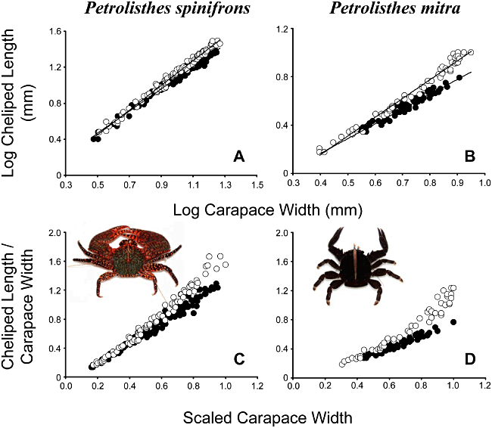
Figure 2. Relative growth of the major cheliped in males and females of Petrolisthes spinifrons and Petrolisthes mitra. ...
Notes:
Figure 2. Relative growth of the major cheliped in males and females of Petrolisthes spinifrons and Petrolisthes mitra. The length of the propodus of the cheliped as a function of carapace width in males and females of Petrolisthes spinifrons and P. mitra are shown in (A) and (B), respectively. Lineal regression equations obtained previous log–log transformations of the data are shown for each sex in Table 1. Measurements are in mm. The relationship between cheliped and body size in males and females of P. spinifrons and P. mitra when the different measurements are scaled relative to the carapace width of the largest crab in our sample are shown in (C) and (D), respectively. The typical colour pattern of P. spinifrons and the brown colour pattern of P. mitra are also shown. White and black dots denote males and females, respectively.
Unless provided in the caption above, the following copyright applies to the content of this slide: © 2011 The Linnean Society of London

Slide 3
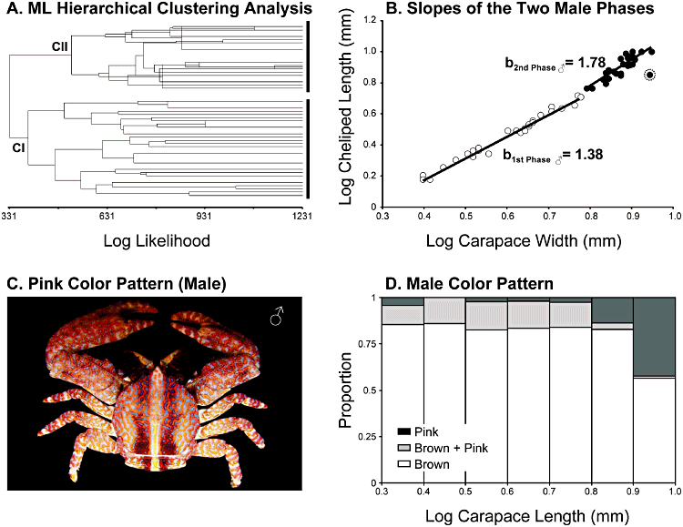
Figure 3. Different male morphotypes in Petrolithes mitra. A, two distinctive well supported clades obtained with the ...
Notes:
Figure 3. Different male morphotypes in Petrolithes mitra. A, two distinctive well supported clades obtained with the maximum likelihood clustering analysis. The analysis segregate male crabs into two major groups comprised of males below and above 7.8 mm CW. B, the two slopes describing the relationship between major claw and carapace width in males from the two different ontogenetic phases (clades) previously determined using clustering analysis. Black and white dots denote males from the first and second ontogenetic phase, respectively. The circled dot represents an outlier that was not considered when the slope of the relationship between major claw and carapace width was calculated for crabs pertaining to the second ontogenetic phase. C, pink colour pattern observed most frequently in male crabs of the second ontogenetic stage. D, the frequency of occurrence of the three colour patterns observed in individuals of different size classes.
Unless provided in the caption above, the following copyright applies to the content of this slide: © 2011 The Linnean Society of London

