Slide 1
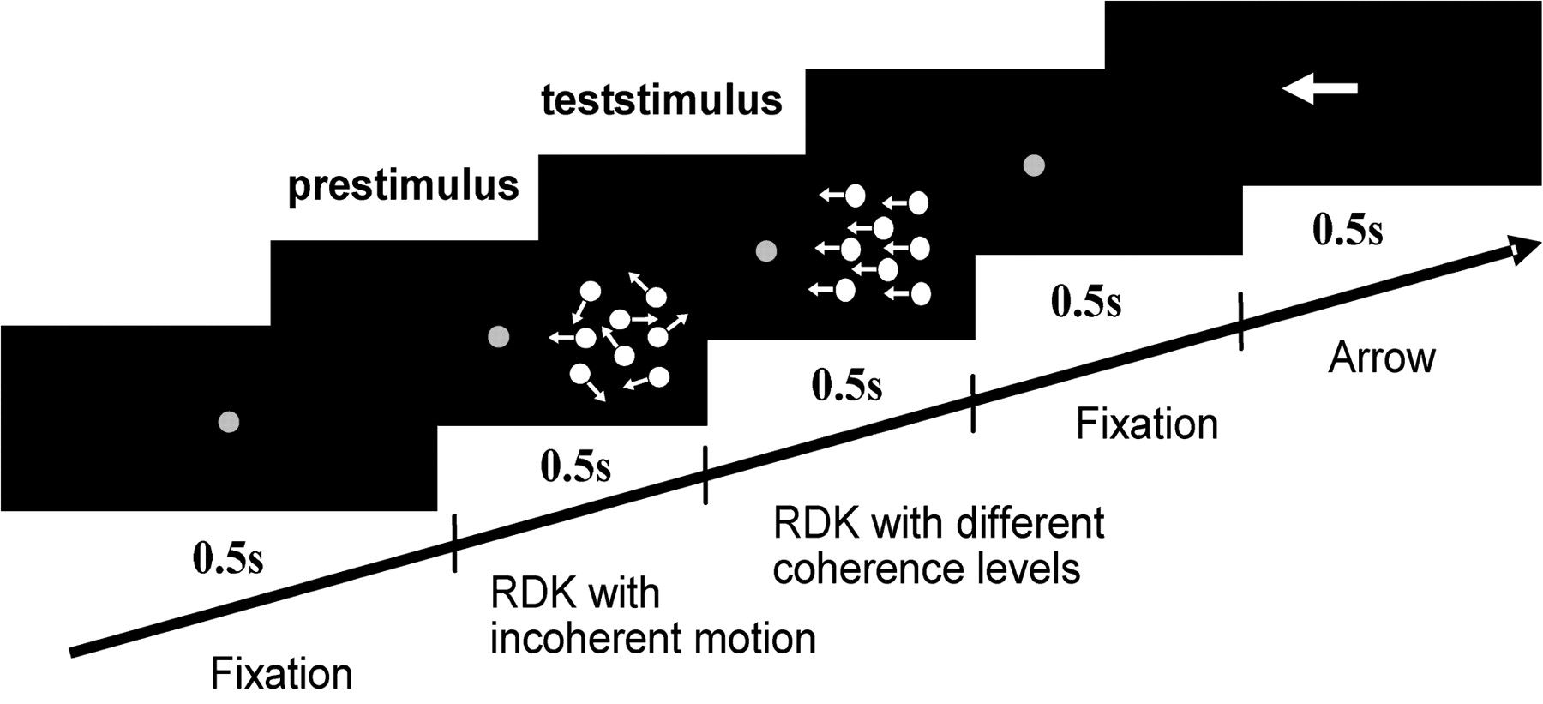
Figure 1. Time course of the stimulus. The stimulus consisted of 5 periods each lasting 500 ms. In contrast to the ...
Notes:
Figure 1. Time course of the stimulus. The stimulus consisted of 5 periods each lasting 500 ms. In contrast to the “prestimulus,” a RDK consisting of incoherent motion, the following “test stimulus” involved the presentation of coherent motion the percentage of which was systematically varied between 0% and 100%. The coherent motion signal was directed either to the left or to the right. Subjects had to indicate whether the motion direction of the coherently moving dots of the test stimulus was identical or opposite to the pointing direction of the arrow presented at the end of the trial. For a first group of 8 subjects, the RDKs were presented right to the fixation dot. A second group of 8 subjects was stimulated with the RDKs located in the left visual field (not shown in the figure).
Unless provided in the caption above, the following copyright applies to the content of this slide: © The Author 2006. Published by Oxford University Press. All rights reserved. For permissions, please e-mail: journals.permissions@oxfordjournals.org

Slide 2
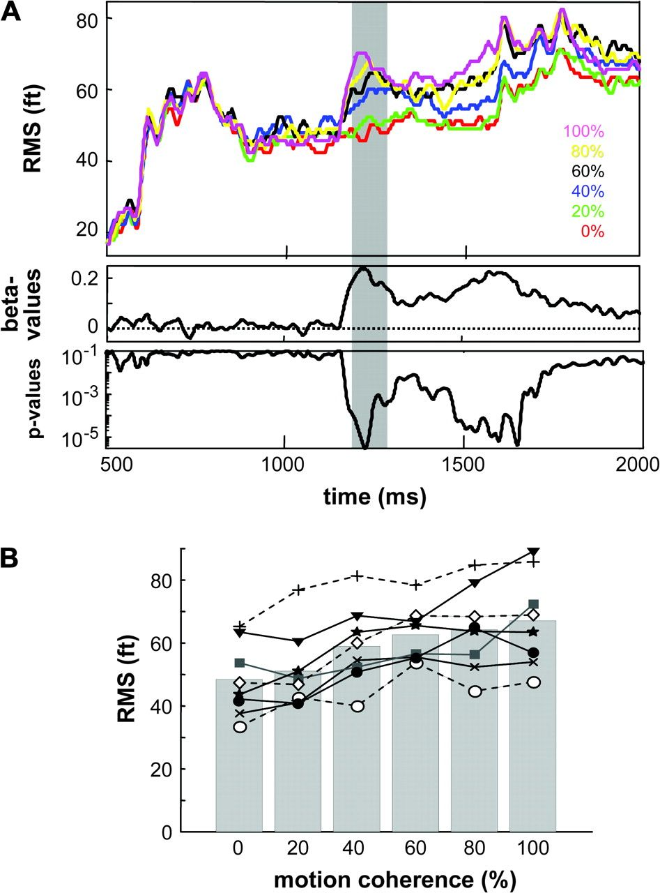
Figure 2. Dependency of the GFP on visual motion coherence. (A) RMS values averaged over the 8 subjects are plotted for ...
Notes:
Figure 2. Dependency of the GFP on visual motion coherence. (A) RMS values averaged over the 8 subjects are plotted for the 6 coherence levels (indicated by different colors) as function of time. The x axis starts with the presentation of the first RDK (incoherent motion, onset at 500 ms) followed by the test stimulus comprising coherent motion of varied strength (onset at 1000 ms). The lower panels show the beta and P values, respectively, obtained from a linear regression between RMS values and motion coherence for each sample point. (B) GFP as function of motion coherence averaged for a 100-ms interval starting 200 ms after test stimulus onset (indicated by the gray area in A). Results of the group (bars) and of the individual subjects (symbols, lines) both reveal a consistent positive correlation between RMS values and motion coherence.
Unless provided in the caption above, the following copyright applies to the content of this slide: © The Author 2006. Published by Oxford University Press. All rights reserved. For permissions, please e-mail: journals.permissions@oxfordjournals.org

Slide 3
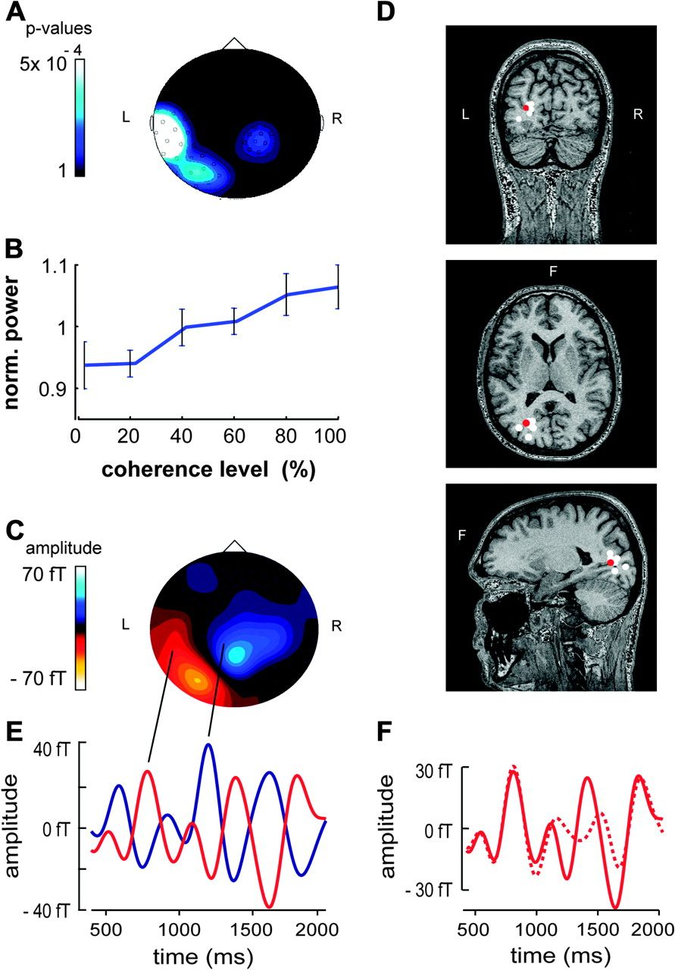
Figure 3. Spectral power in the 3-Hz frequency band during coherent motion presentation correlates with motion ...
Notes:
Figure 3. Spectral power in the 3-Hz frequency band during coherent motion presentation correlates with motion coherence. (A) Statistical probability mapping of spectral amplitude dependencies on motion coherence projected onto a 2-dimensional MEG sensor map (seen from above, nose up). P values denoting the level of statistical significance of the effect of motion coherence on the spectral amplitude were calculated from an ANOVA and are color-coded here in order to provide a quasi-field distribution. R, right; L, left; F, frontal. (B) Spectral power in the 3-Hz frequency band averaged over all channels with P values ≤ 0.0019 as function of motion coherence. The y axis denotes the means and standard deviations of the spectral power for the group of 8 subjects. Before assessing the group statistics, spectral amplitudes for the different coherence levels were normalized in the individual subject based on the mean spectral amplitude obtained from all coherence levels. (C) Magnetic field map of the group difference between MEG signals obtained for the 0% and 100% coherent motion conditions (166 ms after test stimulus onset). (D) Dipole solutions of the differential activity depicted in (C). The red dot marks the dipole obtained from the group analysis, and the white dots delineate the location of dipole solutions derived from 6 out of 8 subjects. (E) 3 ± 2 Hz Gaussian filtered time course of MEG activity recorded from 2 sensors (marked in C with 2 lines and held distinguishable by 2 different colors) for the 100% coherence condition. The coherent stimulus started at 1000 ms. (F) 3 ± 2 Hz Gaussian filtered time course of activity recorded from the left sensor as depicted in red in Figure 3E. The solid line shows the oscillatory activity for this sensor elicited by the 100% coherence condition as compared with the 0% coherence condition (dashed line).
Unless provided in the caption above, the following copyright applies to the content of this slide: © The Author 2006. Published by Oxford University Press. All rights reserved. For permissions, please e-mail: journals.permissions@oxfordjournals.org

Slide 4
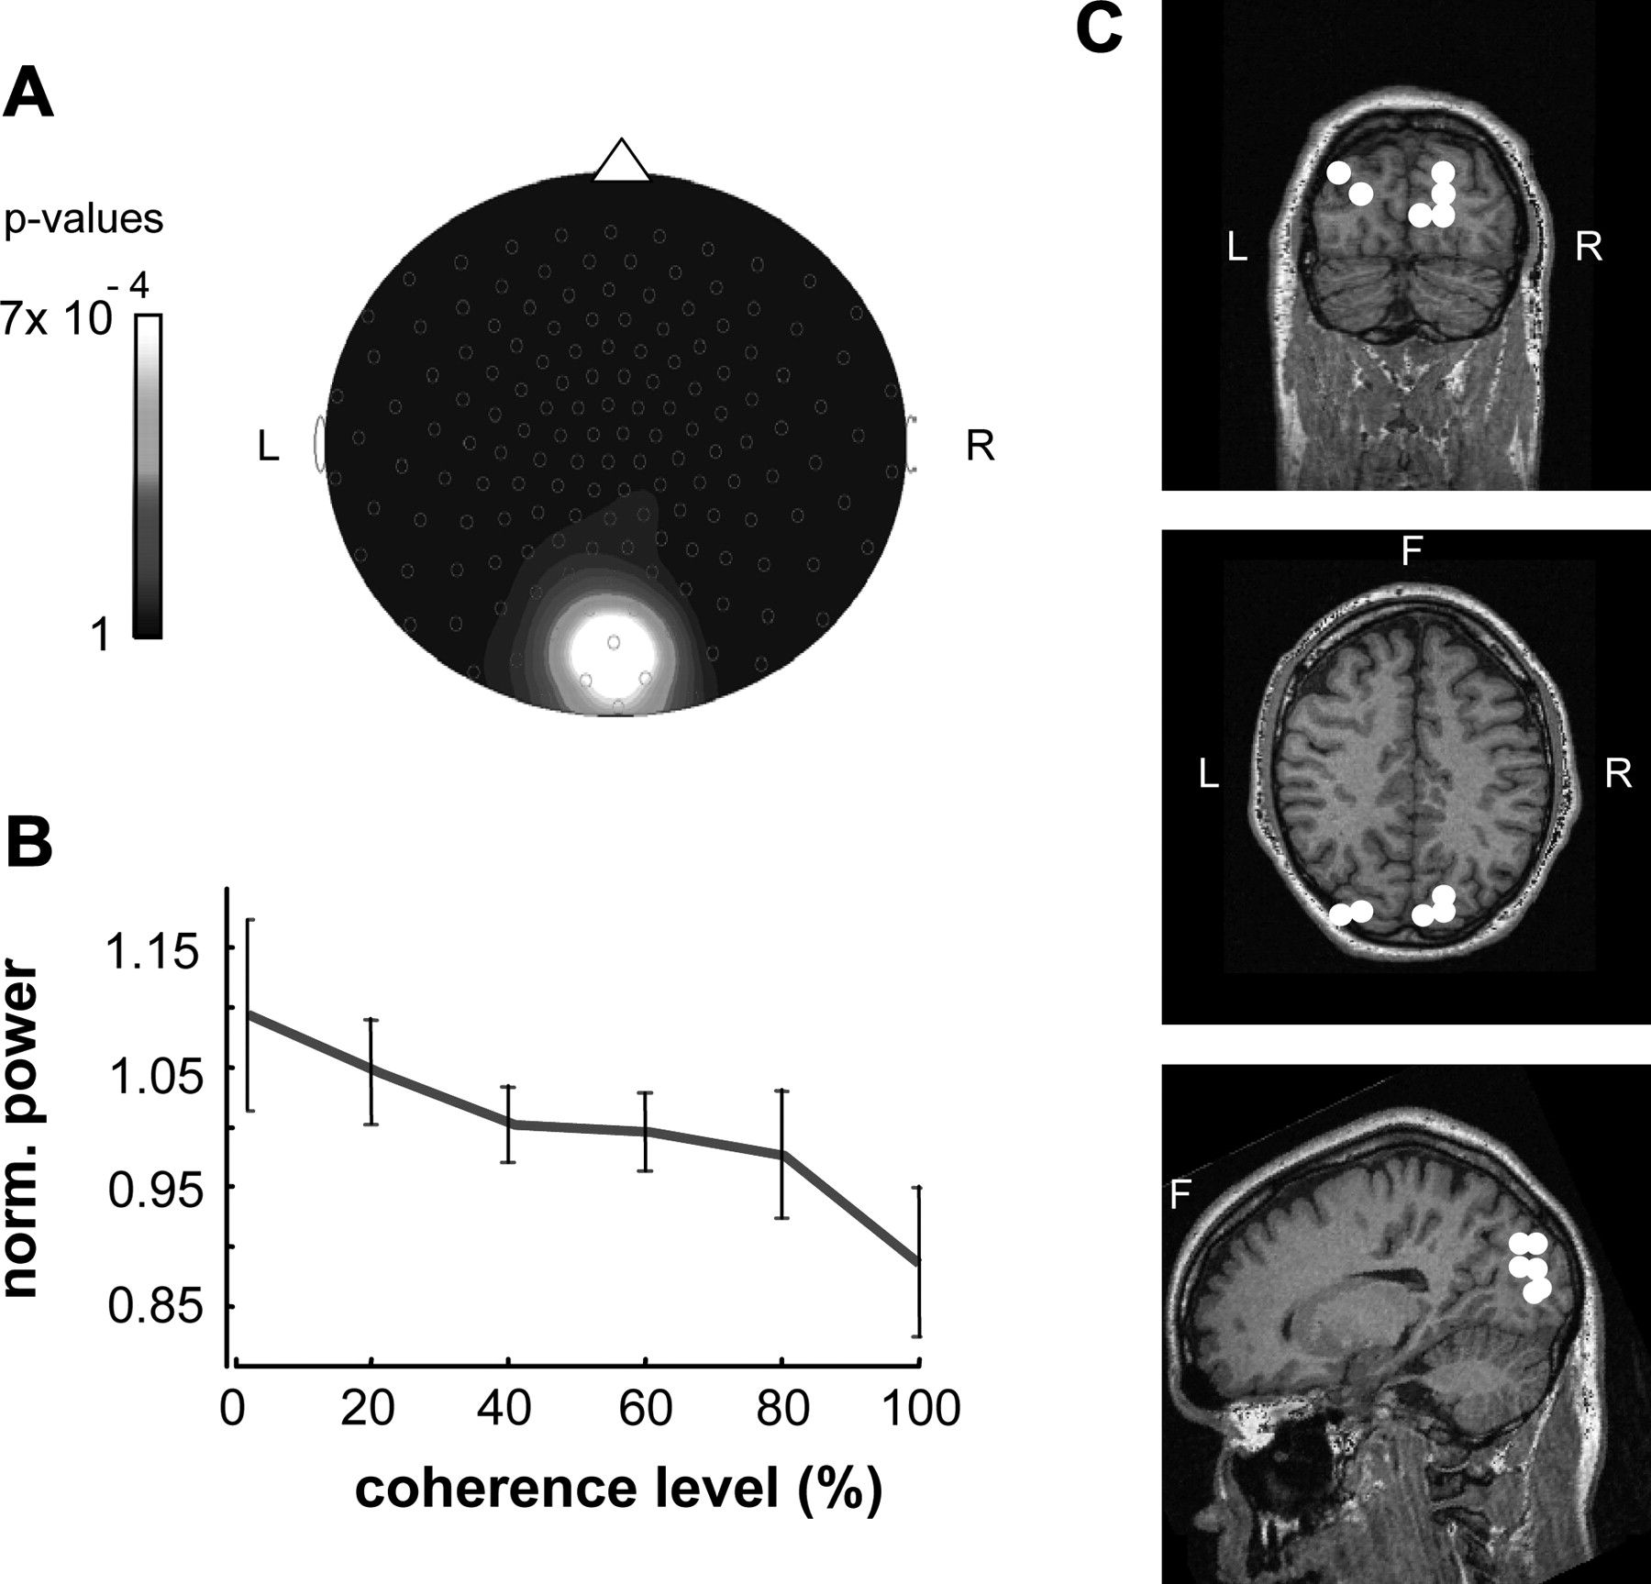
Figure 4. Spectral power in the 10H-z frequency band after coherent motion offset correlates with motion coherence. (A) ...
Notes:
Figure 4. Spectral power in the 10H-z frequency band after coherent motion offset correlates with motion coherence. (A) Statistical probability mapping of spectral amplitude dependencies on motion coherence projected onto a 2-dimensional MEG sensor map (same conventions as in Fig. 3A). (B) Means and standard deviations of the spectral power in the 10-Hz band for the group of 8 subjects as function of motion coherence (same conventions as in Fig. 3B). (C) Localization of voxels with maximum t values obtained from pseudo t statistics estimating the difference in source power between the 0% and 100% coherence condition (results from 6 out of 8 subjects). Source power was obtained using a minimum variance beamformer (SAM) for the 9- to 12-Hz frequency band.
Unless provided in the caption above, the following copyright applies to the content of this slide: © The Author 2006. Published by Oxford University Press. All rights reserved. For permissions, please e-mail: journals.permissions@oxfordjournals.org

Slide 5
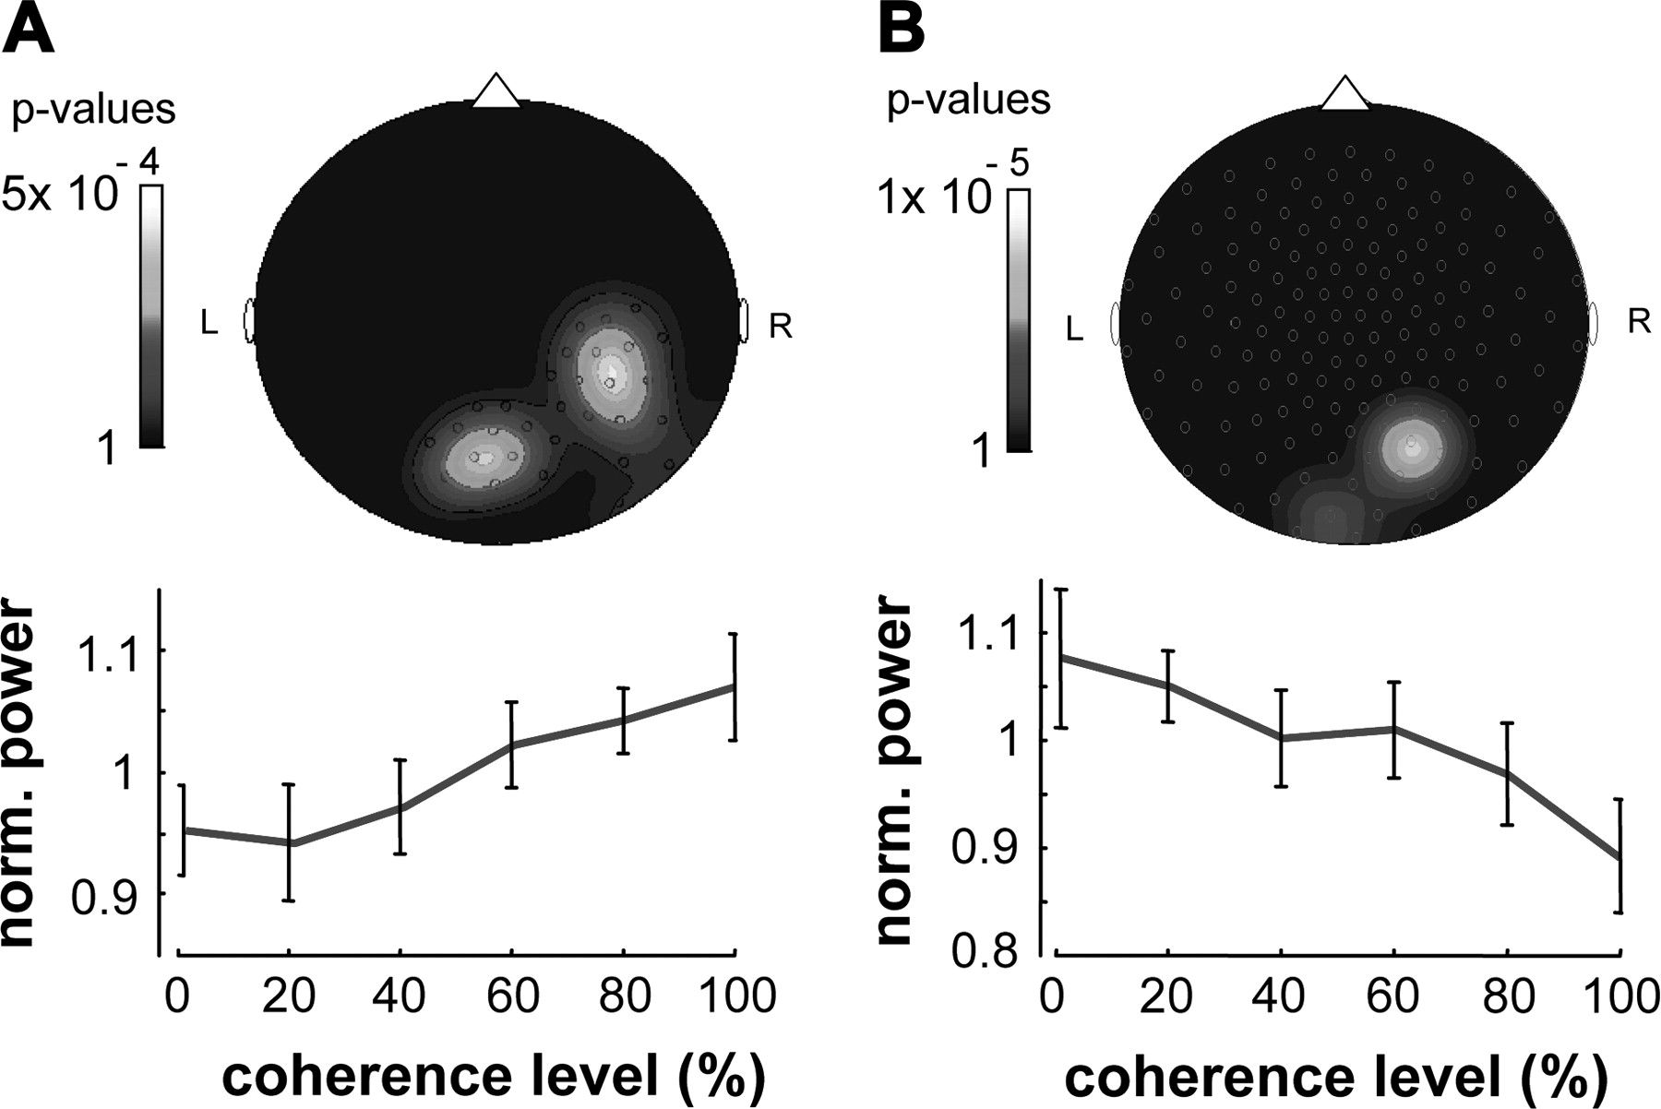
Figure 5. Correlations of spectral power with motion coherence for experiment 2 (visual motion presented in the left ...
Notes:
Figure 5. Correlations of spectral power with motion coherence for experiment 2 (visual motion presented in the left hemifield). (A) Spectral power in the 3-Hz frequency band during coherent motion presentation positively correlates with motion coherence. (B) Spectral power in the 10-Hz frequency band after coherent motion offset negatively correlates with motion coherence. Upper panels: Statistical probability mapping of spectral amplitude dependencies on motion coherence projected onto a 2-dimensional MEG sensor map (same conventions as in Figs 3A and 4A). (B) Means and standard deviations of the spectral amplitudes for the group of 8 subjects as function of motion coherence (same conventions as in Figs 3B and 4B).
Unless provided in the caption above, the following copyright applies to the content of this slide: © The Author 2006. Published by Oxford University Press. All rights reserved. For permissions, please e-mail: journals.permissions@oxfordjournals.org

