Slide 1
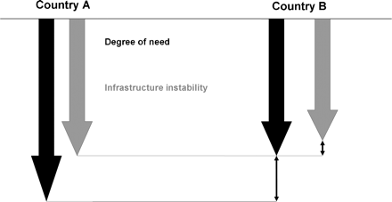
Figure 1 Choosing the smallest degree of wrong when evaluating two specific situations.
Notes:
Figure 1 Choosing the smallest degree of wrong when evaluating two specific situations.
Unless provided in the caption above, the following copyright applies to the content of this slide: © Oxford University Press 2009

