Slide 1
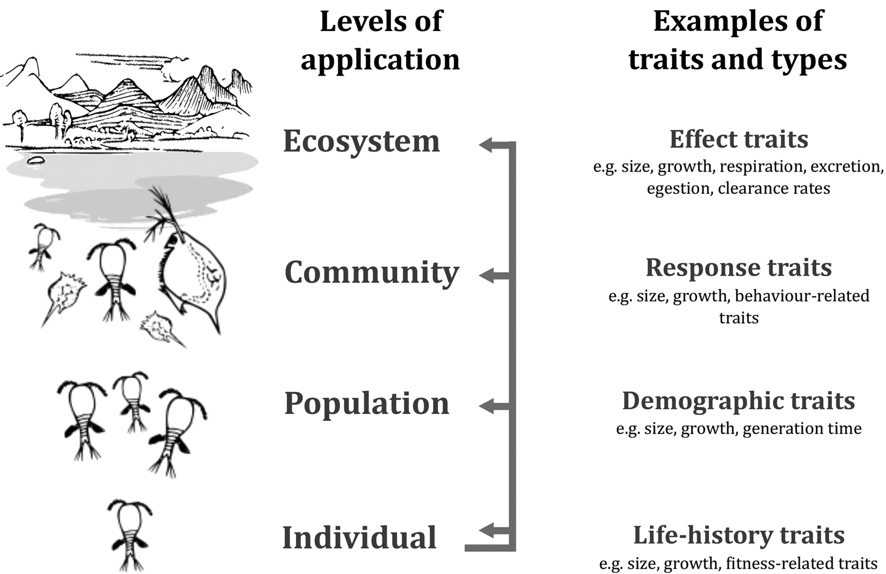
Fig. 1. Integrative framework linking functional trait classification across levels of biological organization ...
Notes:
Fig. 1. Integrative framework linking functional trait classification across levels of biological organization (inspired from Violle et al., 2007). Particular trait types operate predominantly (but not exclusively) on processes at specific levels of biological organization, affecting individuals, populations, communities or ecosystems (i.e. level of application). Some traits affect several or all levels or organization and can thus be classified as multiple trait types (e.g. body size and growth).
Unless provided in the caption above, the following copyright applies to the content of this slide: © The Author 2016. Published by Oxford University Press. All rights reserved. For permissions, please e-mail: journals.permissions@oup.com

Slide 2
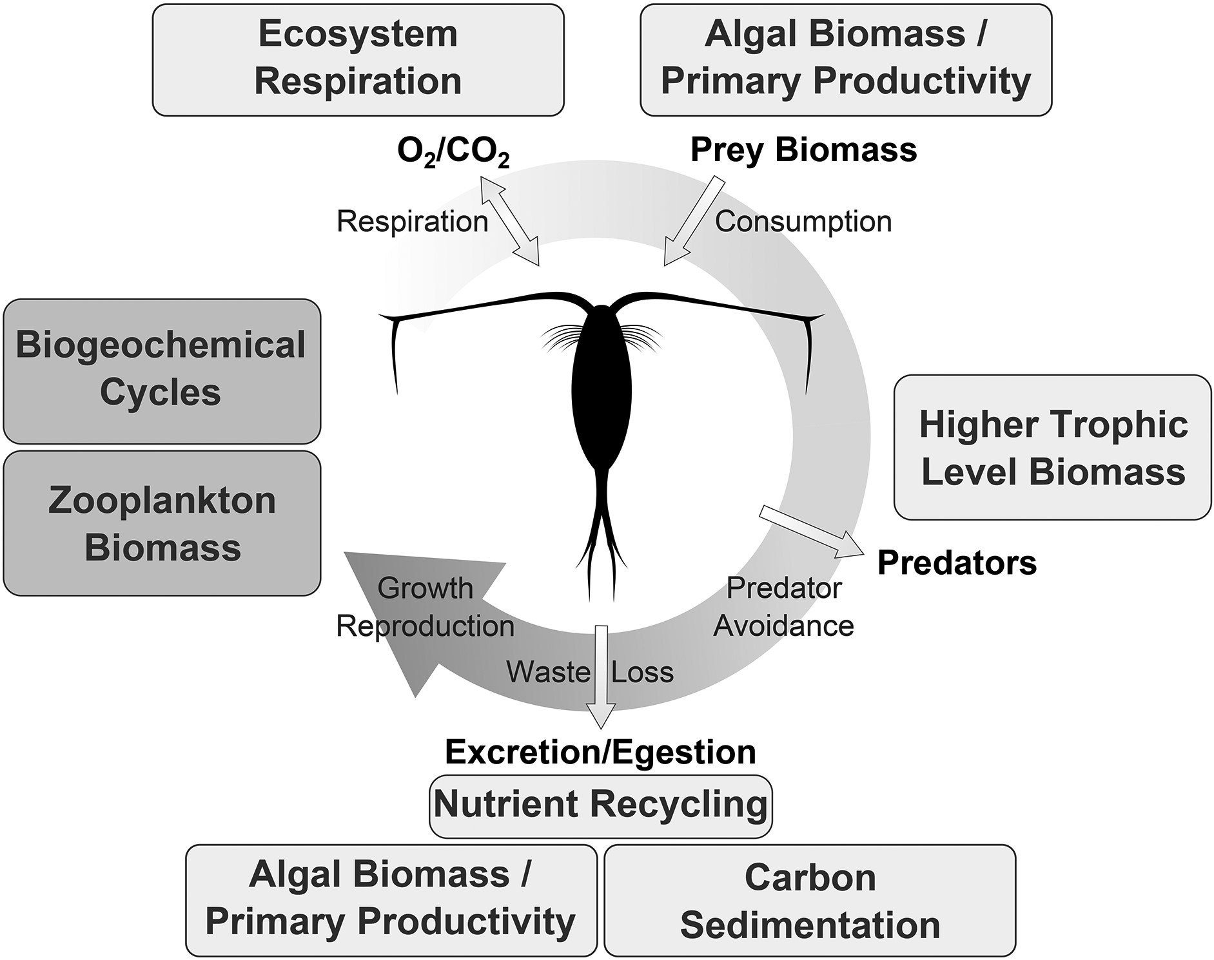
Fig. 2. Interactions of a typical herbivorous copepod with its environment, in terms of elemental and energy ...
Notes:
Fig. 2. Interactions of a typical herbivorous copepod with its environment, in terms of elemental and energy transfer. Inflows include prey and O2 with outflows to predators, respired CO2, and excreted or egested nutrients and organic matter. Organismal functions that regulate these exchanges are consumption, respiration, predator avoidance, waste/loss. Boxes indicate examples of ecosystem properties or processes that are influenced by these organismal functions. The circular arrow indicates that all organismal functions contribute to the overall individual goal of growth and reproduction, affecting zooplankton biomass directly, and biogeochemical cycles indirectly. Note that this concept can be transposed to other zooplankton taxa with other diet types.
Unless provided in the caption above, the following copyright applies to the content of this slide: © The Author 2016. Published by Oxford University Press. All rights reserved. For permissions, please e-mail: journals.permissions@oup.com

Slide 3
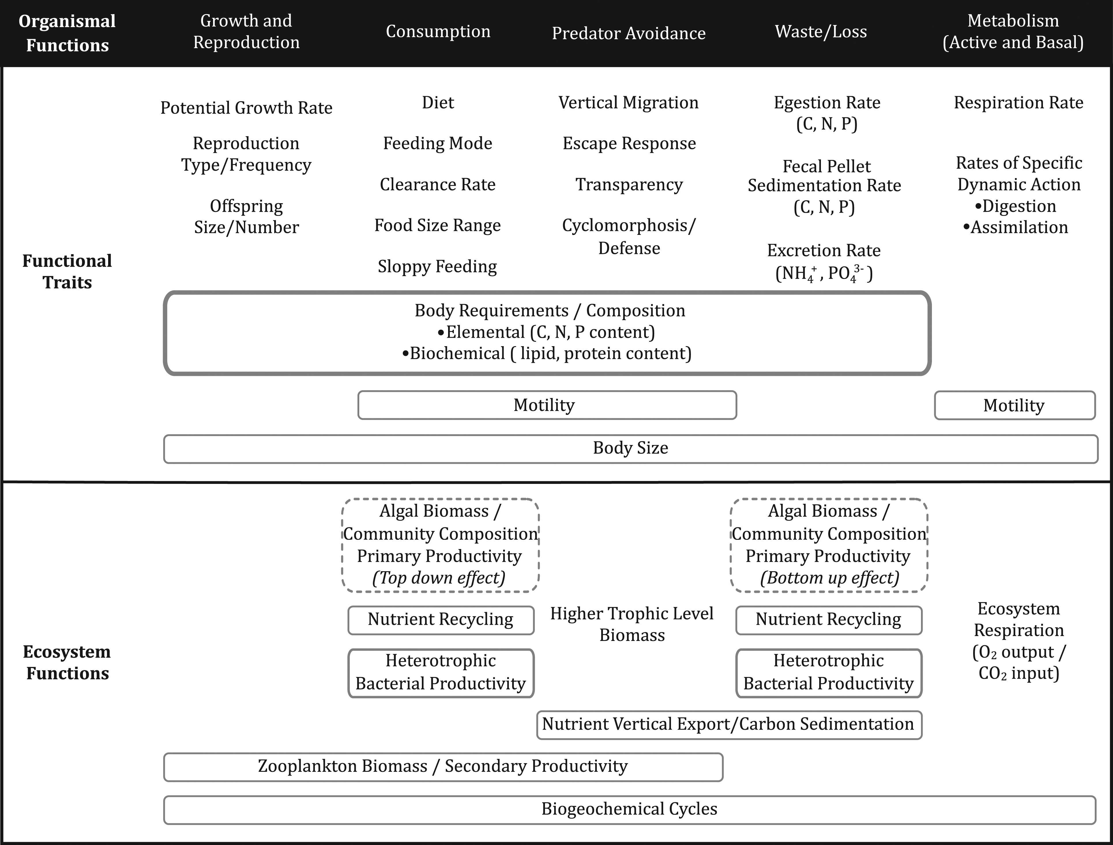
Fig. 3. A non-exhaustive classification of zooplankton functional traits (upper part) based on the energy budget of ...
Notes:
Fig. 3. A non-exhaustive classification of zooplankton functional traits (upper part) based on the energy budget of an individual (organismal functions), aligned with their respective impact at the ecosystem scale (ecosystem functions; lower part). Functional traits that transcend more than one organismal function are framed with solid lines; likewise, zooplankton trait-influenced ecosystem functions transcending organismal functions are also framed with solid lines. Frames with dotted lines indicate the bidirectional control (top-down and bottom-up) on the algal communities. This scheme expands on Litchman et al. (2013).
Unless provided in the caption above, the following copyright applies to the content of this slide: © The Author 2016. Published by Oxford University Press. All rights reserved. For permissions, please e-mail: journals.permissions@oup.com

