Slide 1
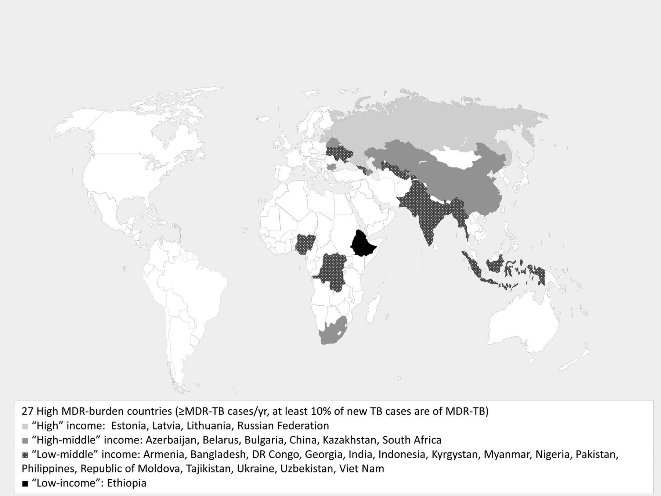
Figure 1. High-burden multidrug-resistant TB (MDR-TB) countries by income status. According to the World Bank, ...
Notes:
Figure 1. High-burden multidrug-resistant TB (MDR-TB) countries by income status. According to the World Bank, low-income economies are defined as those with an annual Gross National Income (GNI) per capita of US$12 746.
Unless provided in the caption above, the following copyright applies to the content of this slide: © The Author 2016. Published by Oxford University Press on behalf of Royal Society of Tropical Medicine and Hygiene. This is an Open Access article distributed under the terms of the Creative Commons Attribution License ( http://creativecommons.org/licenses/by/4.0/ ), which permits unrestricted reuse, distribution, and reproduction in any medium, provided the original work is properly cited.

Slide 2
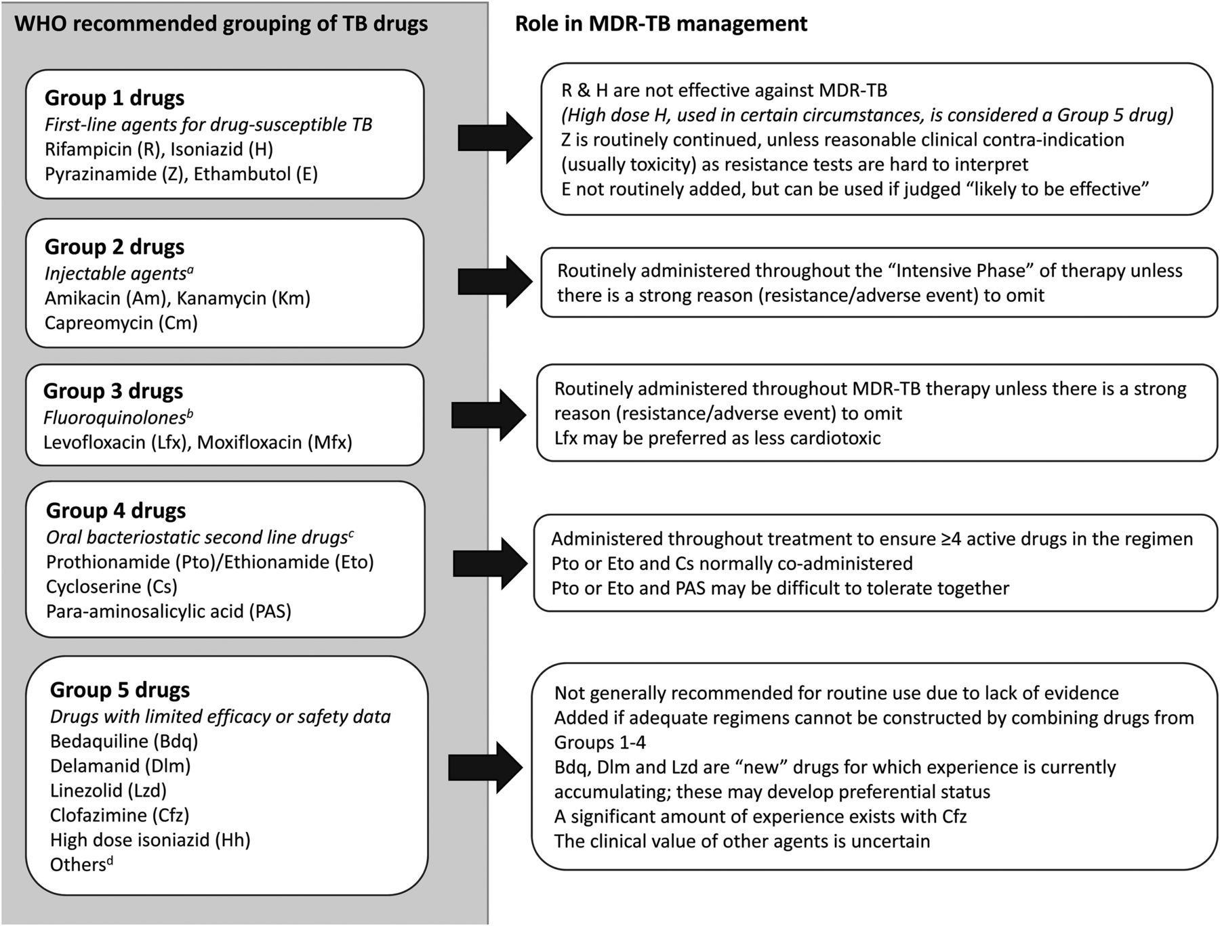
Figure 2. WHO recommended groupings of multidrug-resistant TB (MDR-TB) drugs.
Notes:
Figure 2. WHO recommended groupings of multidrug-resistant TB (MDR-TB) drugs. a There are high rates of streptomycin resistance in MDR-TB strains; it is not considered a second line anti-TB injectable agent. b Gatifloxacin may have side-effects including dysglycaemia. It has been removed from the market in several countries. Early generation fluoroquinolones do not high adequate activity against MDR-TB. c Terizidone may also be listed as Group 4 anti-TB drug. It has limited programmatic and efficacy data compared to the others. d Other Group 5 drugs, with variable in vitro and animal data to support use include amoxicillin/calvulanate, imipenem/cilastatin, meropenem, thioacetazone and clarithromycin.
Unless provided in the caption above, the following copyright applies to the content of this slide: © The Author 2016. Published by Oxford University Press on behalf of Royal Society of Tropical Medicine and Hygiene. This is an Open Access article distributed under the terms of the Creative Commons Attribution License ( http://creativecommons.org/licenses/by/4.0/ ), which permits unrestricted reuse, distribution, and reproduction in any medium, provided the original work is properly cited.

Slide 3
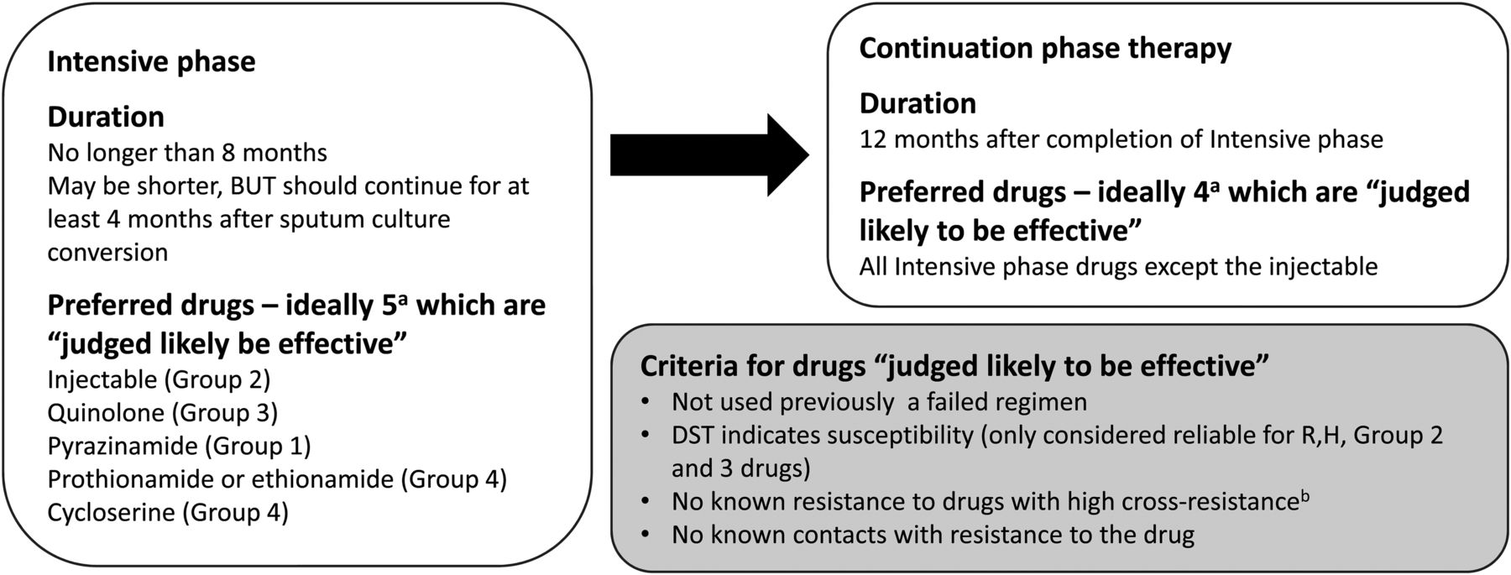
Figure 3. Current WHO recommended design of multidrug-resistant TB regimens. ª There are conditions in ...
Notes:
Figure 3. Current WHO recommended design of multidrug-resistant TB regimens. a There are conditions in which additional drugs are used. These conditions are applicable when the effectiveness for one or more drugs is unlikely or questionable. One important example of this would be treatment of extensively drug-resistant TB (XDR-TB). If an appropriate regimen cannot be constructed using Group 1–4 drugs, Group 5 drugs may be used. b Some examples of high cross-resistance include: there is high cross-resistance between isoniazid and prothionamide/ethionamide if the InhA mutation is present in the Mycobacterium tuberculosis isolate, amikacin and kanamycin have very high cross-resistance, fluroquinolones have variable cross-resistance.
Unless provided in the caption above, the following copyright applies to the content of this slide: © The Author 2016. Published by Oxford University Press on behalf of Royal Society of Tropical Medicine and Hygiene. This is an Open Access article distributed under the terms of the Creative Commons Attribution License ( http://creativecommons.org/licenses/by/4.0/ ), which permits unrestricted reuse, distribution, and reproduction in any medium, provided the original work is properly cited.

