Slide 1
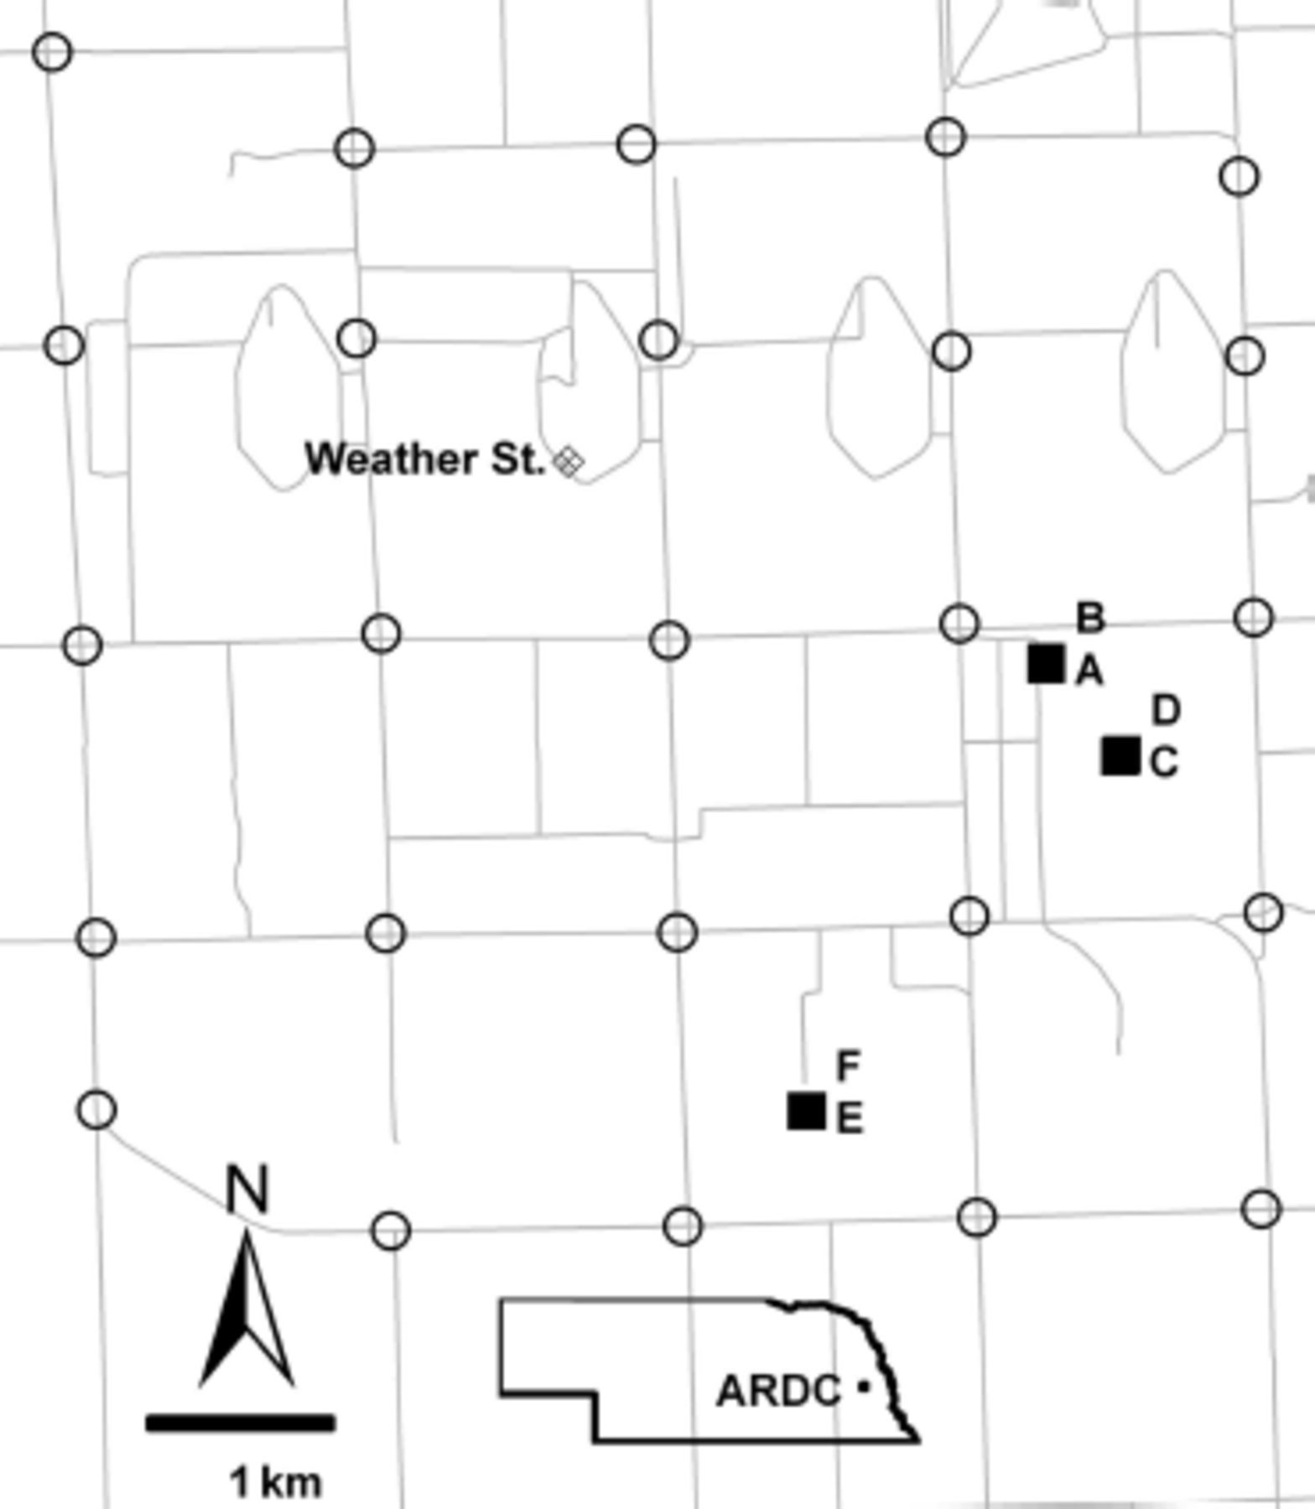
Fig. 1. Map of the University of Nebraska, Agricultural Research and Development Center, Ithaca, NE (ARDC). Solid ...
Notes:
Fig. 1. Map of the University of Nebraska, Agricultural Research and Development Center, Ithaca, NE (ARDC). Solid squares indicate the hay feeding sites sampled. A and B were sampled in 2005, C in 2006, D and E in 2007, and F in 2008. Open circles indicate locations for the 25 adult sticky traps. The cross-hatched diamond indicates the MEADAGROFARM weather station.
Unless provided in the caption above, the following copyright applies to the content of this slide: © 2011 Entomological Society of AmericaThis is an Open Access article distributed under the terms of the Creative Commons Attribution Non-Commercial License (http://creativecommons.org/licenses/by-nc/3.0/), which permits non-commercial reuse, distribution, and reproduction in any medium, provided the original work is properly cited. For commercial re-use, please contact journals.permissions@oup.com

Slide 2
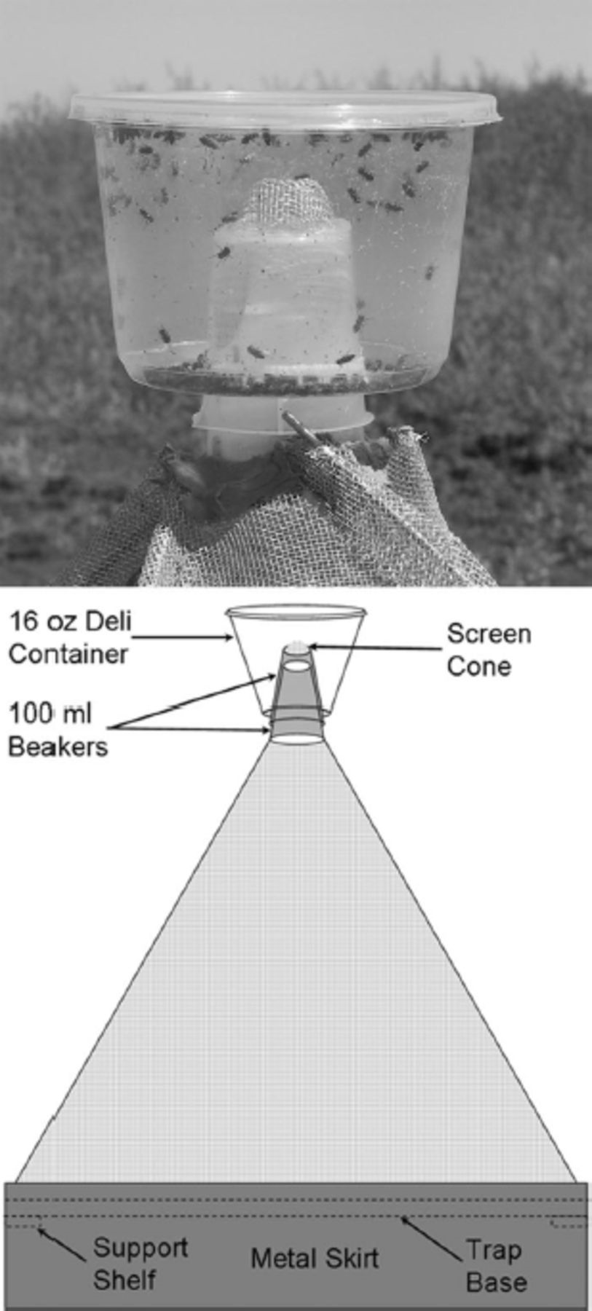
Fig. 2. Emergence trap collection container (above) and schematic of complete emergence trap (below).
Notes:
Fig. 2. Emergence trap collection container (above) and schematic of complete emergence trap (below).
Unless provided in the caption above, the following copyright applies to the content of this slide: © 2011 Entomological Society of AmericaThis is an Open Access article distributed under the terms of the Creative Commons Attribution Non-Commercial License (http://creativecommons.org/licenses/by-nc/3.0/), which permits non-commercial reuse, distribution, and reproduction in any medium, provided the original work is properly cited. For commercial re-use, please contact journals.permissions@oup.com

Slide 3
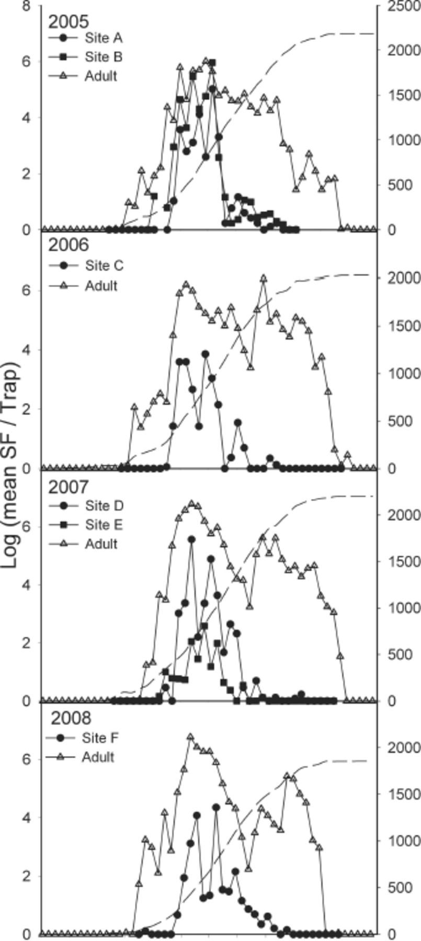
Fig. 3. Weekly emergence and adult trap collections for 2005–2008. Solid symbols indicate emergence trap collections ...
Notes:
Fig. 3. Weekly emergence and adult trap collections for 2005–2008. Solid symbols indicate emergence trap collections and open triangles indicate adult collections on sticky traps. All data are weekly mean log(c+1). Dashed line indicates annual cumulative DD10.
Unless provided in the caption above, the following copyright applies to the content of this slide: © 2011 Entomological Society of AmericaThis is an Open Access article distributed under the terms of the Creative Commons Attribution Non-Commercial License (http://creativecommons.org/licenses/by-nc/3.0/), which permits non-commercial reuse, distribution, and reproduction in any medium, provided the original work is properly cited. For commercial re-use, please contact journals.permissions@oup.com

Slide 4
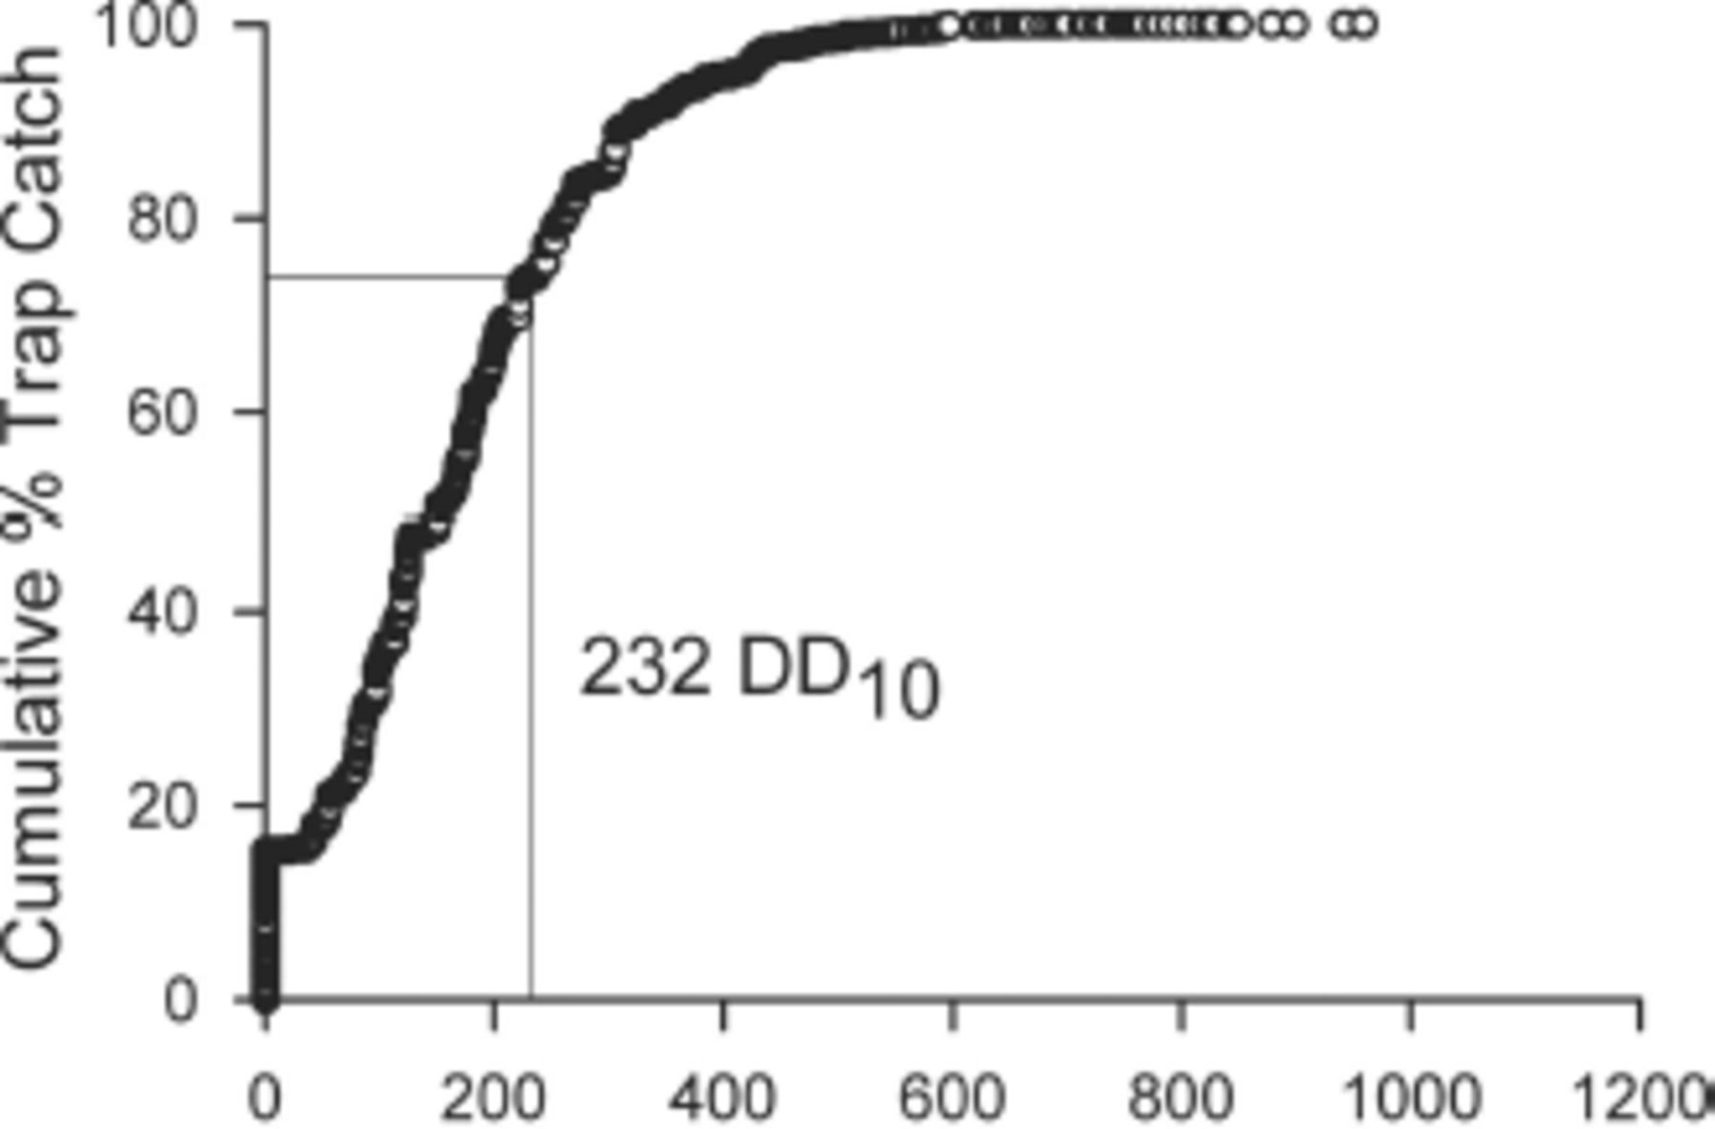
Fig. 4. Empirical distribution function for stable fly emergence trap catch relative to time since the trap was ...
Notes:
Fig. 4. Empirical distribution function for stable fly emergence trap catch relative to time since the trap was installed in cumulative DD10 (232 DD10=74 percentile).
Unless provided in the caption above, the following copyright applies to the content of this slide: © 2011 Entomological Society of AmericaThis is an Open Access article distributed under the terms of the Creative Commons Attribution Non-Commercial License (http://creativecommons.org/licenses/by-nc/3.0/), which permits non-commercial reuse, distribution, and reproduction in any medium, provided the original work is properly cited. For commercial re-use, please contact journals.permissions@oup.com

Slide 5
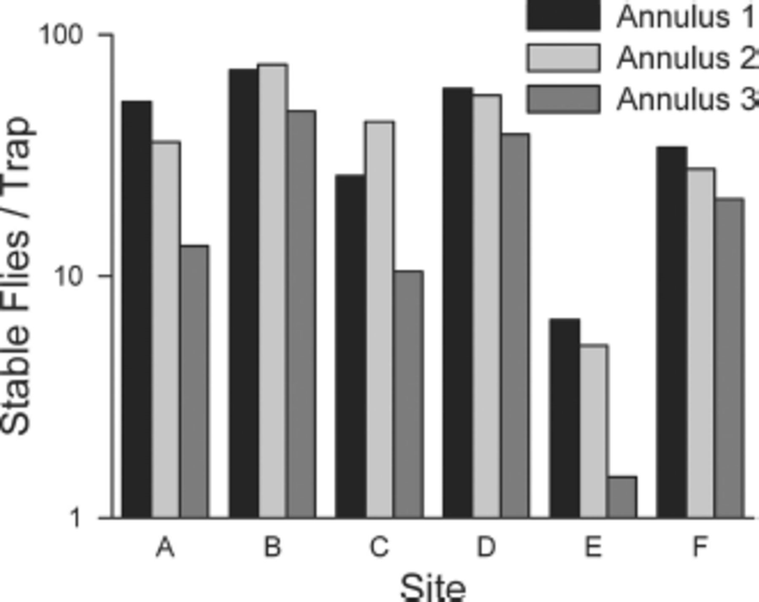
Fig. 5. Mean number of stable flies collected in emergence traps located in concentric 2 m wide annuli radiating from ...
Notes:
Fig. 5. Mean number of stable flies collected in emergence traps located in concentric 2 m wide annuli radiating from center of hay feeding sites.
Unless provided in the caption above, the following copyright applies to the content of this slide: © 2011 Entomological Society of AmericaThis is an Open Access article distributed under the terms of the Creative Commons Attribution Non-Commercial License (http://creativecommons.org/licenses/by-nc/3.0/), which permits non-commercial reuse, distribution, and reproduction in any medium, provided the original work is properly cited. For commercial re-use, please contact journals.permissions@oup.com

Slide 6
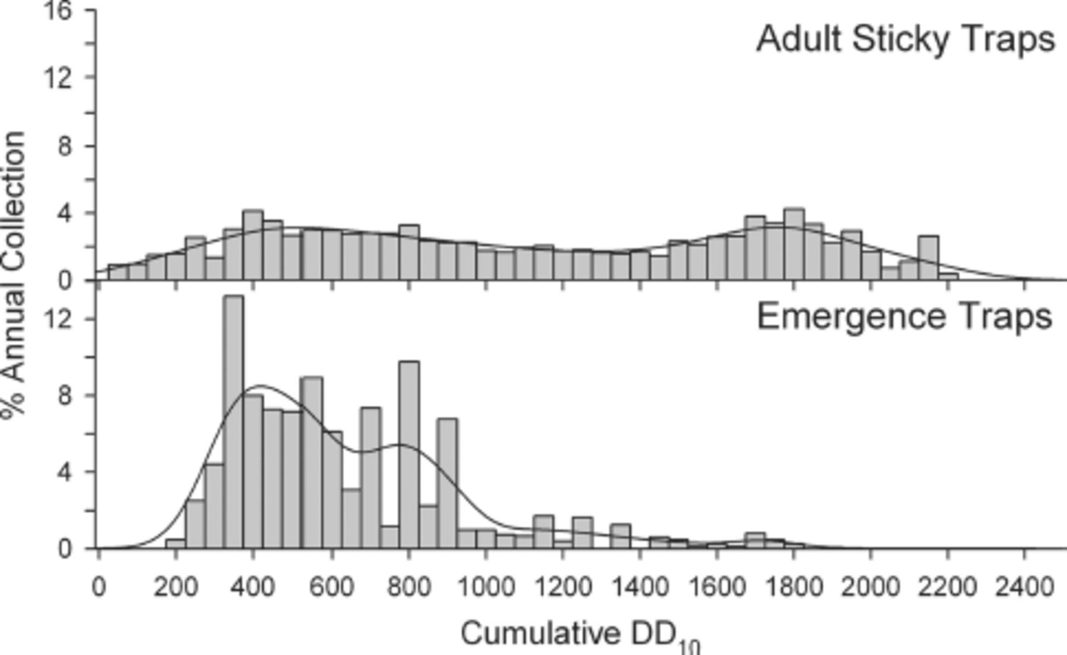
Fig. 6. Seasonal distribution of adult sticky trap and emergence trap collections. Vertical bars indicate the ...
Notes:
Fig. 6. Seasonal distribution of adult sticky trap and emergence trap collections. Vertical bars indicate the percentages of annual trap collections recovered during 50 DD10 intervals for 2005–2008. Line indicates nonparametric kernel density estimate.
Unless provided in the caption above, the following copyright applies to the content of this slide: © 2011 Entomological Society of AmericaThis is an Open Access article distributed under the terms of the Creative Commons Attribution Non-Commercial License (http://creativecommons.org/licenses/by-nc/3.0/), which permits non-commercial reuse, distribution, and reproduction in any medium, provided the original work is properly cited. For commercial re-use, please contact journals.permissions@oup.com

Slide 7
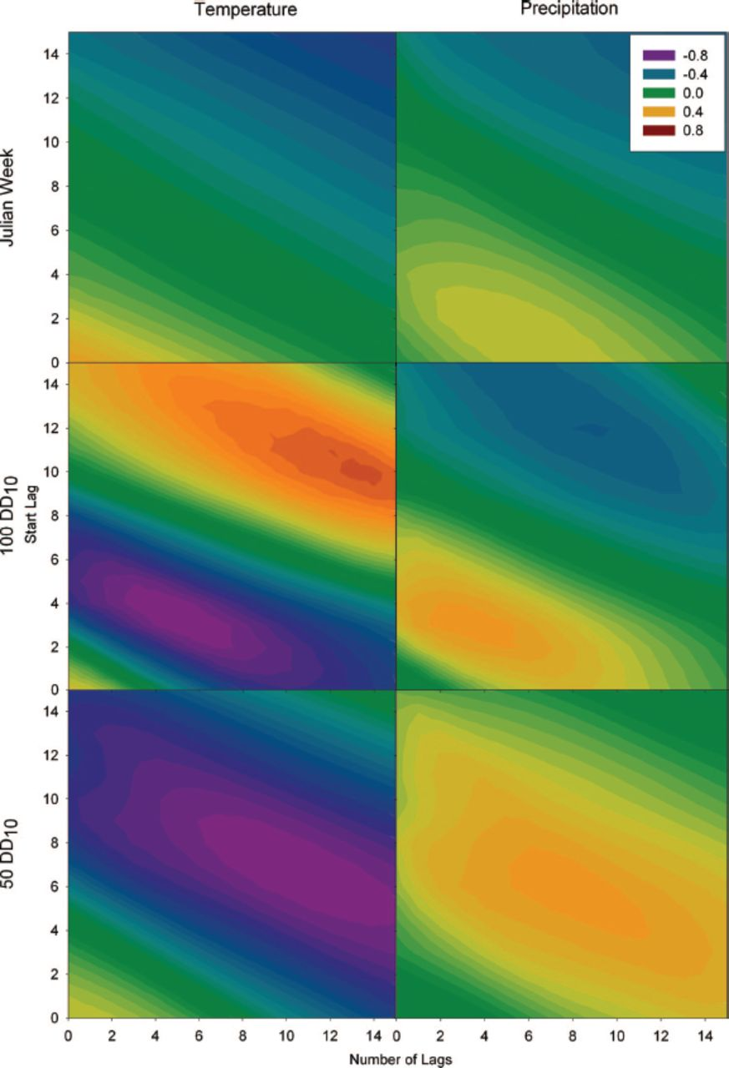
Fig. 7. Cross-correlation maps for mean emergence trap collection per trap-day (ln[c+1]) relative to temperature and ...
Notes:
Fig. 7. Cross-correlation maps for mean emergence trap collection per trap-day (ln[c+1]) relative to temperature and precipitation 0–15 intervals before the collection interval with durations of 0–15 subsequent intervals. Lag of the starting interval is on the y-axis and number of subsequent intervals averaged with the starting interval is on the x-axis. Intervals are 50 DD10, 100 DD10, and Julian weeks.
Unless provided in the caption above, the following copyright applies to the content of this slide: © 2011 Entomological Society of AmericaThis is an Open Access article distributed under the terms of the Creative Commons Attribution Non-Commercial License (http://creativecommons.org/licenses/by-nc/3.0/), which permits non-commercial reuse, distribution, and reproduction in any medium, provided the original work is properly cited. For commercial re-use, please contact journals.permissions@oup.com

