Slide 1
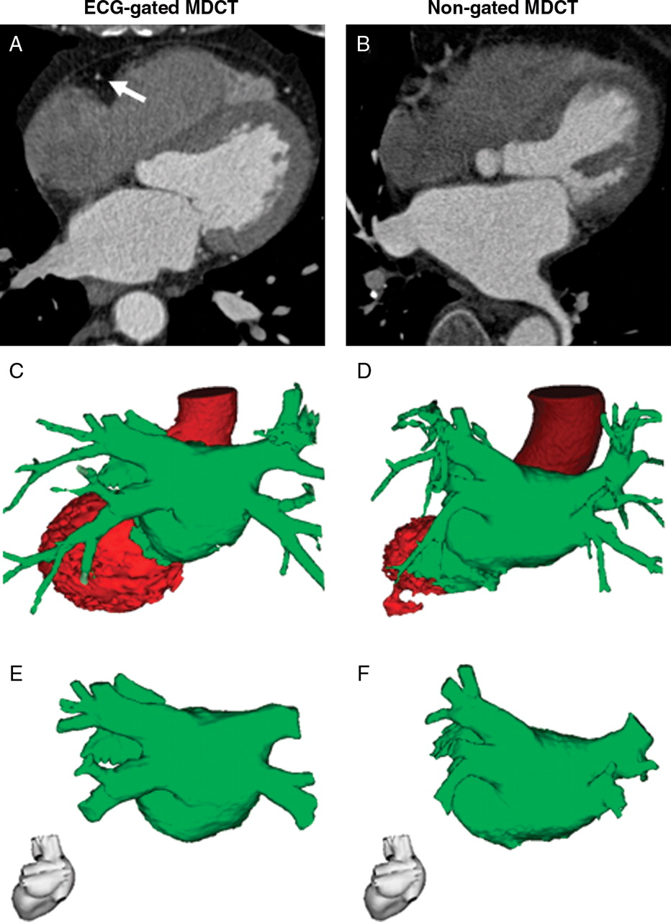
Figure 1 Segmentation of LA from MDCT data sets. Segmentation of ECG-gated ( A , C , and E ) and non-gated ( B , D , ...
Notes:
Figure 1 Segmentation of LA from MDCT data sets. Segmentation of ECG-gated ( A , C , and E ) and non-gated ( B , D , and F ) MDCT data sets was performed using the CartoMerge™ Image Integration Module. Shown are representative axial images of MDCT data sets ( A and B ), the corresponding semi-automatic segmentation results ( C and D ), and the final reconstruction of the LA after manual editing ( E and F ). Note that ECG-gated MDCT ( A ) clearly depicted the right coronary artery (marked with an arrow), whereas the right coronary artery was severely blurred on non-gated MDCT due to motion artefacts ( B ).
Unless provided in the caption above, the following copyright applies to the content of this slide: Published on behalf of the European Society of Cardiology. All rights reserved. © The Author 2010. For permissions please email: journals.permissions@oxfordjournals.org.

Slide 2
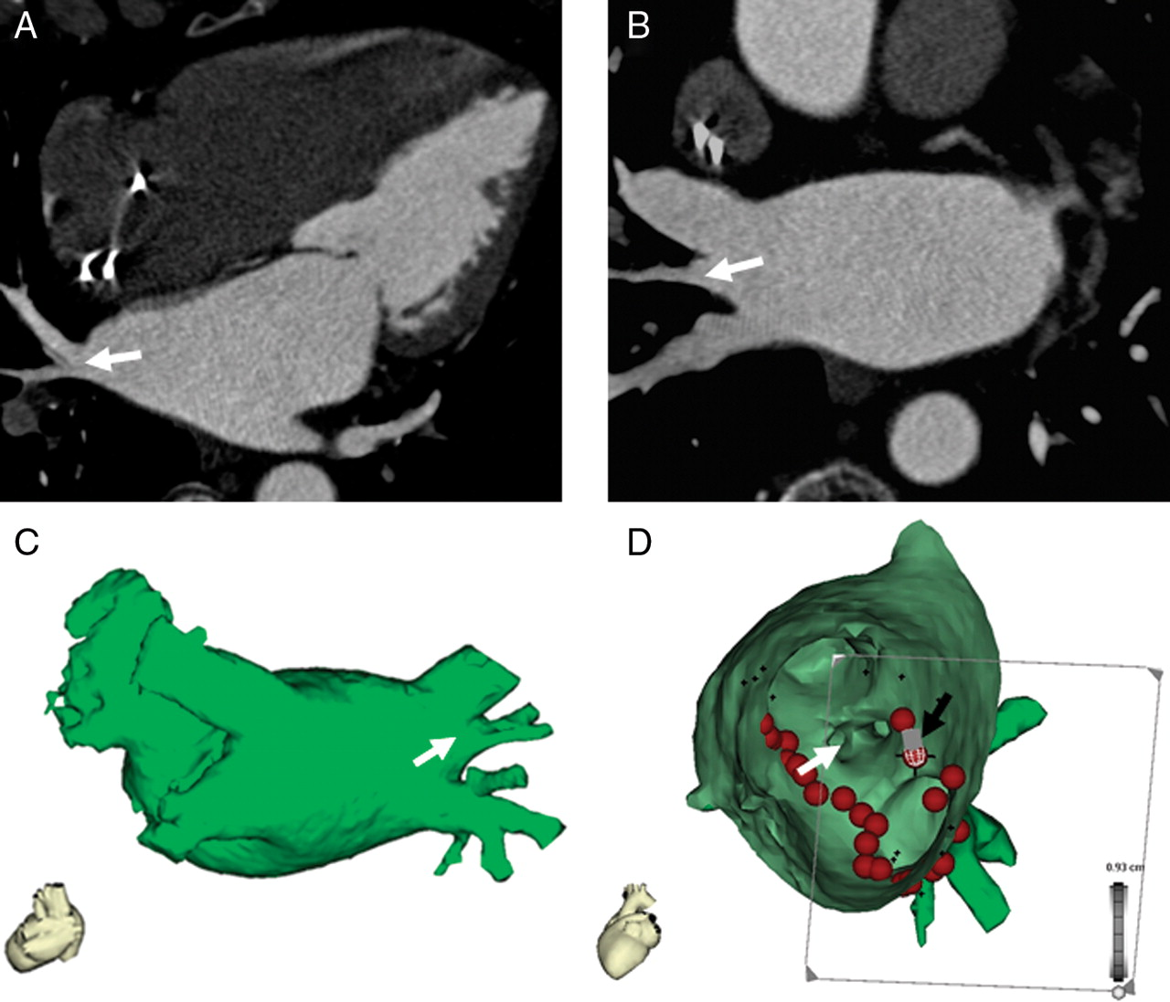
Figure 2 Reconstruction of the LA from non-gated MDCT with excellent image quality. Pulmonary vein isolation was ...
Notes:
Figure 2 Reconstruction of the LA from non-gated MDCT with excellent image quality. Pulmonary vein isolation was performed using LA reconstruction from non-gated MDCT (75-year-old woman with paroxysmal AF and implanted pacemaker). Shown are a representative axial image ( A ), paraaxial image ( B ), corresponding LA reconstruction ( C ), and the fused electroanatomic map ( D , view from inside of the LA to right PVs). The right middle PV (white arrow) is clearly visualized. Tags on fused electroanatomic map indicate sites of radiofrequency current delivery. The black arrow indicates the position of the ablation catheter performing an ablation at the posterior part of the ridge between the right inferior PV and the middle PV.
Unless provided in the caption above, the following copyright applies to the content of this slide: Published on behalf of the European Society of Cardiology. All rights reserved. © The Author 2010. For permissions please email: journals.permissions@oxfordjournals.org.

Slide 3
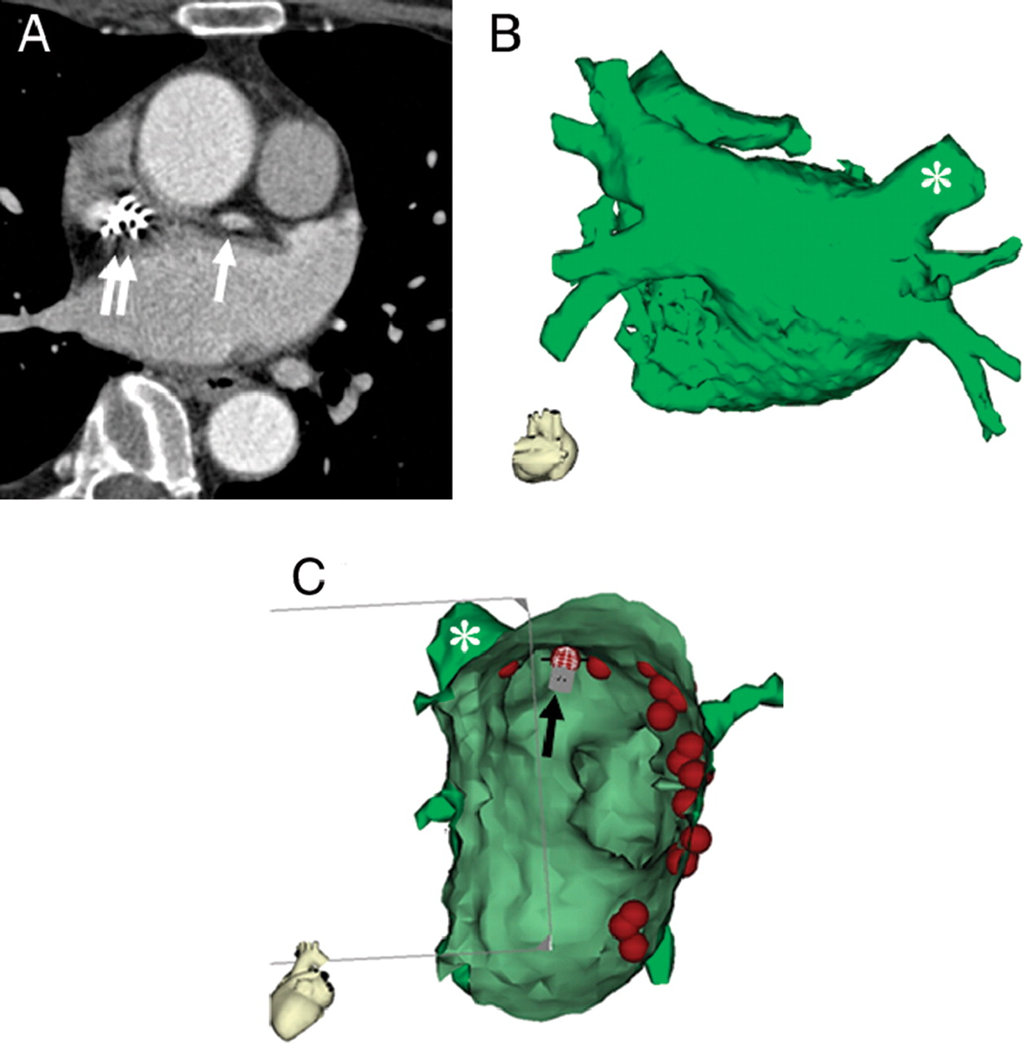
Figure 3 Reconstruction of the LA from non-gated MDCT with moderate image quality. A 59-year-old woman with moderate ...
Notes:
Figure 3 Reconstruction of the LA from non-gated MDCT with moderate image quality. A 59-year-old woman with moderate image quality of non-gated MDCT ( A ) due to motion artefacts from pronounced atrial contraction (white arrow) and streak artefacts from pacemaker leads (white double arrow). Despite moderate irregularities of the endocardial surface, LA reconstruction ( B ) had sufficient image quality for integrated EAM ( C , view from inside of the LA to right PVs). Tags on fused electroanatomic map indicate sites of radiofrequency current delivery. The black arrow indicates the position of the ablation catheter performing ablation at the superior part of the ostium of right superior PV (marked with asterisk).
Unless provided in the caption above, the following copyright applies to the content of this slide: Published on behalf of the European Society of Cardiology. All rights reserved. © The Author 2010. For permissions please email: journals.permissions@oxfordjournals.org.

