Slide 1
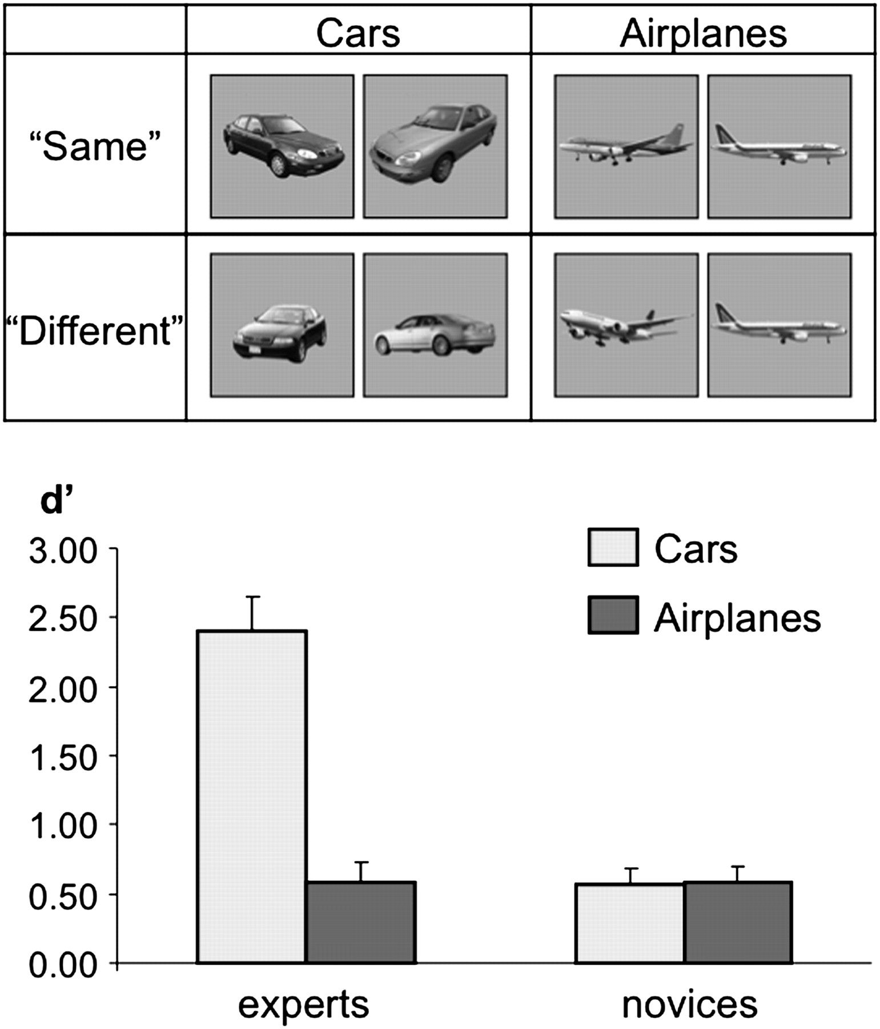
Figure 1. Behavioral performance in the expertise assessment task. Top: examples of the stimuli viewed in the expertise ...
Notes:
Figure 1. Behavioral performance in the expertise assessment task. Top: examples of the stimuli viewed in the expertise assessment experiment are presented. In each trial, subjects viewed a pair of sequentially presented private cars or passenger airplanes and had to indicate whether the 2 stimuli were of the same model or of a different model (examples for an expected “same” response are presented in the top row and for expected “different” response in the bottom row). Trials consisted of 500-ms image presentation followed by 500-ms fixation image after which the second image appeared for 500 ms. Bottom: mean performance (d′) of the car experts and the car novices in the expertise assessment task. Car performance is indicated in light gray, airplane performance in dark gray. Note the low level of performance of the car novices in both the car and airplane conditions, similar to the performance of the car experts in the airplane condition and in comparison the car experts’ superior performance in the car condition. Error bars indicate standard error of the mean (SEM).
Unless provided in the caption above, the following copyright applies to the content of this slide: © The Author 2010. Published by Oxford University Press. All rights reserved. For permissions, please e-mail: journals.permissions@oxfordjournals.org

Slide 2
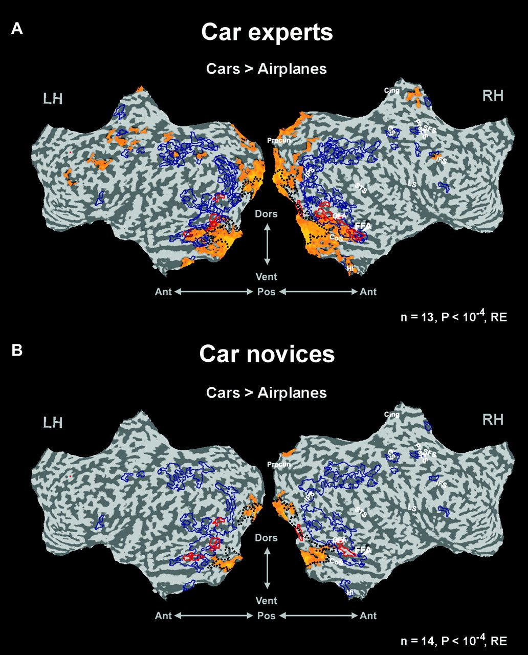
Figure 2. Experiment 1 car-selective activation maps. Experiment 1 multisubject activation maps of car experts and car ...
Notes:
Figure 2. Experiment 1 car-selective activation maps. Experiment 1 multisubject activation maps of car experts and car novices displayed on flattened cortical surfaces. Yellow to orange patches denote regions that were activated above baseline and showed car-selective activation (compared with airplanes) defined by the contrast (cars > airplanes and cars > baseline). The light blue patches denote regions exhibited negative results to that contrast. Face-selective regions are indicated by red contours (defined by above baseline preference to faces over houses in the category localizer experiment). Black dotted lines denote the approximated borders of early visual areas showing preference to textures over objects (“low-level visual areas,” defined separately by the category localizer experiment). The blue contours represent borders of high-level visual object areas (defined as areas showing above baseline preference to objects over textures). Note that in car experts (A), the car-selective activation extends extensively beyond early visual regions (black dotted line) into far peripheral visual representations and face and object-selective regions, whereas in novices (B), the car-selective activation is confined to early visual regions. FFA—fusiform face area, OFA—occipital face area, CoS—collateral sulcus, IPS—intraparietal sulcus, CS—central sulcus, PreCS—precentral sulcus, SFS—superior frontal sulcus, IFS—inferior frontal sulcus, LS—lateral sulcus, Hi—hippocampus, Precun—precuneus, Cing—cingulate, RH—right hemisphere, LH—left hemisphere, Dors—dorsal, Vent—ventral, Pos—posterior, Ant—anterior. All the statistical contrasts were obtained with corrected P < 0.0001, RE analysis, n = 13 experts in the experts’ maps, n = 14 novices in the novices’ maps.
Unless provided in the caption above, the following copyright applies to the content of this slide: © The Author 2010. Published by Oxford University Press. All rights reserved. For permissions, please e-mail: journals.permissions@oxfordjournals.org

Slide 3
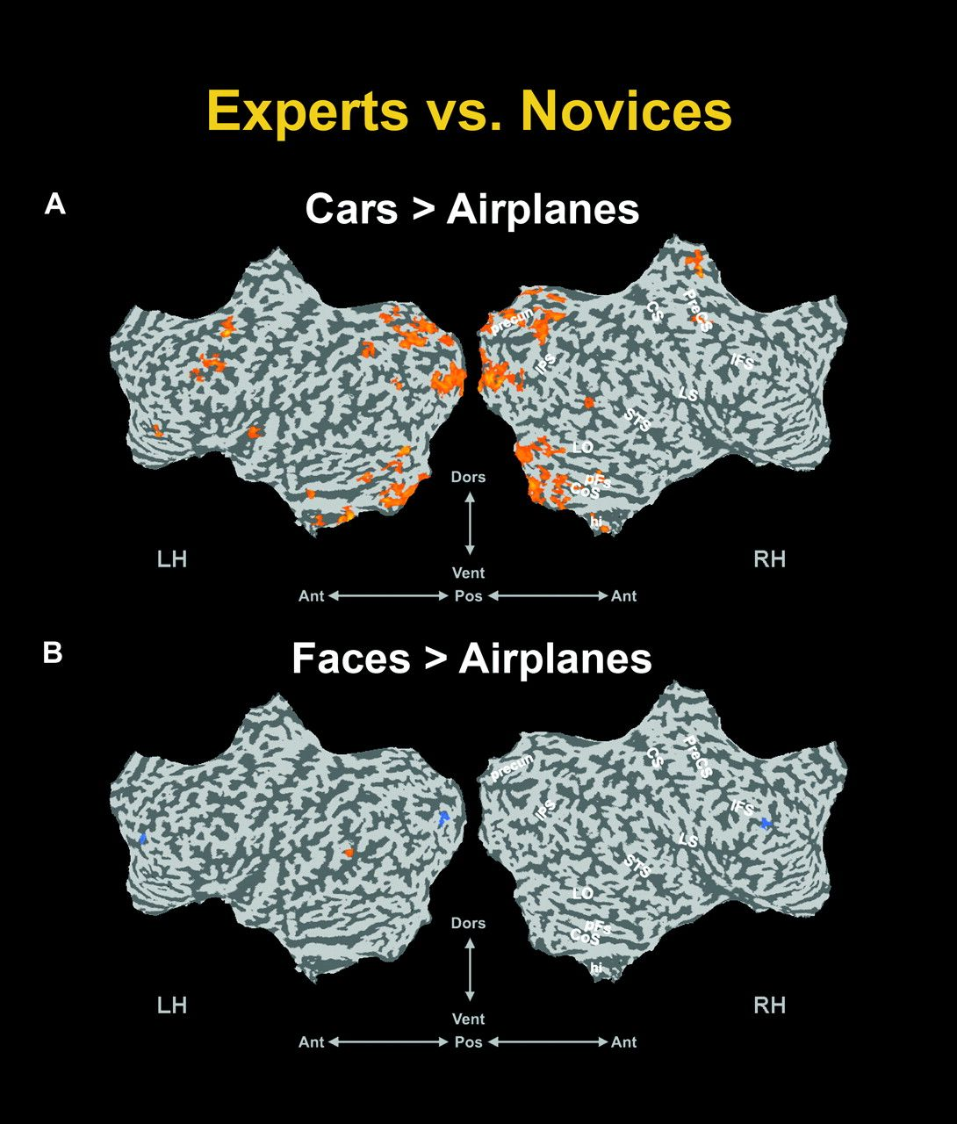
Figure 3. Experiment 1 intergroup comparisons. Experiment 1′s group contrast (Experts vs. Novices) multisubject maps ...
Notes:
Figure 3. Experiment 1 intergroup comparisons. Experiment 1′s group contrast (Experts vs. Novices) multisubject maps for the cars versus airplanes contrast (A) and the faces versus airplanes contrast (B), displayed on flattened cortical surfaces. These statistical maps show up the significant difference between the groups for the contrast specified (P airplanes]experts > [cars > airplanes]novices) and in (B) face-selective regions that were more activated in experts than in novices (i.e., defined by the contrast [faces > airplanes]experts > [faces > airplanes]novices). The light blue patches denote regions exhibited negative results to these contrasts. Presentation format and anatomical landmarks as in Figure 2.
Unless provided in the caption above, the following copyright applies to the content of this slide: © The Author 2010. Published by Oxford University Press. All rights reserved. For permissions, please e-mail: journals.permissions@oxfordjournals.org

Slide 4
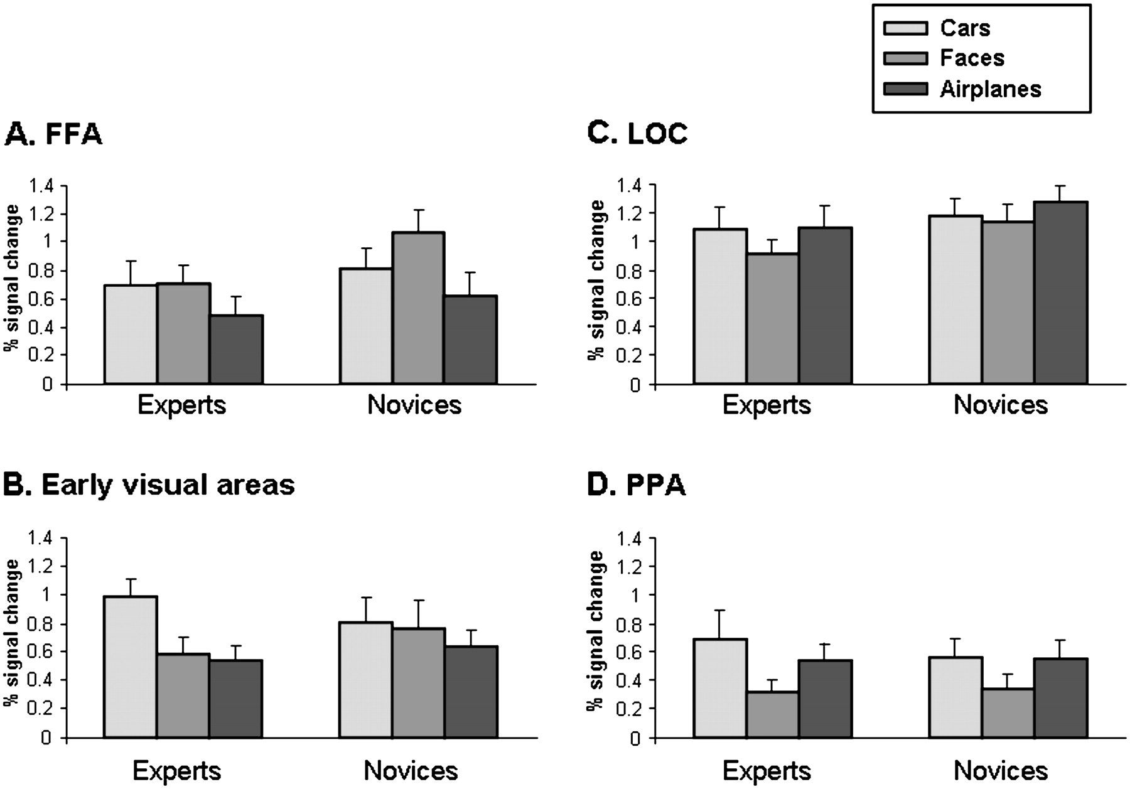
Figure 4. Experiment 1 ROI analysis. Mean activation levels in Experiment 1 to the different categories (cars in light ...
Notes:
Figure 4. Experiment 1 ROI analysis. Mean activation levels in Experiment 1 to the different categories (cars in light gray, faces in medium gray, and airplanes in dark gray) in both experts and novices in the 4 ROIs (which were defined independently, see Materials and Methods for more details). (A) FFA, (B) Early visual areas, (C) LOC, and (D) PPA. The y-axis denotes fMRI BOLD percent signal change relative to the fixation blocks. In LOC and PPA, no significant difference was found between experts and novices. In FFA and early visual areas, significant differences were observed between the experts and the novices (see Results for further details). Error bars, SEM.
Unless provided in the caption above, the following copyright applies to the content of this slide: © The Author 2010. Published by Oxford University Press. All rights reserved. For permissions, please e-mail: journals.permissions@oxfordjournals.org

Slide 5
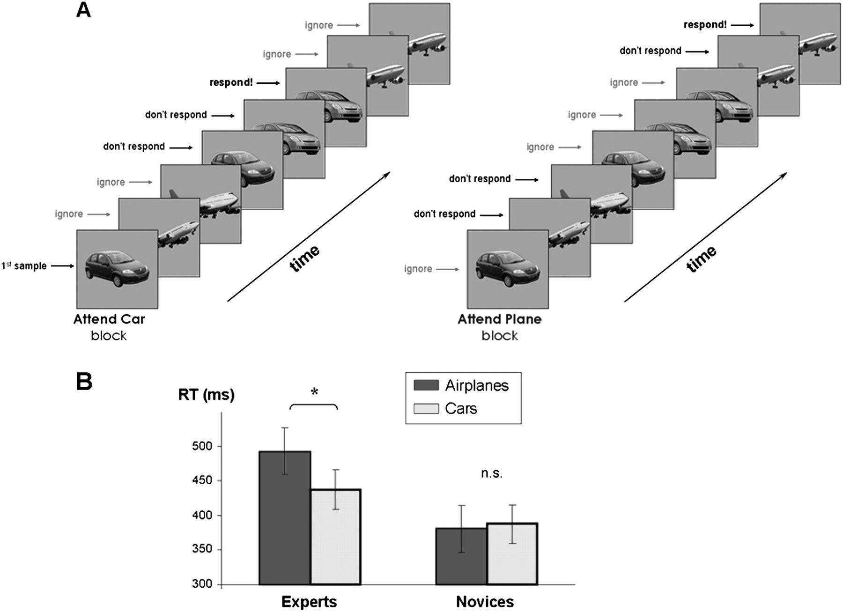
Figure 5. Experiment 2 design and behavior in the high engagement condition. (A) An illustration of Experiment 2′s ...
Notes:
Figure 5. Experiment 2 design and behavior in the high engagement condition. (A) An illustration of Experiment 2′s experimental design. For demonstration purposes, the same sequence is presented once appearing in the “attend-car” block (left) and once appearing in the “attend-airplane” block (right). The expected behavior of the subject is indicated on the left of the sequence. The subjects were instructed to attend a specific category throughout the block and press a button each time an image from the instructed category was immediately repeated, while ignoring the stimuli from the other category. (B) Mean RTs of the car experts and the car novices in response to task-relevant car images (indicated in light gray) and task-relevant airplane images (indicated in dark gray), as measured inside the scanner. In each block of Experiment 2, subjects performed a one-back memory task for a specific predesignated category, deeming one category as task relevant (requiring high level of engagement) and the other category as task-irrelevant (requiring low level of engagement). Note that although the novices show a similar performance for both attended categories, the experts show an enhanced performance for cars compared with airplanes, even though both categories required high engagement.
Unless provided in the caption above, the following copyright applies to the content of this slide: © The Author 2010. Published by Oxford University Press. All rights reserved. For permissions, please e-mail: journals.permissions@oxfordjournals.org

Slide 6
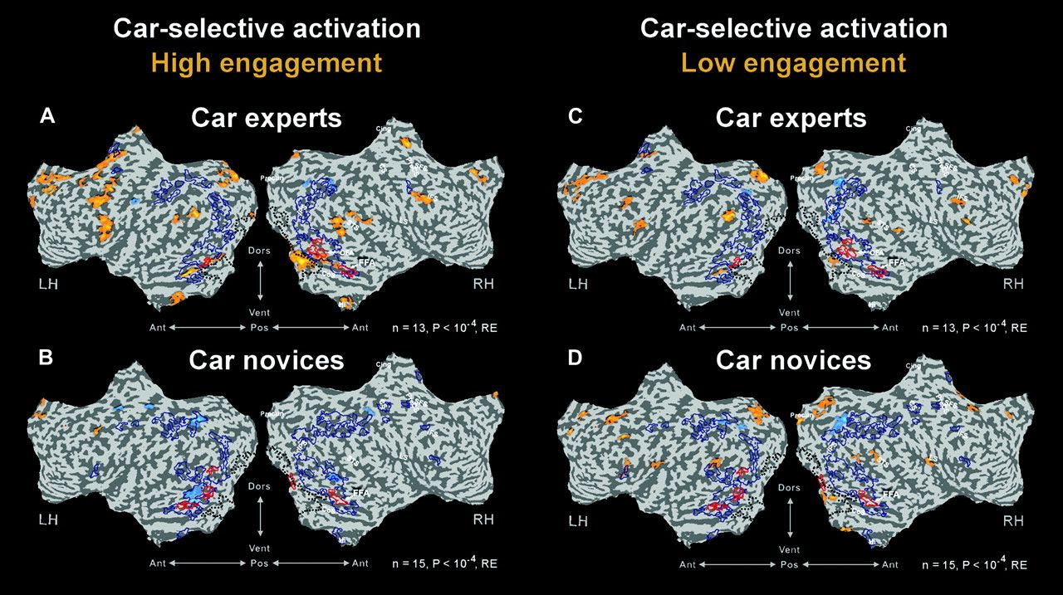
Figure 6. Experiment 2 high and low engagement car-selective activation maps. Experiment 2 multisubject activation maps ...
Notes:
Figure 6. Experiment 2 high and low engagement car-selective activation maps. Experiment 2 multisubject activation maps of car experts and car novices’ are displayed on flattened cortical surfaces. Presentation format, anatomical landmarks, and functional borders (black dotted line, red and blue delineation) as in Figure 2. Left column: high engagement (task-relevant) condition of the car experts (A) and car novices (B). Right column: low engagement (task-irrelevant) condition of the car experts (C) and of the car novices (D). Yellow to orange patches denote car-selective activation (compared with airplanes) defined by the contrast (cars > airplanes and cars > baseline). The light blue patches denote the negative to that contrast. All the statistical contrasts were obtained with corrected P < 0.0001, RE analysis, n = 13 experts in the experts maps, n = 15 novices in the novices maps.
Unless provided in the caption above, the following copyright applies to the content of this slide: © The Author 2010. Published by Oxford University Press. All rights reserved. For permissions, please e-mail: journals.permissions@oxfordjournals.org

Slide 7
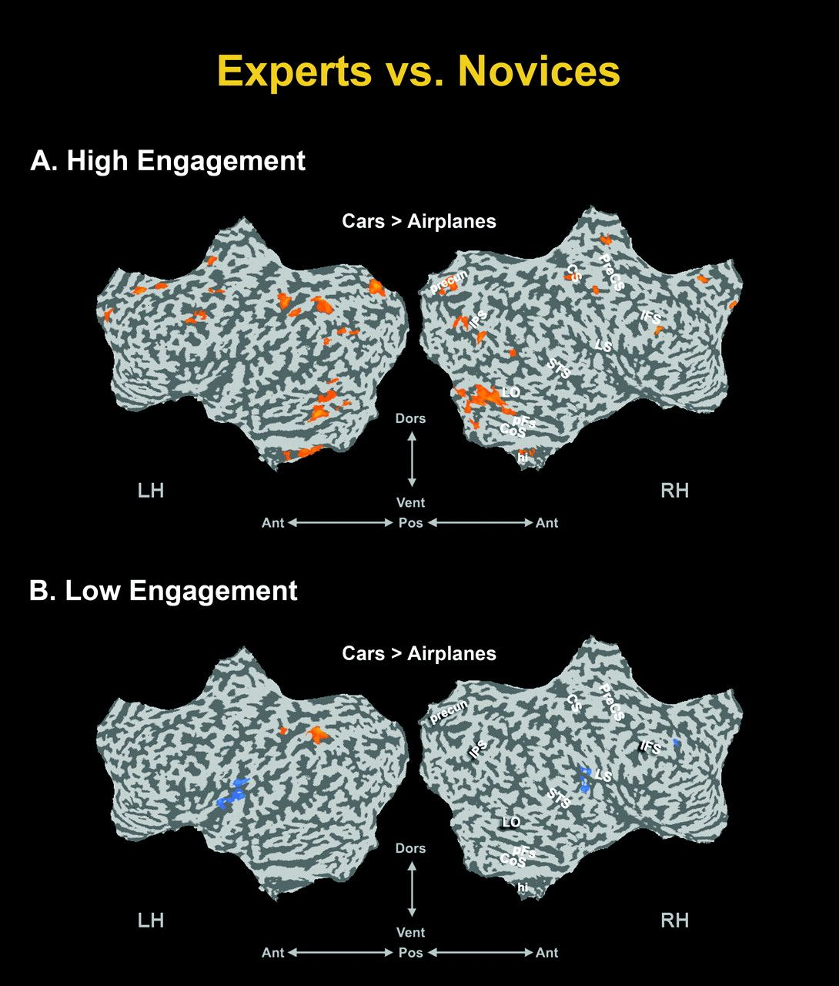
Figure 7. Experiment 2 intergroup comparisons. Experiment 2′s group contrast (Experts vs. Novices) multisubject maps ...
Notes:
Figure 7. Experiment 2 intergroup comparisons. Experiment 2′s group contrast (Experts vs. Novices) multisubject maps for the cars versus airplanes contrast in the high engagement condition (A) and the cars versus airplanes contrast in the low engagement condition (B), displayed on flattened cortical surfaces. These statistical maps show up the significant difference between the groups for the contrast specified (P airplanes High Engagement]experts > [cars High Engagement > airplanes High Engagement]novices) and in (B) car-selective regions that were more activated in experts than in novices (i.e., defined by the contrast [cars Low Engagement > airplanes Low Engagement]experts > [cars Low Engagement > airplanes Low Engagement]novices). The light blue patches denote regions exhibited negative results to these contrasts. Presentation format and anatomical landmarks as in Figure 2.
Unless provided in the caption above, the following copyright applies to the content of this slide: © The Author 2010. Published by Oxford University Press. All rights reserved. For permissions, please e-mail: journals.permissions@oxfordjournals.org

Slide 8
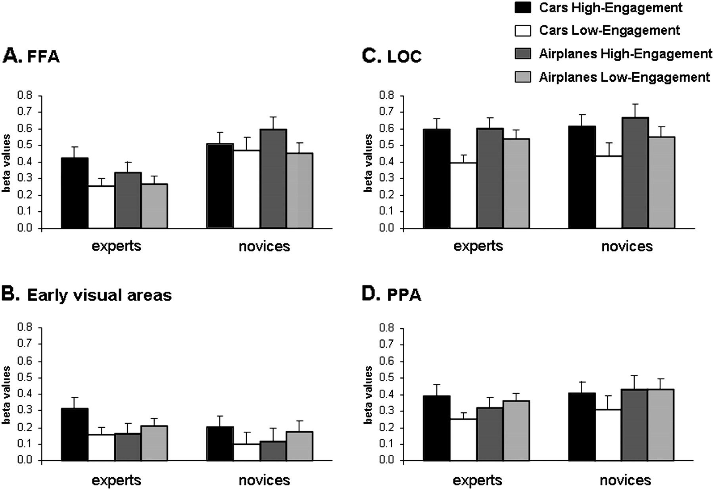
Figure 8. Experiment 2 ROI analysis. Mean activation levels in Experiment 2 to the 4 conditions (cars in the high ...
Notes:
Figure 8. Experiment 2 ROI analysis. Mean activation levels in Experiment 2 to the 4 conditions (cars in the high engagement condition [black], cars in the low engagement condition [white], airplanes in the high engagement condition (dark gray), airplanes in the low engagement condition [light gray]) for the experts and novices in the 4 ROIs (as in Fig. 3, see Materials and Methods for further details). (A) FFA, (B) Early visual areas, (C) LOC, and (D) PPA. Y-axis denotes mean beta values compared with the fixation baseline condition. See Results for further details. Error bars, SEM.
Unless provided in the caption above, the following copyright applies to the content of this slide: © The Author 2010. Published by Oxford University Press. All rights reserved. For permissions, please e-mail: journals.permissions@oxfordjournals.org

