Slide 1
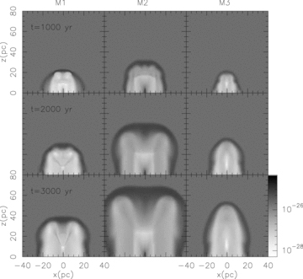
Figure 1 Comparison of the temporal evolution of density stratification maps for models M1, M2 and M3 (left-hand to ...
Notes:
Figure 1 Comparison of the temporal evolution of density stratification maps for models M1, M2 and M3 (left-hand to right-hand panel). The grey-scale is logarithmic and the density is given in units of g cm−3.
Unless provided in the caption above, the following copyright applies to the content of this slide: © 2008 The Authors. Journal compilation © 2008 RAS

Slide 2
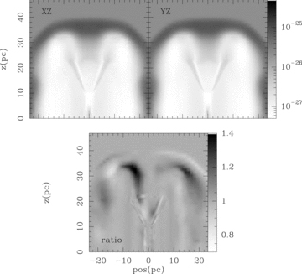
Figure 2 Asymmetry between xz- and yz-projections of the density distribution at t= 3000 yr for model M1. Bottom ...
Notes:
Figure 2 Asymmetry between xz- and yz-projections of the density distribution at t= 3000 yr for model M1. Bottom panel: displays the ratio between the xz and yz density distribution maps. If the system were perfectly symmetric, this ratio would be 1. Note that some regions show asymmetries with values ∼40 per cent showing the importance of full 3D hydrodynamical simulations to model the system.
Unless provided in the caption above, the following copyright applies to the content of this slide: © 2008 The Authors. Journal compilation © 2008 RAS

Slide 3
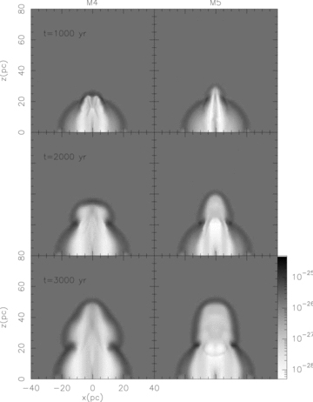
Figure 3 Snapshots of the density distribution for models M4 (left-hand panel) and M5 (right-hand panel) at ...
Notes:
Figure 3 Snapshots of the density distribution for models M4 (left-hand panel) and M5 (right-hand panel) at integration times 1000, 2000 and 3000 yr. Note that the spherical symmetry of the SNR is broken by the precessing jet and the formation of the lobe is clearly observed.
Unless provided in the caption above, the following copyright applies to the content of this slide: © 2008 The Authors. Journal compilation © 2008 RAS

Slide 4
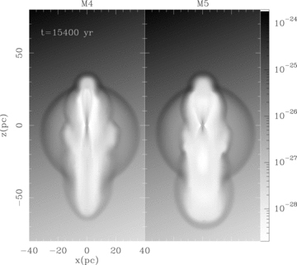
Figure 4 The same parameters for the jet and SNR as for models M4 (left-hand panel) and M5 (right-hand panel) but the ...
Notes:
Figure 4 The same parameters for the jet and SNR as for models M4 (left-hand panel) and M5 (right-hand panel) but the ISM has a density gradient increasing along an axis tilted by an angle of 20° with respect to the vertical axis. The snapshot is for t= 3600 yr after the jet is turned on (a total evolution time of 9600 yr).
Unless provided in the caption above, the following copyright applies to the content of this slide: © 2008 The Authors. Journal compilation © 2008 RAS

Slide 5
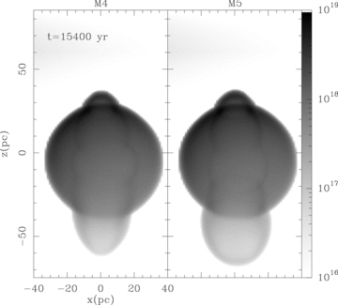
Figure 5 Electronic density integrated along the line of sight with a 21° inclination angle with respect to the plane ...
Notes:
Figure 5 Electronic density integrated along the line of sight with a 21° inclination angle with respect to the plane of the sky for the same models as Fig. 4. The grey-scale is logarithmic and is given in units of cm−2.
Unless provided in the caption above, the following copyright applies to the content of this slide: © 2008 The Authors. Journal compilation © 2008 RAS

Slide 6
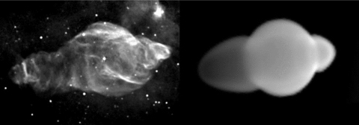
Figure 6 Comparison of the radio-continuum image with the simulated column electronic density map of model M4. The ...
Notes:
Figure 6 Comparison of the radio-continuum image with the simulated column electronic density map of model M4. The left-hand panel shows the 1415-MHz image in grey-scale and contours of the W50 SNR, obtained with the VLA by Dubner et al. (1998), in equatorial coordinates (north is up). The right-hand panel shows the simulated map in a grey colour scale. A distance of 3 kpc to SS433 was assumed.
Unless provided in the caption above, the following copyright applies to the content of this slide: © 2008 The Authors. Journal compilation © 2008 RAS

