Slide 1
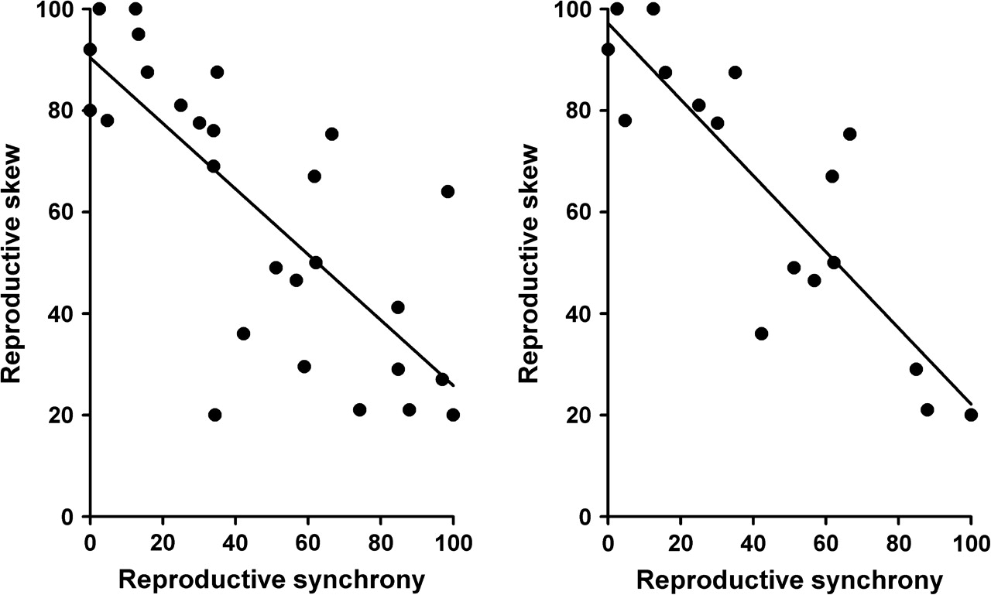
Figure 1 Male reproductive skew (alpha male paternity) within the group regressed on female reproductive synchrony ...
Notes:
Figure 1 Male reproductive skew (alpha male paternity) within the group regressed on female reproductive synchrony (proportion of mating season with more than one female being estrus on the same day) in 27 primate populations (left) and a subset of 17 populations with data on EGP (right; for references, see Table 1).
Unless provided in the caption above, the following copyright applies to the content of this slide: © 2008 The AuthorsThis is an Open Access article distributed under the terms of the Creative Commons Attribution Non-Commercial License (http://creativecommons.org/licenses/by-nc/2.0/uk/) which permits unrestricted non-commercial use, distribution, and reproduction in any medium, provided the original work is properly cited.

Slide 2
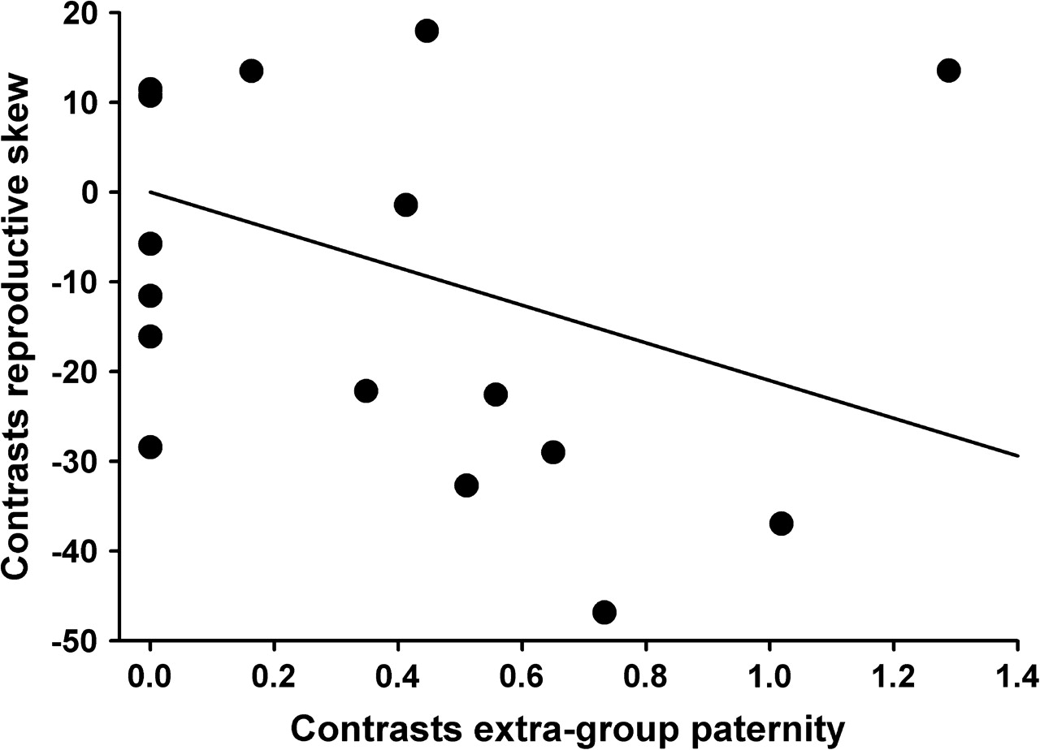
Figure 2 Independent contrasts of male reproductive skew within a group regressed on contrasts of categorical measures ...
Notes:
Figure 2 Independent contrasts of male reproductive skew within a group regressed on contrasts of categorical measures of EGP in the populations data set (for references, see Table 1). Outlier data point in the upper right corner represents the contrast between the 2 chimpanzee populations, Pan troglodytes schweinfurthii and Pan troglodytes verus. Contrasts in EGP can be greater than one when the sum of the branch lengths is less than one, as this sum is used to standardize the contrasts.
Unless provided in the caption above, the following copyright applies to the content of this slide: © 2008 The AuthorsThis is an Open Access article distributed under the terms of the Creative Commons Attribution Non-Commercial License (http://creativecommons.org/licenses/by-nc/2.0/uk/) which permits unrestricted non-commercial use, distribution, and reproduction in any medium, provided the original work is properly cited.

