Slide 1
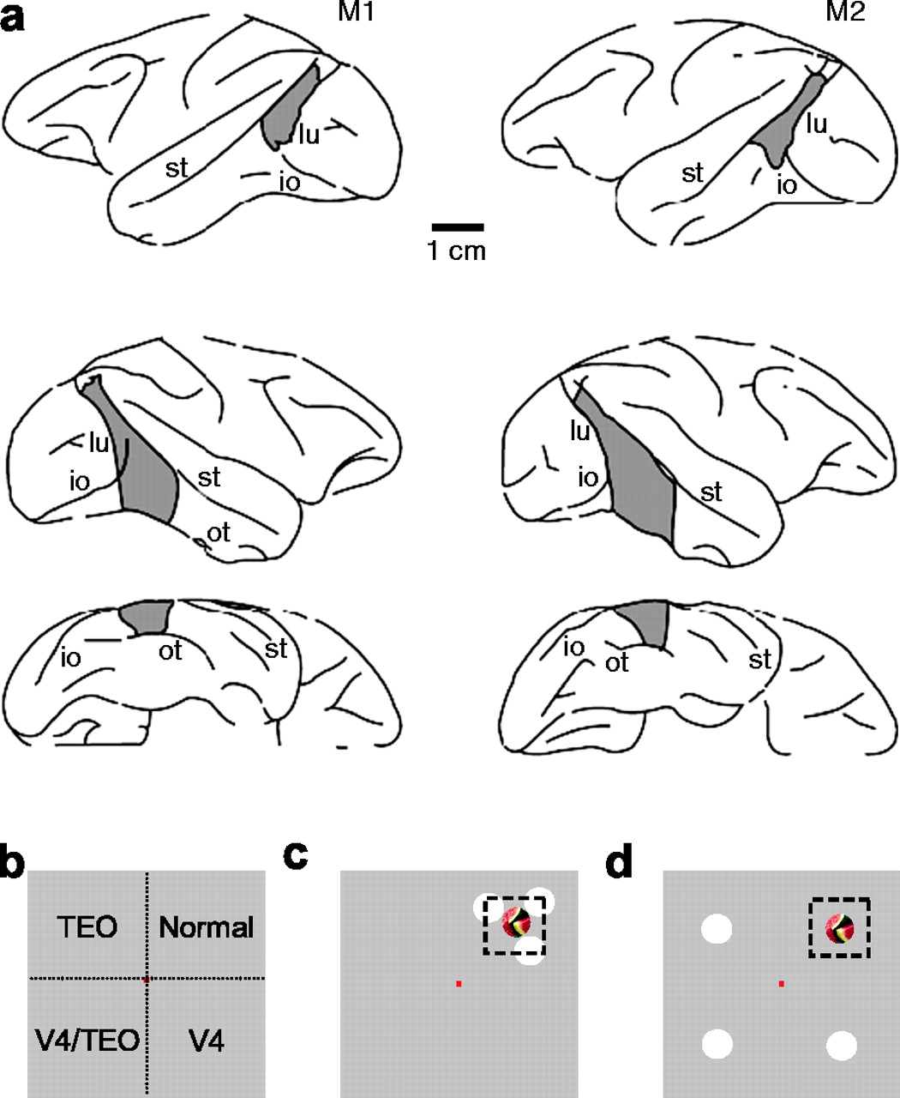
Figure 1. Extent of V4 and TEO lesions in monkeys M1 and M2 and stimulus configurations. (a) Lateral view of the left ...
Notes:
Figure 1. Extent of V4 and TEO lesions in monkeys M1 and M2 and stimulus configurations. (a) Lateral view of the left hemisphere showing a lesion (dark shading) in the dorsal part of V4 for monkeys M1 and M2, shown on top. Below are lateral and ventral views of the right hemisphere showing a lesion in the dorsal part of V4 and in TEO in M1 and M2. MRI scans suggest unintended damage medial to ‘ot’ in monkey M2 (lighter shading). Abbreviations: lu, lunate sulcus; st, superior temporal sulcus; io, inferior occipital sulcus; ot, occipital temporal sulcus. (b) Distribution of lesion effects in the four quadrants of the visual field, derived from retinotopy in areas V4 and TEO. TEO, quadrant affected by TEO lesion; V4, quadrant affected by V4 lesion; V4 + TEO, quadrant affected by combined V4 and TEO lesion. (c) Stimulus configuration with distracters close to the target stimulus and inside of the V4 RF that contained the target. (d) Stimulus configuration with distracters far from the target stimulus and outside of the V4 RF that contained the target. The dotted black line in (c, d) represents the size of a typical V4 RF relative to the size of the stimuli at an eccentricity of 5.6°. The red square in (b–d) represents the central fixation spot.
Unless provided in the caption above, the following copyright applies to the content of this slide: Cerebral Cortex V 15 N 2 © Oxford University Press 2005; all rights reserved

Slide 2
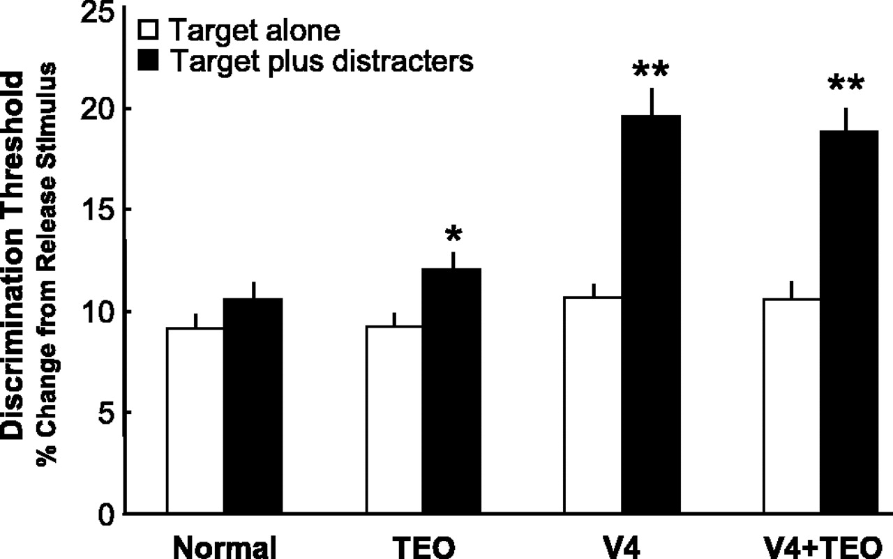
Figure 2. Behavioral performance. Discrimination thresholds in each quadrant, in the presence (black bars) and absence ...
Notes:
Figure 2. Behavioral performance. Discrimination thresholds in each quadrant, in the presence (black bars) and absence (white bars) of distracters. Bars represent averages based on at least 60 thresholds; error bars indicate standard error of the mean. TEO, quadrant affected by TEO lesion; V4, quadrant affected by V4 lesion; V4 + TEO, quadrant affected by combined V4 and TEO lesion. **P < 0.001; *P < 0.01.
Unless provided in the caption above, the following copyright applies to the content of this slide: Cerebral Cortex V 15 N 2 © Oxford University Press 2005; all rights reserved

Slide 3
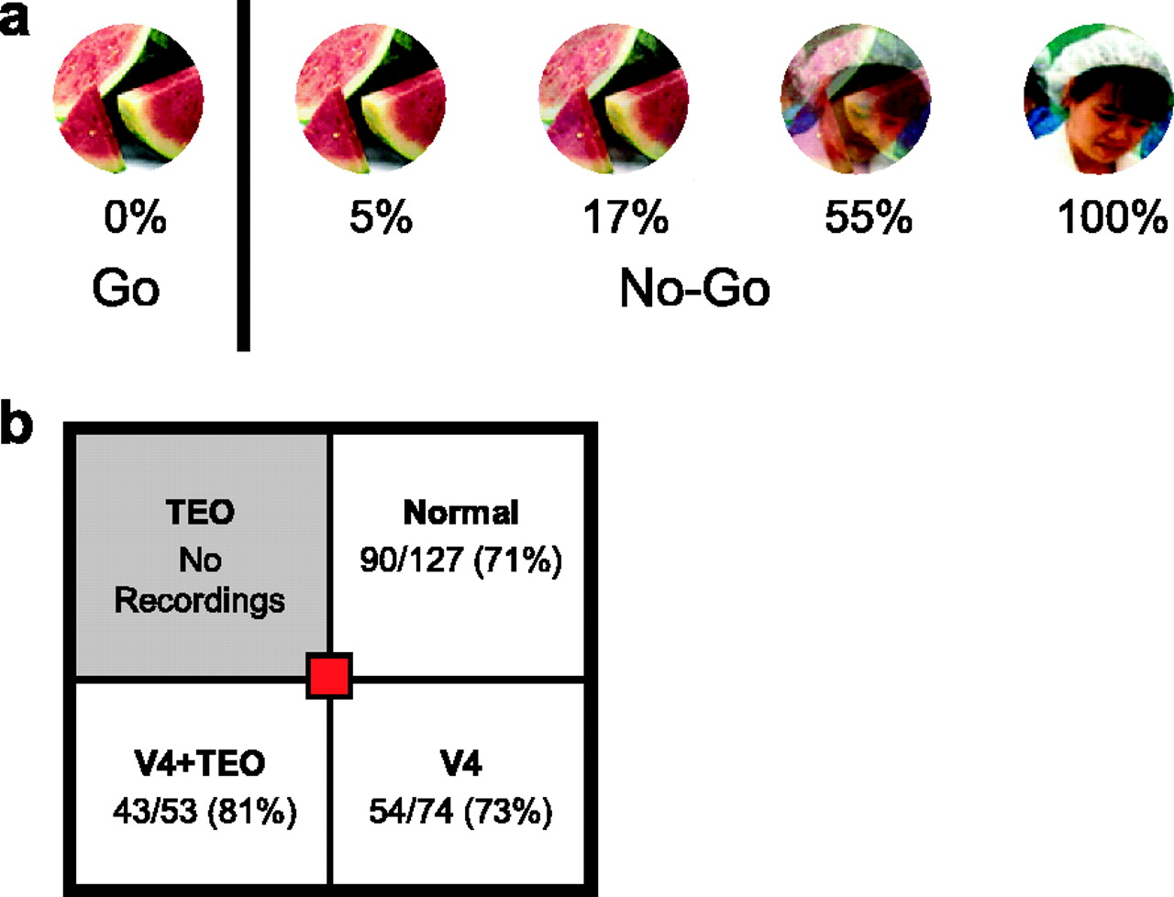
Figure 3. Example of a stimulus pair along with morphed stimuli used for determining discrimination thresholds and to ...
Notes:
Figure 3. Example of a stimulus pair along with morphed stimuli used for determining discrimination thresholds and to record responses of area TE neurons (a). Number and percentage of visually responsive cells in the different quadrants (b).
Unless provided in the caption above, the following copyright applies to the content of this slide: Cerebral Cortex V 15 N 2 © Oxford University Press 2005; all rights reserved

Slide 4
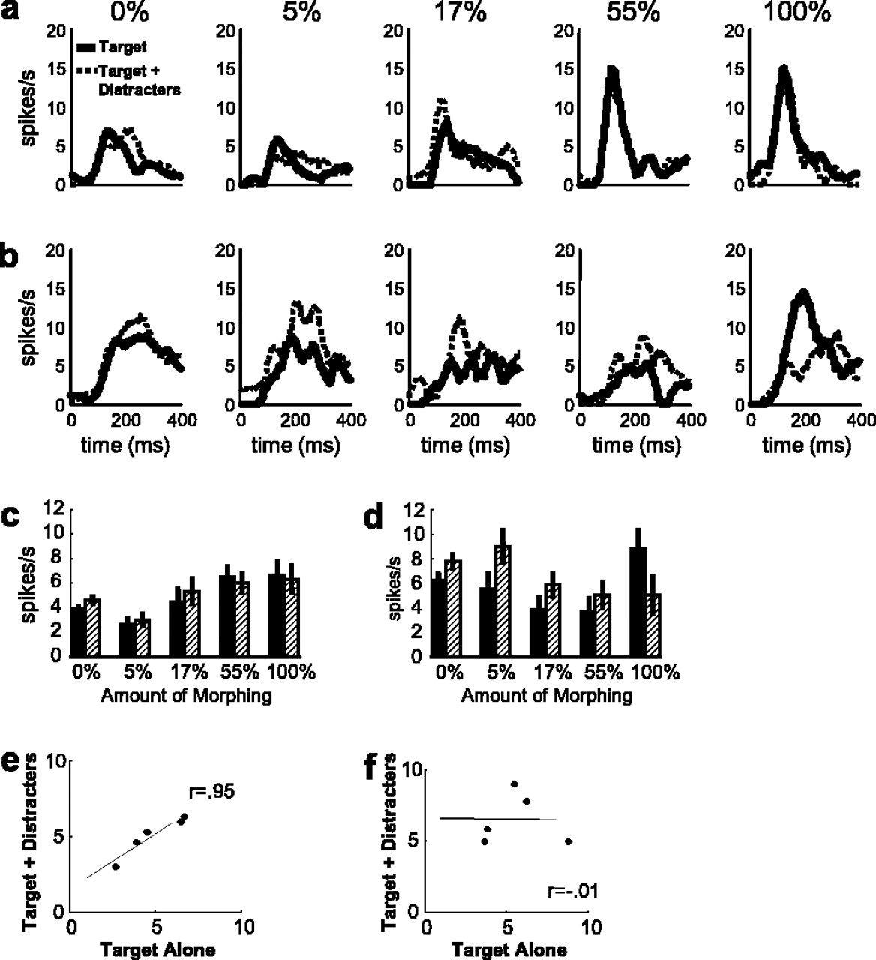
Figure 4. Example of the responses of a TE neuron to five different target stimuli presented in the normal quadrant (a) ...
Notes:
Figure 4. Example of the responses of a TE neuron to five different target stimuli presented in the normal quadrant (a) and in the V4-affected quadrant (b) either alone (solid line) or with distracters (dotted line). Each panel of (a) and (b) shows the responses to the five stimuli with different amounts of morphing (0, 5, 17, 55 and 100%). Mean responses (75–275 ms after stimulus onset) to each of the five target stimuli in the normal quadrant (c) and V4-affected quadrant (d). Filled bars represent responses to target stimuli presented alone; stippled bars represent responses to target stimuli presented with inside distracters. Error bars represent standard error of the mean. Mean responses to each target stimulus presented alone are plotted against the responses to the same stimulus with distracters in the normal quadrant (e) and in the V4-affected quadrant (f). The high correlation between responses across distracter conditions in the normal quadrant (r = 0.95) was substantially reduced in the V4-affected quadrant (r = −0.01).
Unless provided in the caption above, the following copyright applies to the content of this slide: Cerebral Cortex V 15 N 2 © Oxford University Press 2005; all rights reserved

Slide 5
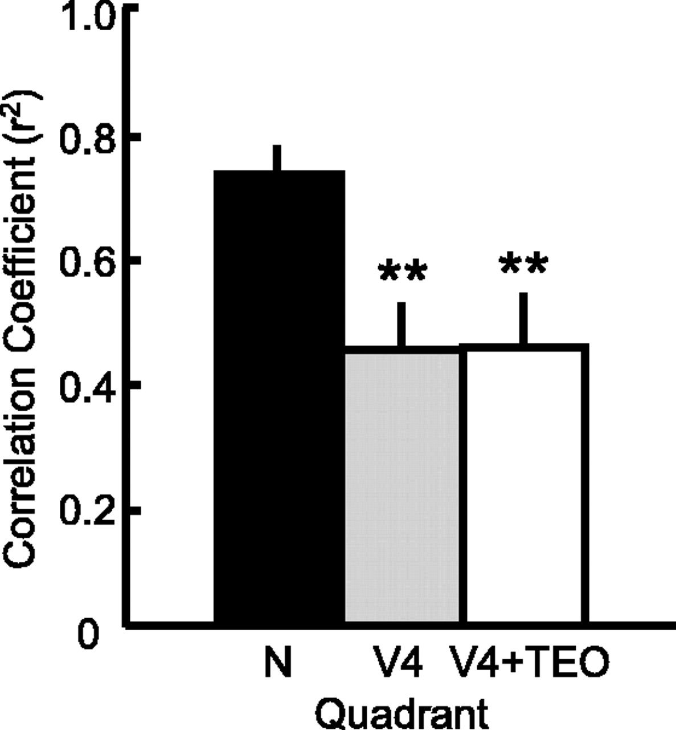
Figure 5. Across the population (n = 74), there was a significant reduction in correlation values when stimuli were ...
Notes:
Figure 5. Across the population (n = 74), there was a significant reduction in correlation values when stimuli were presented in either the V4-affected quadrant (V4) or the quadrant affected by the combined V4 and TEO lesion (V4 + TEO). **P < 0.001.
Unless provided in the caption above, the following copyright applies to the content of this slide: Cerebral Cortex V 15 N 2 © Oxford University Press 2005; all rights reserved

Slide 6
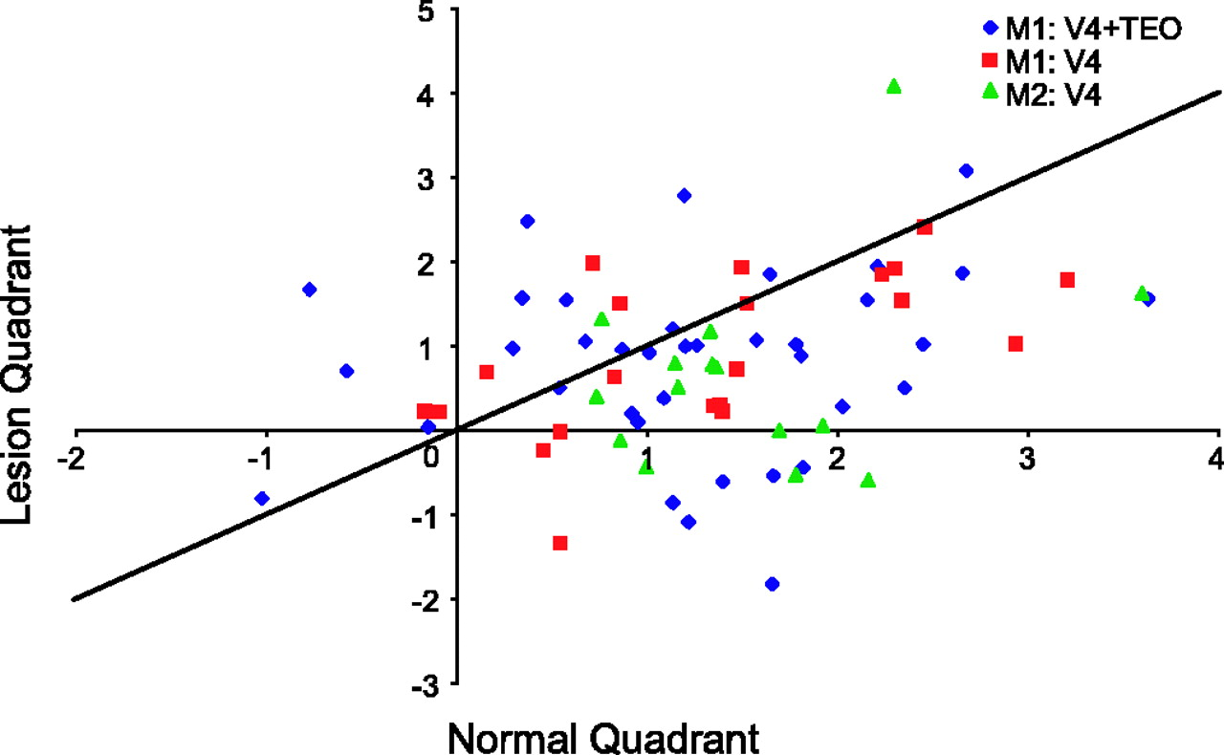
Figure 6. Distribution of loss in correlation across the population of recorded neurons in the lesion quadrant relative ...
Notes:
Figure 6. Distribution of loss in correlation across the population of recorded neurons in the lesion quadrant relative to the normal quadrant. For both monkeys and both lesion quadrants tested, most of the points fell below the identity line, indicating a higher correlation value in the normal quadrant compared to the lesion quadrant. Correlation values plotted are r-values transformed to normalized z-scores; each point represents a single neuron. Blue diamonds, neurons recorded in M1 with stimuli presented in the normal quadrant and the quadrant affected by the combined V4 + TEO lesion; red squares, neurons recorded in M1 with stimuli presented in the normal quadrant and the quadrant affected by the V4 lesion; green triangles, neurons recorded in M2 in the normal quadrant and the quadrant affected by the V4 lesion.
Unless provided in the caption above, the following copyright applies to the content of this slide: Cerebral Cortex V 15 N 2 © Oxford University Press 2005; all rights reserved

Slide 7
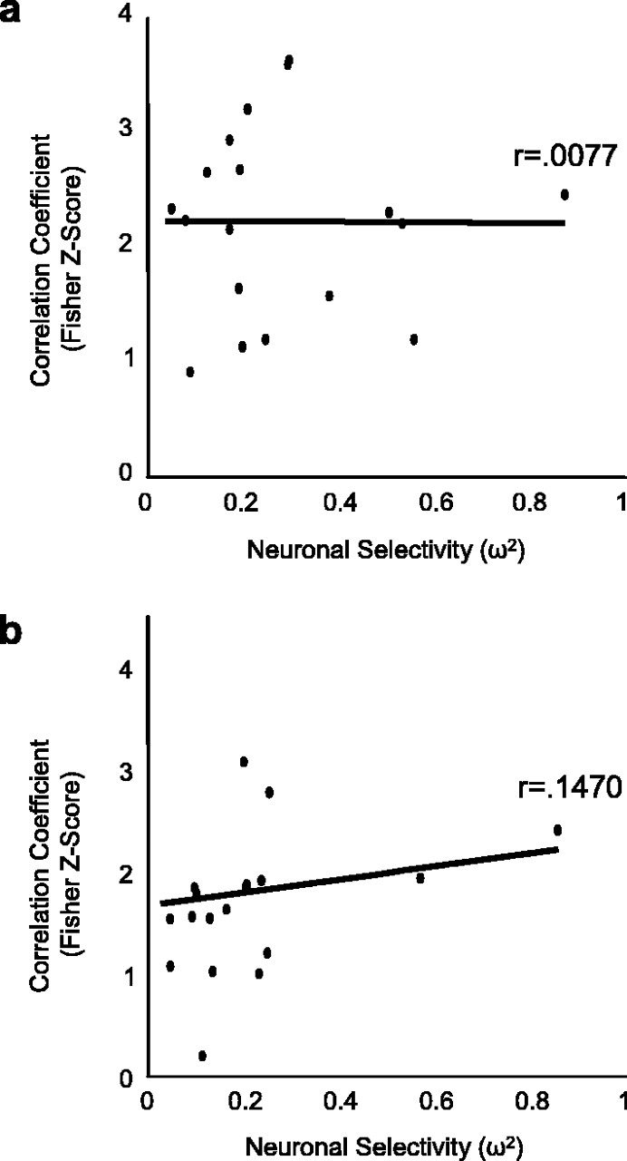
Figure 7. There was no significant relationship between correlation values (transformed to Fisher z-scores) and degree ...
Notes:
Figure 7. There was no significant relationship between correlation values (transformed to Fisher z-scores) and degree of neuronal selectivity (ω2), in either the normal quadrant (a) or the lesion-affected quadrants (b). Each point represents a single neuron.
Unless provided in the caption above, the following copyright applies to the content of this slide: Cerebral Cortex V 15 N 2 © Oxford University Press 2005; all rights reserved

Slide 8
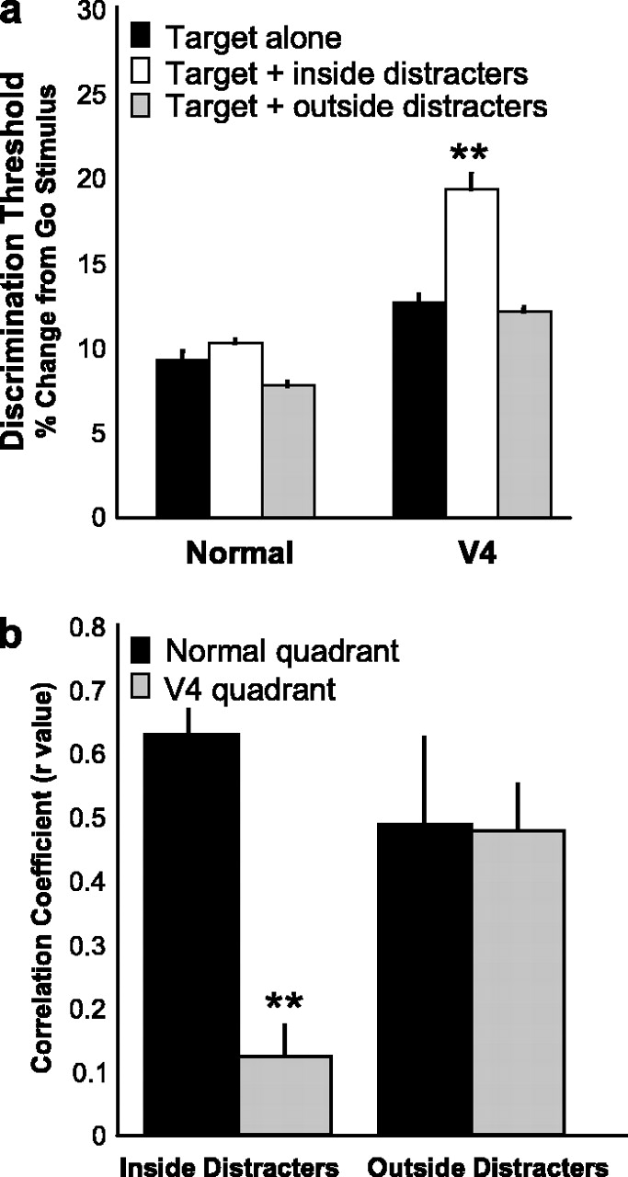
Figure 8. Discrimination thresholds in the normal quadrant and the V4-affected quadrant (V4) across the three ...
Notes:
Figure 8. Discrimination thresholds in the normal quadrant and the V4-affected quadrant (V4) across the three distracter conditions (a). Bars represent averages based on at least 60 thresholds; error bars indicate standard error of the mean. Mean responses to each target stimulus presented alone were correlated to the responses to the same stimulus with inside or outside distracters in the normal quadrant and in the V4-affected quadrant (b). **P < 0.001.
Unless provided in the caption above, the following copyright applies to the content of this slide: Cerebral Cortex V 15 N 2 © Oxford University Press 2005; all rights reserved

