Slide 1
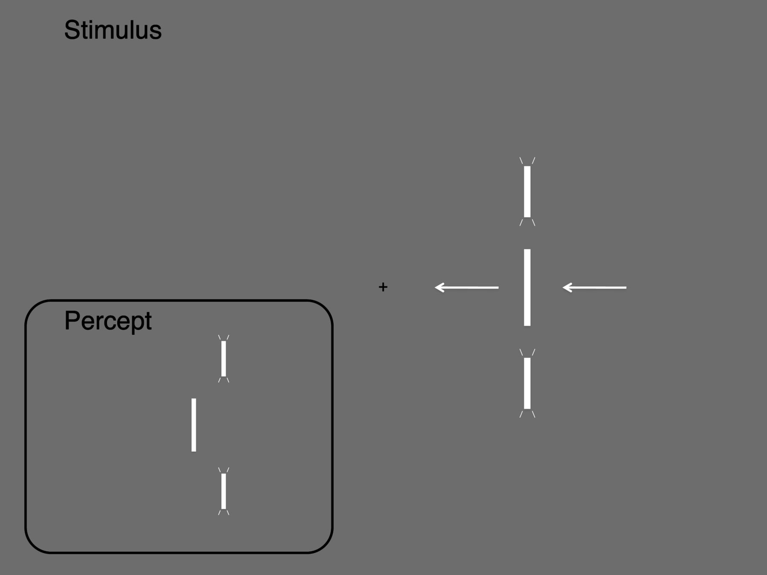
Figure 1. Depiction of the stimulus. A vertical bar moved leftward across the screen toward the fixation point. At a ...
Notes:
Figure 1. Depiction of the stimulus. A vertical bar moved leftward across the screen toward the fixation point. At a position 5° to the right of the fixation point in Experiment 1 (2° in Experiment 2) 2 flashes appeared above and below the moving bar. The inset shows the percept: When the flashes and the moving bar are physically aligned, the moving bar is perceived to be ahead of the flashes.
Unless provided in the caption above, the following copyright applies to the content of this slide: © The Author 2012. Published by Oxford University Press. All rights reserved. For permissions, please e-mail: journals.permissions@oup.com

Slide 2
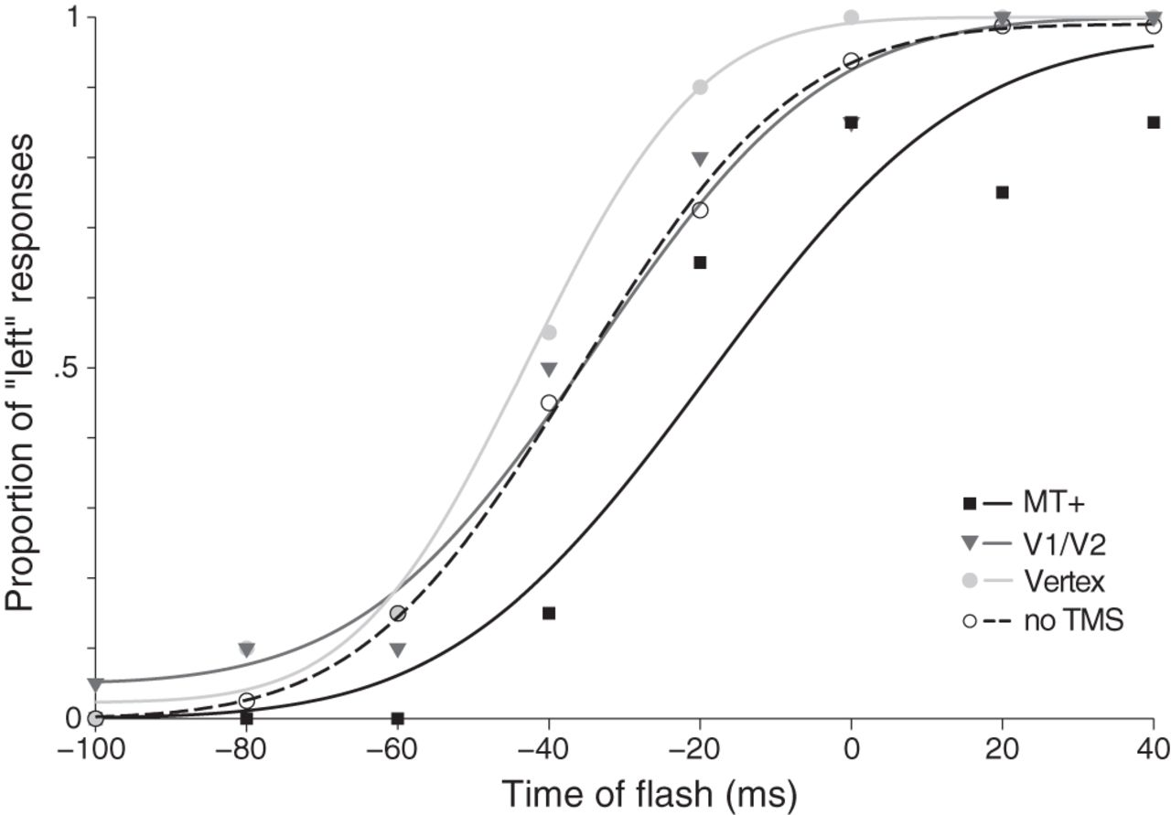
Figure 2. Responses and psychometric functions of one exemplar participant in Experiment 1. The proportion of “left” ...
Notes:
Figure 2. Responses and psychometric functions of one exemplar participant in Experiment 1. The proportion of “left” responses is plotted against the time of the flash relative to the time the moving bar passed the position of the flash. Negative values mean that the leftward-moving bar was still short of the position of the flashes. Responses without TMS are shown in open symbols, dashed line; responses with stimulation of MT+ in black, V1/V2 in dark gray, and vertex in light gray. The bar was perceived as aligned when it was still short of the flash position in all conditions. This mislocalization is reduced with stimulation of area MT+.
Unless provided in the caption above, the following copyright applies to the content of this slide: © The Author 2012. Published by Oxford University Press. All rights reserved. For permissions, please e-mail: journals.permissions@oup.com

Slide 3
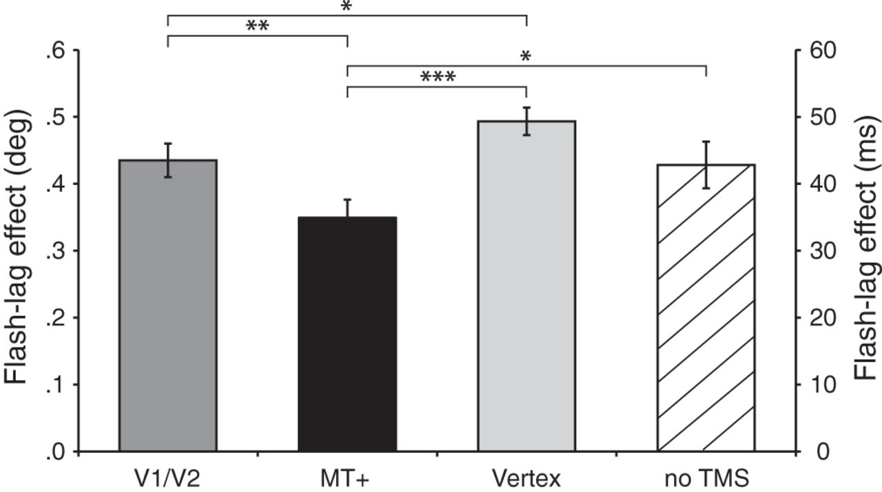
Figure 3. Mean size of the FLE in Experiment 1 with stimulation of V1/V2, MT+, Vertex, and without TMS. Error bars are ...
Notes:
Figure 3. Mean size of the FLE in Experiment 1 with stimulation of V1/V2, MT+, Vertex, and without TMS. Error bars are SDs of the bootstrap distribution (*P < 0.05, **P < 0.01, ***P < 0.001).
Unless provided in the caption above, the following copyright applies to the content of this slide: © The Author 2012. Published by Oxford University Press. All rights reserved. For permissions, please e-mail: journals.permissions@oup.com

Slide 4
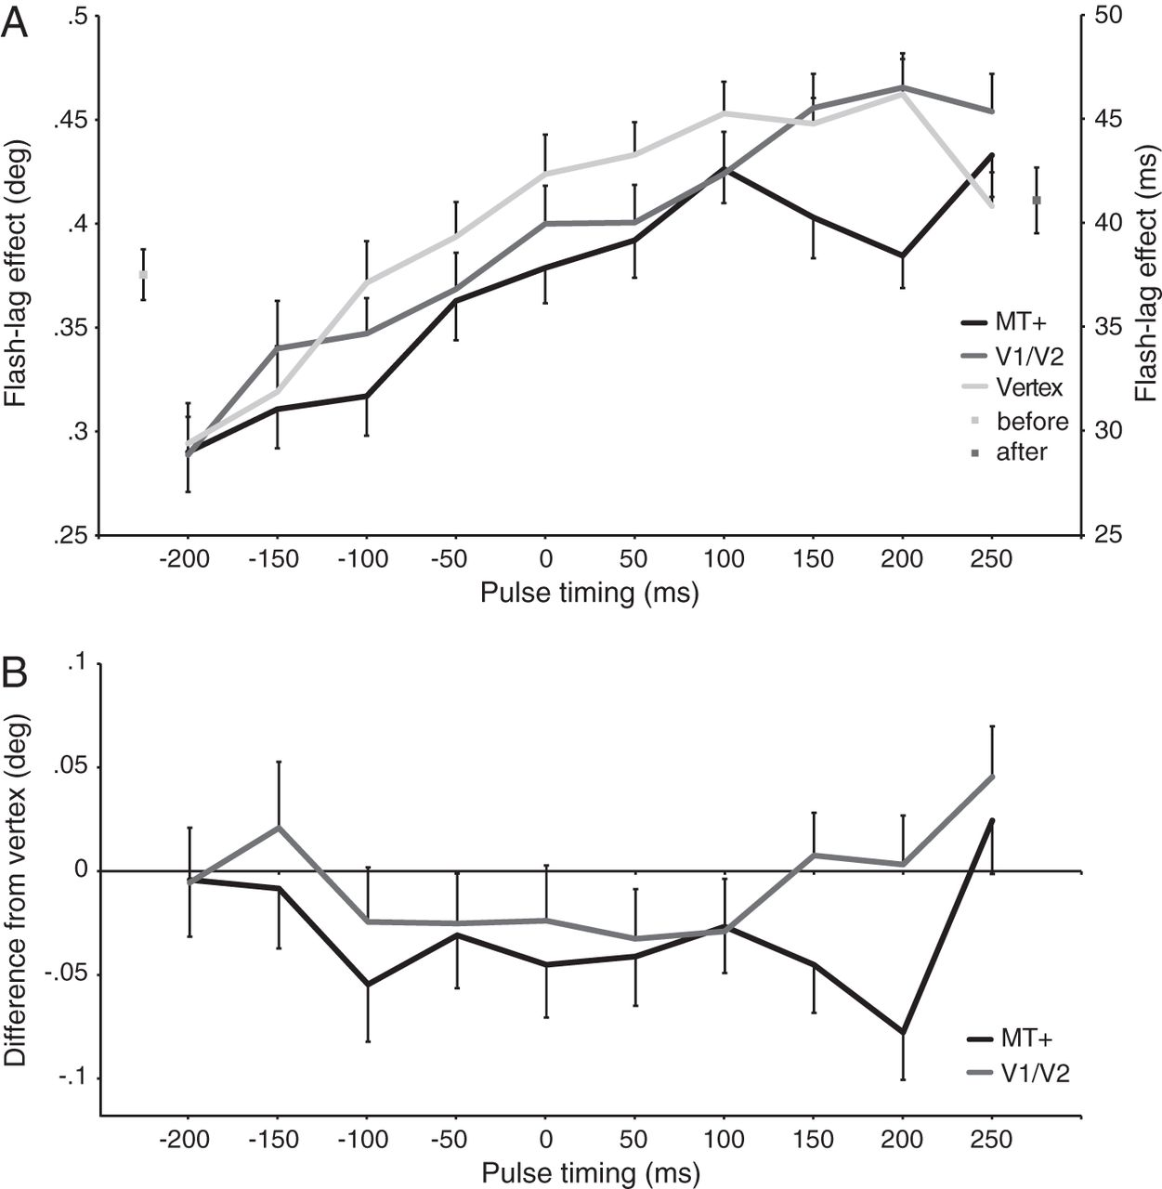
Figure 4. The average flash-lag effect using the method of adjustment in Experiment 2 (A). Positive values indicate ...
Notes:
Figure 4. The average flash-lag effect using the method of adjustment in Experiment 2 (A). Positive values indicate that participants perceived a FLE—the moving bar appeared to the left of the flashes. Adjustments are shown as a function of pulse timing with stimulation of MT+, V1/V2, and vertex, respectively. The 2 data points to either side show participants' adjustments in trials without TMS, before and after the experiment. Error bars are SDs of the bootstrap distribution (plotted in one direction for legibility). (B) The same data as in (A), plotted as difference of MT+ and V1/V2 from Vertex.
Unless provided in the caption above, the following copyright applies to the content of this slide: © The Author 2012. Published by Oxford University Press. All rights reserved. For permissions, please e-mail: journals.permissions@oup.com

