Slide 1
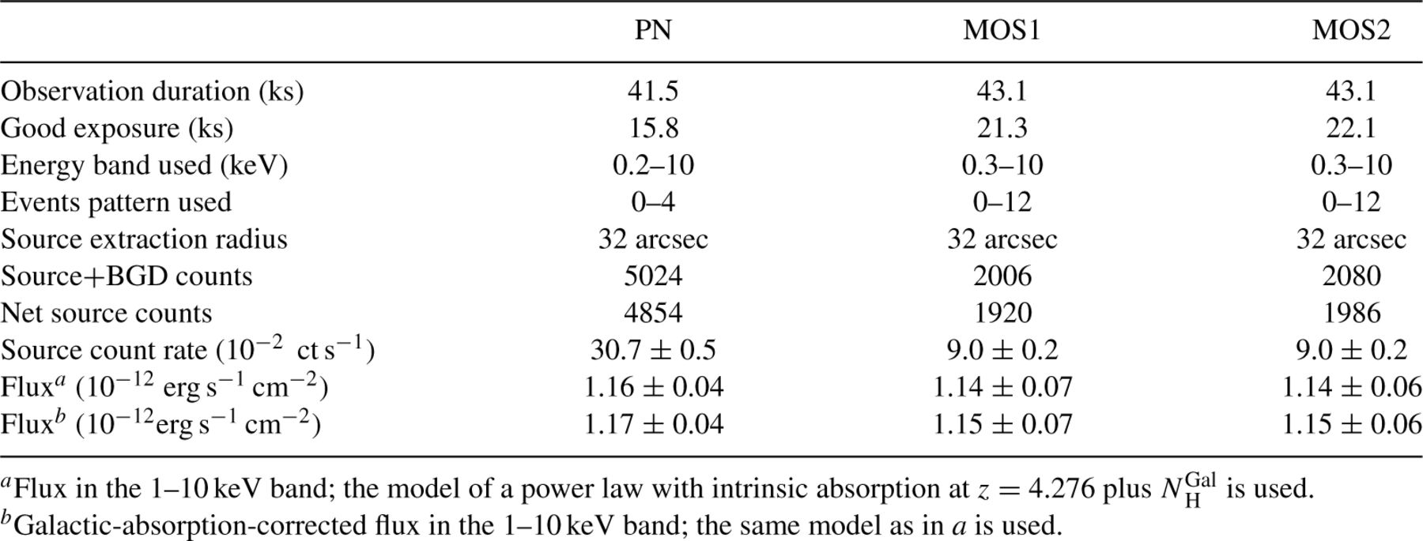
Table 1 Summary of the XMM observations and data reduction information for each EPIC detector.
Notes:
Table 1 Summary of the XMM observations and data reduction information for each EPIC detector.
Unless provided in the caption above, the following copyright applies to the content of this slide: © 2005 RAS

Slide 2
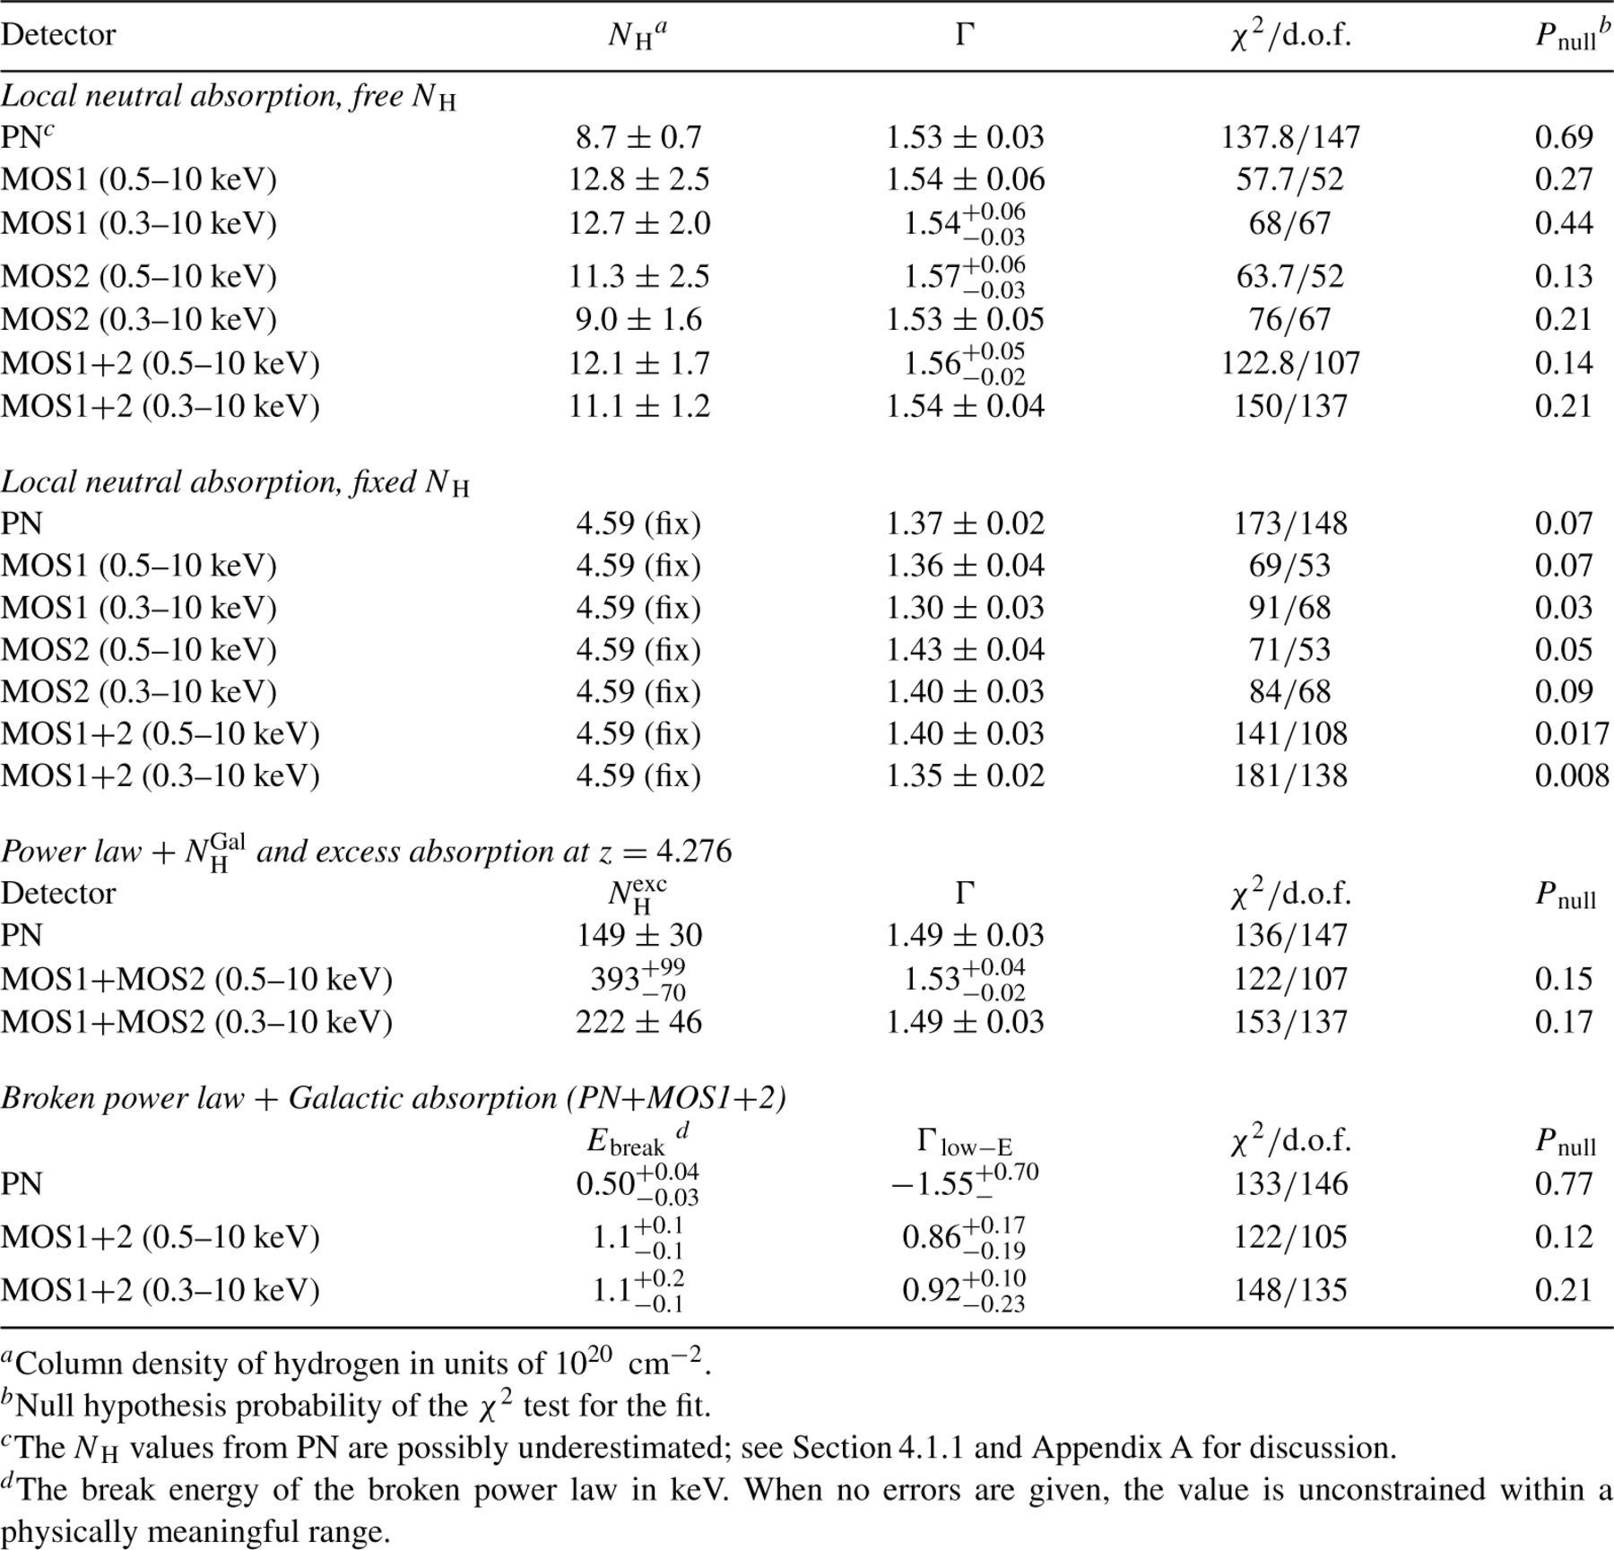
Table 2 Results of X-ray spectral fits.
Notes:
Table 2 Results of X-ray spectral fits.
Unless provided in the caption above, the following copyright applies to the content of this slide: © 2005 RAS

Slide 3
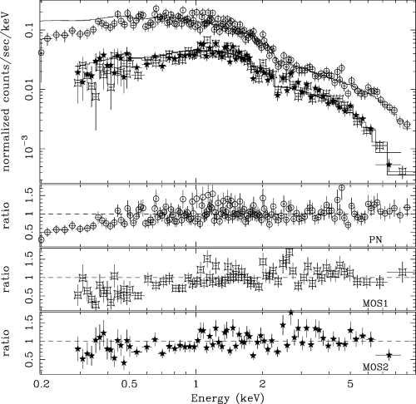
Figure 1 The spectra of the PN (circles), MOS1 (squares), and MOS2 (stars) cameras and the residuals as data-to-model ...
Notes:
Figure 1 The spectra of the PN (circles), MOS1 (squares), and MOS2 (stars) cameras and the residuals as data-to-model ratio. The model is the best-fit power law (with Galactic absorption) to the joint PN+MOS1+MOS2 spectra within the restricted 1–10keV energy band and is extrapolated down to low energies. A systematic deviation from a power-law model with Galactic absorption towards low energies (below 1keV) is clearly indicated.
Unless provided in the caption above, the following copyright applies to the content of this slide: © 2005 RAS

Slide 4
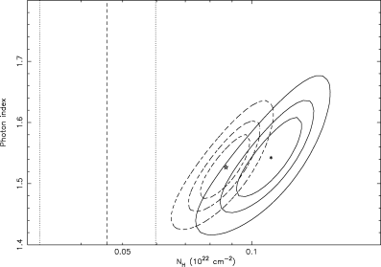
Figure 2 Confidence contours of fitted total column density and photon index for the model of a power law with local ...
Notes:
Figure 2 Confidence contours of fitted total column density and photon index for the model of a power law with local neutral absorption. The contours are at the 68, 90, and 99 per cent confidence levels, respectively, for two interesting parameters. Solid contours: the joint MOS spectra in the range 0.3–10keV; dashed contours: the PN spectrum. Also indicated by lines are the Galactic column density (dashed) and its conservative 30 per cent uncertainty range (dotted). Absorption in excess of the Galactic value is evident for such a model.
Unless provided in the caption above, the following copyright applies to the content of this slide: © 2005 RAS

Slide 5
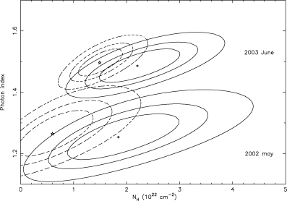
Figure 3 Column density of the intrinsic absorber versus power-law photon index as measured with MOS (solid) and PN ...
Notes:
Figure 3 Column density of the intrinsic absorber versus power-law photon index as measured with MOS (solid) and PN (dashed) detectors. The absorber is assumed to be at the quasar redshift 4.276 and to have cosmic abundances. The contours correspond to confidence levels of 68, 90, and 99 per cent. The results from the current (2003) and the previous XMM observations (2002) are plotted. The variation in the spectral slope is significant, while there is no change in the absorption column density.
Unless provided in the caption above, the following copyright applies to the content of this slide: © 2005 RAS

Slide 6
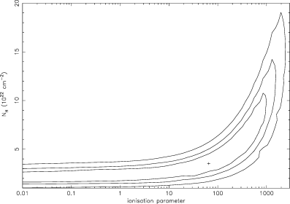
Figure 4 Confidence contours (at the 68, 90, and 99 per cent levels) for the ionization parameter and column density ...
Notes:
Figure 4 Confidence contours (at the 68, 90, and 99 per cent levels) for the ionization parameter and column density of the ionized absorber model. The result is obtained from a joint spectral fit to the MOS spectra from the two XMM–Newton observations in 2003 and 2002 (see Section 3.2.2).
Unless provided in the caption above, the following copyright applies to the content of this slide: © 2005 RAS

Slide 7
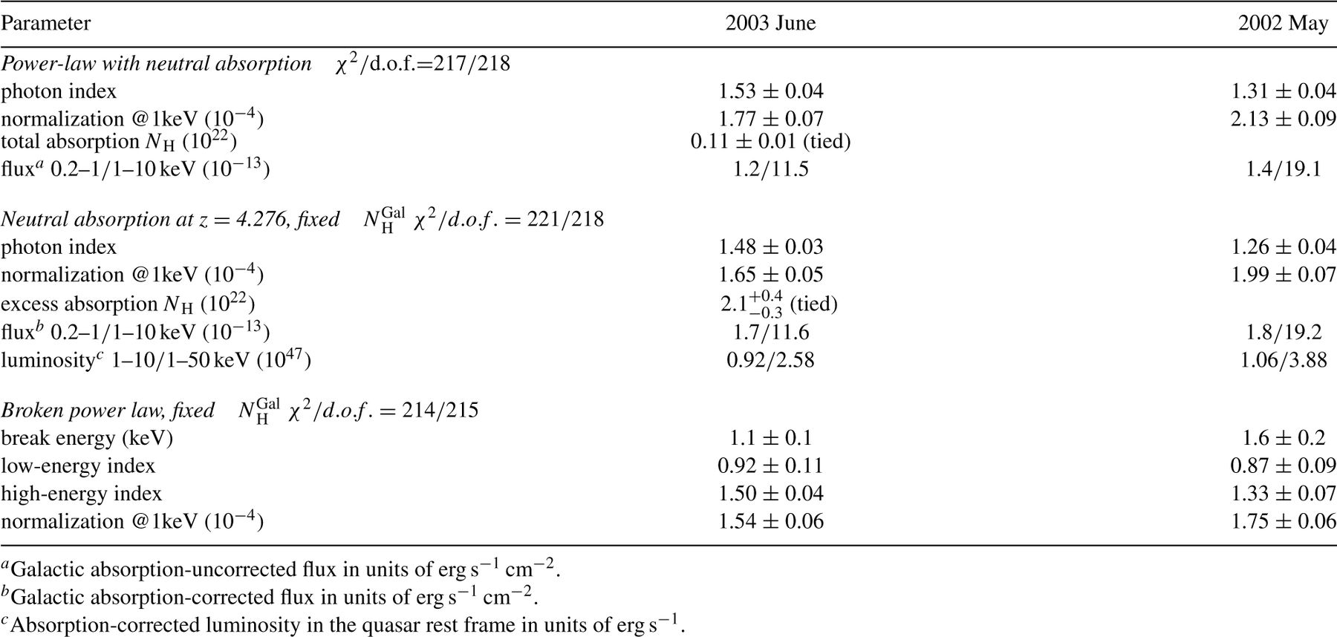
Table 3 Joint fits to the current (2003) and a previous (2002) XMM-Newton observation. Only the MOS spectra were ...
Notes:
Table 3 Joint fits to the current (2003) and a previous (2002) XMM-Newton observation. Only the MOS spectra were used. The absorption NH is assumed to be the same in the two observations and the photon index is freely fitted.
Unless provided in the caption above, the following copyright applies to the content of this slide: © 2005 RAS

Slide 8
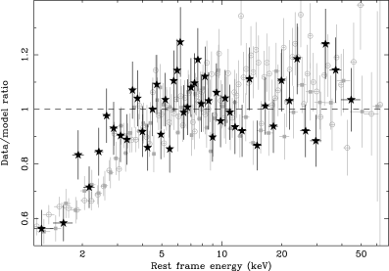
Figure 5 Data-to-model ratio in the rest frame for RXJ1028.6 – 0844 (stars), where the model is the best-fit power law ...
Notes:
Figure 5 Data-to-model ratio in the rest frame for RXJ1028.6 – 0844 (stars), where the model is the best-fit power law with Galactic absorption in the restricted 1–10keV spectral range. Only the PN spectrum (2003 May observation) is plotted, which is rebinned for demonstration. Also plotted are the data-to-model ratios for GB1428 + 4217 (filled squares) and PMNJ0525 − 3343 (open circles) for comparison, taken from fig.5 in Worsley et al. (2004b). The spectra are plotted in their respective rest-frame energies.
Unless provided in the caption above, the following copyright applies to the content of this slide: © 2005 RAS

Slide 9
Table A1 Absorbed power-law model fit to the PN spectrum using the corrected effective area ARF calibration.
Notes:
Table A1 Absorbed power-law model fit to the PN spectrum using the corrected effective area ARF calibration.
Unless provided in the caption above, the following copyright applies to the content of this slide: © 2005 RAS

