Slide 1
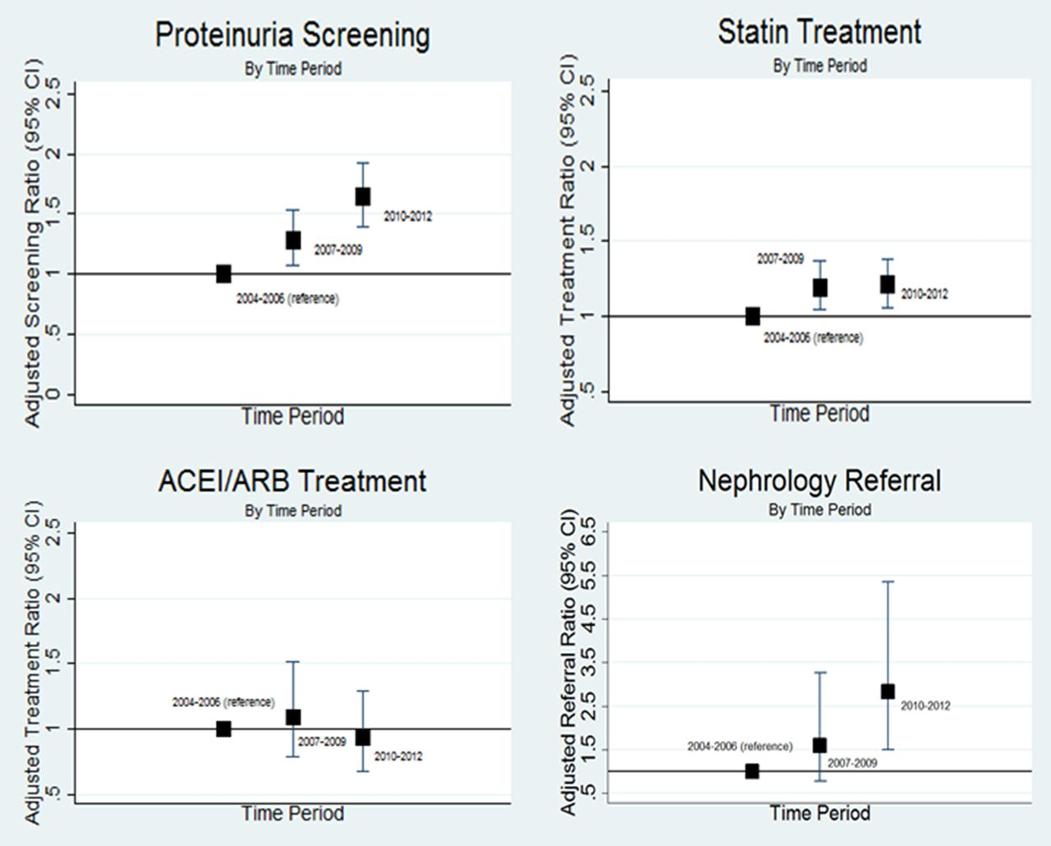
Table 2. Crude and adjustedª screening and treatment rates among incident CKD patients, by time ...
Notes:
Table 2. Crude and adjusteda screening and treatment rates among incident CKD patients, by time period Proteinuria screening and nephrology referral: n = 728, 788 and 956 during Periods 1, 2 and 3, respectively. Statin treatment was limited to those aged 50 years and older at entry: n = 713, 773 and 930 during Periods 1, 2 and 3, respectively. ACEI or ARB treatment was limited to those with an indication (proteinuria): n = 82, 102 and 115 during periods 1, 2 and 3, respectively. CI, confidence interval; py, person-years. aStandardized to a 73-year-old male with baseline eGFR of 49 mL/min/1.73 m2. Fig. 1.Adjusted rate ratios for screening and treatment among incident CKD patients. Analyses are adjusted for age, gender and baseline eGFR. The y-axis scale for ‘Nephrology Referral’ differs from the scale used for the other three figures for purposes of legibility.
Unless provided in the caption above, the following copyright applies to the content of this slide: © The Author 2016. Published by Oxford University Press on behalf of ERA-EDTA.This is an Open Access article distributed under the terms of the Creative Commons Attribution Non-Commercial License (http://creativecommons.org/licenses/by-nc/4.0/), which permits non-commercial re-use, distribution, and reproduction in any medium, provided the original work is properly cited. For commercial re-use, please contact journals.permissions@oup.com

Slide 2
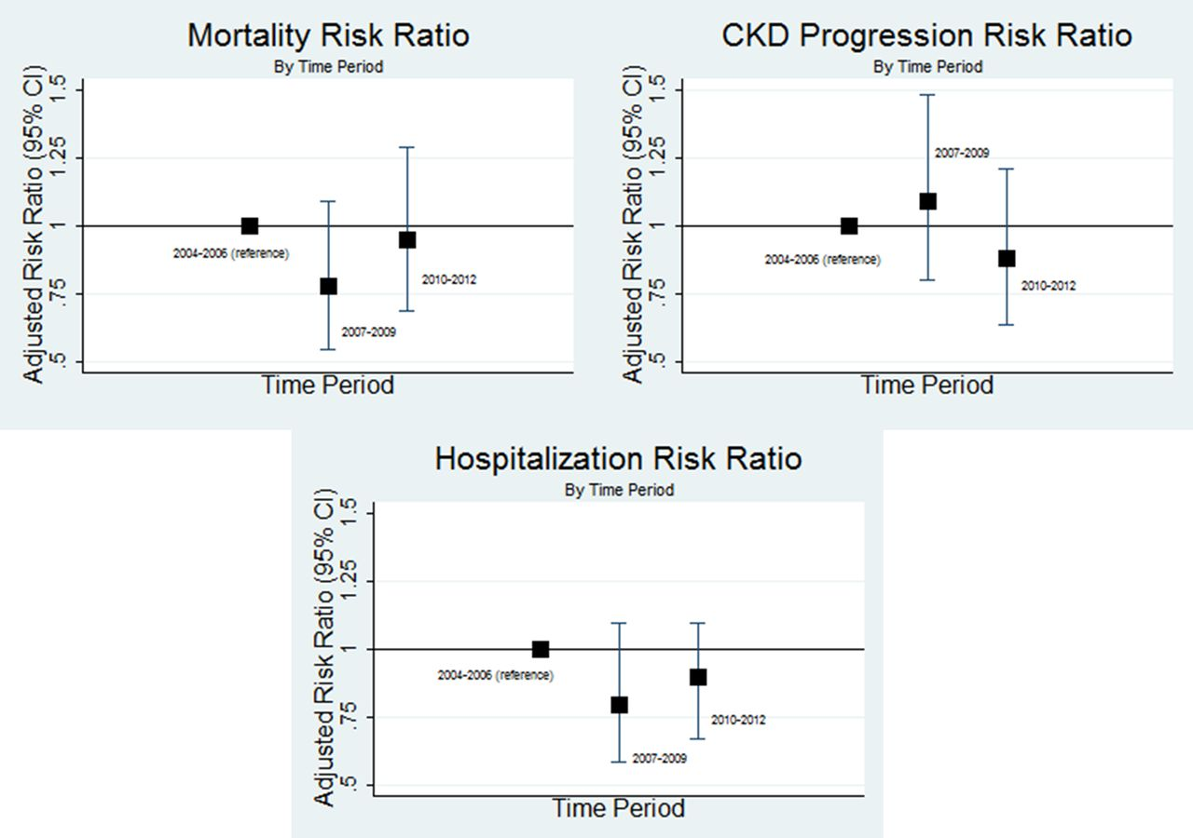
Table 3. Crude and adjustedª event rates among incident CKD patients, by time ...
Notes:
Table 3. Crude and adjusteda event rates among incident CKD patients, by time period aStandardized to a 73-year-old male with baseline eGFR of 49 mL/min/1.73 m2. CI, confidence interval; py, person-years. Fig. 2.Adjusted rate ratios for mortality, CKD progression and cardiovascular hospitalization among incident CKD patients. Analyses are adjusted for age, gender and baseline eGFR.
Unless provided in the caption above, the following copyright applies to the content of this slide: © The Author 2016. Published by Oxford University Press on behalf of ERA-EDTA.This is an Open Access article distributed under the terms of the Creative Commons Attribution Non-Commercial License (http://creativecommons.org/licenses/by-nc/4.0/), which permits non-commercial re-use, distribution, and reproduction in any medium, provided the original work is properly cited. For commercial re-use, please contact journals.permissions@oup.com

