Slide 1
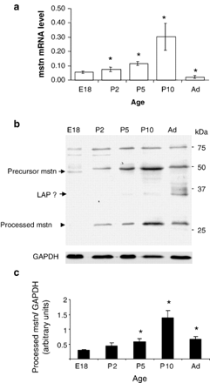
Fig. 1 Developmental expression of myostatin in isolated rat cardiomyocytes. Myostatin (a) mRNA and (b) protein ...
Notes:
Fig. 1 Developmental expression of myostatin in isolated rat cardiomyocytes. Myostatin (a) mRNA and (b) protein levels are expressed differentially in foetal (E 18), neonatal (P2, P5 and P10) and adult (Ad) rat cardiomyocytes as determined by qPCR and Western blot analysis, respectively. For qPCR analysis, cardiomyocytes isolated from hearts of pups (n=4–6 separate litters) were used to generate total RNA analysed for each data point. For protein analysis, 20 μg of total protein isolated from foetal (E 18), neonatal (P2, P5 and P10) and adult (Ad) rat cardiomyocytes were subjected to Western blot analysis and probed with a rabbit anti-myostatin polyclonal antibody. The position of myostatin precursor protein and active C-terminal myostatin band is indicated as previously described [13]. GAPDH was used as loading control. (c) Relative abundance of the processed, active form of myostatin as determined by densitometric analysis of at least 4 independent experiments. * indicates p<0.05 relative to myostatin levels in E18 cardiomyocytes.
Unless provided in the caption above, the following copyright applies to the content of this slide: Copyright © 2007, European Society of Cardiology

Slide 2
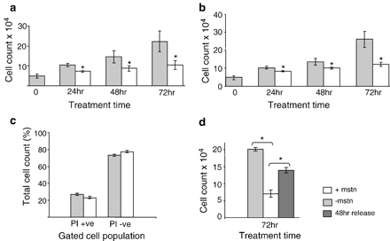
Fig. 2 Myostatin mediated inhibition of rat cardiomyocyte proliferation. Myostatin treatment inhibits (a) foetal ...
Notes:
Fig. 2 Myostatin mediated inhibition of rat cardiomyocyte proliferation. Myostatin treatment inhibits (a) foetal (E18) and (b) neonatal (P0) cardiomyocyte proliferation. Cardiomyocytes were cultured in 5% FBS with or without 5 μg/ml recombinant E. coli overexpressed myostatin and harvested at the various time points indicated. Viable cells were identified by trypan blue exclusion and counted using a haemocytometer. Day 0 time point represents the average number of adherent cells/well (n=6) 24 h after plating. Data are mean values±SD of 4 independent experiments. (c) Inhibition of cardiomyocyte proliferation was not due to loss of cell viability as determined by PI cell exclusion staining. (d) Inhibition by myostatin was reversible following myostatin release. In the release experiments, cells were treated with 5 μg/ml of recombinant E. coli-expressed myostatin for 24 h then washed with PBS and cultured in 5% FBS myocyte medium for a further 48 h. * p<0.05 for myostatin-treated compared with untreated control cultures.
Unless provided in the caption above, the following copyright applies to the content of this slide: Copyright © 2007, European Society of Cardiology

Slide 3
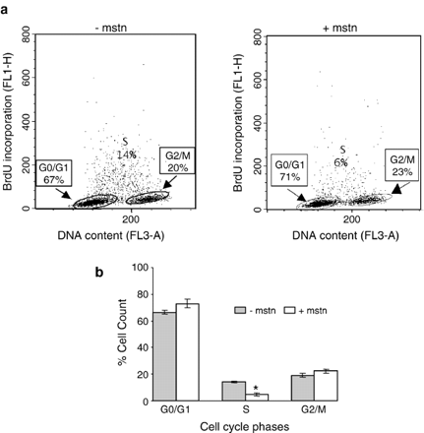
Fig. 3 Myostatin alters the cell cycle profile of E18 cardiomyocytes. Representative cell cycle profiles of ...
Notes:
Fig. 3 Myostatin alters the cell cycle profile of E18 cardiomyocytes. Representative cell cycle profiles of proliferating E18 cardiomyocytes cultured with or without myostatin for 48 h. (a) BrdU treated cardiomyocytes were stained with anti-BrdU/FITC labelled secondary antibody and propidium iodide then analysed by FACS. X-axis represents FL3-A (red flouresence) and Y-axis represents FL1-H (green fluorescence). (b) Graphical representation of the percentage of cells in the G0/G1, S, or G2/M phases of the cell cycle following myostatin treatment for 48 h versus control. Data are mean values±SD from 3 independent experiments. * indicates p<0.05.
Unless provided in the caption above, the following copyright applies to the content of this slide: Copyright © 2007, European Society of Cardiology

Slide 4
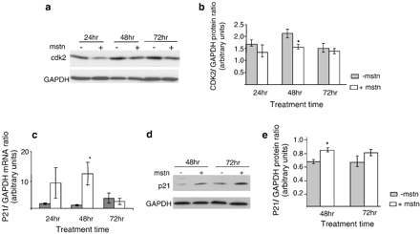
Fig. 4 Myostatin affects the expression of G1/S cell cycle proteins in E18 cardiomyocytes. Pooled protein extracts ...
Notes:
Fig. 4 Myostatin affects the expression of G1/S cell cycle proteins in E18 cardiomyocytes. Pooled protein extracts from triplicate experiments for each treatment group were blotted onto PVDF membranes and probed with the antibodies indicated. GAPDH was used as loading control. (a) Representative Western blot analysis of CDK2 expression shows that myostatin treatment decreases its expression in proliferating cardiomyocytes. (b) Densitometric analysis (n=5) demonstrates that CDK2 expression is downregulated significantly in 48 h myostatin-treated cultures. (c) Myostatin-treatment increases the expression of p21 mRNA and (d) protein in E18 cardiomyocytes cultures. (e) Densitometric analysis (n=4) demonstrates that p21 protein expression is significantly upregulated within 48 h of myostatin treatment.
Unless provided in the caption above, the following copyright applies to the content of this slide: Copyright © 2007, European Society of Cardiology

Slide 5
Fig. 5 Effects of myostatin on protein synthesis in proliferating and PE stimulated non-proliferating ...
Notes:
Fig. 5 Effects of myostatin on protein synthesis in proliferating and PE stimulated non-proliferating cardiomyocytes. The effect of myostatin on the rate of [14C]-phenylalanine incorporation in proliferating E18 cardiomyocytes culture with or without myostatin for 24 h. Data expressed as (a) total [14C]-phenylalanine incorporation shows significant difference in myostatin treated cultures compared to controls. Data expressed as (b) the rate of phenylalanine incorporation per cell shows comparable protein synthesis rate between myostatin-treated and control cultures. (c) In contrast the effect of myostatin on the rate of [14C]-phenylalanine incorporation per cell in non-proliferating serum starved P2 cardiomyocytes following PE stimulation are significantly different to PE stimulated controls. Data are means±SD from triplicate experiments. * indicates p<0.05.
Unless provided in the caption above, the following copyright applies to the content of this slide: Copyright © 2007, European Society of Cardiology

Slide 6
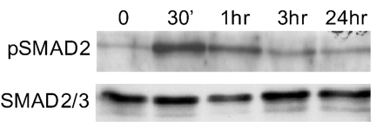
Fig. 6 Myostatin stimulates SMAD2 phosphorylation in E18 cardiomyocytes. (a) Representative western blot ...
Notes:
Fig. 6 Myostatin stimulates SMAD2 phosphorylation in E18 cardiomyocytes. (a) Representative western blot demonstrates myostatin's ability to induce SMAD2 phosphorylation in proliferating E18 cardiomyocytes within 30 mins of treatment. E18 cardiomyocytes stimulated with 500 ng of recombinant myostatin (R&D Systems) for the length of time indicated were analysed by Western blotting for SMAD phosphorylation.
Unless provided in the caption above, the following copyright applies to the content of this slide: Copyright © 2007, European Society of Cardiology

