Slide 1
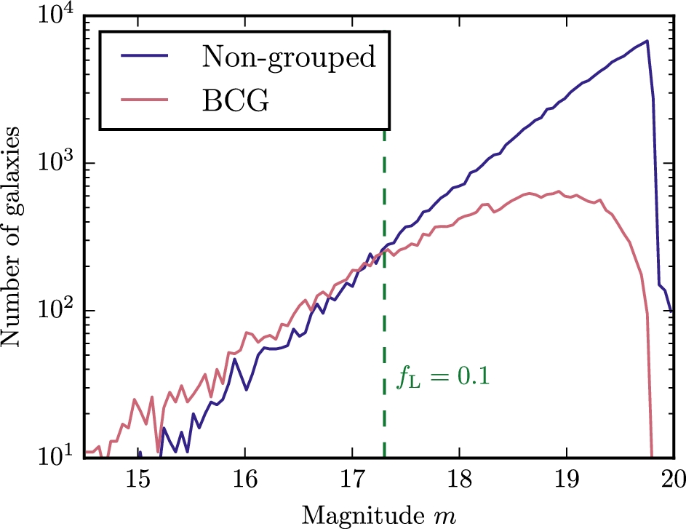
Figure 1. The magnitude distribution of non-grouped galaxies (blue) and BCGs (red). The green dashed line indicates the ...
Notes:
Figure 1. The magnitude distribution of non-grouped galaxies (blue) and BCGs (red). The green dashed line indicates the selection that removes galaxies that might have a satellite beyond the visible magnitude limit. These hypothetical satellites have at most a fraction fL = 0.1 of the central galaxy luminosity, corresponding to the magnitude limit: mr < 17.3. We use this ‘nearby’ sample to obtain a reliable estimate of the satellite distribution around our centrals.
Unless provided in the caption above, the following copyright applies to the content of this slide: © 2016 The Authors Published by Oxford University Press on behalf of the Royal Astronomical Society

Slide 2
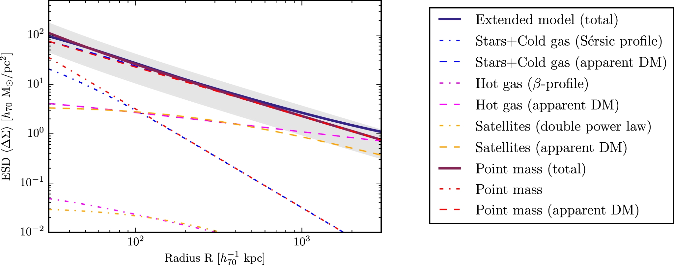
Figure 2. The ESD profile predicted by EG for isolated centrals, both in the case of the point mass approximation (dark ...
Notes:
Figure 2. The ESD profile predicted by EG for isolated centrals, both in the case of the point mass approximation (dark red, solid) and the extended galaxy model (dark blue, solid). The former consists of a point source with the mass of the stars and cold gas component (red), with the lensing signal evaluated for both the baryonic mass (dash–dotted) and the apparent DM (dashed). The latter consists of a stars and cold gas component modelled by a Sérsic profile (blue), a hot gas component modelled by a β-profile (magenta) and a satellite distribution modelled by a double power law (orange), all with the lensing signal evaluated for both the baryonic mass (dash–dotted) and the apparent DM (dashed). Note that the total ESD of the extended mass distribution is not equal to the sum of its components, due to the non-linear conversion from baryonic mass to apparent DM. All profiles are shown for our highest mass bin ($10^{10.9} < M_{\ast } < 10^{11} \,h_{70}^{-2}\,{\rm M_{\odot }}$), but the difference between the two models is similar for the other galaxy sub-samples. The difference between the ESD predictions of the two models is comparable to the median 1σ uncertainty on our lensing measurements (illustrated by the grey band).
Unless provided in the caption above, the following copyright applies to the content of this slide: © 2016 The Authors Published by Oxford University Press on behalf of the Royal Astronomical Society

Slide 3
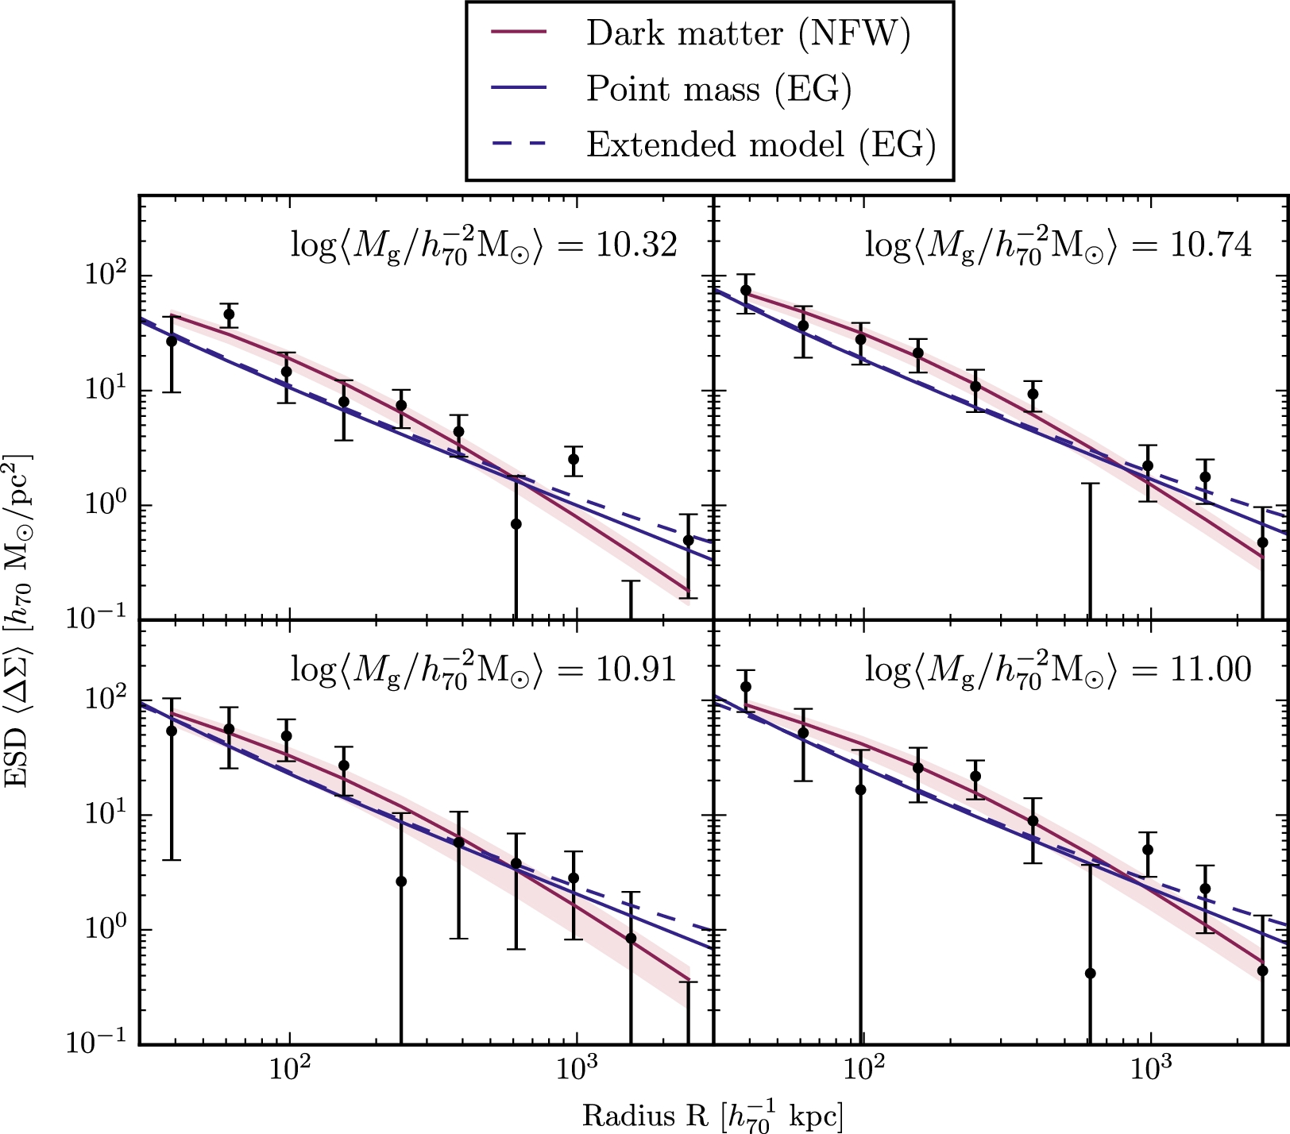
Figure 3. The measured ESD profiles of isolated centrals with 1σ error bars (black), compared to those predicted by EG ...
Notes:
Figure 3. The measured ESD profiles of isolated centrals with 1σ error bars (black), compared to those predicted by EG in the point source mass approximation (blue) and for the extended mass profile (blue, dashed). Note that none of these predictions are fitted to the data: they follow directly from the EG theory by substitution of the baryonic masses Mg of the galaxies in each sample (and, in the case of the extended mass profile, reasonable assumptions for the other baryonic mass distributions). The mean measured galaxy mass is indicated at the top of each panel. For comparison, we show the ESD profile of a simple NFW profile as predicted by GR (red), with the DM halo mass Mh fitted as a free parameter in each stellar mass bin.
Unless provided in the caption above, the following copyright applies to the content of this slide: © 2016 The Authors Published by Oxford University Press on behalf of the Royal Astronomical Society

