Slide 1
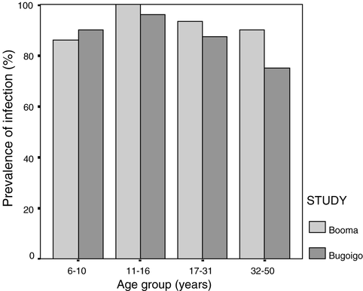
Fig. 1 Estimates of S. mansoni infection prevalence in the Booma and Bugoigo cohorts, stratified by age group.
Notes:
Fig. 1 Estimates of S. mansoni infection prevalence in the Booma and Bugoigo cohorts, stratified by age group.
Unless provided in the caption above, the following copyright applies to the content of this slide: © Royal Society of Tropical Medicine and Hygiene 2003

Slide 2
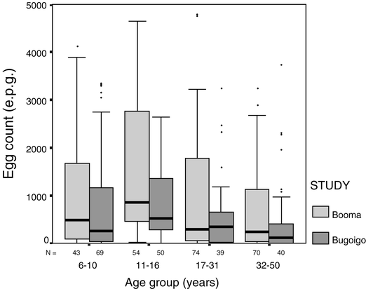
Fig. 2 Box plots of S. mansoni egg count distributions in the Booma and Bugoigo cohorts, stratified by age group. ...
Notes:
Fig. 2 Box plots of S. mansoni egg count distributions in the Booma and Bugoigo cohorts, stratified by age group. Medians are represented by horizontal bars within each box, which represent the 25–75th percentile range. The whiskers represent the range of data within the distance on the y-axis corresponding to 1.5x the height of the box. Individual outliers beyond this range are shown. The number of individuals in each age group is given underneath each plot.
Unless provided in the caption above, the following copyright applies to the content of this slide: © Royal Society of Tropical Medicine and Hygiene 2003

Slide 3
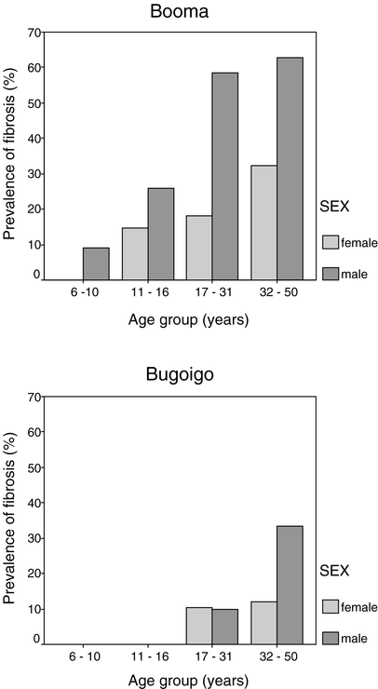
Fig. 3 Estimates of the probability of periportal fibrosis in each cohort, stratified by age group and sex.
Notes:
Fig. 3 Estimates of the probability of periportal fibrosis in each cohort, stratified by age group and sex.
Unless provided in the caption above, the following copyright applies to the content of this slide: © Royal Society of Tropical Medicine and Hygiene 2003

Slide 4
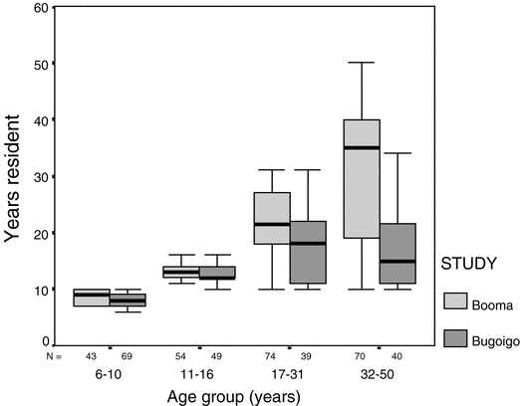
Fig. 4 Box plots of years resident in each cohort, stratified by age group.
Notes:
Fig. 4 Box plots of years resident in each cohort, stratified by age group.
Unless provided in the caption above, the following copyright applies to the content of this slide: © Royal Society of Tropical Medicine and Hygiene 2003

Slide 5
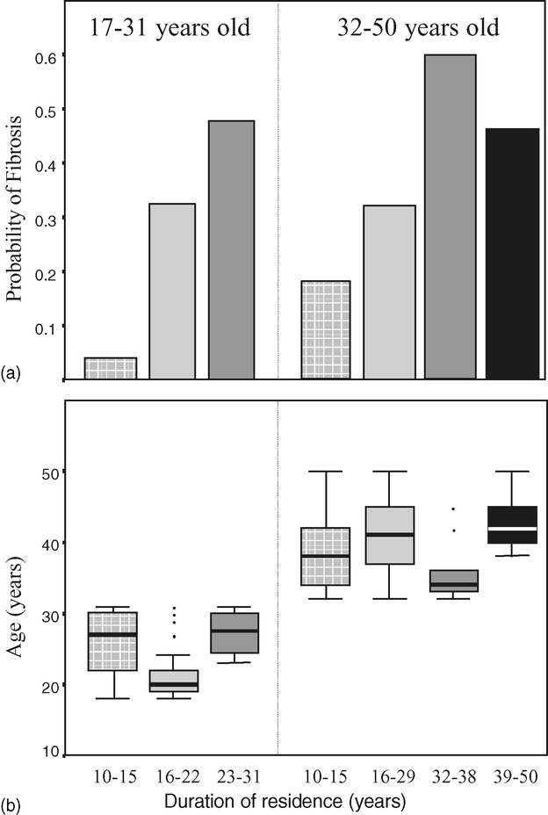
Fig. 5 (a): Bar charts illustrating the correlation between duration of residence (categorised) and probability of ...
Notes:
Fig. 5 (a): Bar charts illustrating the correlation between duration of residence (categorised) and probability of peri-portal fibrosis (y-axis). The left hand chart is for the 17–31 year age group and the right hand chart is for the 32–50 year age group. In Fig. 5(b), box and whisker plots illustrate the independence of age (y-axis) and duration of residence within each in the two age groups.
Unless provided in the caption above, the following copyright applies to the content of this slide: © Royal Society of Tropical Medicine and Hygiene 2003

Slide 6
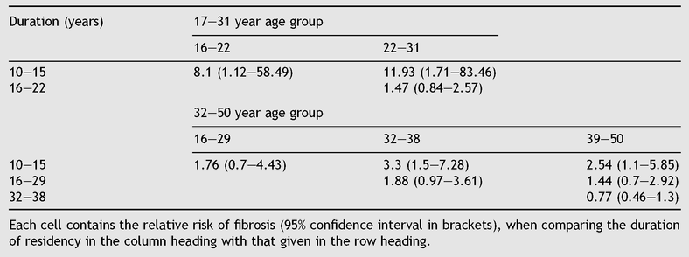
Table 1 Relative risk estimates for peri-portal fibrosis in the two adult age groups from Booma
Notes:
Table 1 Relative risk estimates for peri-portal fibrosis in the two adult age groups from Booma
Unless provided in the caption above, the following copyright applies to the content of this slide: © Royal Society of Tropical Medicine and Hygiene 2003

Slide 7
Table 2 Results of age-stratified analysis comparing height-standardised portal vein diameter (PVD), parasternal ...
Notes:
Table 2 Results of age-stratified analysis comparing height-standardised portal vein diameter (PVD), parasternal liver length (PLL), spleen length (SL) and splenic vein diameter (SVD) between the cohorts from Booma and Bugoigo
Unless provided in the caption above, the following copyright applies to the content of this slide: © Royal Society of Tropical Medicine and Hygiene 2003

Slide 8
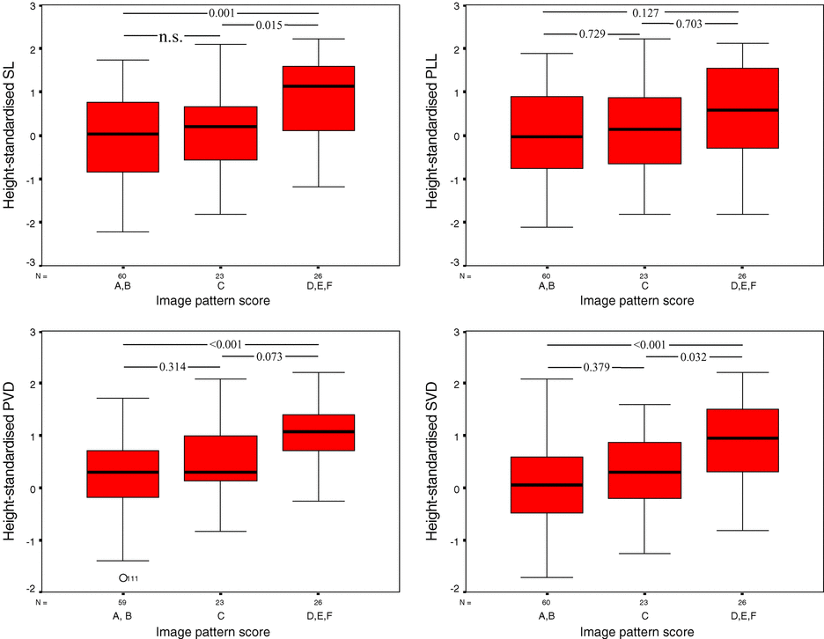
Fig. 6 Box plots of height-standardised organometric parameters in adults from Booma stratified by image pattern ...
Notes:
Fig. 6 Box plots of height-standardised organometric parameters in adults from Booma stratified by image pattern score. P-values for each pairwise post-hoc comparison are shown.
Unless provided in the caption above, the following copyright applies to the content of this slide: © Royal Society of Tropical Medicine and Hygiene 2003

