Slide 1
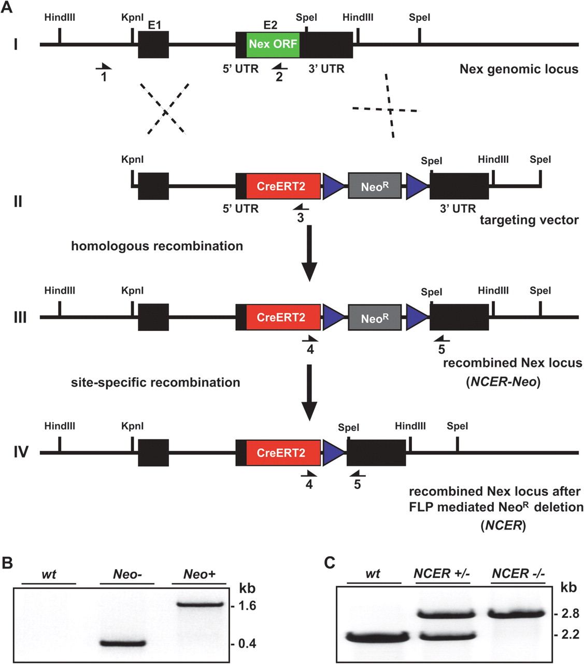
Figure 1. Strategy to “knock-in” CreERT2 into the mouse Nex1 gene. (A) 1) Genomic structure of the wild-type Nex1 ...
Notes:
Figure 1. Strategy to “knock-in” CreERT2 into the mouse Nex1 gene. (A) 1) Genomic structure of the wild-type Nex1 allele. The locus comprises 2 exons (E1, E2; black boxes). The entire coding region (ORF; green box) is located on exon 2. 2) NEX-CreERT2 targeting vector. The construct harbors 5′ and 3′ homology arms (black), the CreERT2 cDNA (red box) fused to the start codon of the Nex1 gene and a neomycin resistance cassette (NeoR; gray box) flanked by 2 FRT sites (blue triangles). 3) NEX-CreERT2 allele (NCER-Neo) after homologous recombination in murine ES cells. 4) NEX-CreERT2 allele after site-specific removal of the NeoR cassette (NCER) by breeding NCER-Neo mice to FLP deleter mice. Arrows #1–5 indicate primer locations for PCR-based characterization of NCER-Neo and NCER mice. (B) FLP-mediated removal of the NeoR cassette is verified by PCR with primers #4, 5 on genomic tail DNA from wt (no amplification), heterozygous NCER mice before (Neo+; 1.6 kb), and after breeding to FLP deleter mice (Neo−; 400 bp). (C) PCR with primers #1–3 on genomic tail DNA from wild type (wt; 2.2 kb), NCER heterozygous (NCER+/−; 2.2 and 2.8 kb), and NCER homozygous mice (NCER−/−; 2.8 kb) confirms correct targeting of CreERT2 cDNA into the Nex1 locus. Note: primer #1 is located outside the targeting vector.
Unless provided in the caption above, the following copyright applies to the content of this slide: © The Author 2011. Published by Oxford University Press. All rights reserved. For permissions, please e-mail: journals.permissions@oup.com

Slide 2
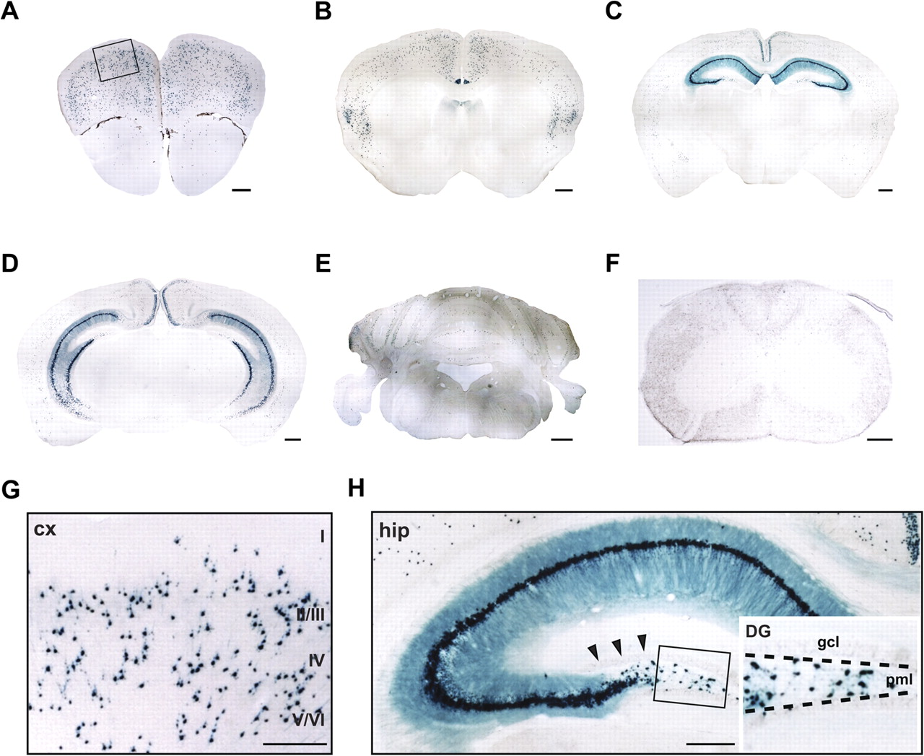
Figure 2. Inducible CreERT2-mediated recombination in adult brains of NCER mice. NCER*R26R-floxLacZ double transgenic ...
Notes:
Figure 2. Inducible CreERT2-mediated recombination in adult brains of NCER mice. NCER*R26R-floxLacZ double transgenic mice at 3–4 weeks of age were injected with tamoxifen (100 mg/kg body weight) for 10 consecutive days. CreERT2-mediated recombination was analyzed by X-gal histochemistry on coronal vibratome sections (40 μm) at 2–3 months of age. (A–F) Overviews reveal β-galactosidase expression in neocortex, induseum griseum, and hippocampus, whereas only few cerebellar granular cells and no spinal cord neurons were recombined. (G) Blow up of boxed area in A. Scattered recombination in layers II–VI of motor cortex. (H) Virtually all pyramidal cells of the hippocampal CA1–3 region express β-galactosidase. While recombination is completely absent from dentate granule cells (arrows), a subset of cells in the dentate hilar region, most likely mossy cells, express β-galactosidase (inset). Abbreviations: cx, neocortex; DG, dentate gyrus; gcl, granule cell layer; hip, hippocampus; pml, polymorphic layer; I–VI, cortical layers. Scale bars: 500 μm (A–E); 250 μm (F–H).
Unless provided in the caption above, the following copyright applies to the content of this slide: © The Author 2011. Published by Oxford University Press. All rights reserved. For permissions, please e-mail: journals.permissions@oup.com

Slide 3
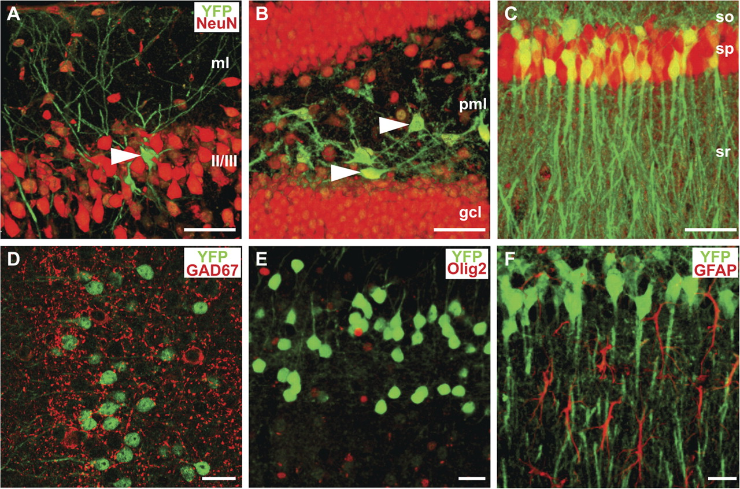
Figure 3. Nex promoter activity in neocortex is restricted to principal neurons. Confocal images of fluorescent ...
Notes:
Figure 3. Nex promoter activity in neocortex is restricted to principal neurons. Confocal images of fluorescent immunostainings for a CreERT2-induced YFP reporter and the pan-neuronal marker NeuN (A–C) or neural cell type-specific markers (D–F) on coronal vibratome sections (40 μm) from 2- to 3-month-old NCER*R26R-floxYFP mice after tamoxifen injections for 10 consecutive days starting at 3–4 weeks of age. (A) Individual YFP-positive neuron (arrowhead) in layers II/III of motor cortex. (B) Mossy cells in the polymorphic layer (pml) of the hilar region express YFP (arrowheads), whereas dentate granule cells (gcl) completely lack NEX promoter activity at this age. (C) In CA1, NeuN-positive cells in the pyramidal cell layer (sp) coexpress YFP, the remaining NeuN-positive cells are mainly interneurons. (D–F) NEX promoter activity is completely absent from interneurons and glial cells as demonstrated by immunostaining for YFP and antibodies directed against pan-interneuronal marker GAD67 (D), Olig2 (oligodendrocytes; E) and GFAP (astrocytes, F). All images are 3D volume rendered from confocal z-stacks and pseudocolored using ImageJ. Abbreviations: gcl, granule cell layer; ml, molecular layer; pml, polymorphic layer; so, stratum oriens; sp, stratum pyramidale; sr, stratum radiatum; II/III, cortical layers. Scale bars: 50 μm (A–C); 20 μm (D–F).
Unless provided in the caption above, the following copyright applies to the content of this slide: © The Author 2011. Published by Oxford University Press. All rights reserved. For permissions, please e-mail: journals.permissions@oup.com

Slide 4
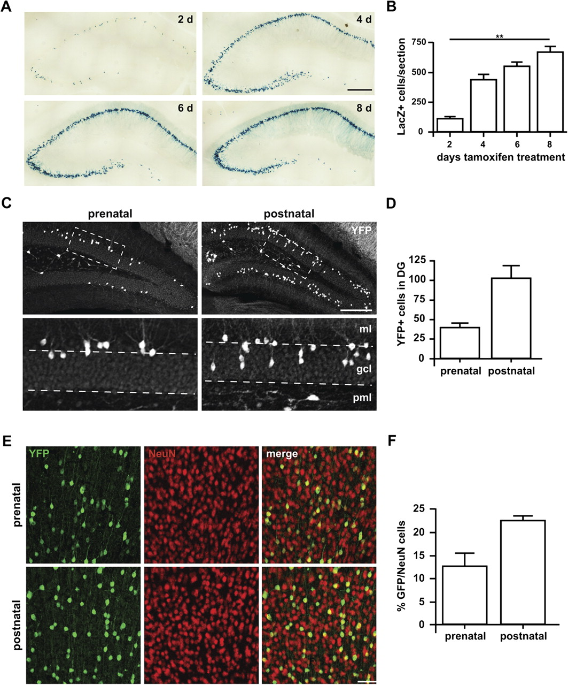
Figure 4. Tamoxifen induces dosage- and stage-dependent recombination in NCER mice. (A–B) NCER-Neo*R26R-floxLacZ mice ...
Notes:
Figure 4. Tamoxifen induces dosage- and stage-dependent recombination in NCER mice. (A–B) NCER-Neo*R26R-floxLacZ mice exhibit tamoxifen dosage-depended recombination in hippocampal CA1–3 subfields. CreERT2-mediated recombination was induced in NCER-Neo*R26R-floxLacZ mice by tamoxifen injection for 2–8 consecutive days beginning at 4–8 weeks of age. (A) Coronal vibratome sections (40 μm) were analyzed by X-Gal histochemistry at 4–5 months of age. (B) Quantification of β-galactosidase-positive cells reveals a significant increase in the number of recombined pyramidal cells after 8 days tamoxifen treatment compared with a 2-day treatment (n = 3; P = 0.006, one-way analysis of variance; Kruskal–Wallis test). (C–F) Perinatal induction of CreERT2 activity results in recombination of dentate granular cells and projection neurons in hippocampus and neocortex. Tamoxifen was administered either by injecting pregnant females at E19 (one injection of 5 mg; “prenatal”) or by injecting lactating females for 5 consecutive days (100 mg/kg) starting on the day of parturition (“postnatal”). NCER*R26R-floxYFP mice were analyzed at 1 month of age by immunostaining for YFP on coronal vibratome sections (40 μm). (C) YFP-positive granule cells are preferentially located in the outer shell of the granule cell layer (gcl) in mice that received prenatal tamoxifen treatment (blow up of boxed area in upper panel). In the postnatal paradigm, granule cells are more scattered within the granule cell layer, according to an “inside-in” pattern of migration. (D) Quantification of recombined granule cells following prenatal and postnatal tamoxifen treatment, respectively. Postnatal treatment produced more recombined granule cells, but this was not statistically significant. (E) Fluorescent micrographs of coronal brain sections from NCER*R26R-floxYFP mice double labeled for YFP and NeuN show scattered recombination in the motor cortex after prenatal and postnatal tamoxifen treatment. (F) Quantification of YFP- and NeuN-positive cells following prenatal and postnatal treatment. Abbreviations: gcl, granule cell layer; ml, molecular layer; pml, polymorphic layer. Scale bars: 300 μm (A); 200 μm (C), boxed: 50 μm; 50 μm (E).
Unless provided in the caption above, the following copyright applies to the content of this slide: © The Author 2011. Published by Oxford University Press. All rights reserved. For permissions, please e-mail: journals.permissions@oup.com

Slide 5
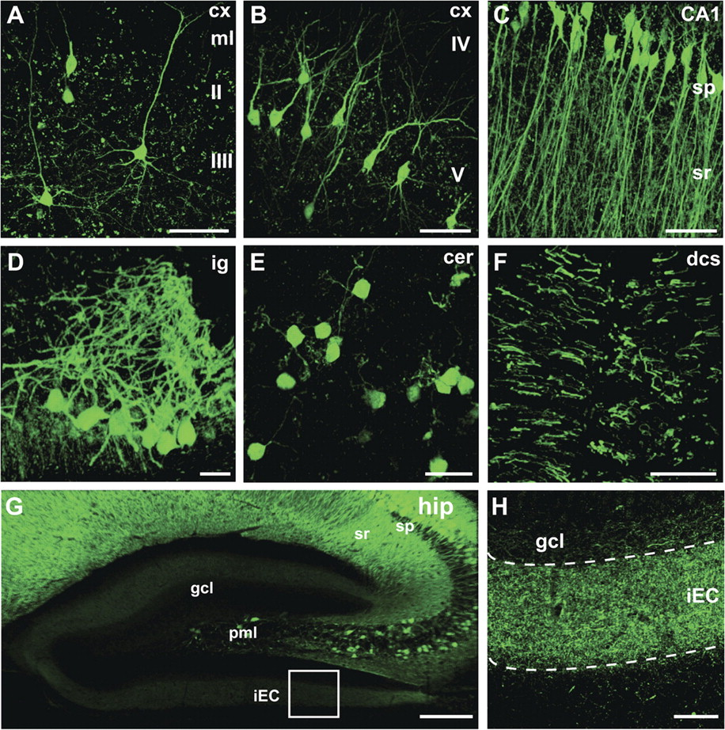
Figure 5. Analysis of pyramidal cell arborization by single-cell imaging in NCER mice. Confocal imaging of coronal ...
Notes:
Figure 5. Analysis of pyramidal cell arborization by single-cell imaging in NCER mice. Confocal imaging of coronal vibratome sections (100 μm) from NCER*CAG-CAT-EGFP mice at 7 months of age after tamoxifen injection for 2 days (A–C) and 10 days (D–H) starting at 4 weeks of age. Tamoxifen induction for 2 days allows visualization of individual EGFP-positive pyramidal cell arbors in cortical layers II/III (A), layer V (B), and the hippocampal CA1 subfield (C). Following 10 days of tamoxifen administration, imaging reveals a dense dendritic network of neurons in indusium griseum (D), whereas only a small number of cerebellar granule cells are recombined (E). NCER*CAG-CAT-EGFP mice also permit imaging of individual motor axons in the dorsal spinal cord (F). Sustained NEX promoter activity in entorhinal cortex (but not dentate granule cells) allows selective labeling of perforant path terminals on granule cells in the entorhinal cortex (G,H). (H) Blow up of boxed area in (G). All images are 3D volume rendered from confocal z-stacks and pseudocolored using ImageJ. Abbreviations: CA1, CA1 subfield of hippocampus; cer, cerebellum; cx, neocortex; dcs, dorsal column of spinal cord; gcl, granular cell layer; hip, hippocampus; iEC, projections from internal principal stratum of entorhinal cortex; ig, indusium griseum; ml, molecular layer; pml, polymorphic layer; so, stratum oriens; sp, stratum pyramidal; sr, stratum radiatum; II/III, cortical layers. Scale bars: 50 μm (A–C,F,H); 20 μm (D,E); 200 μm (G).
Unless provided in the caption above, the following copyright applies to the content of this slide: © The Author 2011. Published by Oxford University Press. All rights reserved. For permissions, please e-mail: journals.permissions@oup.com

Slide 6
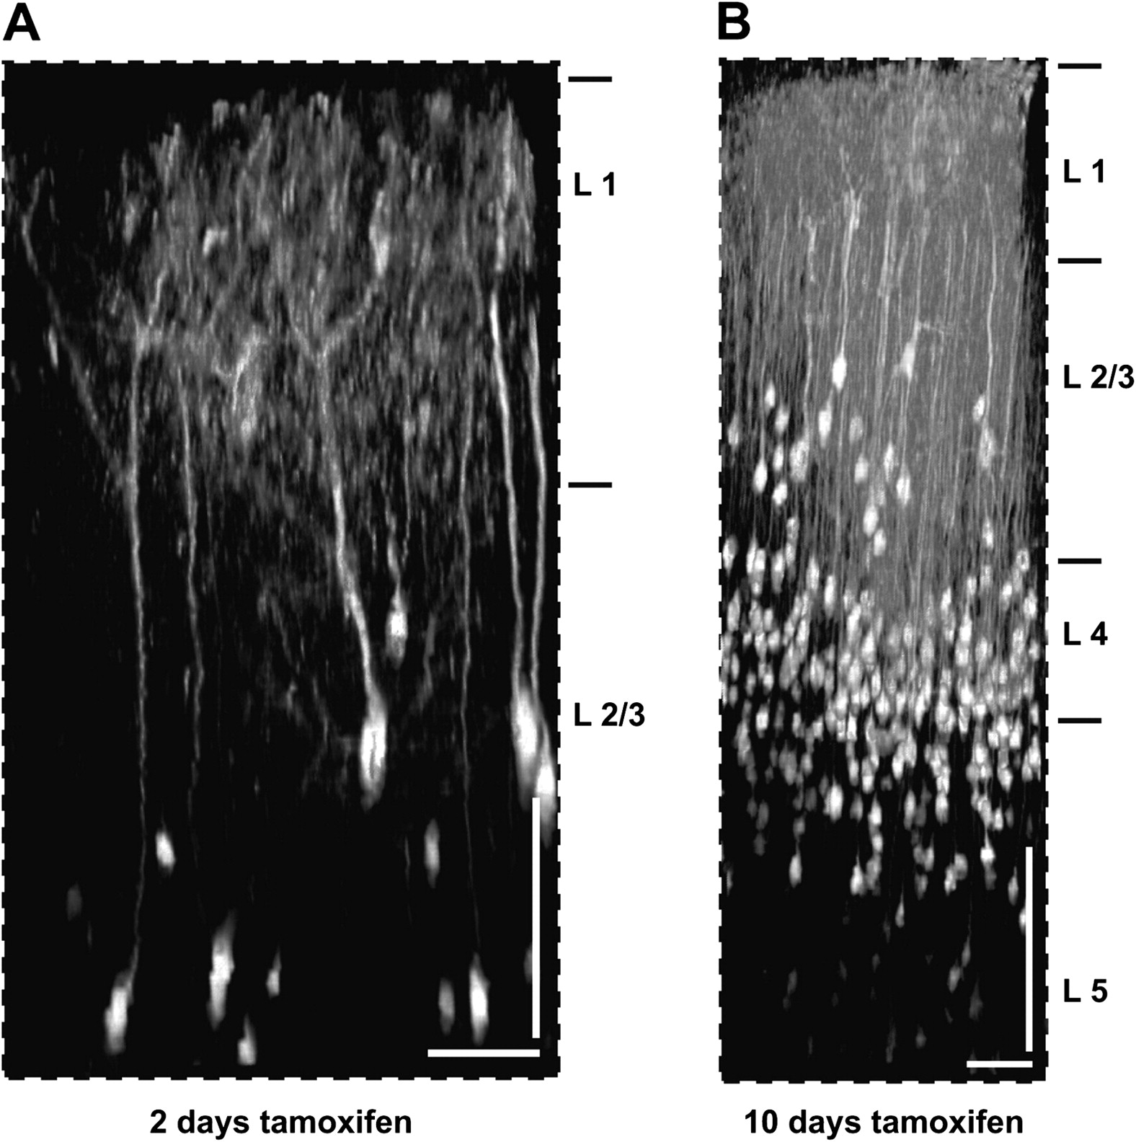
Figure 6. In vivo 2-photon imaging of individual pyramidal neurons in NCER mice. 2-photon imaging of neocortical ...
Notes:
Figure 6. In vivo 2-photon imaging of individual pyramidal neurons in NCER mice. 2-photon imaging of neocortical projection neurons was carried out through a cranial window in the motor cortex sealed with a cover glass. Fluorescent image stacks were recorded in NCER*CAG-CAT-EGFP mice at 7–8 weeks of age following tamoxifen induction (100 mg/kg body weight) for 2 (A) and 10 days (B) starting at 3 weeks of age. Data were acquired with a pumped titanium:sapphire oscillator using a 20× water immersion lens with NA 1.0 (Zeiss). Note different scales of imaging depth in A and B. Tamoxifen induction for 10 days permits imaging of projection neurons throughout the entire depth of the neocortex (∼800 μm). Dimensions of cortical layers (L) are indicated. Images are presented as a 3D volume rendered from fluorescent image stacks. Scale bars: A,B: 50 μm (horizontal); 100 μm (vertical).
Unless provided in the caption above, the following copyright applies to the content of this slide: © The Author 2011. Published by Oxford University Press. All rights reserved. For permissions, please e-mail: journals.permissions@oup.com

Slide 7
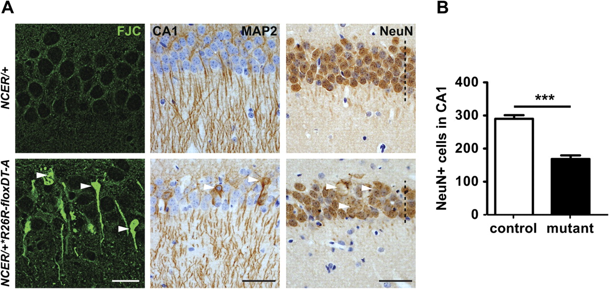
Figure 7. Selective ablation of adult hippocampal pyramidal neurons by NCER-mediated diphteria toxin expression. (A) ...
Notes:
Figure 7. Selective ablation of adult hippocampal pyramidal neurons by NCER-mediated diphteria toxin expression. (A) Expression of DT-A in NCER/+*R26R-floxDT-A mice causes widespread death of hippocampal pyramidal neurons (arrowheads) as demonstrated by FJC staining (left panels). Accumulation of the dendritic marker Map2 in neuronal cell bodies (arrowheads; middle panels) supports neuronal degeneration. Immunostaining for NeuN reveals thinning of the pyramidal cell layer and loss of pyramidal cell somata in NCER/+*R26R-floxDT-A mice (right panels). Heterozygous NCER controls (NCER/+) and mice additionally harboring the diptheria toxin transgene (NCER/+*R26R-floxDT-A) were injected with tamoxifen (100 mg/kg body weight) for 10 days starting at 3 weeks of age and analyzed at 7 weeks of age. (B) When quantified, the number of NeuN-positive cells in the CA1 subfield of NCER/+*R26R-floxDT-A mice is significantly reduced by 50% when compared with controls (n = 3, P < 0.001, unpaired, 2 tailed t-test with Welch's correction). Scale bars: 20 μm (FJC); 50 μm (Map2, NeuN).
Unless provided in the caption above, the following copyright applies to the content of this slide: © The Author 2011. Published by Oxford University Press. All rights reserved. For permissions, please e-mail: journals.permissions@oup.com

Slide 8
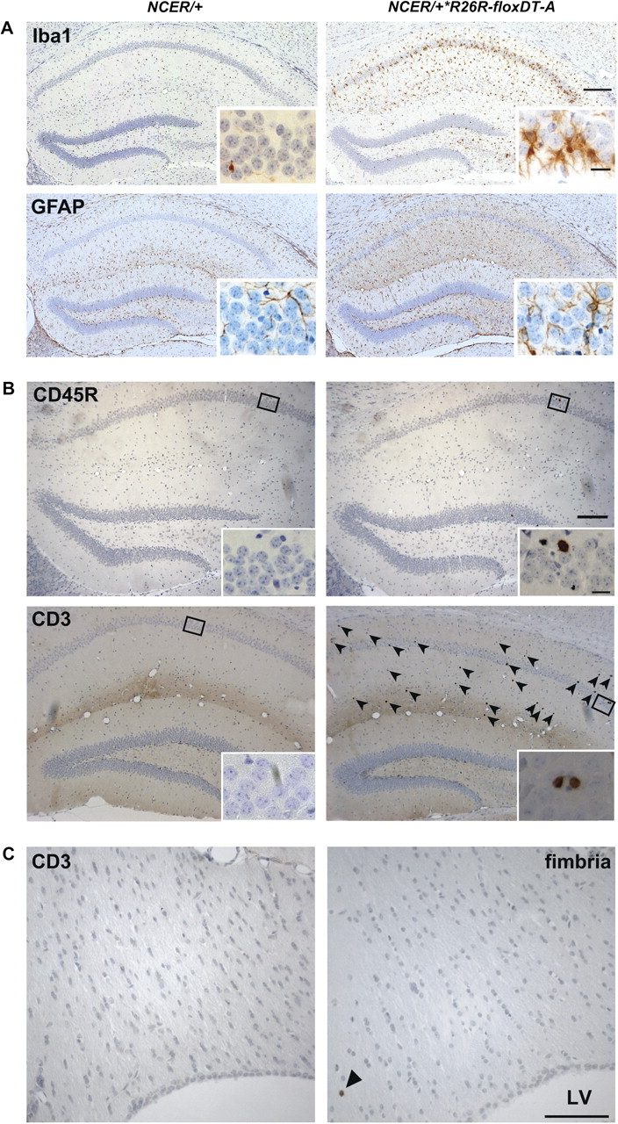
Figure 8. Genetic ablation of hippocampal projection neurons induces reactive gliosis and lymphocyte infiltration. (A) ...
Notes:
Figure 8. Genetic ablation of hippocampal projection neurons induces reactive gliosis and lymphocyte infiltration. (A) Pyramidal cell death in the hippocampal CA1–3 region of tamoxifen-treated NCER/+*R26R-floxDT-A mice is associated with severe microgliosis and astrogliosis as demonstrated by immunostaining for microglia (Iba1, upper panels) and astrocytes (GFAP; lower panels). NCER/+ controls and NCER*R26R-floxDT-A mice were injected with tamoxifen for 10 days starting at 4 weeks of age and harvested at 6.5 weeks of age. (B) Lymphocyte infiltration into the hippocampal region of mutant brains shown by immunostaining for B cell-specific phosphatase CD45R (upper panels; magnified in inset) and T cell receptor CD3 (arrows in lower right; magnified in inset). B cells were never observed in brains of control mice. (C) Immunostaining for CD3 demonstrates absence of significant T cell infiltration in hippocampal fimbriae (i.e., myelinated axons derived from degenerating hippocampal neurons) of tamoxifen-treated NCER/+*R26R-floxDT-A mice. Arrowhead marks rare example of a T cell infiltrate. Abbreviations: LV, lateral ventricle. Scale bars: 200 μm (A,B); 20 μm (insets); 100 μm (C).
Unless provided in the caption above, the following copyright applies to the content of this slide: © The Author 2011. Published by Oxford University Press. All rights reserved. For permissions, please e-mail: journals.permissions@oup.com

Slide 9
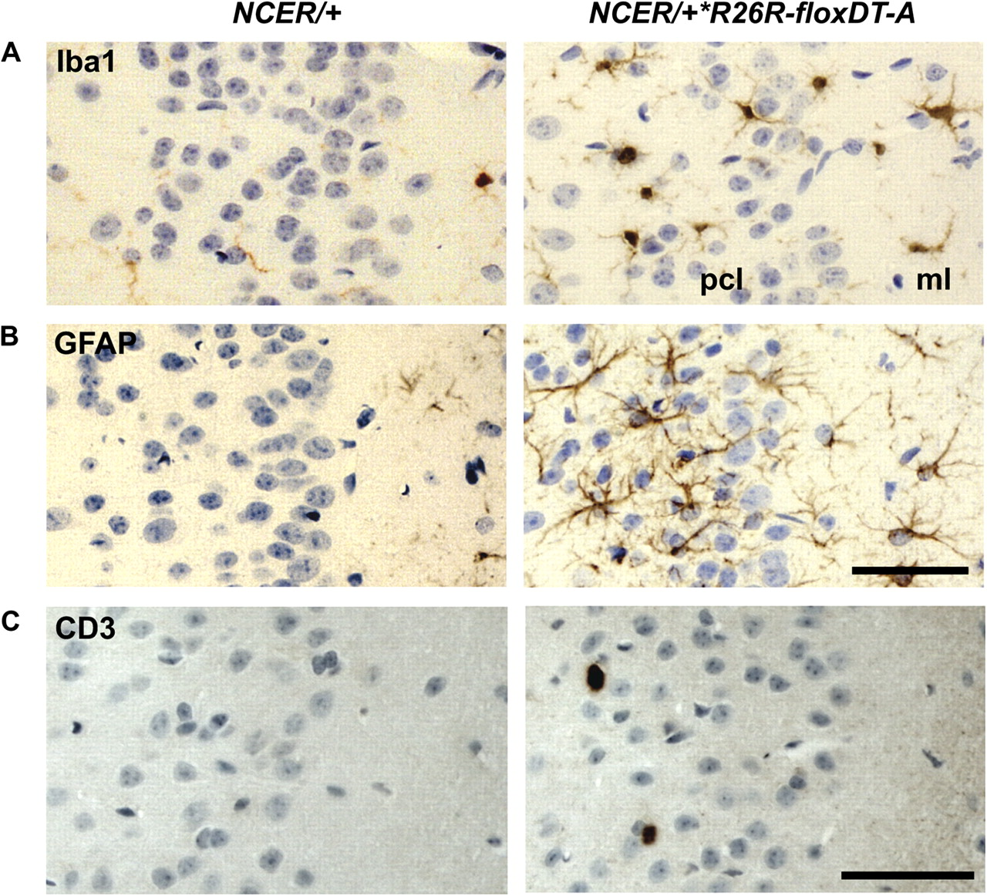
Figure 9. Gliosis and mild T cell infiltration in the cingulate cortex of tamoxifen-treated NCER/+*R26R-floxDT-A mice. ...
Notes:
Figure 9. Gliosis and mild T cell infiltration in the cingulate cortex of tamoxifen-treated NCER/+*R26R-floxDT-A mice. (A) Immunostaining for Iba1 demonstrates activated microglia as a consequence of DT-A-induced death of pyramidal neurons in the cingulate cortex of tamoxifen-treated NCER/+*R26R-floxDT-A mice. (B) Accumulation of reactive astroglia in the cingulate cortex of NCER/+*R26R-floxDT-A mice revealed by immunostaining for GFAP. (C) Occasional T cell infiltration in the cingulate cortex of NCER/+*R26R-floxDT-A mice as demonstrated by immunostaining for CD3. Note that CD3+ T cells were not observed in the cingulate cortex of tamoxifen-treated NCER/+ controls. Abbreviations: ml, molecular layer; pcl, pyramidal cell layer. Scale bars: 50 μm.
Unless provided in the caption above, the following copyright applies to the content of this slide: © The Author 2011. Published by Oxford University Press. All rights reserved. For permissions, please e-mail: journals.permissions@oup.com

