Slide 1
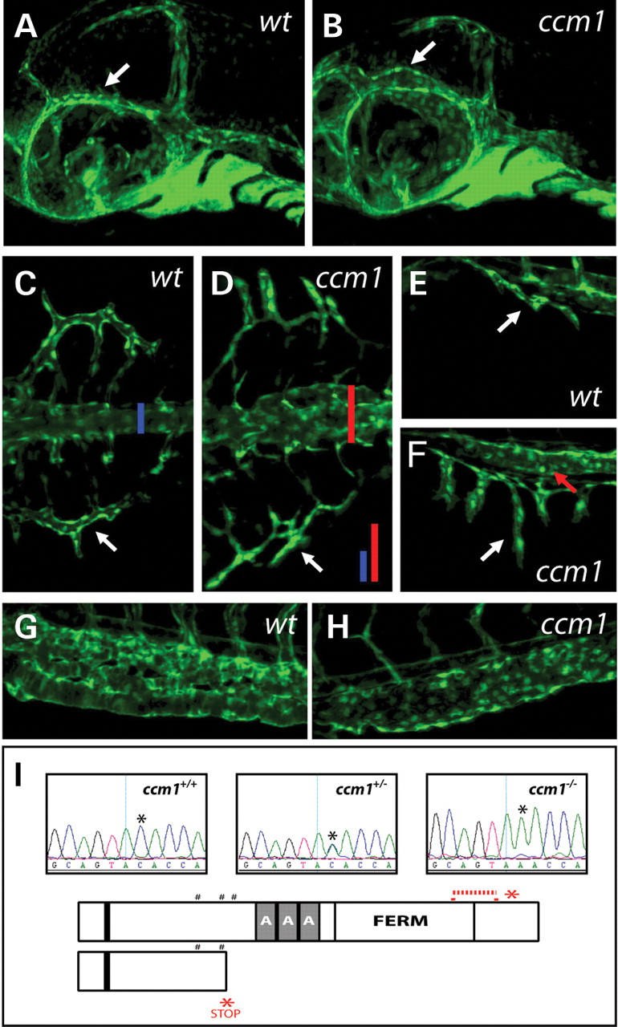
Figure 1. ( A–H ) Phenotypes of ccm1 mutants in the fli1:GFP transgenic background analysed by confocal imaging. The ...
Notes:
Figure 1. ( A–H ) Phenotypes of ccm1 mutants in the fli1:GFP transgenic background analysed by confocal imaging. The PMBC (arrow) is dilated in ccm1 mutant (B) but not wild-type (A) embryos at 32 h. The SIVs (arrows) and trunk vasculature (coloured bars in C and D) are dilated and spread in ccm1 (D) but not wild-type (C) embryos viewed dorsally at 50 h. ccm1 mutants viewed laterally (F) reveal overgrown, dilated SIVs (white arrow) and dilated PCV (red arrow) by comparison with wild-type embryos (E). The CV is a single dilated tube in ccm1 mutants at 50 h (H) by comparison with the highly organized plexus of a wild-type CV (G). ( I ) Sequence chromatograms (upper) spanning the ccm1 mutation indicate representative wild-type, heterozygous and mutant samples (mutation indicated by asterisk). Predicted mutant ccm1 protein (lower) is truncated by a premature stop codon (asterisk) lacking ankyrin repeats and the FERM domain. Previously reported zebrafish alleles ( 11 ) (upper) removed a small region of the FERM domain (hashed bar) and truncated a C-terminal fragment (asterisk). The black bar close to the N-terminus indicates the conserved nuclear localization signal and the # indicates NPXY motifs.
Unless provided in the caption above, the following copyright applies to the content of this slide: © The Author 2008. Published by Oxford University Press. All rights reserved. For Permissions, please email: journals.permissions@oxfordjournals.org

Slide 2
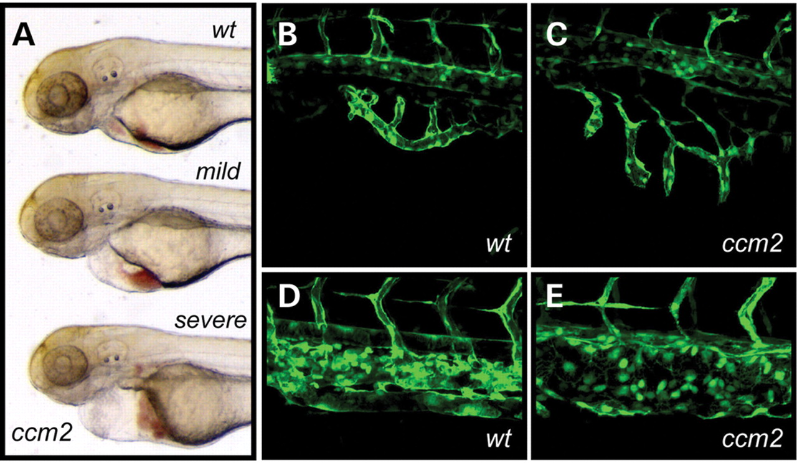
Figure 2. ( A ) ccm2^{hi296} insertional mutant phenotype. ccm2^{hi296} mutants display either mild ...
Notes:
Figure 2. ( A ) ccm2hi296 insertional mutant phenotype. ccm2hi296 mutants display either mild heart dilation (middle) or severe heart dilation (bottom) compared with wild-type siblings (top). ( B and C ) Lateral views of the SIVs of wild-type (B) and severe ccm2hi296 (C) mutants visualized using a fli1:GFP background at 48 h. ( D and E ) Wild-type (D) and severe ccm2hi296 (E) mutant CV phenotypes visualized using a fli1:GFP background at 48 h.
Unless provided in the caption above, the following copyright applies to the content of this slide: © The Author 2008. Published by Oxford University Press. All rights reserved. For Permissions, please email: journals.permissions@oxfordjournals.org

Slide 3
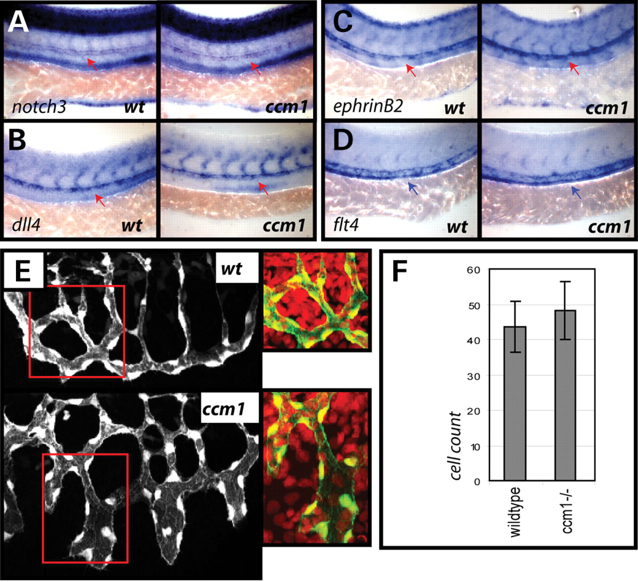
Figure 3. ( A – D ) Arterial and venous markers are expressed normally in the trunk of individually genotyped ccm1 ...
Notes:
Figure 3. ( A – D ) Arterial and venous markers are expressed normally in the trunk of individually genotyped ccm1 mutant embryos viewed laterally at 24 h (full analysis Supplementary Material, Fig. S2 ). (A) notch3 expression in representative mutant and sibling embryos. (B) dll4 expression in representative mutant and sibling embryos. (C) ephrinB2 expression in representative mutant and sibling embryos. (D) flt4 expression in representative mutant and sibling embryos. Red arrows indicate arterial expression, blue arrows indicate venous expression. ( E and F ) Cell counts of endothelial cells in wholemount wild-type and ccm1 mutant SIVs using anti-GFP staining and nuclear counter-stain (DAPI) at 72 h ( E ). No significant difference in cell number was observed between mutant ( n =10) and sibling ( n =10) SIVs counted ( F ).
Unless provided in the caption above, the following copyright applies to the content of this slide: © The Author 2008. Published by Oxford University Press. All rights reserved. For Permissions, please email: journals.permissions@oxfordjournals.org

Slide 4
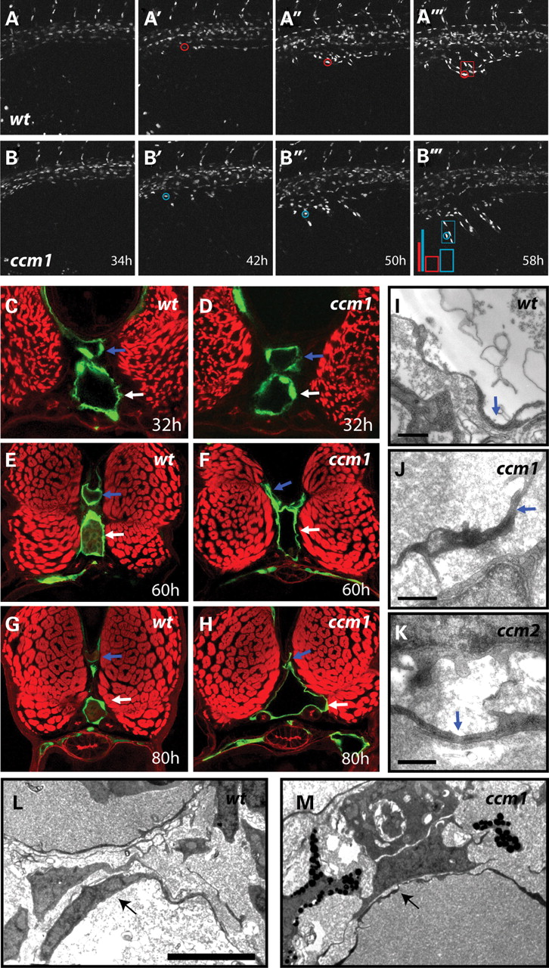
Figure 4. ( A and B ) Timelapse imaging of the SIVs of fli1:nucGFP wild-type and ccm1 mutant embryos over a 24 h ...
Notes:
Figure 4. ( A and B ) Timelapse imaging of the SIVs of fli1:nucGFP wild-type and ccm1 mutant embryos over a 24 h period (34–58 h). Coloured bars track dorsal-ventral movement of the individual cells indicated by the circles. Coloured boxes indicate the spread of four nuclei at the ventral edge of each SIV [(A–A′′′) wild-type sibling, (B–B′′′) ccm1 mutant, image width=375 µm). n = 3 analysed for each genotype. ( C – H ) Progressive dilation and vessel wall thinning in ccm1 mutant vessels. Equivalent confocal stacks of vibratome sections of wild-type (C, E, G) and ccm1 mutant (D, F, H) vessels in fli1:GFP animals counterstained with rhodamine phalloidin at the indicated time-points (blue arrow=DA, white arrow=PCV, n > 8 analysed for each time-point). ( I – K ) Visualization of cell–cell junctions in the PCV of wild-type (I) ccm1 mutant (J) and ccm2 mutant (severe phenotype) (K) embryos using electron microscopy at 48 h ( n = 5 wild-type, n = 5 ccm1 and n = 4 ccm2 embryos analysed). Blue arrows indicate junctions. Scale=0.5 µm. ( L and M ) EM analysis of the PCV (arrow) in the trunk of both wt (L) and ccm1 mutant (M) animals confirms thinning of the endothelial wall in mutants at 48 h ( n = 5 wild-type and n =5 mutant embryos analysed). Scalebar =5 µm, equivalent magnification was used for both (A) and (B).
Unless provided in the caption above, the following copyright applies to the content of this slide: © The Author 2008. Published by Oxford University Press. All rights reserved. For Permissions, please email: journals.permissions@oxfordjournals.org

Slide 5
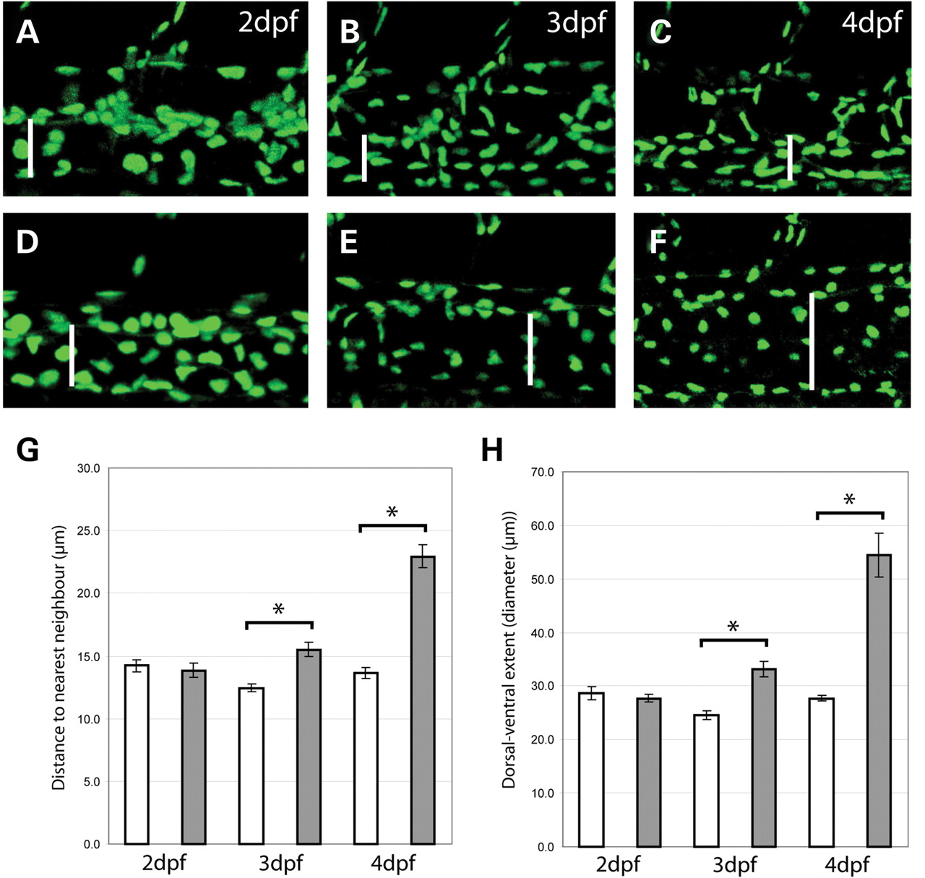
Figure 5. ( A – F ) Representative lateral views of z-stack projections through the trunk vasculature in fli1:nucGFP ...
Notes:
Figure 5. ( A – F ) Representative lateral views of z-stack projections through the trunk vasculature in fli1:nucGFP animals between 2 somites immediately anterior to the cloaca at 2, 3 and 4 dpf. (A–C) Wild-type and (D–F) mutant. White bars indicate the dorsal–ventral extent (diameter) of the PCV at each time-point (determination of diameter aided by transmitted light images). ( G ) Column graphical summary of distance in μm between nearest neighbouring nuclei in the PCV at 2 (wt: n =34 measurements; n = 5 embryos, mut: n = 38 measurements; n = 6 embryos), 3 (wt: n = 30 measurements; n = 5 embryos, mut: n = 30 measurements; n = 5 embryos) and 4 dpf (wt: n = 38 measurements; n = 5 embryos, mut: n = 35 measurements; n = 5 embryos). Mean±SEM: * P < 0.01. ( H ) Column graphical summary of the dorsal ventral extent (as a measure of diameter) of the PCV at 2 (wt: n = 5; mut: n = 6), 3 (wt: n = 5; mut: n = 5) and 4 dpf (wt: n = 5; mut: n = 5). Mean±SEM: * P < 0.01. White bars indicate wild-type values and grey bars indicate mutant values.
Unless provided in the caption above, the following copyright applies to the content of this slide: © The Author 2008. Published by Oxford University Press. All rights reserved. For Permissions, please email: journals.permissions@oxfordjournals.org

Slide 6
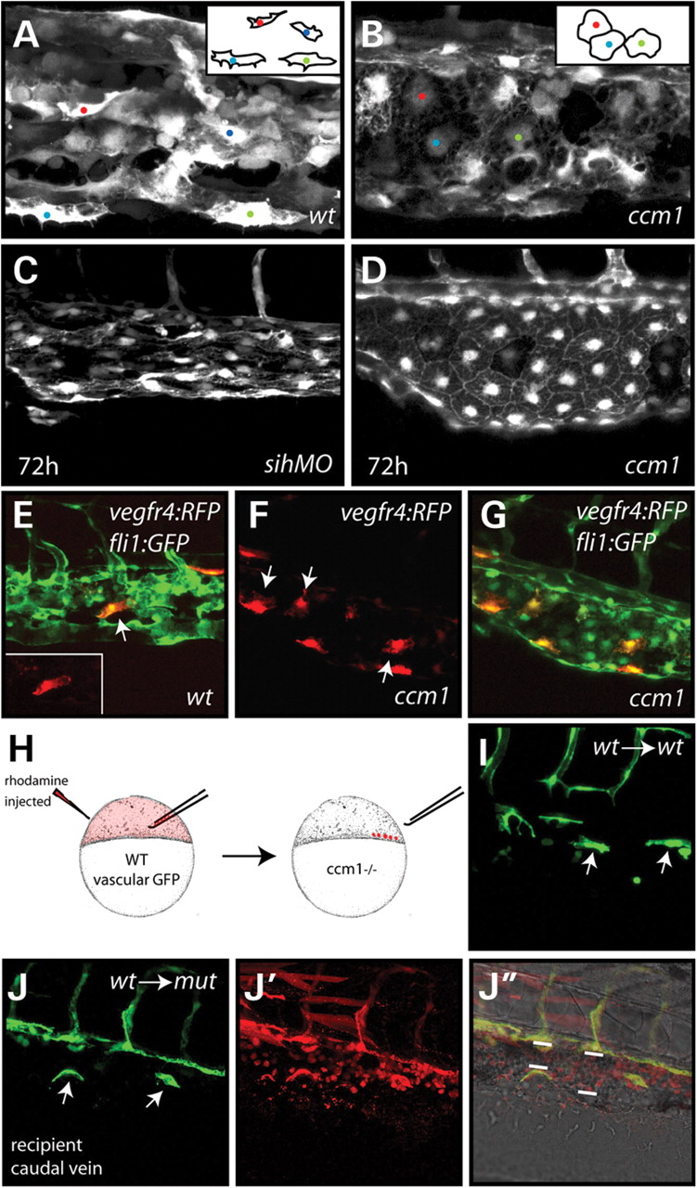
Figure 6. ( A and B ) Morphology of endothelial cells in the CV of wild-type and ccm1 mutant embryos at 48 h (image ...
Notes:
Figure 6. ( A and B ) Morphology of endothelial cells in the CV of wild-type and ccm1 mutant embryos at 48 h (image width=188 µm, cartoon inset indicates approximate morphology of cells). ( C and D ) Comparison of ccm1 mutant (D) and sih MO injected (C) CVs viewed laterally at 72 h. sih MO injected but not ccm1 mutant CVs contain elongated endothelial cells (for full analysis, see Supplementary Material, Fig. S5 ). ( E – G ) Analysis of endothelial cell shape in the CV by mosaic labelling of endothelial cells upon injection of DNA encoding vegfR4:tandem Tomato (RFP) in the fli1:GFP background. Individually labelled, wild-type endothelial cells take up an elongated endothelial morphology (E), whereas individually labelled mutant cells show a typical spread morphology (F and G). (E) and (G) show merged GFP and RFP z-stack images, (F) shows isolated mutant endothelial cells in an RFP z-stack image. Inset in (E) is an isolated, elongated wild-type endothelial cell from an RFP z-stack. Arrowheads indicate isolated cells at the lateral surface of each vessel, image width=248 µm (see Supplementary Material, Fig. S5 for full analysis). ( H ) Summary of transplantation approach. Rhodamine-labelled cells were transplanted from pre-dome stage fli1:GFP or vegfR4:GFP transgenic wild-type embryos into clutches from GFP negative ccm1 carriers (25% mutant). ( I and J ) Transplanted wild-type cell morphology in the CV of wild-type (I) and mutant (J) embryos at 48h [GFP indicates transplanted endothelial cells (I and J), rhodamine indicates all transplanted cells (J′), arrows indicate individual elongated cells in the CV, bars in J″ indicate vascular diameter). Wild-type cellular morphology scored in n = 4 DC grafts, n = 1 SIV graft and n = 2 CV grafts. Image width=248 µm.
Unless provided in the caption above, the following copyright applies to the content of this slide: © The Author 2008. Published by Oxford University Press. All rights reserved. For Permissions, please email: journals.permissions@oxfordjournals.org

