Slide 1
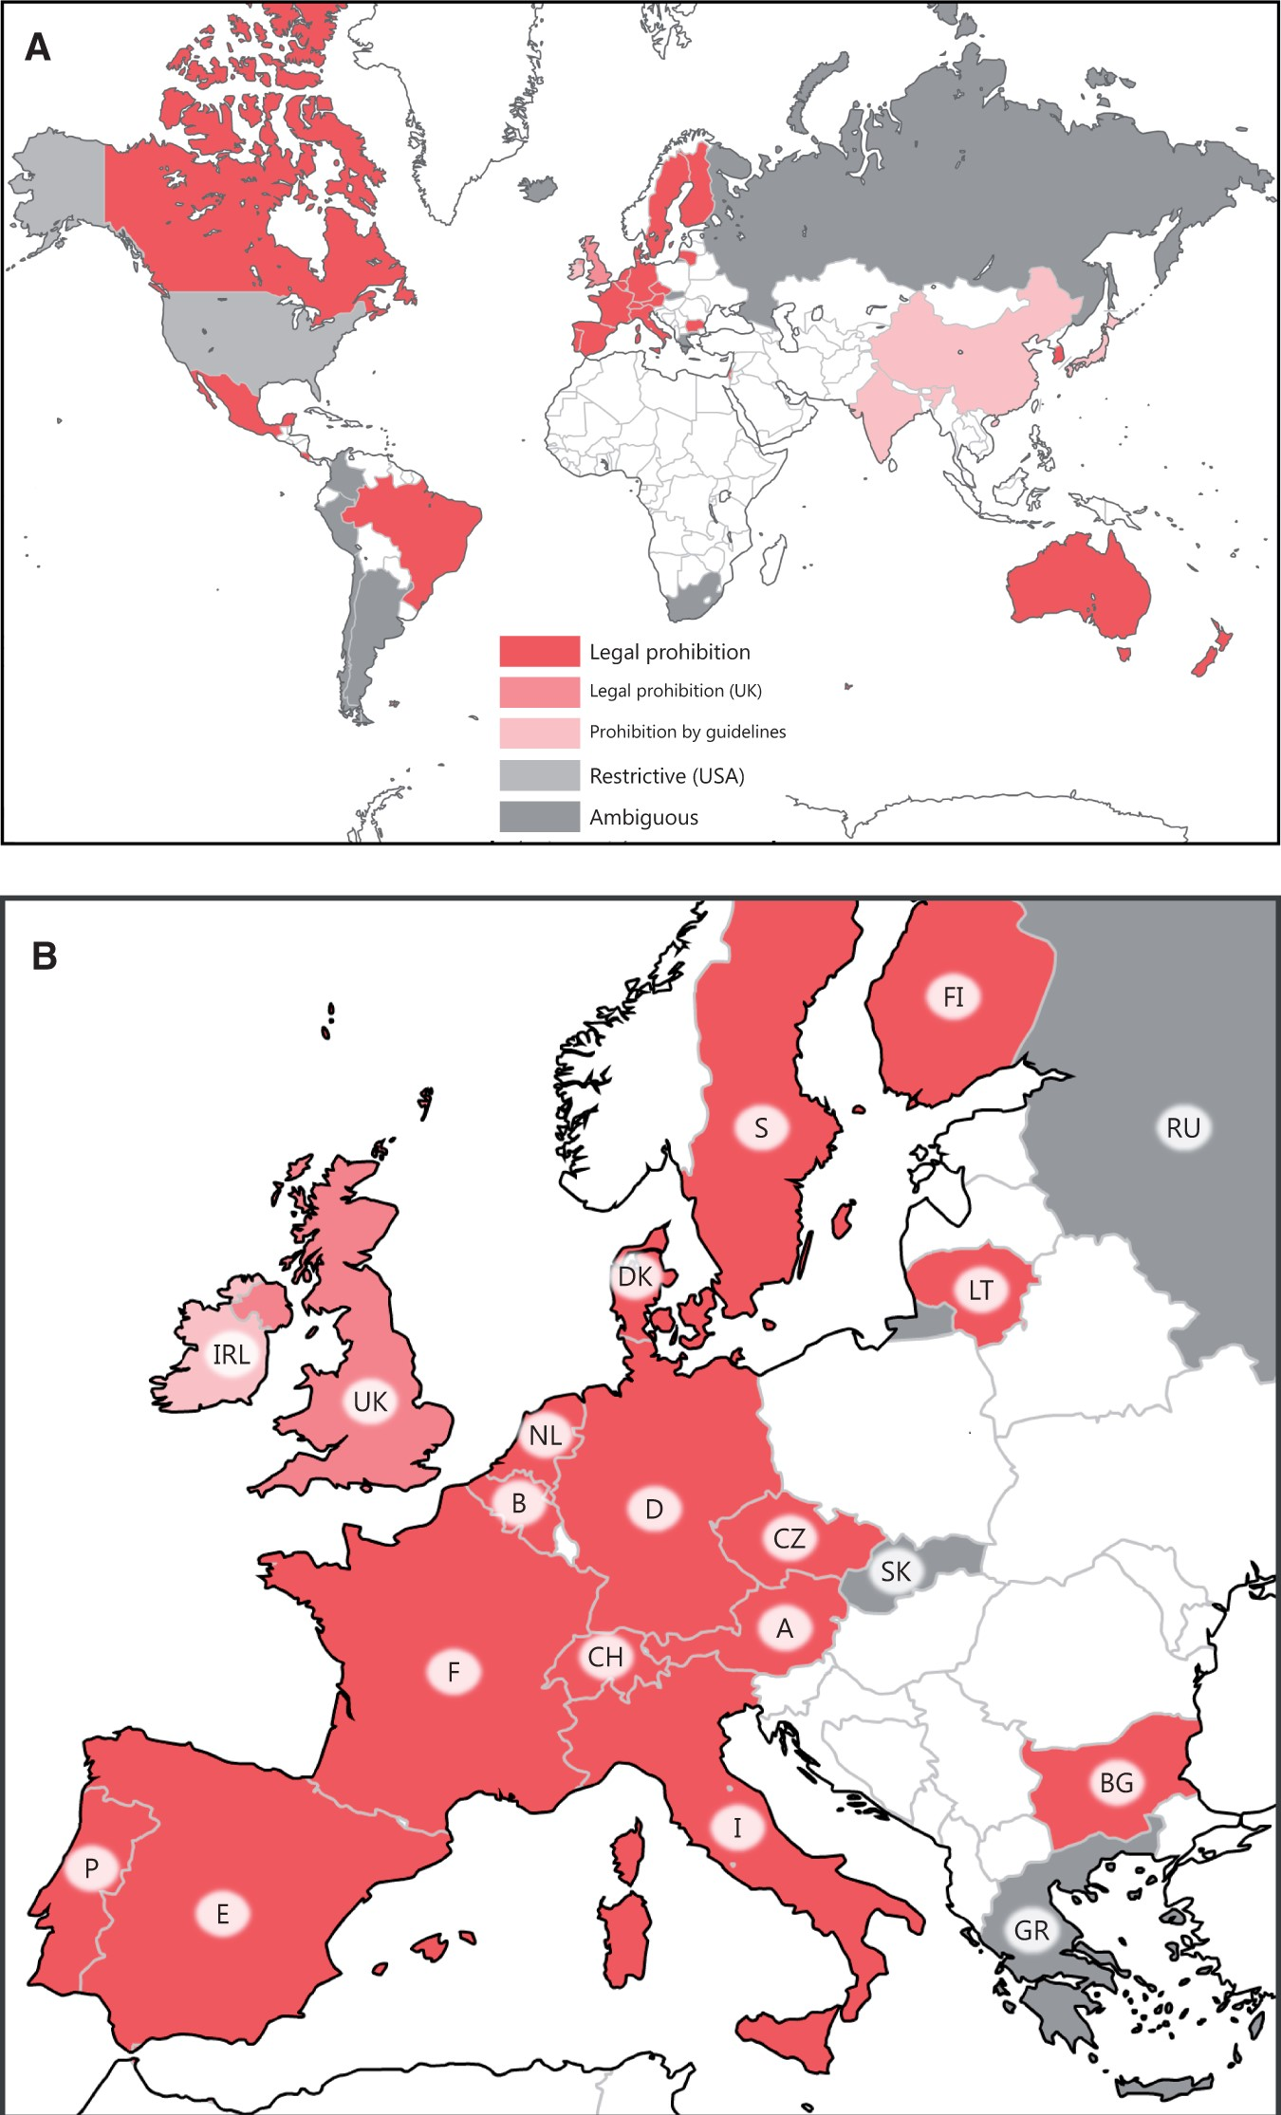
Figure 1 The international regulatory landscape of human germ line gene modification (permission to reuse and modify ...
Notes:
Figure 1 The international regulatory landscape of human germ line gene modification (permission to reuse and modify the figure was granted by the authors of [11]). (A) Thirty-nine countries were investigated and categorized with regard to their view on germ line gene modification. The different categories include ‘legal prohibition’ (24 countries, red), legal prohibition (the UK, pink), ‘prohibition by guidelines’ (four countries: China, India, Ireland and Japan; faint pink),‘ambiguous’ (nine countries: Argentina, Chile, Colombia, Greece, Iceland, Peru, Russia, Slovakia and South Africa; gray) and ‘restrictive’ (the USA, light gray). Note that the UK has recently legalized a form of germ line gene modification, mitochondrial donation (effective in October 2015). The noncolored countries were excluded from this survey. (B) An enlarged figure in Europe. See also the full list of the 39 countries shown in Supplementary Table S1 and Table 3 in the present article.
Unless provided in the caption above, the following copyright applies to the content of this slide: © The Author 2015. Published by Oxford University Press.This is an Open Access article distributed under the terms of the Creative Commons Attribution Non-Commercial License (http://creativecommons.org/licenses/by-nc/4.0/), which permits non-commercial re-use, distribution, and reproduction in any medium, provided the original work is properly cited. For commercial re-use, please contact journals.permissions@oup.com

Slide 2
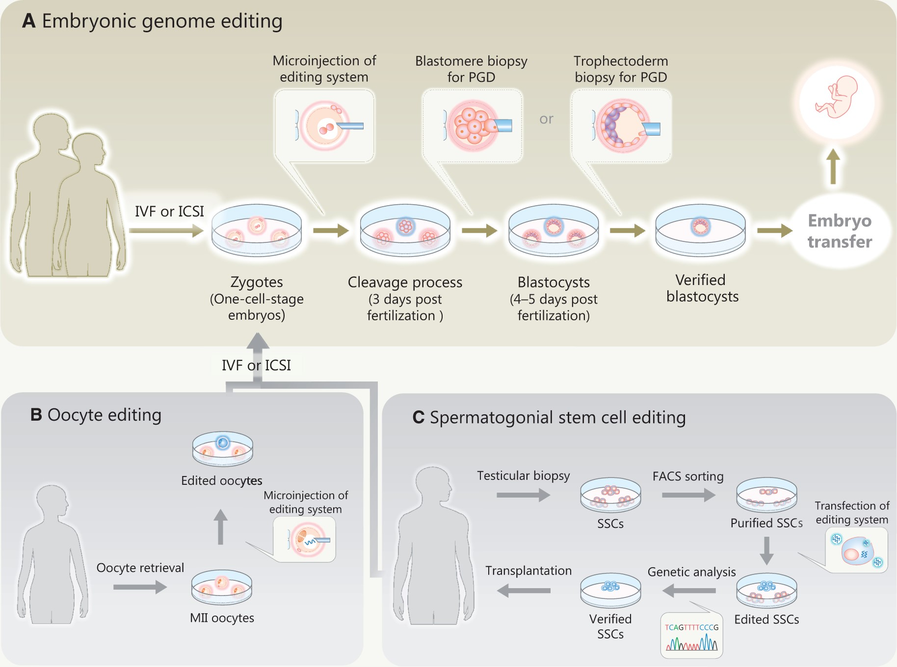
Figure 2 An outline of human germ line genome editing. (A) Embryonic genome editing. The nucleases are microinjected ...
Notes:
Figure 2 An outline of human germ line genome editing. (A) Embryonic genome editing. The nucleases are microinjected into zygotes (one-cell-stage embryos). Subsequently, on-target gene modifications and off-target mutations are investigated by preimplantation genetic diagnosis (PGD) with either blastomore biopsy or trophectoderm biopsy before the embryo transfer. (B) Oocyte editing. (C) SSC editing. Genetically modified SSCs are transplanted for differentiation in vivo. The genetically modified oocytes or spermatozoa are used for in vitro fertilization (IVF) or intracytoplasmic sperm injection (ICSI). The resultant embryos are also investigated by a PGD.
Unless provided in the caption above, the following copyright applies to the content of this slide: © The Author 2015. Published by Oxford University Press.This is an Open Access article distributed under the terms of the Creative Commons Attribution Non-Commercial License (http://creativecommons.org/licenses/by-nc/4.0/), which permits non-commercial re-use, distribution, and reproduction in any medium, provided the original work is properly cited. For commercial re-use, please contact journals.permissions@oup.com

