Slide 1
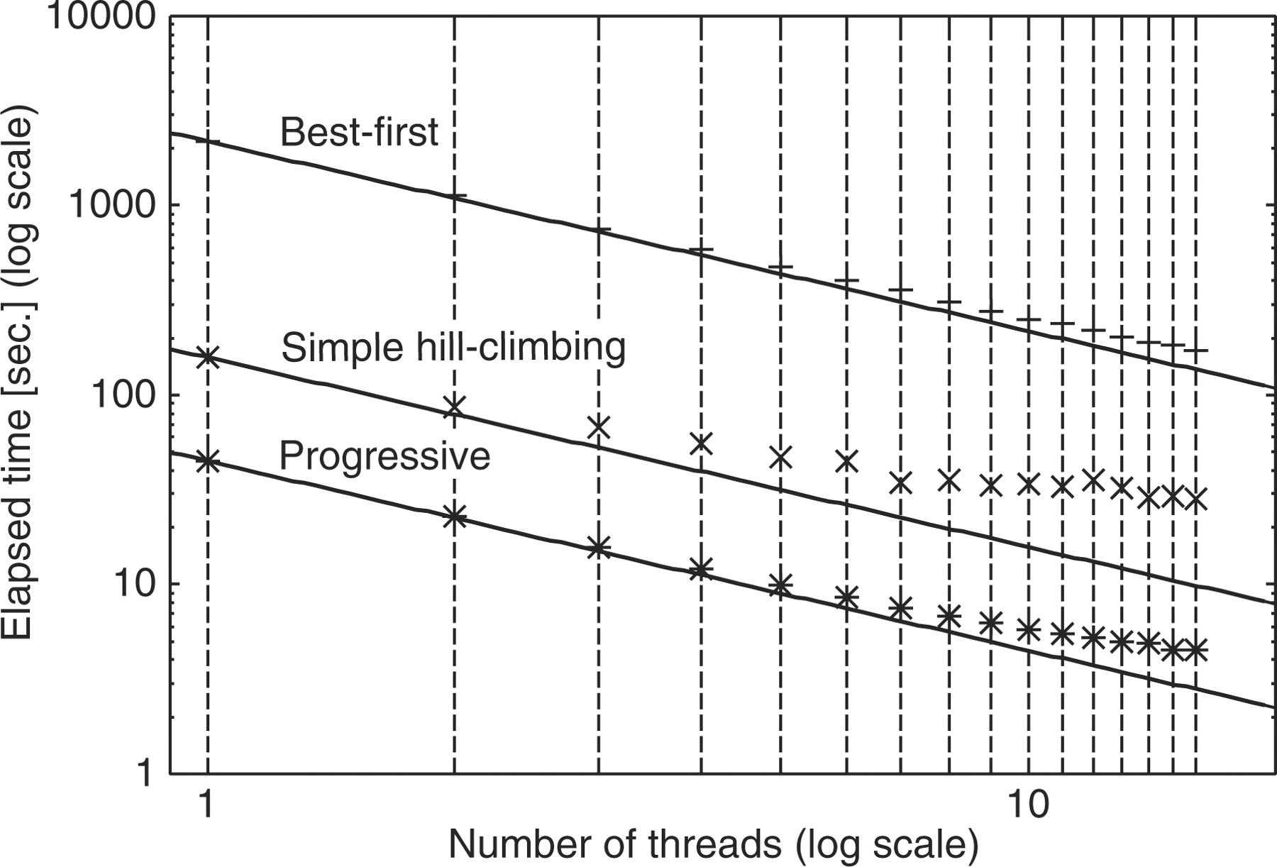
Fig. 1. Efficiency of parallelization for an iterative refinement option (L-INS-i) with two parallelization ...
Notes:
Fig. 1. Efficiency of parallelization for an iterative refinement option (L-INS-i) with two parallelization strategies (best-first and simple hill-climbing) and a progressive option (L-INS-1). Lines correspond to the ideal situation where (Elapsed time with n threads) = (Elapsed time with single thread) / n. The command-line arguments are: Best-first, mafft-linsi --bestfirst --thread n input Simple hill-climbing, mafft-linsi --thread n input Progressive, mafft-linsi --maxiterate 0 --thread n input
Unless provided in the caption above, the following copyright applies to the content of this slide: © The Author(s) 2010. Published by Oxford University Press.This is an Open Access article distributed under the terms of the Creative Commons Attribution Non-Commercial License (http://creativecommons.org/licenses/by-nc/2.5), which permits unrestricted non-commercial use, distribution, and reproduction in any medium, provided the original work is properly cited.

