Slide 1
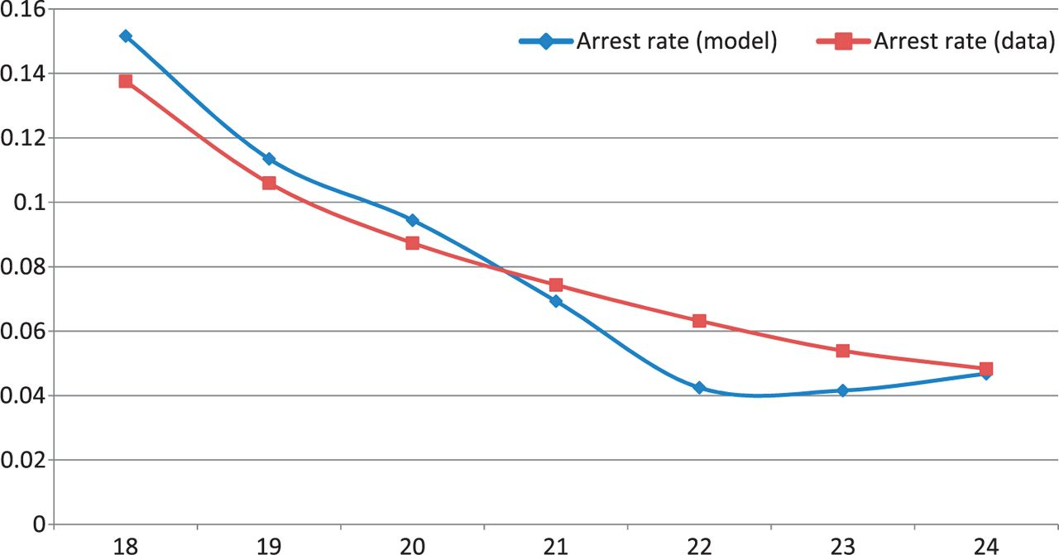
Figure 1 Yearly arrest rates for ages 18-25 in data and model.
Notes:
Figure 1 Yearly arrest rates for ages 18-25 in data and model.
Unless provided in the caption above, the following copyright applies to the content of this slide: © The Author 2014. Published by Oxford University Press on behalf of The Review of Economic Studies Limited.

Slide 2
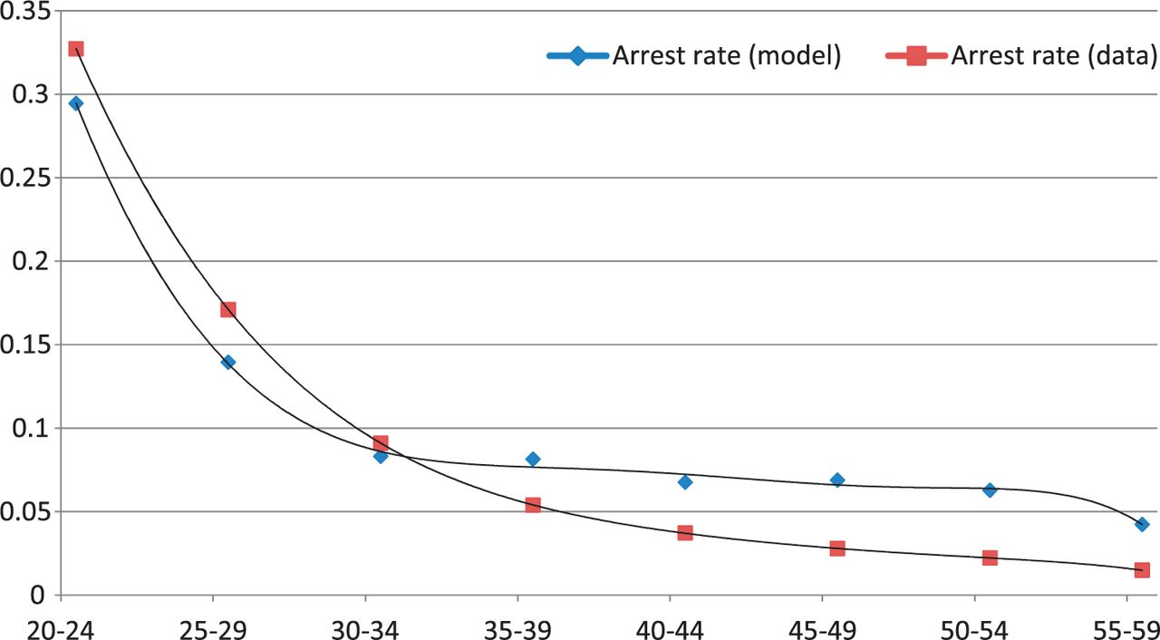
Figure 2 Five-year arrest rates for ages 20-55 in data and model.
Notes:
Figure 2 Five-year arrest rates for ages 20-55 in data and model.
Unless provided in the caption above, the following copyright applies to the content of this slide: © The Author 2014. Published by Oxford University Press on behalf of The Review of Economic Studies Limited.

