Slide 1
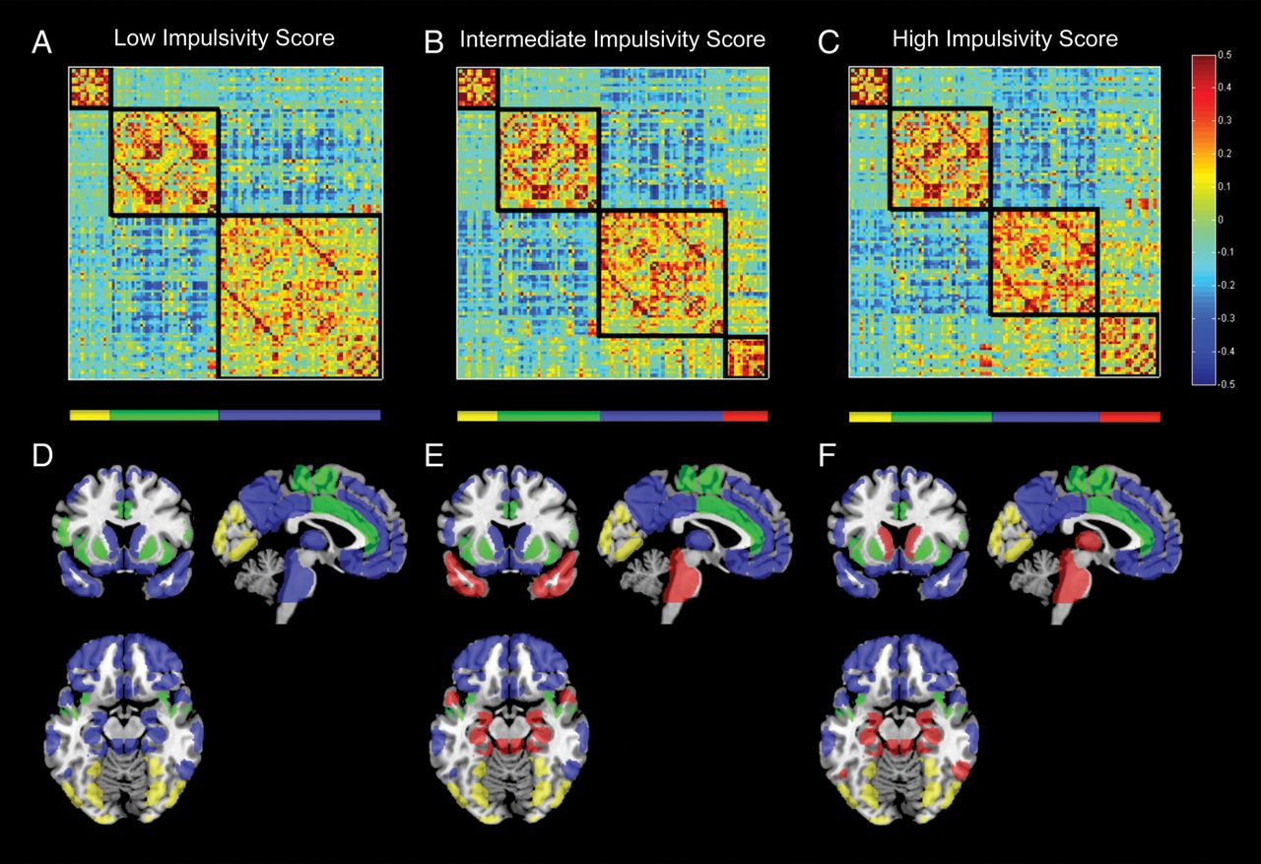
Figure 1. Matrix of inter-regional FC averaged over participants with the bottom 10% (A), middle 10% (B), and top 10% ...
Notes:
Figure 1. Matrix of inter-regional FC averaged over participants with the bottom 10% (A), middle 10% (B), and top 10% (C) of latent impulsivity scores (i.e. low, intermediate, and high impulsivity groups) and displayed for the HOA ROIs used in all analyses. Rows and columns correspond to 111 cortical and subcortical regions, partitioned according to the maximal modularity score and arranged so as to match the ordering of regions given in Supplementary Table S3. Red entries refer to positive FC and blue entries refer to negative FC (see scale to the right). Additionally, the HOA ROIs are overlaid on a template brain using MRIcron and color-coded by the corresponding module partition for the low (D), intermediate (E), and high (F) impulsivity groups: yellow = Module 1, green = Module 2, blue = Module 3, and red = Module 4.
Unless provided in the caption above, the following copyright applies to the content of this slide: © The Author 2012. Published by Oxford University Press. All rights reserved. For Permissions, please e-mail: journals.permissions@oup.com

Slide 2
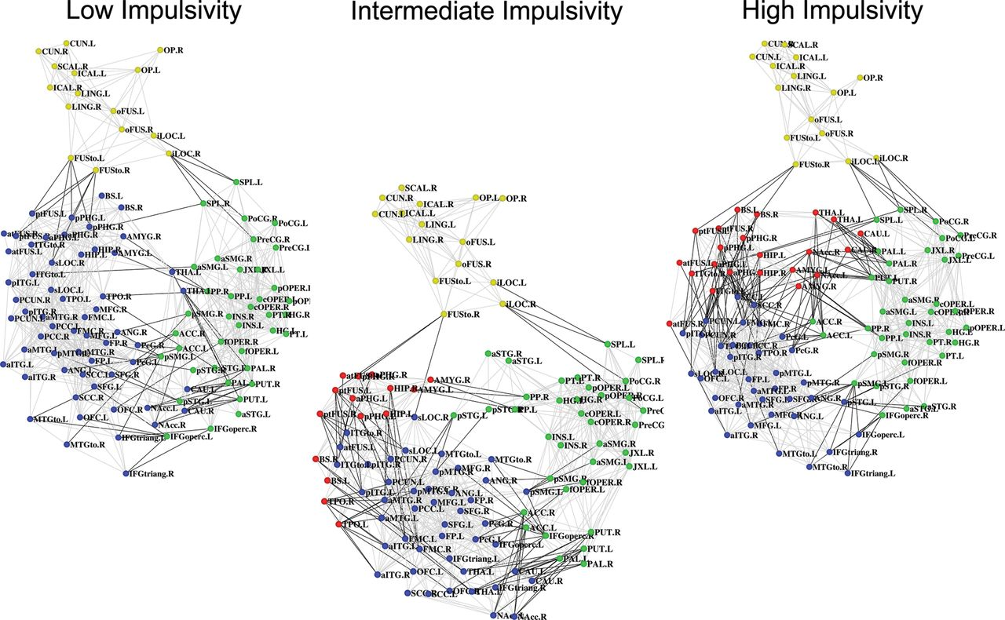
Figure 2. Backbone plots visualizing the inter-regional FC for the low, intermediate, and high impulsivity groups. The ...
Notes:
Figure 2. Backbone plots visualizing the inter-regional FC for the low, intermediate, and high impulsivity groups. The connectivity backbone is derived in 2 steps (Hidalgo et al. 2007). First, we extracted within-module maximum spanning trees connecting all the nodes in each module such that connection weights are maximal. Secondly, connections across the whole network were added in order of their weight until a desired average node degree k (here, k = 14) was reached. The resulting connectivity backbone was then laid out in 2 dimensions using the Kamada–Kawai spring embedding algorithm (Kamada and Kawai 1989). Nodes are colored according to their module assignment: yellow = Module 1, green = Module 2, blue = Module 3, and red = Module 4. See Supplementary Table S4 for ROI abbreviations.
Unless provided in the caption above, the following copyright applies to the content of this slide: © The Author 2012. Published by Oxford University Press. All rights reserved. For Permissions, please e-mail: journals.permissions@oup.com

Slide 3
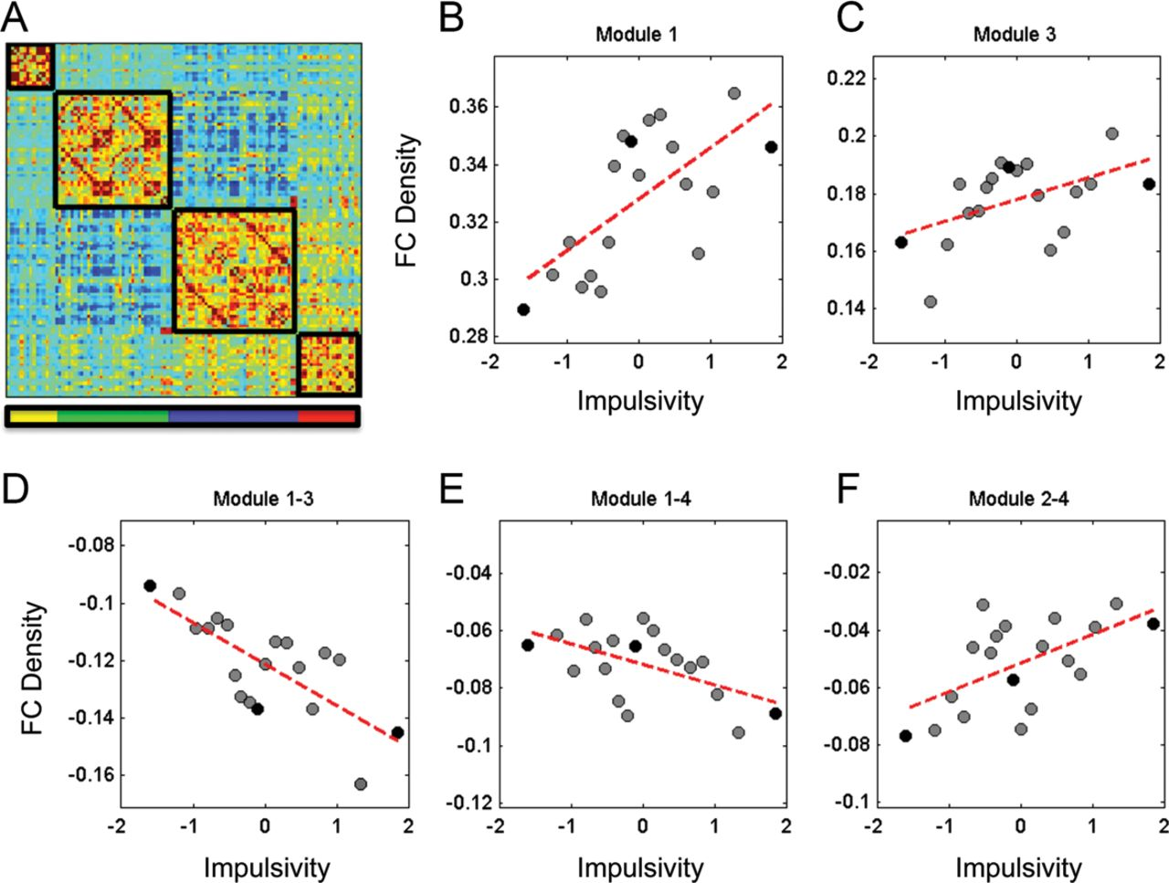
Figure 3. (A) Group average matrix of inter-regional FC with module partitions reflecting those used in the sliding ...
Notes:
Figure 3. (A) Group average matrix of inter-regional FC with module partitions reflecting those used in the sliding window analysis. (B–F) Scatterplots depicting FC density as a function of impulsivity (z-score). Circles represent average FC density and impulsivity obtained from 20 subject windows of participants ordered along the impulsivity scale (windows overlap by 10 subjects, resulting in 19 group samples across the spectrum of 200 subjects). Black circles represent the low, medium, and high impulsivity groups.
Unless provided in the caption above, the following copyright applies to the content of this slide: © The Author 2012. Published by Oxford University Press. All rights reserved. For Permissions, please e-mail: journals.permissions@oup.com

