Slide 1
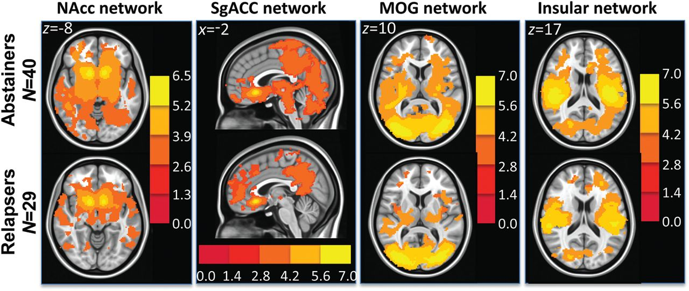
Figure 1. t-Maps showing within group t-test results in abstainers (top row) and relapsers (bottom row) in the NAcc ...
Notes:
Figure 1. t-Maps showing within group t-test results in abstainers (top row) and relapsers (bottom row) in the NAcc (reward), sgACC (executive control), middle occipital gyrus (MOG) (visual), and insular networks.
Unless provided in the caption above, the following copyright applies to the content of this slide: © The Author 2012. Published by Oxford University Press. All rights reserved. For Permissions, please e-mail: journals.permissions@oup.com

Slide 2
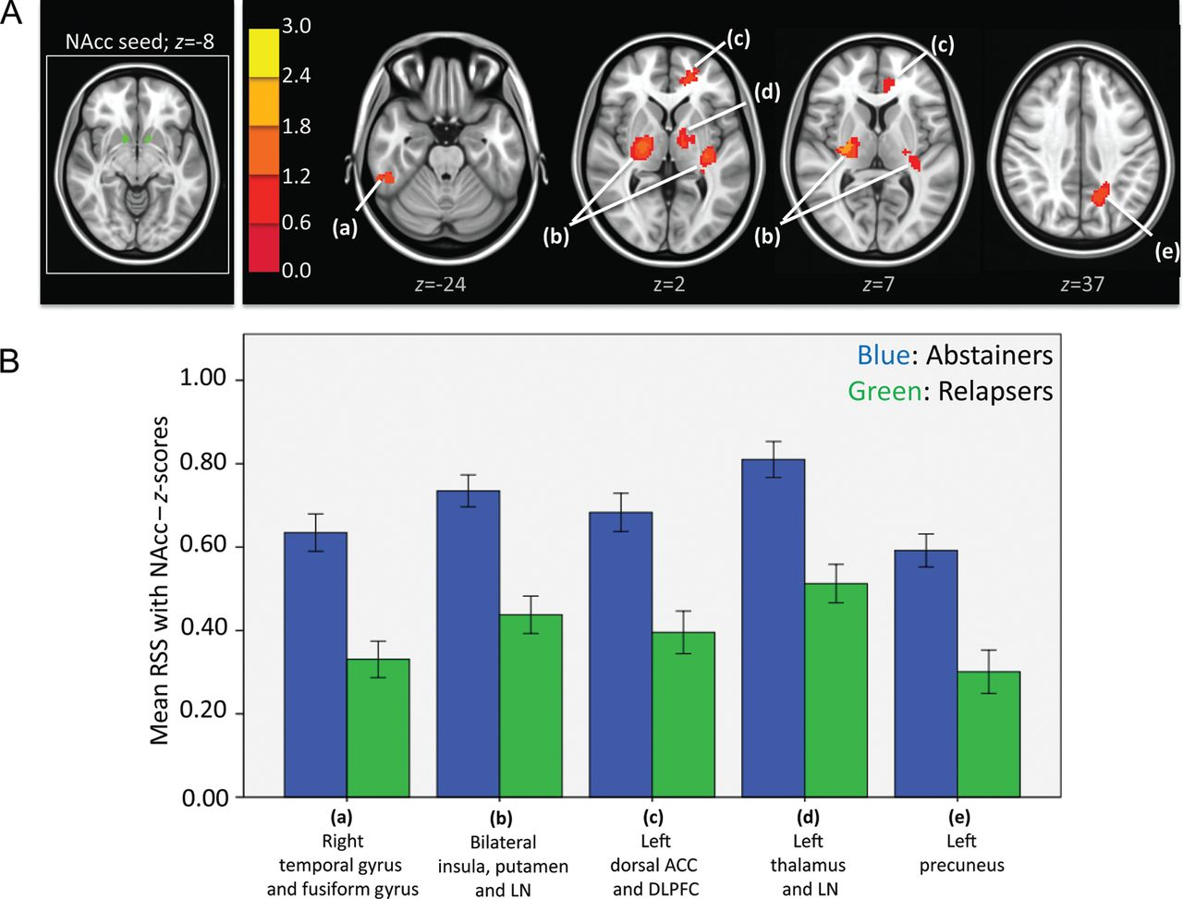
Figure 2. (A) Left: NAcc seeds in green. Right: Resulting t-map showing regions in which abstainers had significantly ...
Notes:
Figure 2. (A) Left: NAcc seeds in green. Right: Resulting t-map showing regions in which abstainers had significantly higher strength of RSS than relapsers within the nucleus accumbens network. t-Map is overlaid on a MNI brain in radiological orientation (right is left). (B) Bar graphs (with ±1 standard error bars) showing strength of RSS between subgenual ACC and regions with significant differences between abstainers (blue bars) and relapsers (green bars). ANCOVA analysis showed that differences in all regions showed were still significant after controlling for noise (see F and Sig. values in Table 6A). RSS, resting-state synchrony; NAcc, nucleus accumbens; LN, lentiform nucleus; ACC, anterior cingulate cortex; DLPFC, dorsolateral prefrontal cortex.
Unless provided in the caption above, the following copyright applies to the content of this slide: © The Author 2012. Published by Oxford University Press. All rights reserved. For Permissions, please e-mail: journals.permissions@oup.com

Slide 3
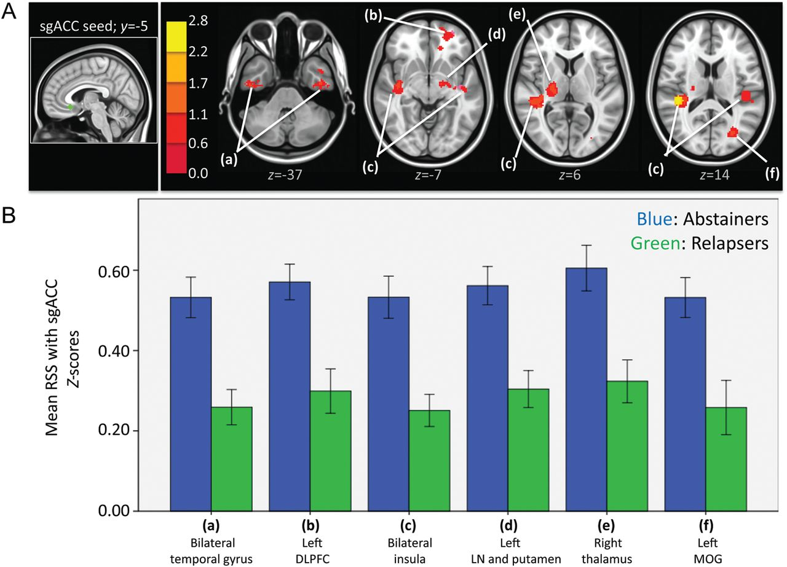
Figure 3. (A) Left: sgACC seed in green. Right: Resulting t-map showing regions in which abstainers had significantly ...
Notes:
Figure 3. (A) Left: sgACC seed in green. Right: Resulting t-map showing regions in which abstainers had significantly higher strength of RSS than relapsers within the sgACC network. t-Map is overlaid on a MNI brain in radiological orientation (right is left). (B) Bar graphs (with ±1 standard error bars) showing strength of RSS between sgACC and regions with significant differences between abstainers (blue bars) and relapsers (green bars). ANCOVA analysis showed that differences in all regions showed were still significant after controlling for noise (see F and Sig. values in Table 6B). RSS, resting-state synchrony; sgACC, subgenual anterior cingulate cortex; DLPFC, dorsolateral prefrontal cortex; LN, lentiform nucleus; MOG, middle occipital gyrus.
Unless provided in the caption above, the following copyright applies to the content of this slide: © The Author 2012. Published by Oxford University Press. All rights reserved. For Permissions, please e-mail: journals.permissions@oup.com

Slide 4
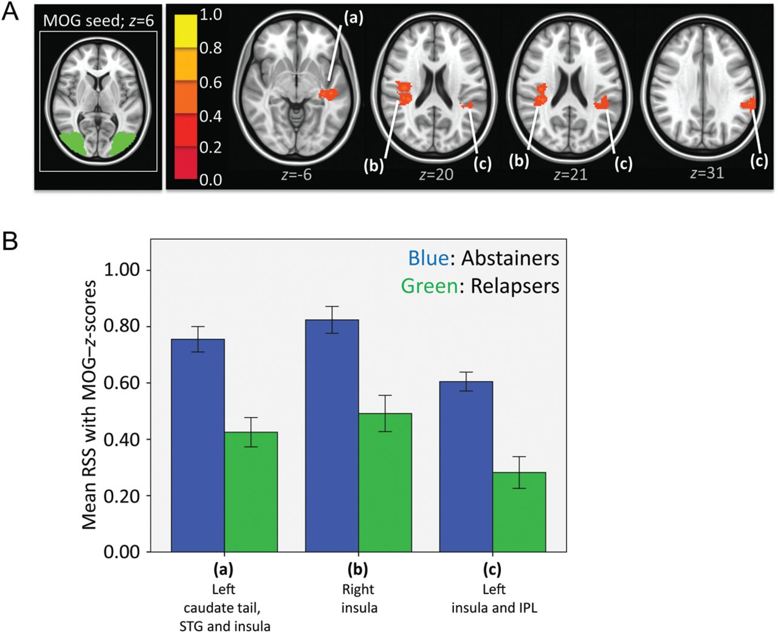
Figure 4. (A) Left: MOG seed in green. Right: Resulting t-map showing regions in which abstainers had significantly ...
Notes:
Figure 4. (A) Left: MOG seed in green. Right: Resulting t-map showing regions in which abstainers had significantly higher strength of RSS than relapsers within the MOG network. t-Map is overlaid on a MNI brain in radiological orientation (right is left). (B) Bar graphs (with ±1 standard error bars) showing strength of RSS between MOG and regions with significant differences between abstainers (blue bars) and relapsers (green bars). ANCOVA analysis showed that differences in all regions showed were still significant after controlling for noise (see F and Sig. values in Table 7A). RSS, resting-state synchrony; MOG, middle occipital gyrus; STG, superior temporal gyrus; IPL, inferior parietal lobule.
Unless provided in the caption above, the following copyright applies to the content of this slide: © The Author 2012. Published by Oxford University Press. All rights reserved. For Permissions, please e-mail: journals.permissions@oup.com

Slide 5
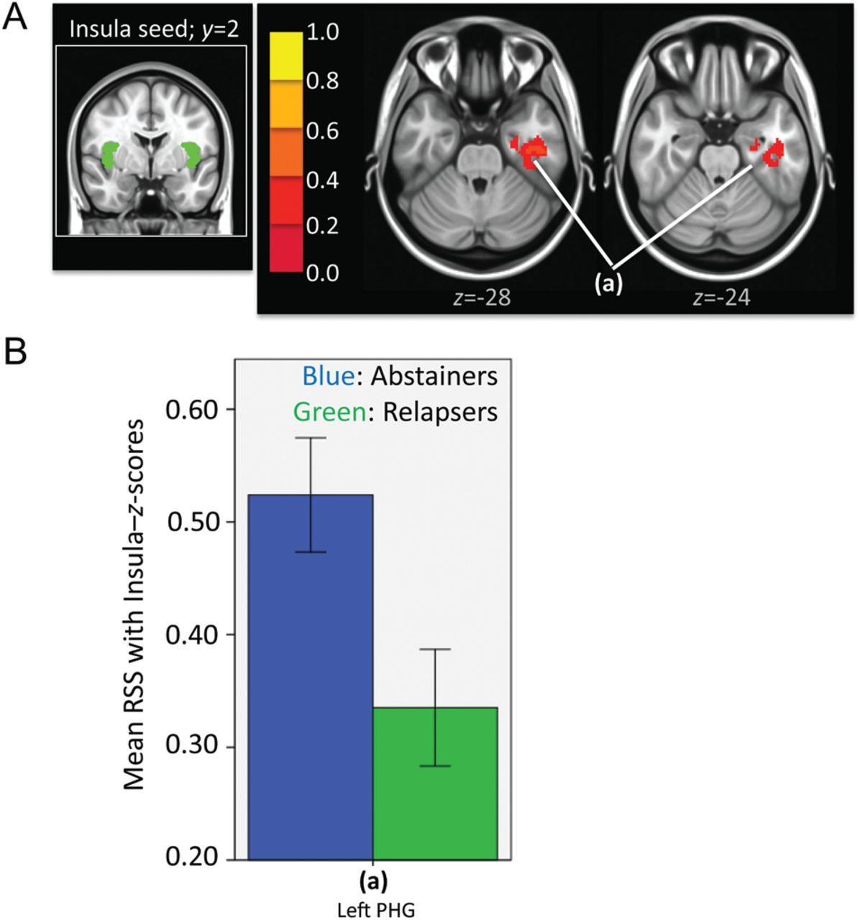
Figure 5. (A) Left: Insula seed in green. Right: Resulting t-map showing regions in which abstainers had significantly ...
Notes:
Figure 5. (A) Left: Insula seed in green. Right: Resulting t-map showing regions in which abstainers had significantly higher strength of RSS than relapsers within the insular network. t-Map is overlaid on a MNI brain in radiological orientation (right is left). (B) Bar graphs (with ±1 standard error bars) showing strength of RSS between insula and regions with significant differences between abstainers (blue bars) and relapsers (green bars). ANCOVA analysis showed that differences did not reach significance after controlling for noise (see F and Sig. values in Table 7B). RSS, resting-state synchrony; PHG, parahippocampal gyrus.
Unless provided in the caption above, the following copyright applies to the content of this slide: © The Author 2012. Published by Oxford University Press. All rights reserved. For Permissions, please e-mail: journals.permissions@oup.com

Slide 6
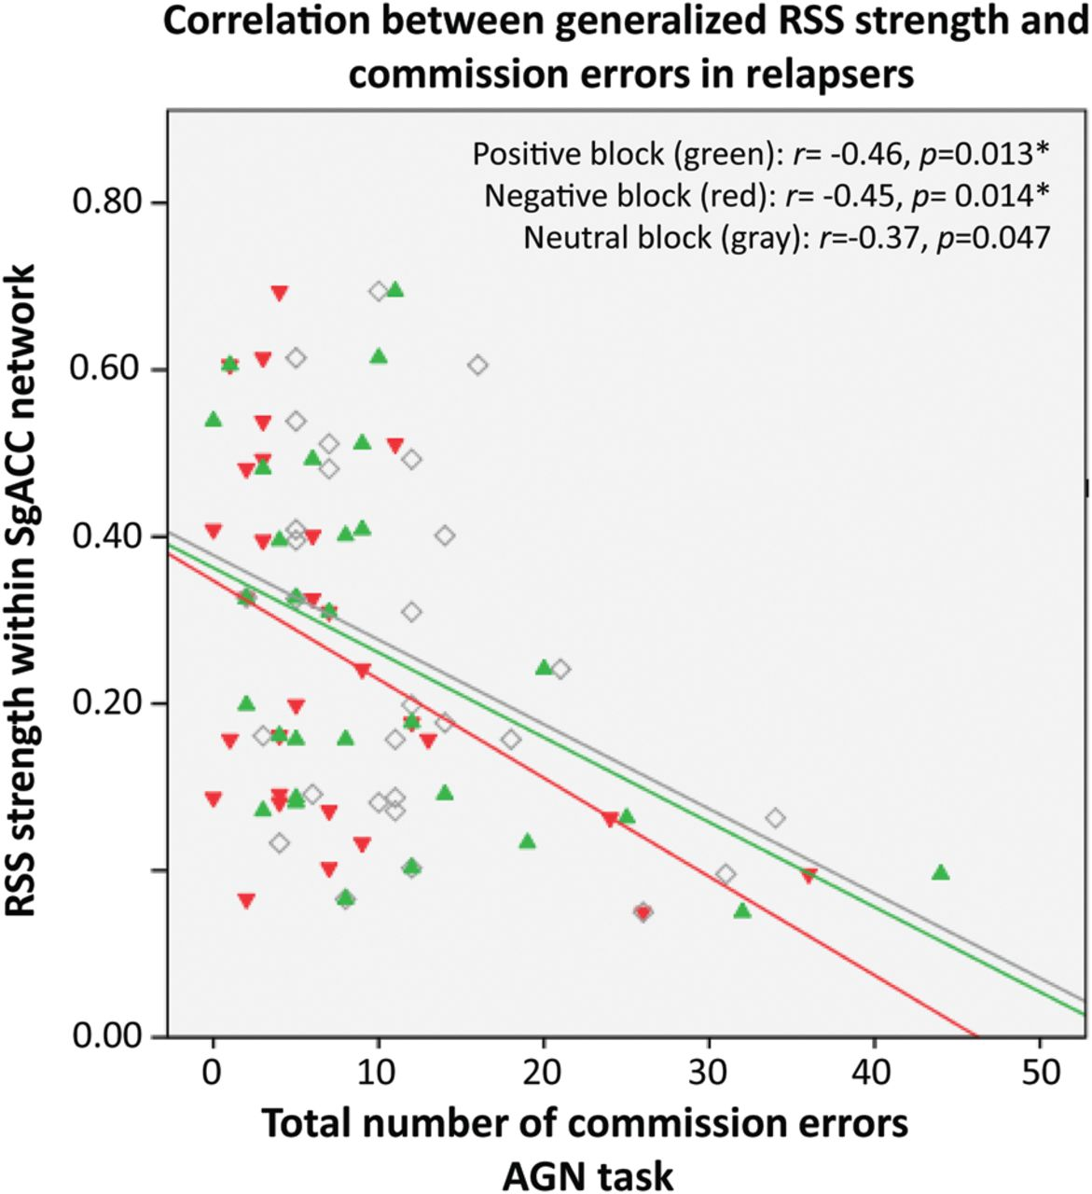
Figure 6. Scatterplot showing correlations between generalized RSS strength and commission errors (response to a ...
Notes:
Figure 6. Scatterplot showing correlations between generalized RSS strength and commission errors (response to a distractor stimulus) during positive (green), negative (red), and neutral (gray) target blocks in relapsers. Each dot is an individual subject. RSS, resting-state synchrony; AGN, affective go/no-go task.
Unless provided in the caption above, the following copyright applies to the content of this slide: © The Author 2012. Published by Oxford University Press. All rights reserved. For Permissions, please e-mail: journals.permissions@oup.com

Slide 7
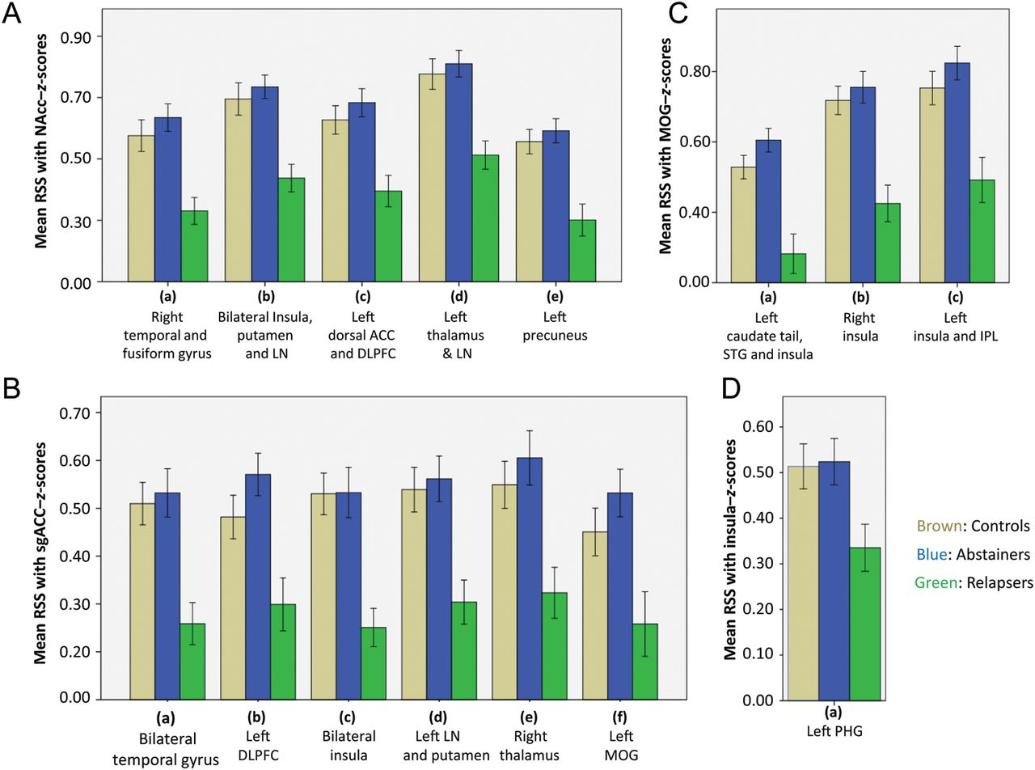
Figure 7. Bar graphs showing mean RSS for NSAC (brown), abstainers (blue), and relapsers (green) in specific clusters ...
Notes:
Figure 7. Bar graphs showing mean RSS for NSAC (brown), abstainers (blue), and relapsers (green) in specific clusters within the (A) NAcc, (B) sgACC, (C) visual, and (D) insular networks shown in Tables 6 and 7. ANOVA results showed that relapsers were significantly different from both abstainers and NSAC. Abstainers were only significantly different from relapsers. NSAC, non-substance abuse controls.
Unless provided in the caption above, the following copyright applies to the content of this slide: © The Author 2012. Published by Oxford University Press. All rights reserved. For Permissions, please e-mail: journals.permissions@oup.com

