Slide 1
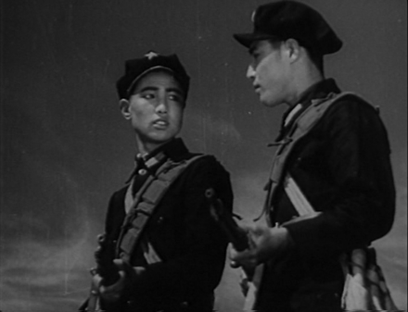
Figure 1 The White-Haired Girl: Revolutionary soldiers.
Notes:
Figure 1 The White-Haired Girl: Revolutionary soldiers.
Unless provided in the caption above, the following copyright applies to the content of this slide: © The Author 2010. Published by Oxford University Press. All rights reserved.For permissions, please e-mail: journals.permissions@oxfordjournals.org

Slide 2
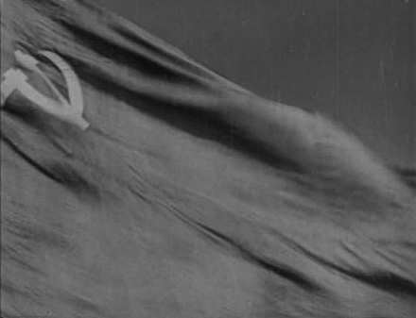
Figure 2 The White-Haired Girl: Extradiegetic Communist flag.
Notes:
Figure 2 The White-Haired Girl: Extradiegetic Communist flag.
Unless provided in the caption above, the following copyright applies to the content of this slide: © The Author 2010. Published by Oxford University Press. All rights reserved.For permissions, please e-mail: journals.permissions@oxfordjournals.org

Slide 3
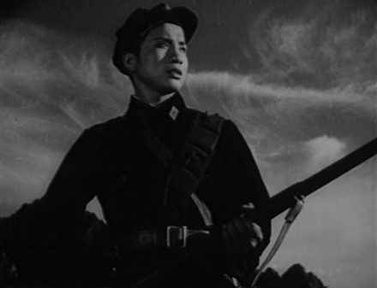
Figure 3 The White-Haired Girl: Wang Dachun empowered with the socialist realist gaze.
Notes:
Figure 3 The White-Haired Girl: Wang Dachun empowered with the socialist realist gaze.
Unless provided in the caption above, the following copyright applies to the content of this slide: © The Author 2010. Published by Oxford University Press. All rights reserved.For permissions, please e-mail: journals.permissions@oxfordjournals.org

Slide 4
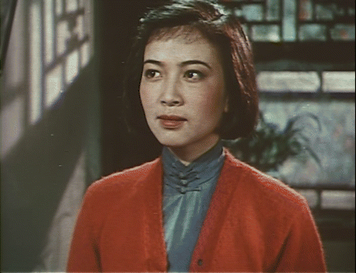
Figure 4 The Song of Youth: Lin Daojing looks offscreen.
Notes:
Figure 4 The Song of Youth: Lin Daojing looks offscreen.
Unless provided in the caption above, the following copyright applies to the content of this slide: © The Author 2010. Published by Oxford University Press. All rights reserved.For permissions, please e-mail: journals.permissions@oxfordjournals.org

Slide 5
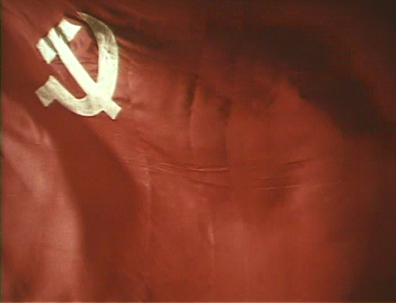
Figure 5 The Song of Youth: Cut to semi-diegetic flag.
Notes:
Figure 5 The Song of Youth: Cut to semi-diegetic flag.
Unless provided in the caption above, the following copyright applies to the content of this slide: © The Author 2010. Published by Oxford University Press. All rights reserved.For permissions, please e-mail: journals.permissions@oxfordjournals.org

Slide 6
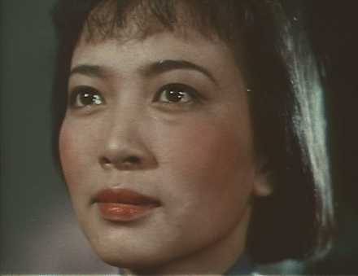
Figure 6 The Song of Youth: Close-up of Lin Daojing's socialist realist gaze.
Notes:
Figure 6 The Song of Youth: Close-up of Lin Daojing's socialist realist gaze.
Unless provided in the caption above, the following copyright applies to the content of this slide: © The Author 2010. Published by Oxford University Press. All rights reserved.For permissions, please e-mail: journals.permissions@oxfordjournals.org

Slide 7
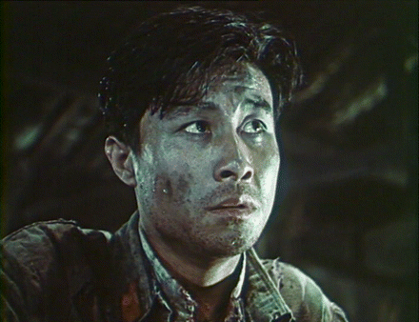
Figure 7 Red Detachment of Women: Hong Changqing at beginning of confession scene.
Notes:
Figure 7 Red Detachment of Women: Hong Changqing at beginning of confession scene.
Unless provided in the caption above, the following copyright applies to the content of this slide: © The Author 2010. Published by Oxford University Press. All rights reserved.For permissions, please e-mail: journals.permissions@oxfordjournals.org

Slide 8
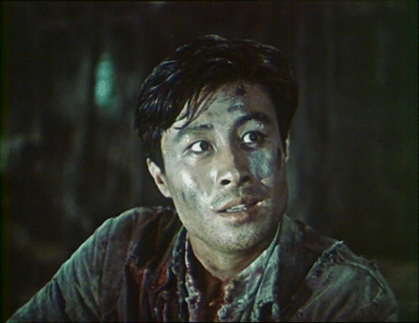
Figure 8 Red Detachment of Women: Hong Changqing reading Communist graffiti.
Notes:
Figure 8 Red Detachment of Women: Hong Changqing reading Communist graffiti.
Unless provided in the caption above, the following copyright applies to the content of this slide: © The Author 2010. Published by Oxford University Press. All rights reserved.For permissions, please e-mail: journals.permissions@oxfordjournals.org

Slide 9
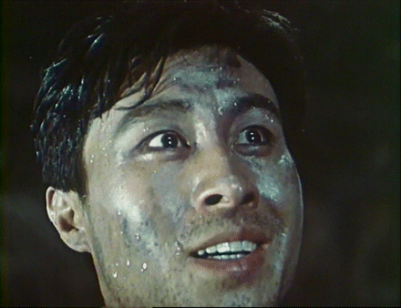
Figure 9 Red Detachment of Women: Dawning ideological realization.
Notes:
Figure 9 Red Detachment of Women: Dawning ideological realization.
Unless provided in the caption above, the following copyright applies to the content of this slide: © The Author 2010. Published by Oxford University Press. All rights reserved.For permissions, please e-mail: journals.permissions@oxfordjournals.org

Slide 10
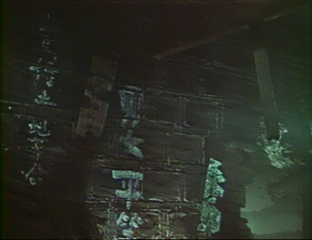
Figure 10 Red Detachment of Women: Graffiti reading “gender equality.”
Notes:
Figure 10 Red Detachment of Women: Graffiti reading “gender equality.”
Unless provided in the caption above, the following copyright applies to the content of this slide: © The Author 2010. Published by Oxford University Press. All rights reserved.For permissions, please e-mail: journals.permissions@oxfordjournals.org

Slide 11
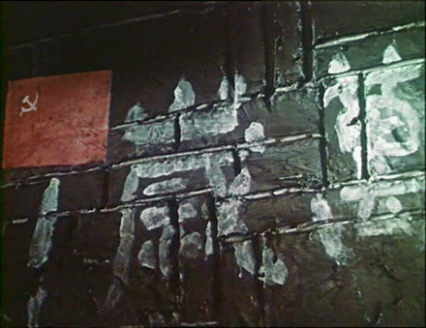
Figure 11 Red Detachment of Women: Small flag next to “Long live the Communist Party!” graffiti.
Notes:
Figure 11 Red Detachment of Women: Small flag next to “Long live the Communist Party!” graffiti.
Unless provided in the caption above, the following copyright applies to the content of this slide: © The Author 2010. Published by Oxford University Press. All rights reserved.For permissions, please e-mail: journals.permissions@oxfordjournals.org

Slide 12
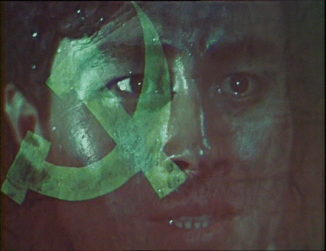
Figure 12 Red Detachment of Women: flag superimposed on extreme close-up of Hong Changqing.
Notes:
Figure 12 Red Detachment of Women: flag superimposed on extreme close-up of Hong Changqing.
Unless provided in the caption above, the following copyright applies to the content of this slide: © The Author 2010. Published by Oxford University Press. All rights reserved.For permissions, please e-mail: journals.permissions@oxfordjournals.org

Slide 13
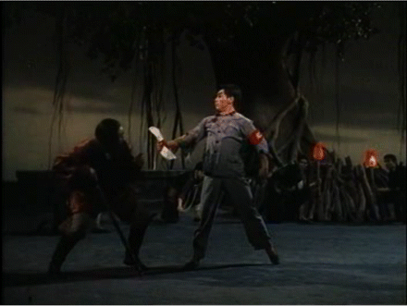
Figure 13 Red Detachment of Women, ballet: Confession scene.
Notes:
Figure 13 Red Detachment of Women, ballet: Confession scene.
Unless provided in the caption above, the following copyright applies to the content of this slide: © The Author 2010. Published by Oxford University Press. All rights reserved.For permissions, please e-mail: journals.permissions@oxfordjournals.org

Slide 14
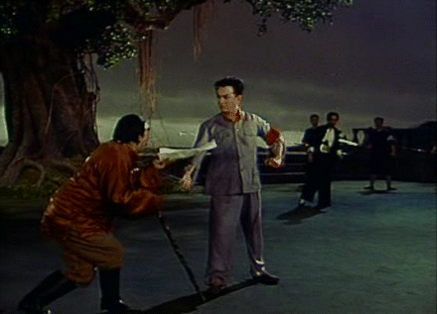
Figure 14 Red Detachment of Women, opera: Confession scene.
Notes:
Figure 14 Red Detachment of Women, opera: Confession scene.
Unless provided in the caption above, the following copyright applies to the content of this slide: © The Author 2010. Published by Oxford University Press. All rights reserved.For permissions, please e-mail: journals.permissions@oxfordjournals.org

Slide 15
Figure 15 Red Detachment of Women, ballet: Execution scene.
Notes:
Figure 15 Red Detachment of Women, ballet: Execution scene.
Unless provided in the caption above, the following copyright applies to the content of this slide: © The Author 2010. Published by Oxford University Press. All rights reserved.For permissions, please e-mail: journals.permissions@oxfordjournals.org

Slide 16
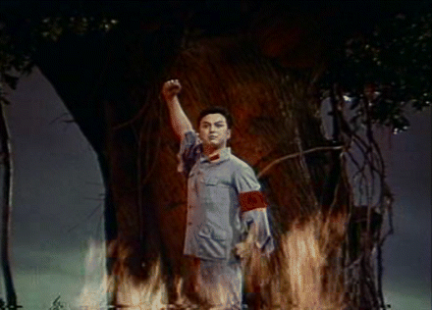
Figure 16 Red Detachment of Women, opera: Execution scene.
Notes:
Figure 16 Red Detachment of Women, opera: Execution scene.
Unless provided in the caption above, the following copyright applies to the content of this slide: © The Author 2010. Published by Oxford University Press. All rights reserved.For permissions, please e-mail: journals.permissions@oxfordjournals.org

Slide 17
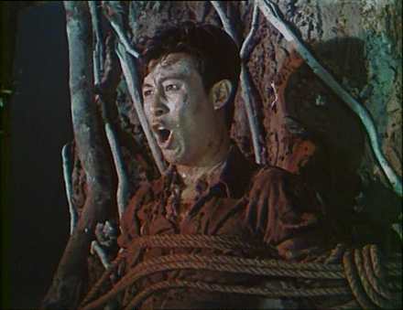
Figure 17 Red Detachment of Women, narrative film: Execution scene.
Notes:
Figure 17 Red Detachment of Women, narrative film: Execution scene.
Unless provided in the caption above, the following copyright applies to the content of this slide: © The Author 2010. Published by Oxford University Press. All rights reserved.For permissions, please e-mail: journals.permissions@oxfordjournals.org

Slide 18
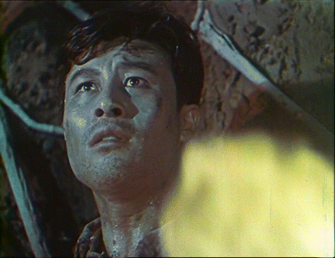
Figure 18 Red Detachment of Women, narrative film: Hong Changqing engulfed by flames.
Notes:
Figure 18 Red Detachment of Women, narrative film: Hong Changqing engulfed by flames.
Unless provided in the caption above, the following copyright applies to the content of this slide: © The Author 2010. Published by Oxford University Press. All rights reserved.For permissions, please e-mail: journals.permissions@oxfordjournals.org

Slide 19
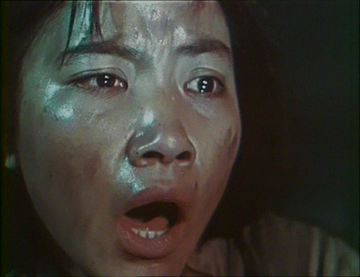
Figure 19 Red Detachment of Women, narrative film: Wu Qionghua reaction shot.
Notes:
Figure 19 Red Detachment of Women, narrative film: Wu Qionghua reaction shot.
Unless provided in the caption above, the following copyright applies to the content of this slide: © The Author 2010. Published by Oxford University Press. All rights reserved.For permissions, please e-mail: journals.permissions@oxfordjournals.org

Slide 20
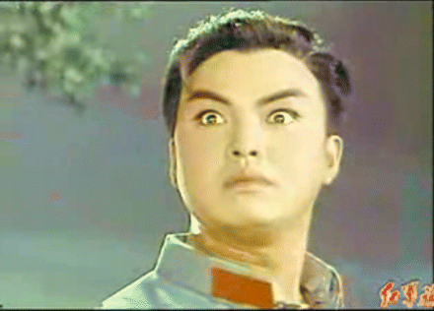
Figure 20 Red Detachment of Women, opera: The socialist realist gaze as liangxiang.
Notes:
Figure 20 Red Detachment of Women, opera: The socialist realist gaze as liangxiang.
Unless provided in the caption above, the following copyright applies to the content of this slide: © The Author 2010. Published by Oxford University Press. All rights reserved.For permissions, please e-mail: journals.permissions@oxfordjournals.org

