Slide 1
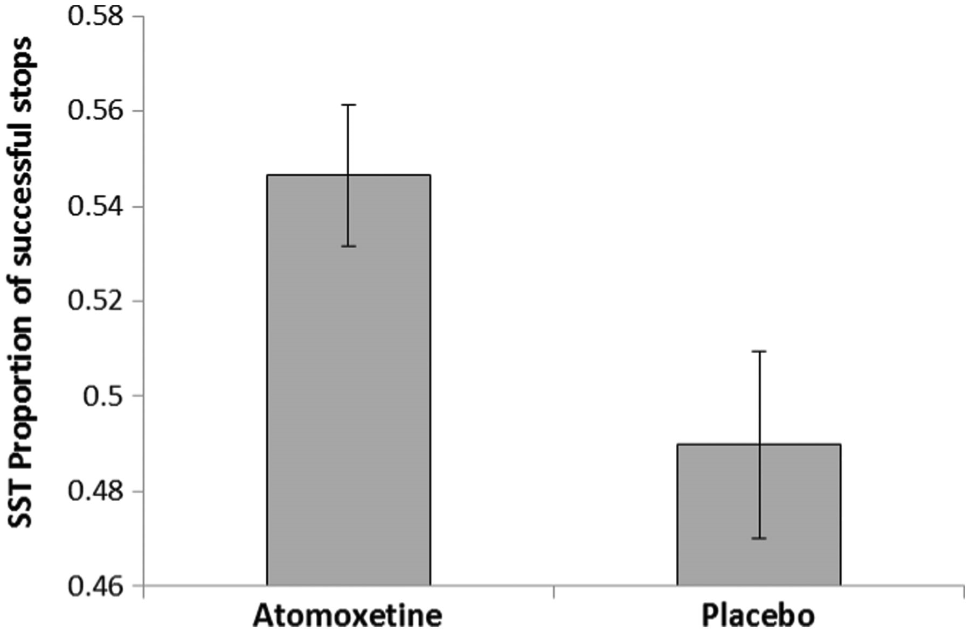
Figure 1 Effect of atomoxetine on the Stop Signal Task (SST). Patients tested on atomoxetine exhibited a greater ...
Notes:
Figure 1 Effect of atomoxetine on the Stop Signal Task (SST). Patients tested on atomoxetine exhibited a greater proportion of successfully inhibited responses. Error bars represent standard errors.
Unless provided in the caption above, the following copyright applies to the content of this slide: © The Author (2014). Published by Oxford University Press on behalf of the Guarantors of Brain.This is an Open Access article distributed under the terms of the Creative Commons Attribution License (http://creativecommons.org/licenses/by/3.0/), which permits unrestricted reuse, distribution, and reproduction in any medium, provided the original work is properly cited.

Slide 2
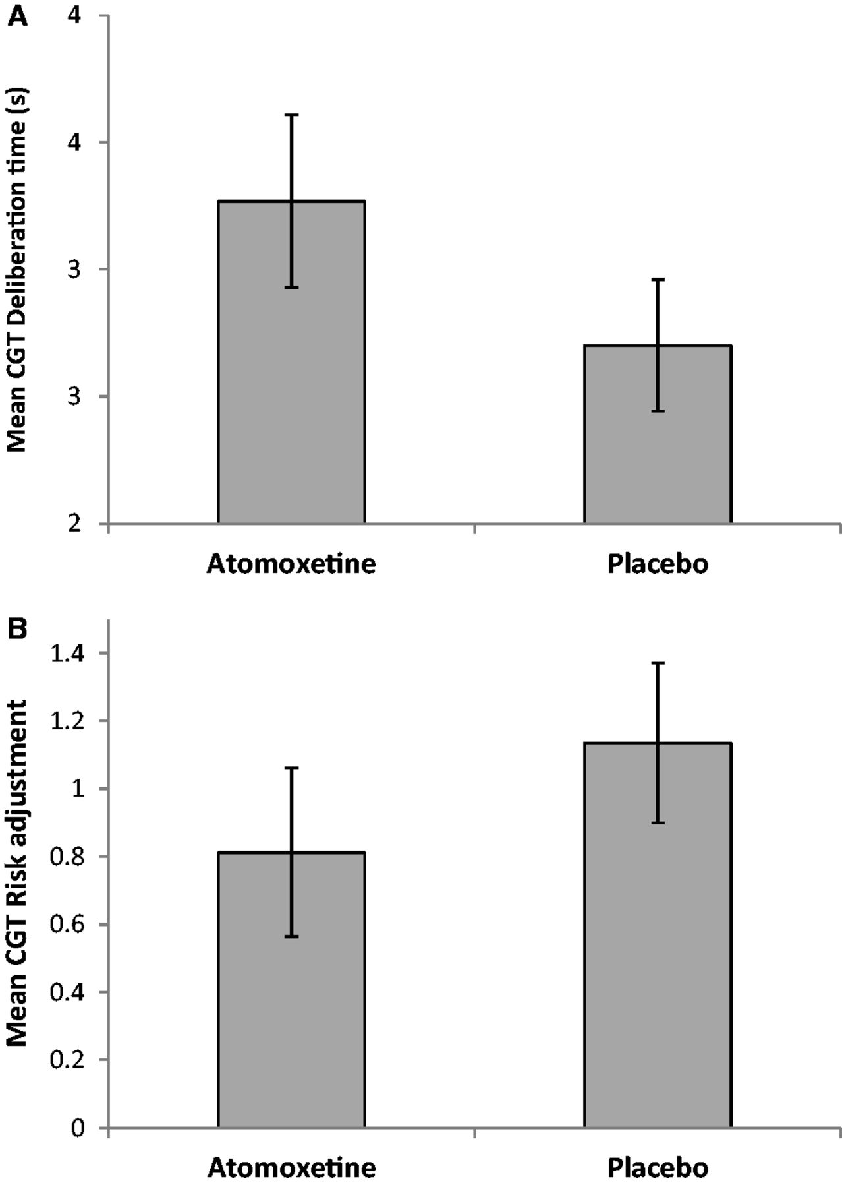
Figure 2 Effects of atomoxetine on the Cambridge Gamble Task. Atomoxetine reduced impulsivity when it was administered ...
Notes:
Figure 2 Effects of atomoxetine on the Cambridge Gamble Task. Atomoxetine reduced impulsivity when it was administered on the first session. Patients receiving atomoxetine exhibited (A) increased deliberation time and (B) more modest increases in betting as the probability of winning increased. Error bars represent standard errors.
Unless provided in the caption above, the following copyright applies to the content of this slide: © The Author (2014). Published by Oxford University Press on behalf of the Guarantors of Brain.This is an Open Access article distributed under the terms of the Creative Commons Attribution License (http://creativecommons.org/licenses/by/3.0/), which permits unrestricted reuse, distribution, and reproduction in any medium, provided the original work is properly cited.

Slide 3
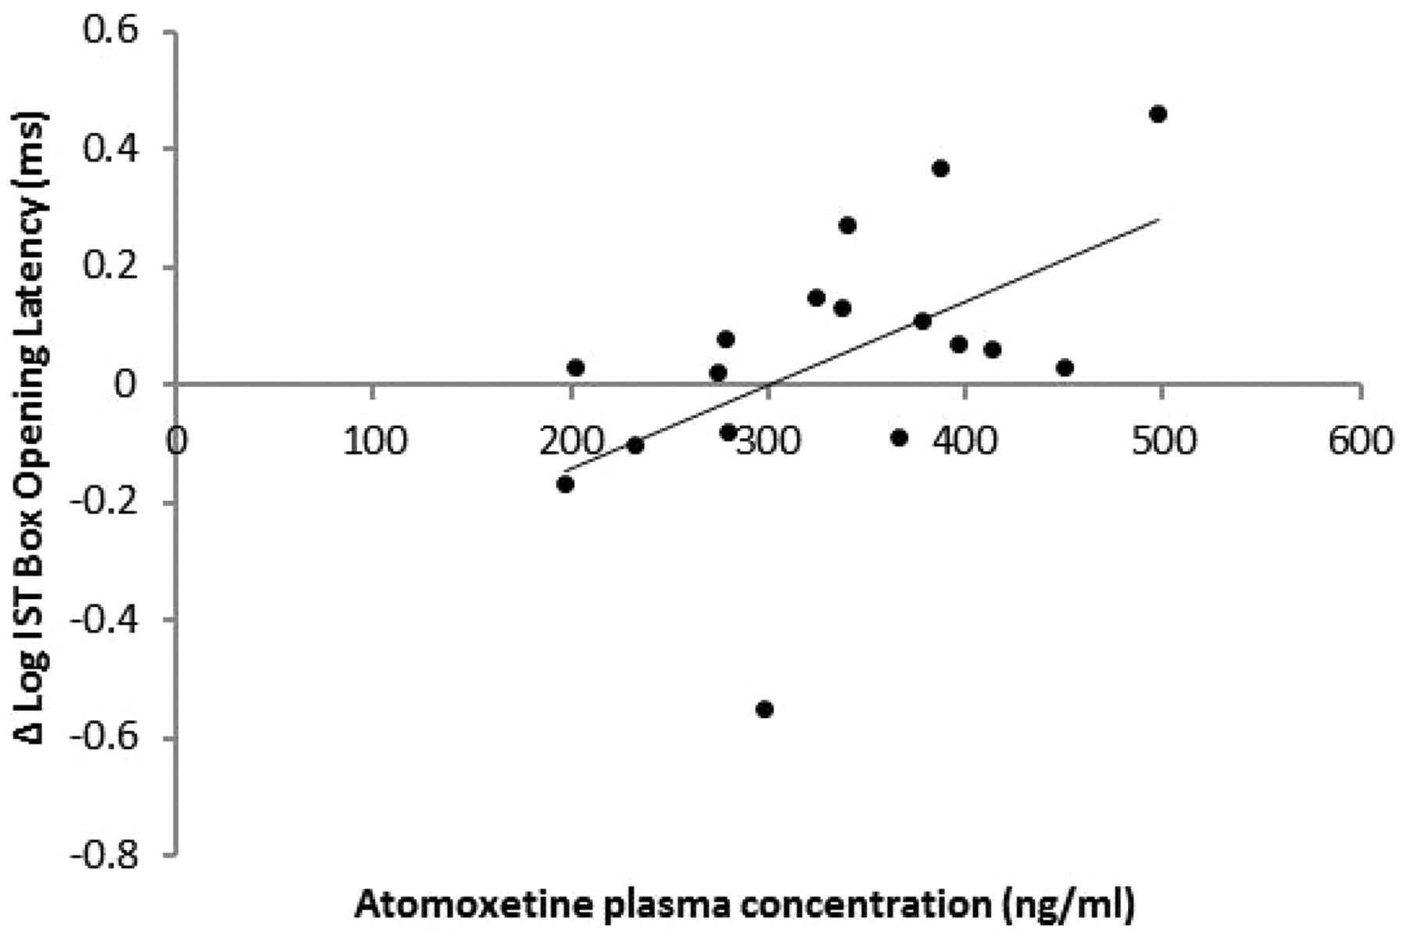
Figure 3 Effect of atomoxetine plasma concentration on mean box opening latency in the fixed win condition of the ...
Notes:
Figure 3 Effect of atomoxetine plasma concentration on mean box opening latency in the fixed win condition of the Information Sampling Task (IST). Plasma atomoxetine levels predicted increases in box opening latency when patients were tested on drug compared to placebo.
Unless provided in the caption above, the following copyright applies to the content of this slide: © The Author (2014). Published by Oxford University Press on behalf of the Guarantors of Brain.This is an Open Access article distributed under the terms of the Creative Commons Attribution License (http://creativecommons.org/licenses/by/3.0/), which permits unrestricted reuse, distribution, and reproduction in any medium, provided the original work is properly cited.

Slide 4
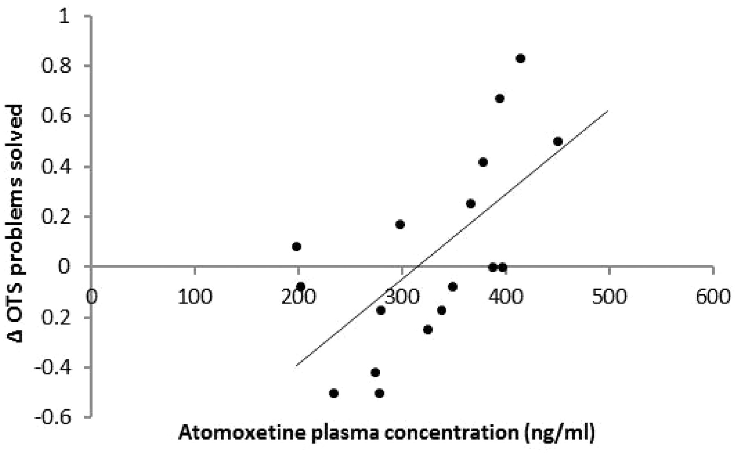
Figure 4 Performance on the One-Touch Stockings (OTS) of Cambridge. Atomoxetine plasma concentration predicted ...
Notes:
Figure 4 Performance on the One-Touch Stockings (OTS) of Cambridge. Atomoxetine plasma concentration predicted superior problem solving.
Unless provided in the caption above, the following copyright applies to the content of this slide: © The Author (2014). Published by Oxford University Press on behalf of the Guarantors of Brain.This is an Open Access article distributed under the terms of the Creative Commons Attribution License (http://creativecommons.org/licenses/by/3.0/), which permits unrestricted reuse, distribution, and reproduction in any medium, provided the original work is properly cited.

