Slide 1
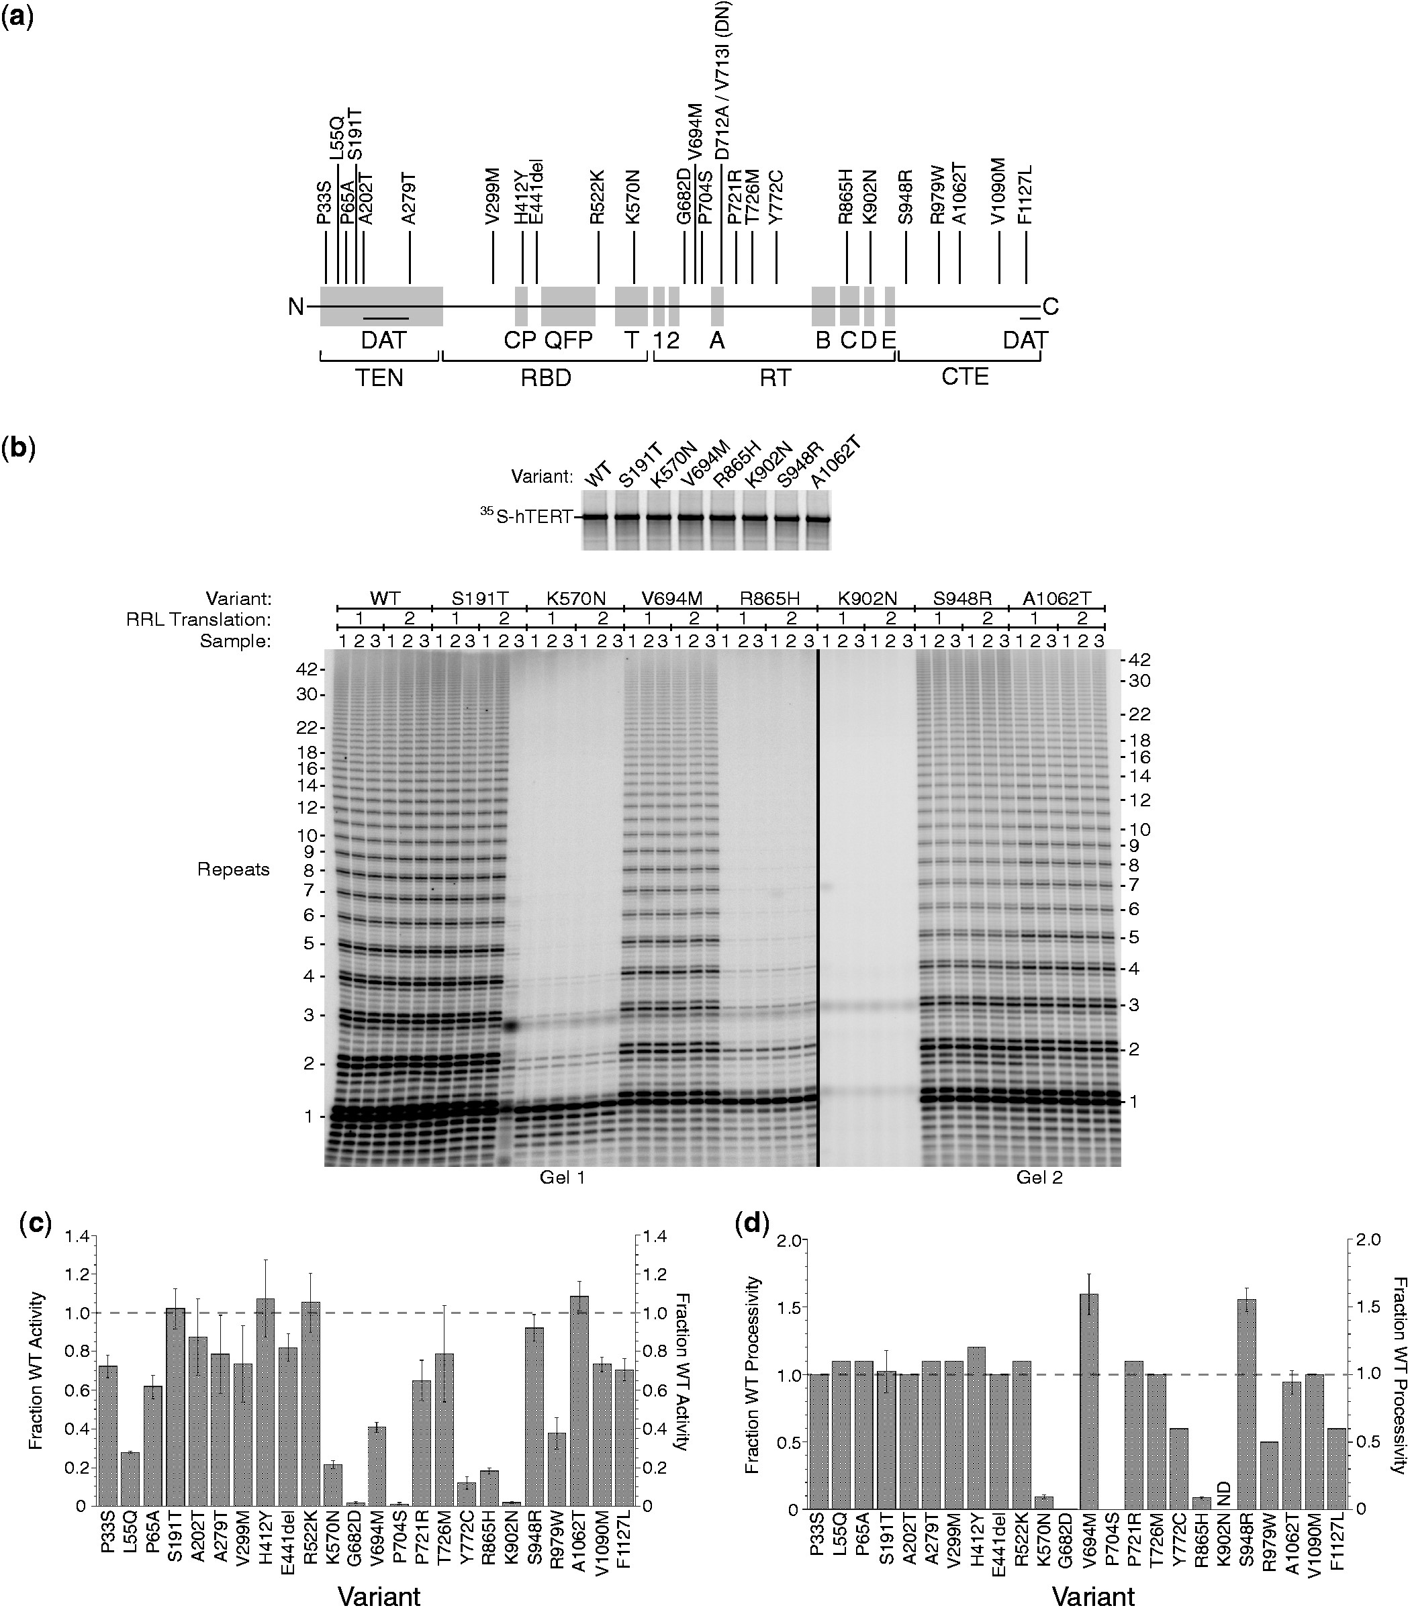
Figure 1. Disease-associated mutations in hTERT have wide-ranging effects on telomerase activity in the RRL assay. (a) ...
Notes:
Figure 1. Disease-associated mutations in hTERT have wide-ranging effects on telomerase activity in the RRL assay. (a) Map of the hTERT protein showing location of disease-associated alleles studied here. Directly below, amino acid sequence motifs; DAT, mutations in these regions dissociate the in vivo and in vitro activities of telomerase. TEN, RBD, RT and CTE, protein structural domains. (b) Expression of variant hTERT proteins in the RRL system (Top panel, SDS–PAGE and autoradiography) and direct telomerase assays (Bottom panel, PAGE and autoradiography). (c) Activity of mutant telomerases relative to WT. (d) Processivity calculated by the linear regression method.
Unless provided in the caption above, the following copyright applies to the content of this slide: © The Author(s) 2013. Published by Oxford University Press.This is an Open Access article distributed under the terms of the Creative Commons Attribution Non-Commercial License (http://creativecommons.org/licenses/by-nc/3.0/), which permits non-commercial re-use, distribution, and reproduction in any medium, provided the original work is properly cited. For commercial re-use, please contact journals.permissions@oup.com

Slide 2
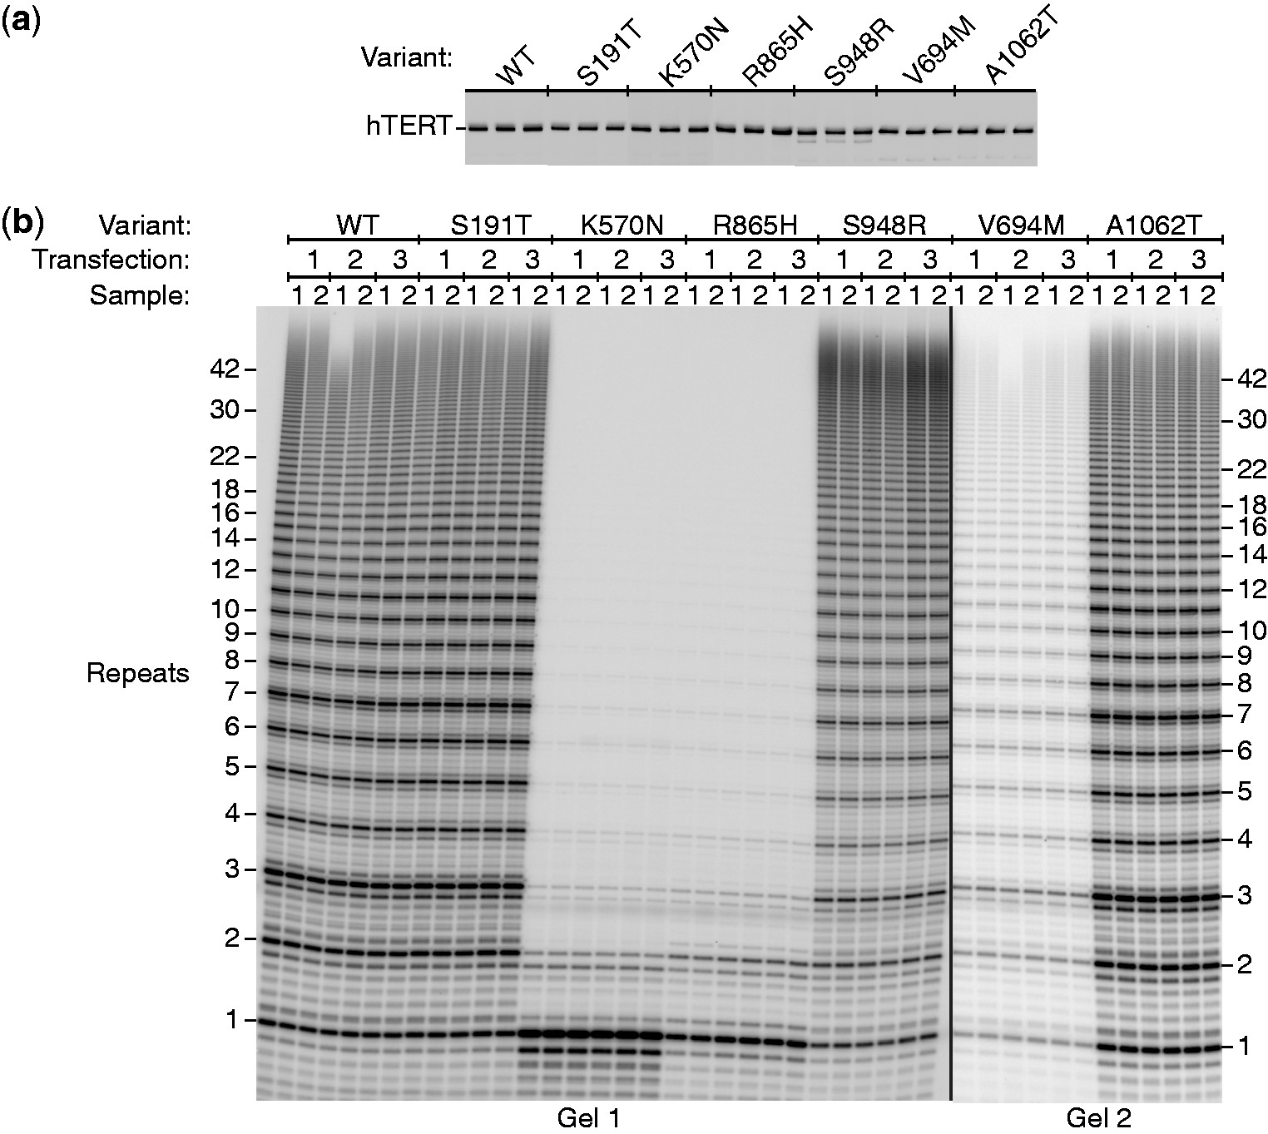
Figure 2. Disease-associated variants of hTERT expressed in HEK293T cells with hTR and analyzed by the direct assay. ...
Notes:
Figure 2. Disease-associated variants of hTERT expressed in HEK293T cells with hTR and analyzed by the direct assay. (a) Western blot with an anti-hTERT antibody showing uniform expression of the alleles in triplicate. It is not known whether the minor breakdown of S948R hTERT contributes to its reduced activity or enhanced processivity. (b) Direct telomerase assays.
Unless provided in the caption above, the following copyright applies to the content of this slide: © The Author(s) 2013. Published by Oxford University Press.This is an Open Access article distributed under the terms of the Creative Commons Attribution Non-Commercial License (http://creativecommons.org/licenses/by-nc/3.0/), which permits non-commercial re-use, distribution, and reproduction in any medium, provided the original work is properly cited. For commercial re-use, please contact journals.permissions@oup.com

Slide 3
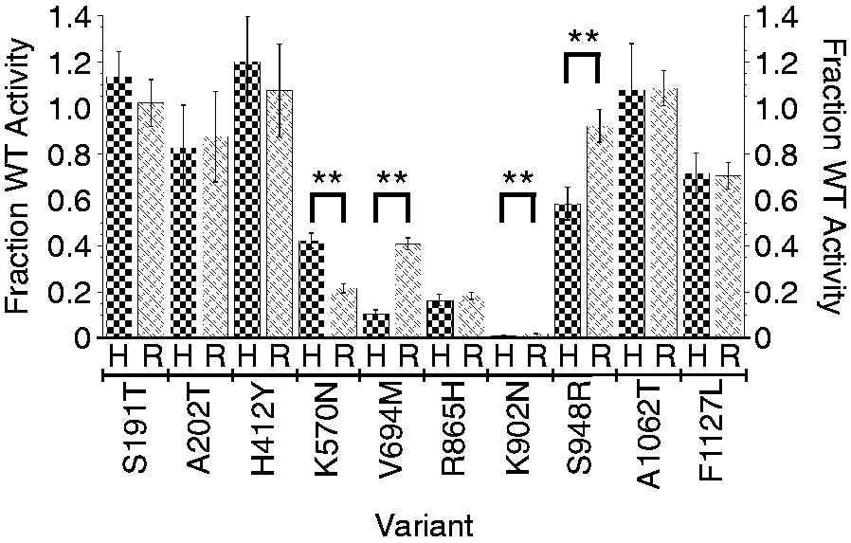
Figure 3. Comparison of relative activities of telomerases expressed in HEK cells (H) and RRLs (R). Error bars = SEM, n ...
Notes:
Figure 3. Comparison of relative activities of telomerases expressed in HEK cells (H) and RRLs (R). Error bars = SEM, n = 4–18. **Statistically significant differences (P < 0.0001).
Unless provided in the caption above, the following copyright applies to the content of this slide: © The Author(s) 2013. Published by Oxford University Press.This is an Open Access article distributed under the terms of the Creative Commons Attribution Non-Commercial License (http://creativecommons.org/licenses/by-nc/3.0/), which permits non-commercial re-use, distribution, and reproduction in any medium, provided the original work is properly cited. For commercial re-use, please contact journals.permissions@oup.com

Slide 4
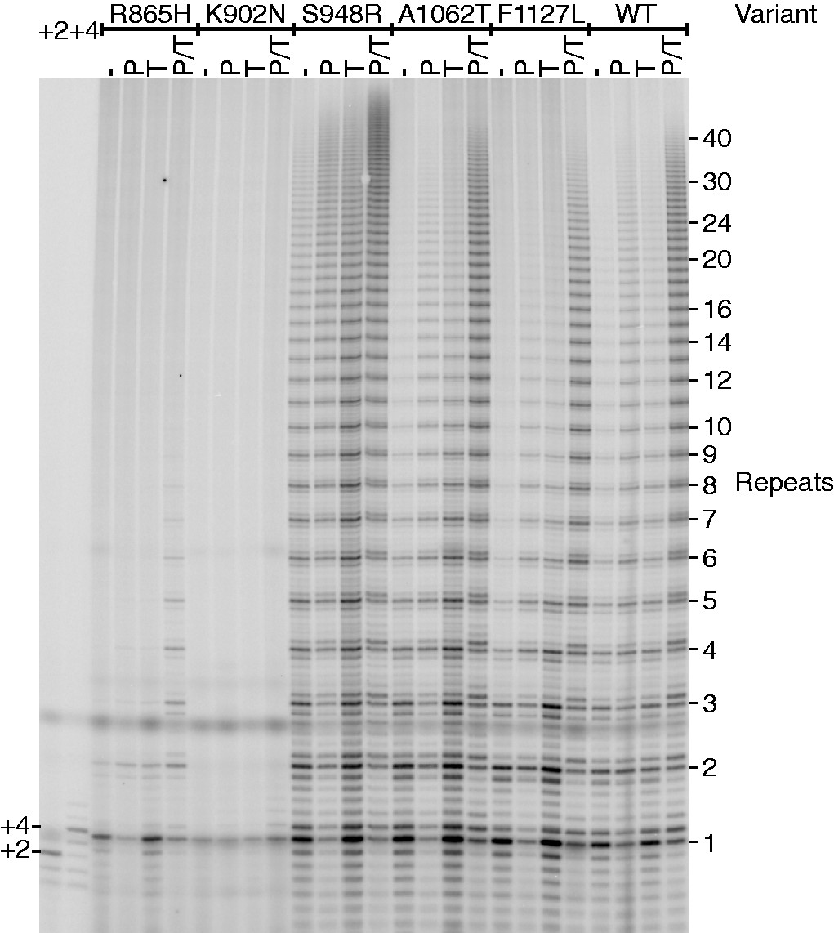
Figure 4. Telomerases assembled from WT and mutant hTERT assayed for activity in the presence and absence of telomere ...
Notes:
Figure 4. Telomerases assembled from WT and mutant hTERT assayed for activity in the presence and absence of telomere proteins. Telomerase was reconstituted in RRLs and activity measured by the standard assay (−) or in the presence of 500 nM POT1 (P), 500 nM TPP1 (T) and 500 nM of each protein (P/T), concentrations high enough to saturate the oligonucleotide primer (22). +2 and +4, markers for primer extended by two and four nt, respectively.
Unless provided in the caption above, the following copyright applies to the content of this slide: © The Author(s) 2013. Published by Oxford University Press.This is an Open Access article distributed under the terms of the Creative Commons Attribution Non-Commercial License (http://creativecommons.org/licenses/by-nc/3.0/), which permits non-commercial re-use, distribution, and reproduction in any medium, provided the original work is properly cited. For commercial re-use, please contact journals.permissions@oup.com

