Slide 1
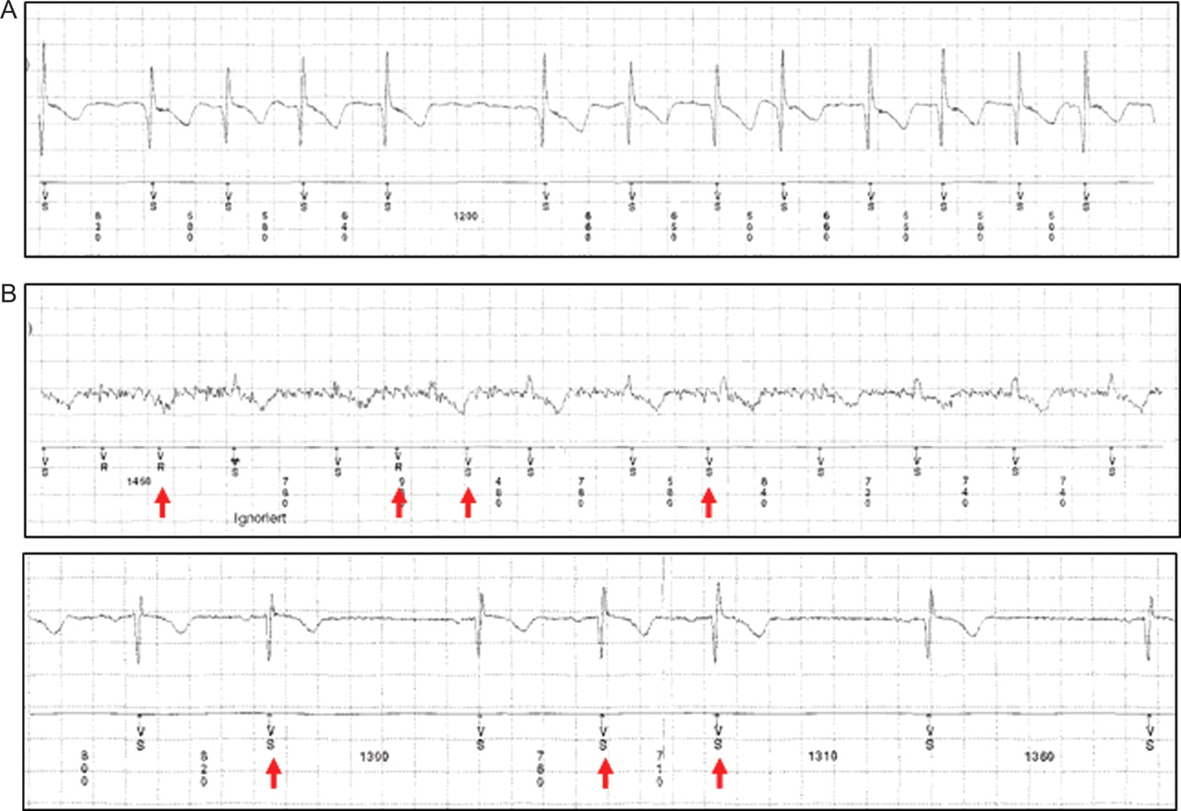
Figure 1 (A) Device stored electrogram with correctly classified atrial fibrillation. (B) Device stored electrogram ...
Notes:
Figure 1 (A) Device stored electrogram with correctly classified atrial fibrillation. (B) Device stored electrogram with misclassified AF (red arrows) due to myopotentials (upper panel) and PAC (lower panel).
Unless provided in the caption above, the following copyright applies to the content of this slide: Published on behalf of the European Society of Cardiology. All rights reserved. © The Author 2011. For permissions please email: journals.permissions@oup.com.The online version of this article has been published under an open access model. Users are entitled to use, reproduce, disseminate, or display the open access version of this article for non-commercial purposes provided that the original authorship is properly and fully attributed; the Journal, Learned Society and Oxford University Press are attributed as the original place of publication with correct citation details given; if an article is subsequently reproduced or disseminated not in its entirety but only in part or as a derivative work this must be clearly indicated. For commercial re-use, please contact journals.permissions@oup.com.

Slide 2
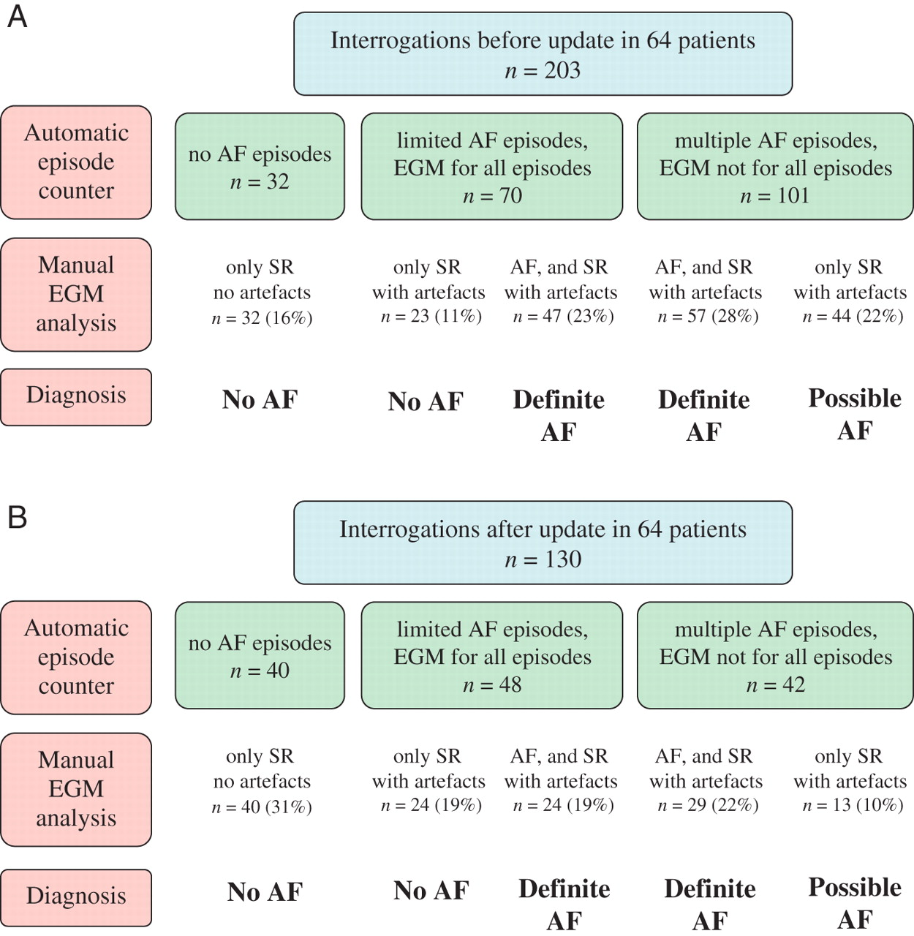
Figure 2 (A and B) Clinical classification of interrogations before and after software upgrade.
Notes:
Figure 2 (A and B) Clinical classification of interrogations before and after software upgrade.
Unless provided in the caption above, the following copyright applies to the content of this slide: Published on behalf of the European Society of Cardiology. All rights reserved. © The Author 2011. For permissions please email: journals.permissions@oup.com.The online version of this article has been published under an open access model. Users are entitled to use, reproduce, disseminate, or display the open access version of this article for non-commercial purposes provided that the original authorship is properly and fully attributed; the Journal, Learned Society and Oxford University Press are attributed as the original place of publication with correct citation details given; if an article is subsequently reproduced or disseminated not in its entirety but only in part or as a derivative work this must be clearly indicated. For commercial re-use, please contact journals.permissions@oup.com.

Slide 3
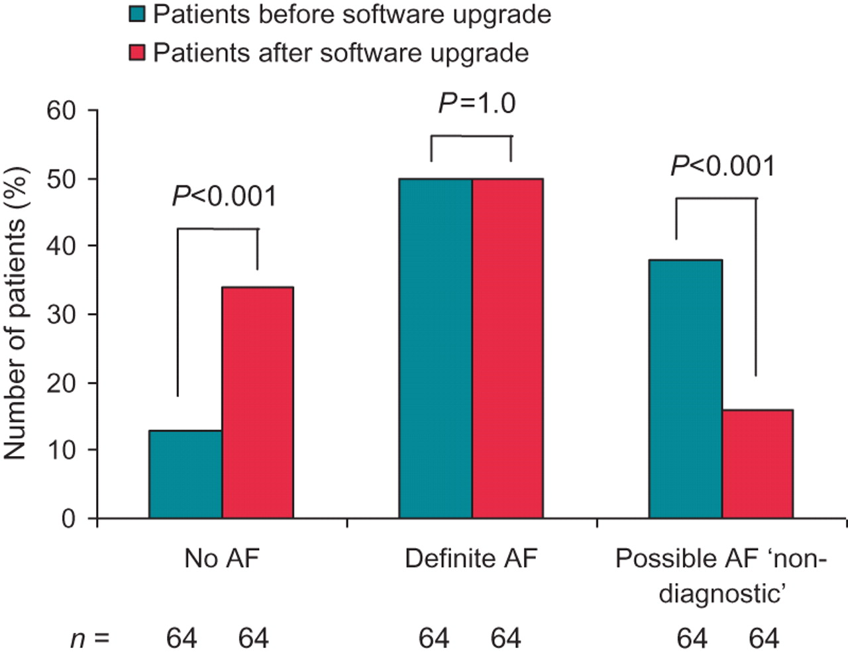
Figure 3 Clinical classification of patients before and after the software upgrade.
Notes:
Figure 3 Clinical classification of patients before and after the software upgrade.
Unless provided in the caption above, the following copyright applies to the content of this slide: Published on behalf of the European Society of Cardiology. All rights reserved. © The Author 2011. For permissions please email: journals.permissions@oup.com.The online version of this article has been published under an open access model. Users are entitled to use, reproduce, disseminate, or display the open access version of this article for non-commercial purposes provided that the original authorship is properly and fully attributed; the Journal, Learned Society and Oxford University Press are attributed as the original place of publication with correct citation details given; if an article is subsequently reproduced or disseminated not in its entirety but only in part or as a derivative work this must be clearly indicated. For commercial re-use, please contact journals.permissions@oup.com.

