Slide 1
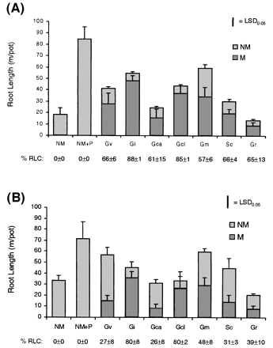
Fig. 1. Total and colonized root length of M. truncatula (A) and L. esculentum (B) grown without mycorrhizas ...
Notes:
Fig. 1. Total and colonized root length of M. truncatula (A) and L. esculentum (B) grown without mycorrhizas or in association with seven AMF. Colonized root length is presented both as a percentage (% RLC) and as absolute values (dark columns). Treatments: NM, non‐mycorrhizal control; NM+P, P‐fertilized, non‐mycorrhizal control; Gv, Glomus versiforme; Gi, Glomus intraradices; Gca, Glomus caledonium; Gcl, Glomus claroideum; Gm, Glomus mosseae; Sc, Scutellospora calospora, and Gr, Gigaspora rosea mycorrhizas. Abbreviation: % RLC, percentage root length colonized. Values presented ±SE, n=3. The offset bar represents the LSD at P=0.05.
Unless provided in the caption above, the following copyright applies to the content of this slide:

Slide 2
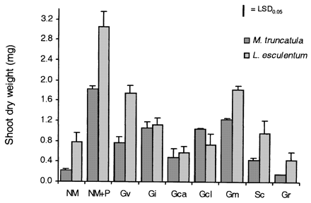
Fig. 2. Shoot dry weight of M. truncatula and L. esculentum grown without mycorrhizas or in association with ...
Notes:
Fig. 2. Shoot dry weight of M. truncatula and L. esculentum grown without mycorrhizas or in association with seven AMF. Dark bars represent M. truncatula and light bars represent L. esculentum. Treatments: NM, non‐mycorrhizal control; NM+P, P‐fertilized, non‐mycorrhizal control; Gv, Glomus versiforme; Gi, Glomus intraradices; Gca, Glomus caledonium; Gcl, Glomus claroideum; Gm, Glomus mosseae; Sc, Scutellospora calospora, and Gr, Gigaspora rosea mycorrhizas. Values presented ±SE, n=3. The offset bar represents the LSD at P=0.05.
Unless provided in the caption above, the following copyright applies to the content of this slide:

Slide 3
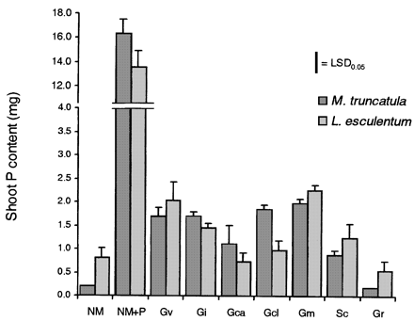
Fig. 3. Shoot P content of M. truncatula and L. esculentum grown without mycorrhizas or in association with ...
Notes:
Fig. 3. Shoot P content of M. truncatula and L. esculentum grown without mycorrhizas or in association with seven AMF. Dark bars represent M. truncatula and light bars represent L. esculentum. Treatments: NM, non‐mycorrhizal control; NM+P, P‐fertilized, non‐mycorrhizal control; Gv, Glomus versiforme; Gi, Glomus intraradices; Gca, Glomus caledonium; Gcl, Glomus claroideum; Gm, Glomus mosseae; Sc, Scutellospora calospora, and Gr, Gigaspora rosea mycorrhizas. Values presented ±SE, n=3. The offset bar represents the LSD at P=0.05.
Unless provided in the caption above, the following copyright applies to the content of this slide:

Slide 4
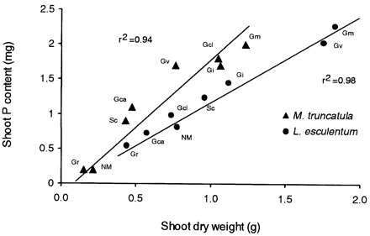
Fig. 4. Relationship between shoot dry weight and shoot P content in M. truncatula and L. esculentum grown ...
Notes:
Fig. 4. Relationship between shoot dry weight and shoot P content in M. truncatula and L. esculentum grown without mycorrhizas or in association with seven AMF. Treatments: NM, non‐mycorrhizal control; Gv, Glomus versiforme; Gi, Glomus intraradices; Gca, Glomus caledonium; Gcl, Glomus claroideum; Gm, Glomus mosseae; Sc, Scutellospora calospora, and Gr, Gigaspora rosea mycorrhizas. A positive linear correlation can be observed between shoot dry weight and shoot P content in both M. truncatula (r2=0.94) and L. esculentum (r2=0.98). The P‐fertilized non‐mycorrhizal control was excluded from these analyses.
Unless provided in the caption above, the following copyright applies to the content of this slide:

Slide 5
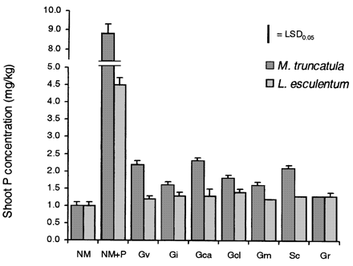
Fig. 5. Shoot P concentrations in M. truncatula and L. esculentum grown without mycorrhizas or in association ...
Notes:
Fig. 5. Shoot P concentrations in M. truncatula and L. esculentum grown without mycorrhizas or in association with seven AMF. Dark bars represent M. truncatula and light bars represent L. esculentum. Treatments: NM, non‐mycorrhizal control; NM+P, P‐fertilized, non‐mycorrhizal control; Gv, Glomus versiforme; Gi, Glomus intraradices; Gca, Glomus caledonium; Gcl, Glomus claroideum; Gm, Glomus mosseae; Sc, Scutellospora calospora, and Gr, Gigaspora rosea mycorrhizas Values presented ±SE, n=3. The offset bar represents the LSD at P=0.05.
Unless provided in the caption above, the following copyright applies to the content of this slide:

Slide 6
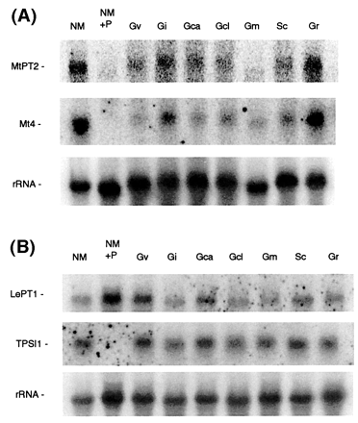
Fig. 6. Expression of the P starvation‐inducible plant genes Mt4 and MtPT2 from M. truncatula and LePT1 and ...
Notes:
Fig. 6. Expression of the P starvation‐inducible plant genes Mt4 and MtPT2 from M. truncatula and LePT1 and TPSI1 from L. esculentum in roots from plants grown without mycorrhizas or in association with seven AMF. Northern blots of total RNA isolated from mycorrhizal roots of M. truncatula probed with either 32P‐labelled MtPT2 cDNA (upper panel), Mt4 cDNA (middle panel) or 18S rDNA (lower panel) (A) and RNA isolated from mycorrhizal roots of L. esculentum probed with either 32P‐labelled LePT1 cDNA (upper panel), TPSI1 cDNA (middle panel) or 18S rDNA (lower panel) (B). Treatments: NM, non‐mycorrhizal control; NM+P, P‐fertilized, non‐mycorrhizal control; Gv, Glomus versiforme; Gi, Glomus intraradices; Gca, Glomus caledonium; Gcl, Glomus claroideum; Gm, Glomus mosseae; Sc, Scutellospora calospora, and Gr, Gigaspora rosea mycorrhizas.
Unless provided in the caption above, the following copyright applies to the content of this slide:

Slide 7
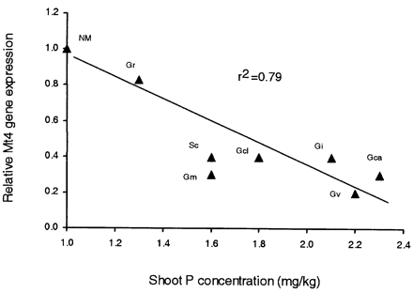
Fig. 7. Relationship between the root expression of the P starvation‐inducible gene Mt4 and shoot P ...
Notes:
Fig. 7. Relationship between the root expression of the P starvation‐inducible gene Mt4 and shoot P concentration in seven mycorrhizas of M. truncatula. Relative expression was calculated as the signal intensity of Mt4 divided by that of the rRNA control and presented relative to that of the NM control. Treatments: NM, non‐mycorrhizal control; Gv, Glomus versiforme; Gi, Glomus intraradices; Gca, Glomus caledonium; Gcl, Glomus claroideum; Gm, Glomus mosseae; Sc, Scutellospora calospora, and Gr, Gigaspora rosea mycorrhizas. A negative, linear correlation can be observed between relative Mt4 gene expression and shoot P concentration (r2=0.79). The P‐fertilized, non‐mycorrhizal control was excluded from this analysis.
Unless provided in the caption above, the following copyright applies to the content of this slide:

