Slide 1
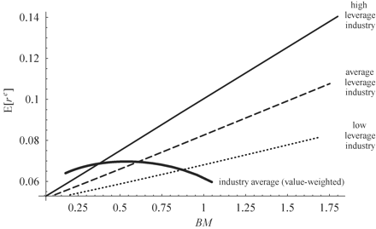
Figure 1 The relation between book-to-market and expected returns within and across industriesThis figure depicts the ...
Notes:
Figure 1 The relation between book-to-market and expected returns within and across industriesThis figure depicts the unconditional relation between expected excess returns and book-to-market within three different industries, and also across industries. The top line (solid) shows the expected return / book-to-market relation in a high operating leverage industry (operating costs-to-assets equal to two and a half), the middle line (dashed) shows a moderate operating leverage industry (operating costs-to-assets equal to one), while the bottom line (dotted) shows a low operating leverage industry (operating costs-to-assets equal to two fifths). The bold curve depicts the relation between expected excess industry returns and industry book-to-market.
Unless provided in the caption above, the following copyright applies to the content of this slide: © Oxford University Press 2010

