Slide 1
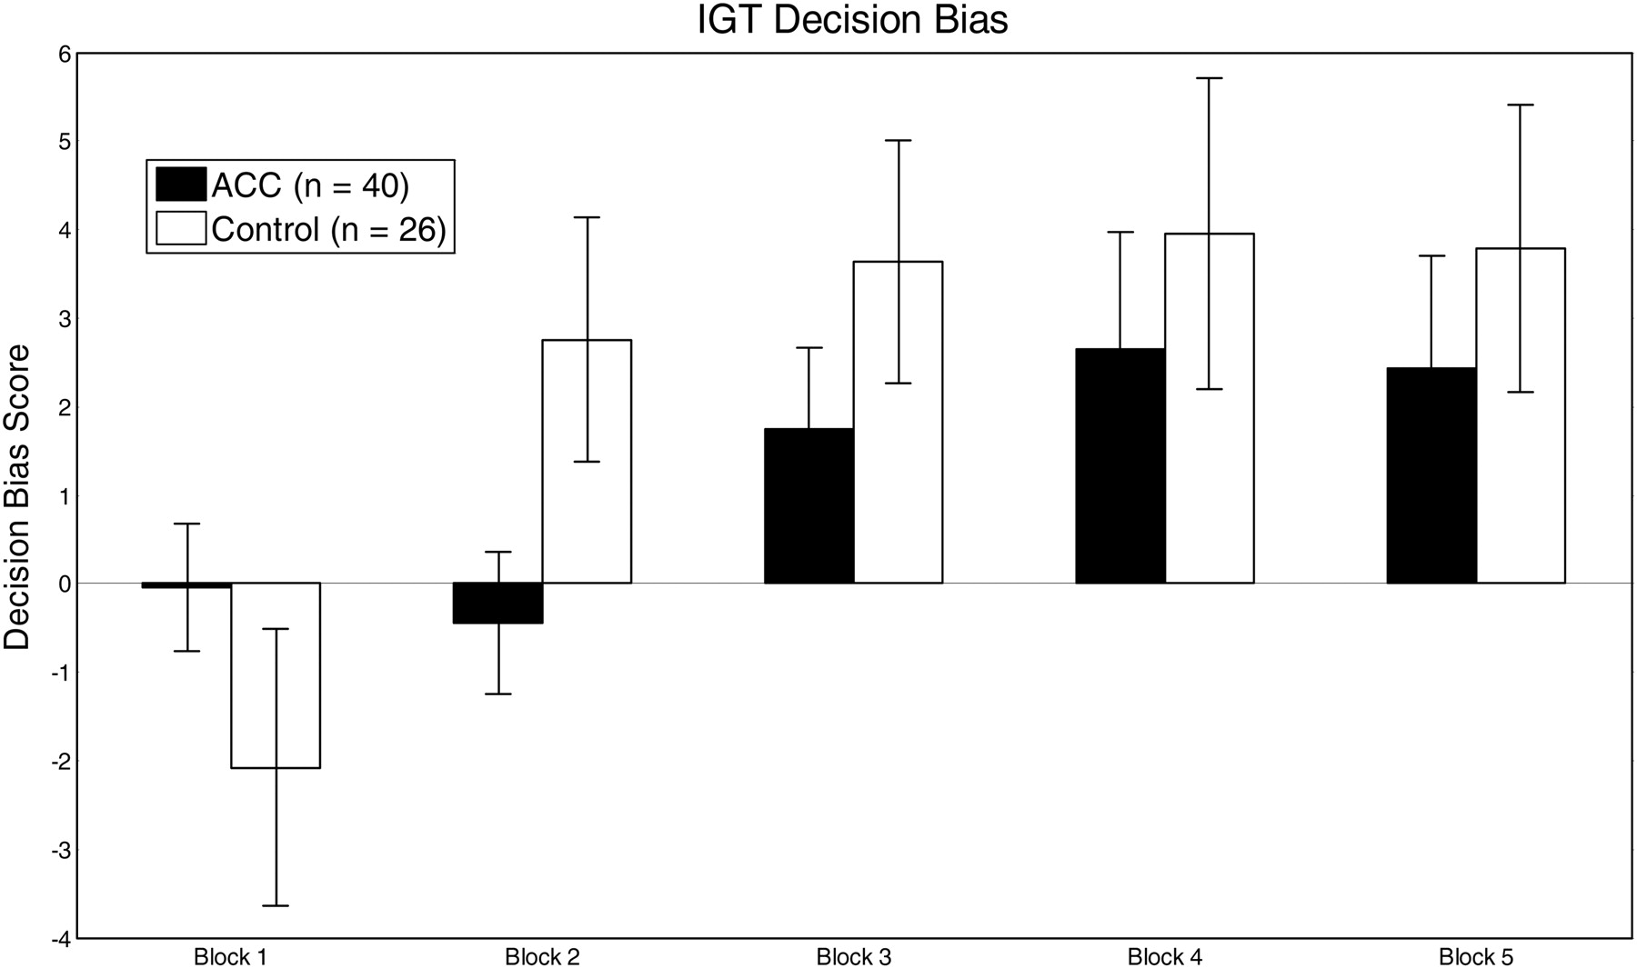
Fig. 1. Change in mean decision bias over the five 20-trial blocks of the IGT for the ACC and control groups. ...
Notes:
Fig. 1. Change in mean decision bias over the five 20-trial blocks of the IGT for the ACC and control groups. Decision bias indicates whether a group made more advantageous or disadvantageous selections, with the positive numbers on this axis indicating more advantageous decision-making and negative numbers reflecting more disadvantageous decision-making.
Unless provided in the caption above, the following copyright applies to the content of this slide: © The Author 2012. Published by Oxford University Press. All rights reserved. For permissions, please e-mail: journals.permissions@oup.com.

Slide 2
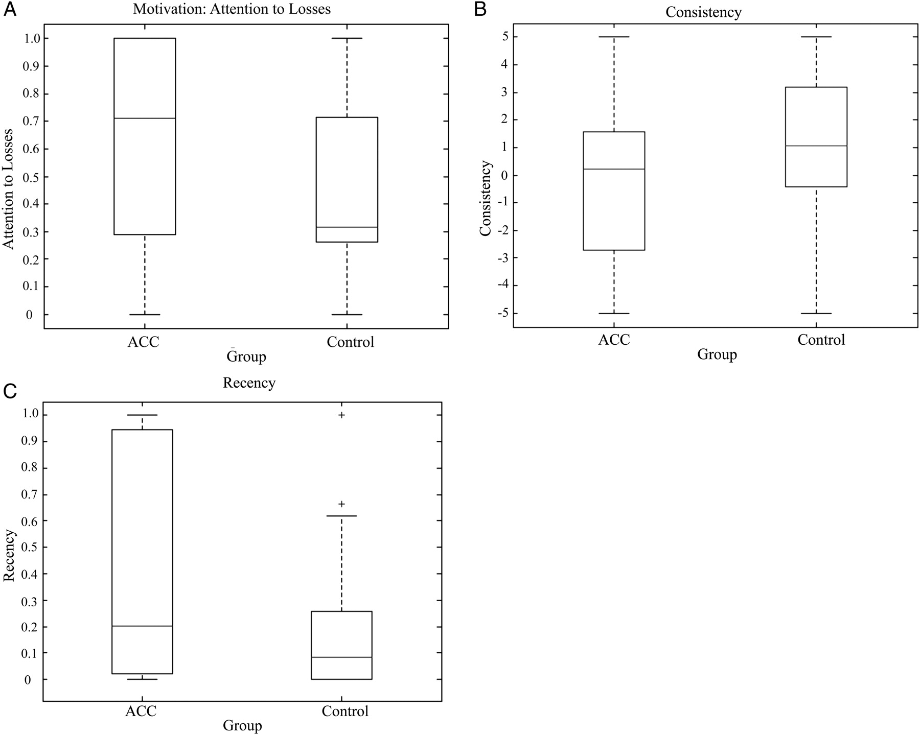
Fig. 2. Box plots of the three EV parameters comparing individuals with ACC and controls.
Notes:
Fig. 2. Box plots of the three EV parameters comparing individuals with ACC and controls.
Unless provided in the caption above, the following copyright applies to the content of this slide: © The Author 2012. Published by Oxford University Press. All rights reserved. For permissions, please e-mail: journals.permissions@oup.com.

