Slide 1
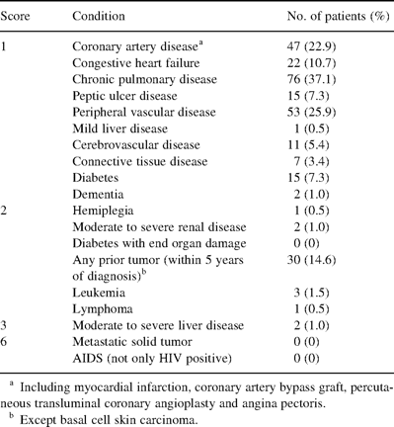
Table 1 Charlson comorbidity index and prevalence of comorbid conditions among 205 operated primary non-small cell ...
Notes:
Table 1 Charlson comorbidity index and prevalence of comorbid conditions among 205 operated primary non-small cell lung cancer patients
Unless provided in the caption above, the following copyright applies to the content of this slide: © Elsevier Science B.V. 2003

Slide 2
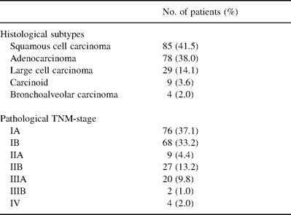
Table 2 Histology and pathological TNM-stage
Notes:
Table 2 Histology and pathological TNM-stage
Unless provided in the caption above, the following copyright applies to the content of this slide: © Elsevier Science B.V. 2003

Slide 3
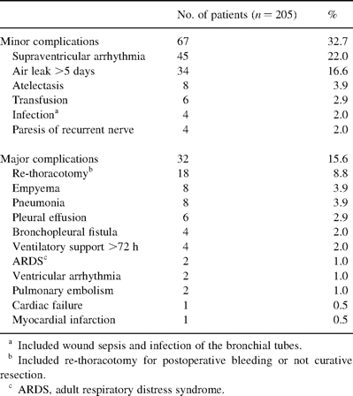
Table 3 Incidence of complications
Notes:
Table 3 Incidence of complications
Unless provided in the caption above, the following copyright applies to the content of this slide: © Elsevier Science B.V. 2003

Slide 4
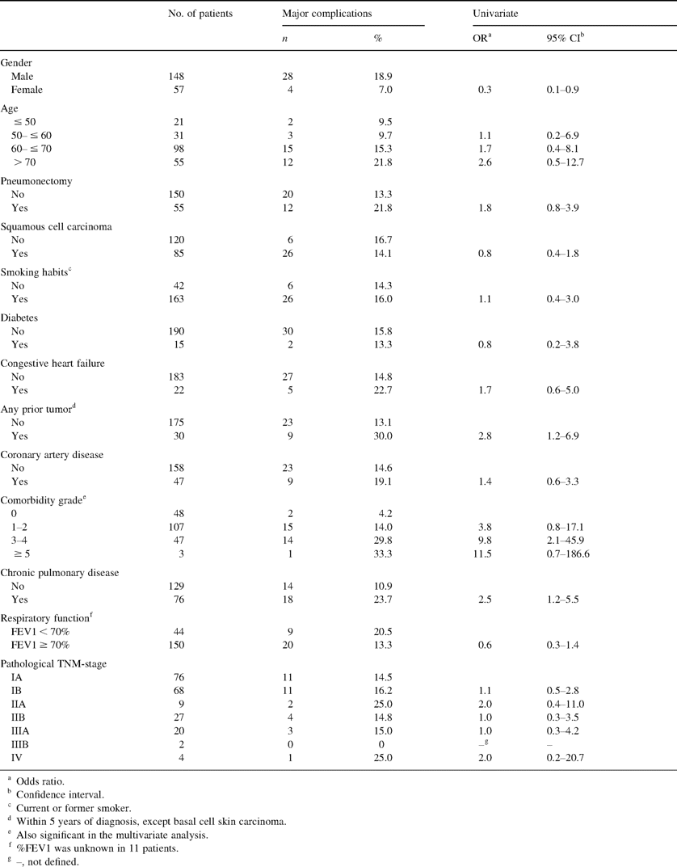
Table 4 Risk factors related to early death or other major complications in uni- and multivariate logistic ...
Notes:
Table 4 Risk factors related to early death or other major complications in uni- and multivariate logistic regression
Unless provided in the caption above, the following copyright applies to the content of this slide: © Elsevier Science B.V. 2003

Slide 5
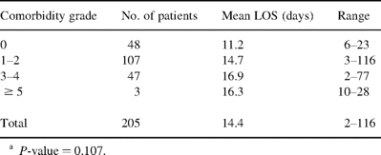
Table 5 Influence of comorbidity grade on the length of hospital stay (LOS)
Notes:
Table 5 Influence of comorbidity grade on the length of hospital stay (LOS)
Unless provided in the caption above, the following copyright applies to the content of this slide: © Elsevier Science B.V. 2003

