Slide 1
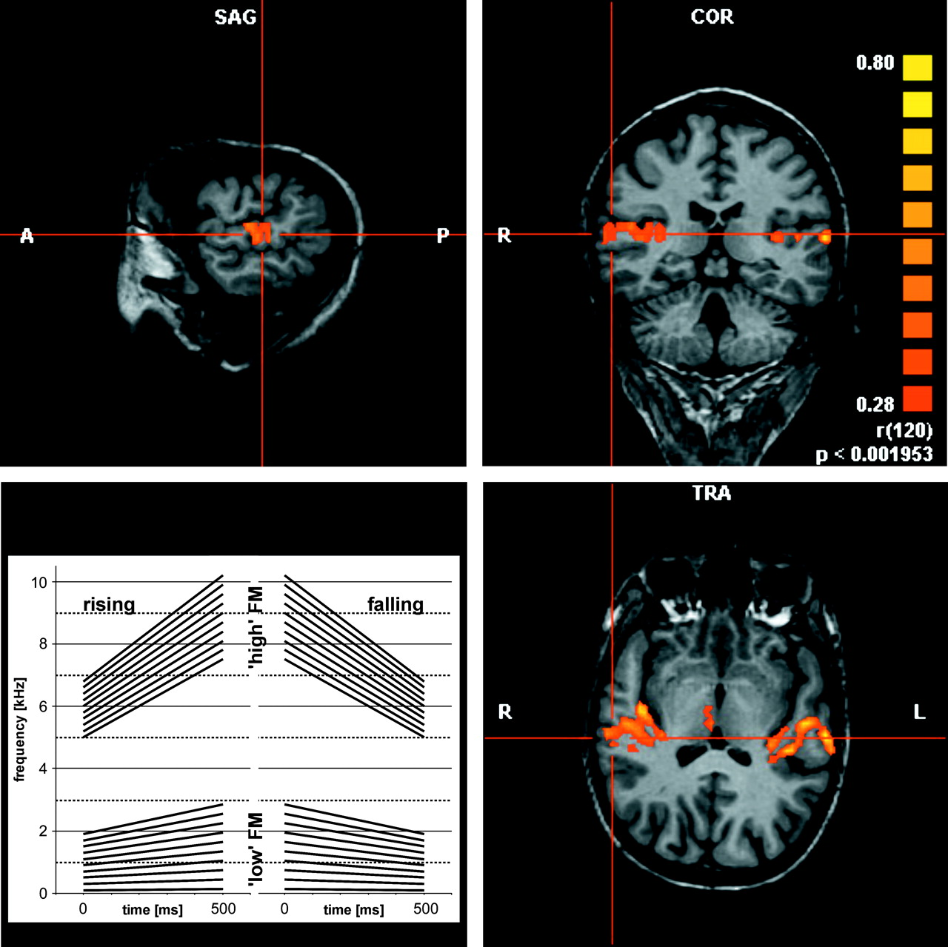
Figure 1. Three dimensional analysis of auditory cortex activation in an individual subject and set of FM stimuli used ...
Notes:
Figure 1. Three dimensional analysis of auditory cortex activation in an individual subject and set of FM stimuli used in experiment I.
Unless provided in the caption above, the following copyright applies to the content of this slide: Cerebral Cortex V 15 N 5 © Oxford University Press 2004; all rights reserved

Slide 2
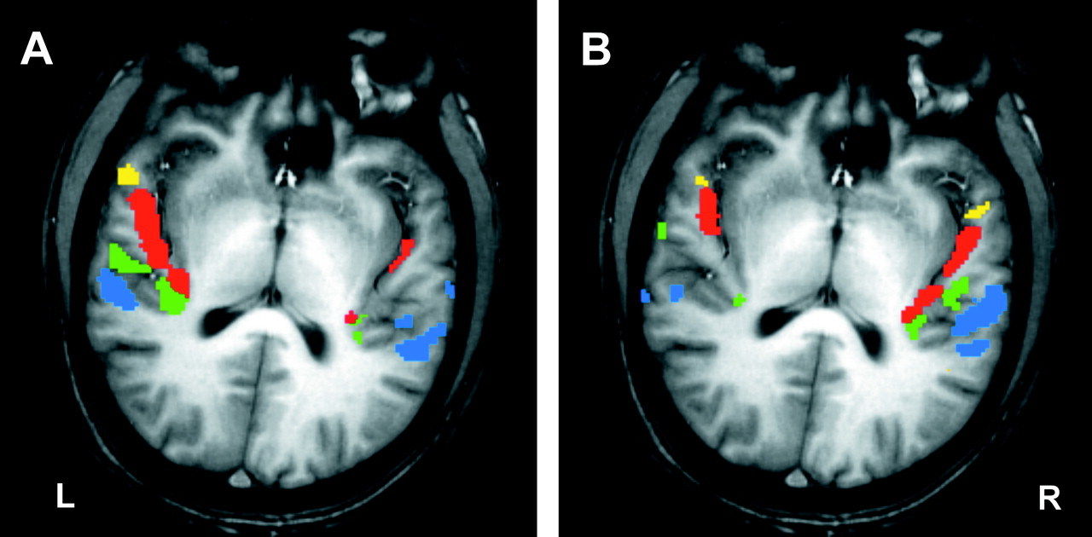
Figure 2. Patterns of auditory cortex activation in an individual subject in experiment I. (A) Uninformed listening, ...
Notes:
Figure 2. Patterns of auditory cortex activation in an individual subject in experiment I. (A) Uninformed listening, (B) categorization of FM direction. Significant activation (P < 0.05) is colour coded for each territory (TA yellow, T1 red, T2 green and T3 blue). Note the extreme lateralization contrast between (A) and (B).
Unless provided in the caption above, the following copyright applies to the content of this slide: Cerebral Cortex V 15 N 5 © Oxford University Press 2004; all rights reserved

Slide 3
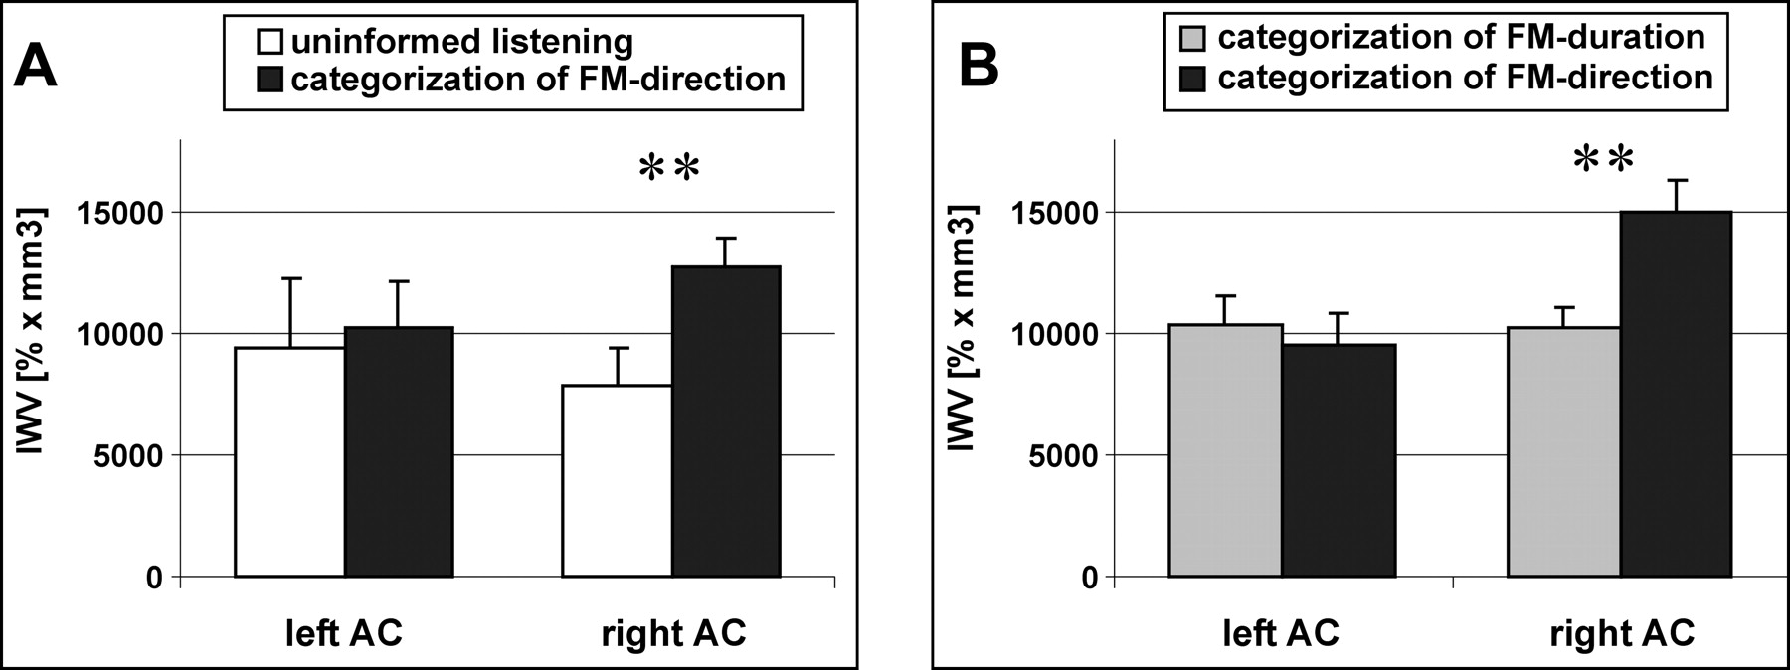
Figure 3. Global activation (IWV) of auditory cortex of each hemisphere in experiment I (low frequency range) (A) and ...
Notes:
Figure 3. Global activation (IWV) of auditory cortex of each hemisphere in experiment I (low frequency range) (A) and experiment II (B). During the directional categorization task activation of the right auditory cortex was stronger than during uninformed listening (A) and stronger than during the durational categorization task (B).
Unless provided in the caption above, the following copyright applies to the content of this slide: Cerebral Cortex V 15 N 5 © Oxford University Press 2004; all rights reserved

Slide 4
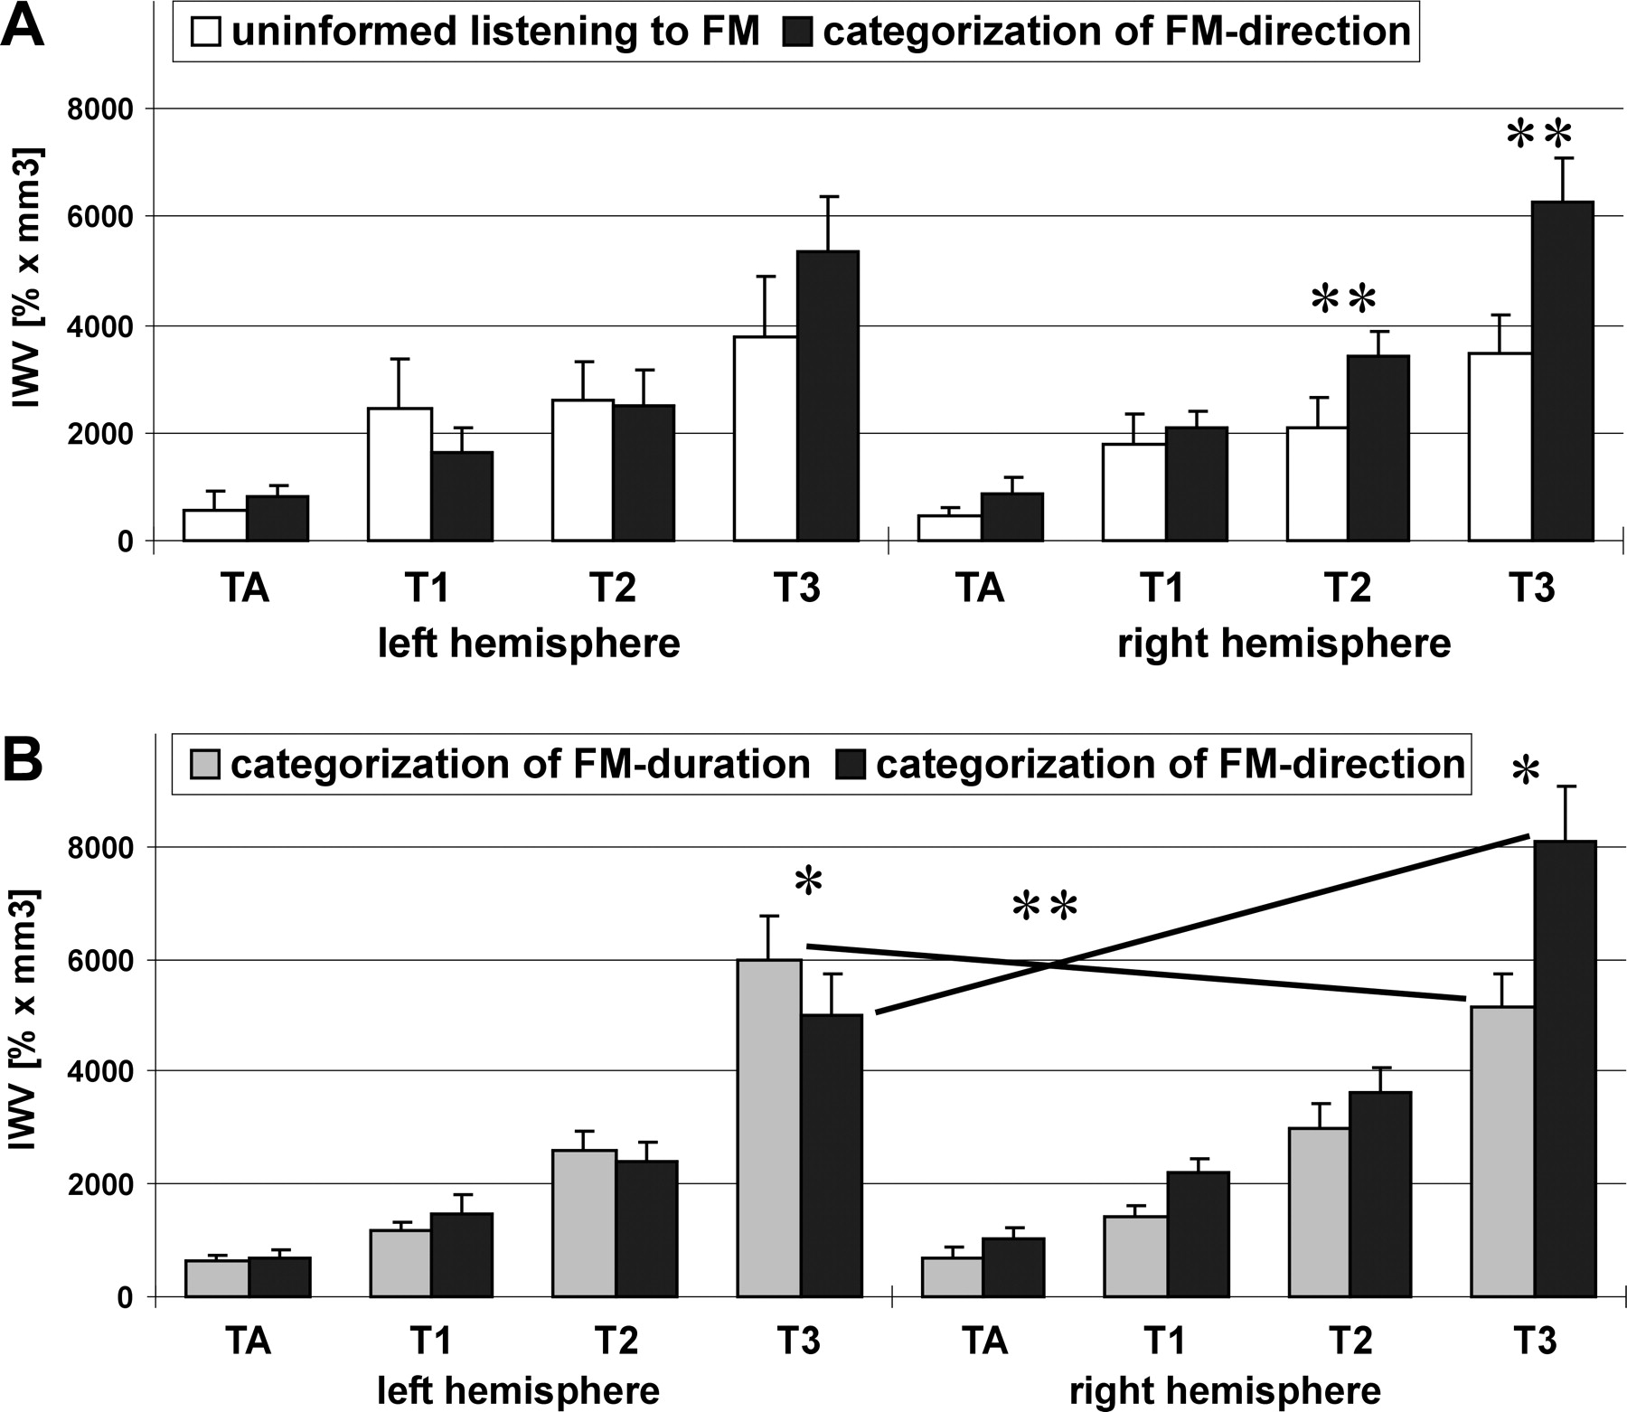
Figure 4. Activation (IWV) of the auditory territories of each hemisphere in experiment I (low frequency range) (A) and ...
Notes:
Figure 4. Activation (IWV) of the auditory territories of each hemisphere in experiment I (low frequency range) (A) and in experiment II (B). Analysis of variance in experiment I revealed a main effect of task in T2 and T3 of the right posterior auditory cortex with stronger activation during the categorization task. Analysis of variance in experiment II revealed a significant interaction of factors task × hemisphere for IWV of T3 with stronger activation of right T3 during directional categorization and a stronger activation of left T3 during categorization of FM-duration.
Unless provided in the caption above, the following copyright applies to the content of this slide: Cerebral Cortex V 15 N 5 © Oxford University Press 2004; all rights reserved

Slide 5
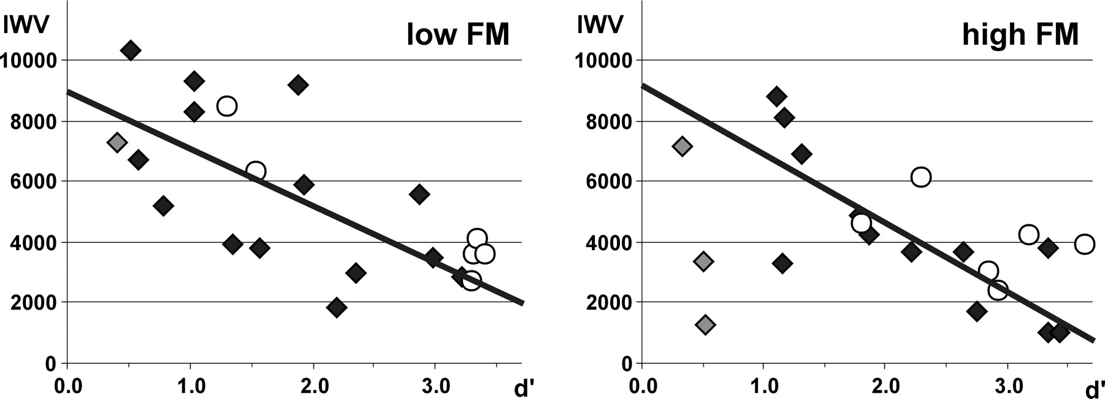
Figure 5. Correlation of activation (IWV) in right T3 and performance (sensitivity index d′) of subjects in experiment ...
Notes:
Figure 5. Correlation of activation (IWV) in right T3 and performance (sensitivity index d′) of subjects in experiment I during directional categorization of FM (excluding subjects with below change performance, gray diamonds). (A) low frequency range, (B) high frequency range. Open circles represent the data of an individual subject who was measured six times.
Unless provided in the caption above, the following copyright applies to the content of this slide: Cerebral Cortex V 15 N 5 © Oxford University Press 2004; all rights reserved

Slide 6
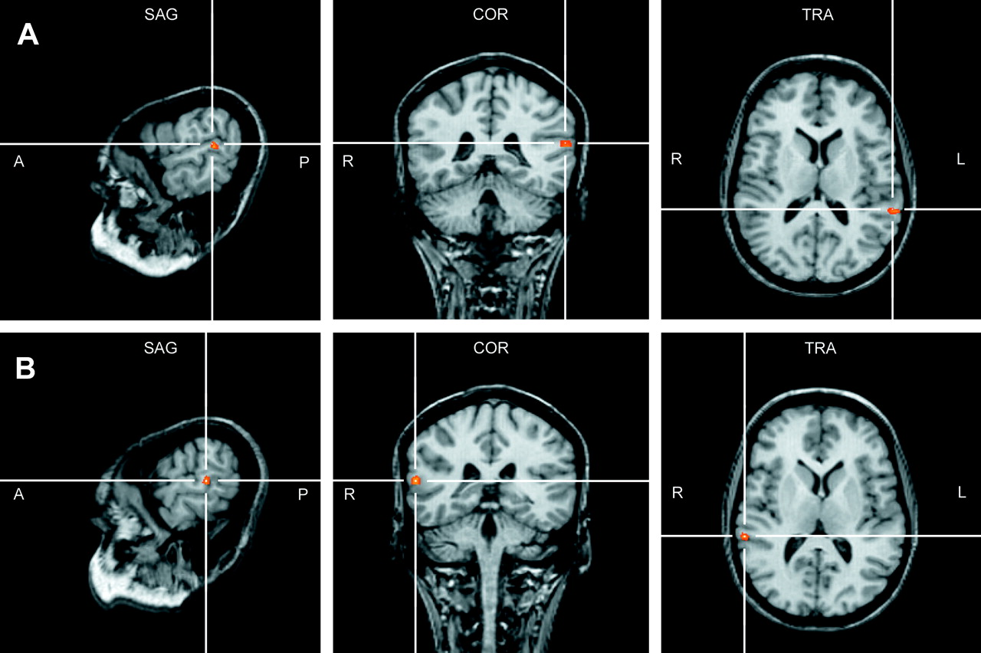
Figure 6. Grand average analysis for durational versus directional categorization (A) and the reverse (B) projected on ...
Notes:
Figure 6. Grand average analysis for durational versus directional categorization (A) and the reverse (B) projected on an individual brain in Talairach space. Coordinates of larger activation for the durational categorization were in left BA 22 (peak: −59, −40, 14) and larger activation for the directional categorization in right BA 22 (peak: 60, −35, 11).
Unless provided in the caption above, the following copyright applies to the content of this slide: Cerebral Cortex V 15 N 5 © Oxford University Press 2004; all rights reserved

