Slide 1
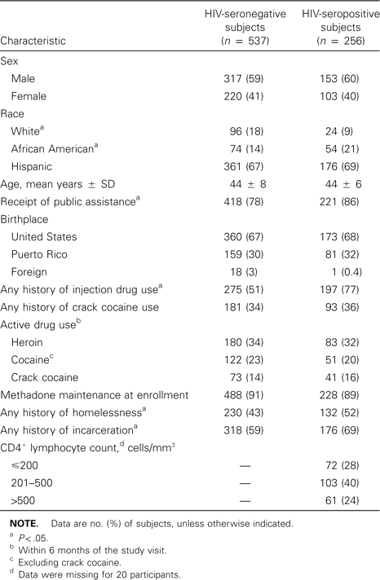
Table 1 Characteristics of current and former drug users enrolled in a study of risk factors for tuberculin ...
Notes:
Table 1 Characteristics of current and former drug users enrolled in a study of risk factors for tuberculin positivity.
Unless provided in the caption above, the following copyright applies to the content of this slide: © 2002 Infectious Diseases Society of America

Slide 2
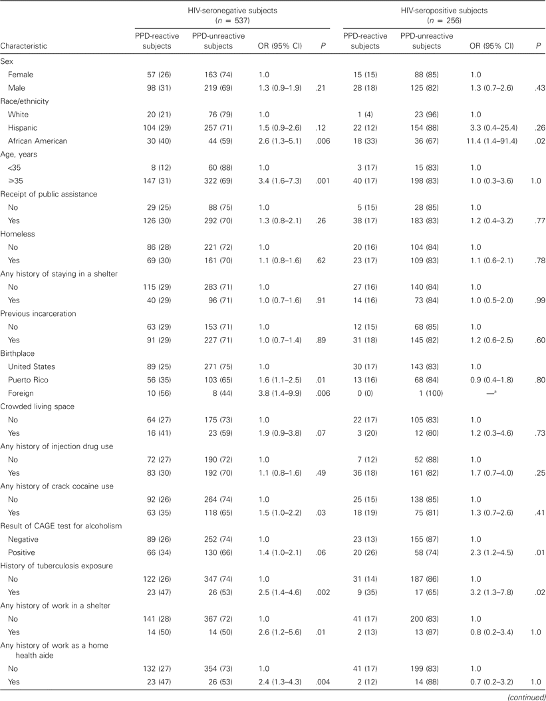
Table 2 Associations between participant characteristics and tuberculin positivity in drug users, according to HIV ...
Notes:
Table 2 Associations between participant characteristics and tuberculin positivity in drug users, according to HIV serostatus, on univariate analysis.
Unless provided in the caption above, the following copyright applies to the content of this slide: © 2002 Infectious Diseases Society of America

Slide 3
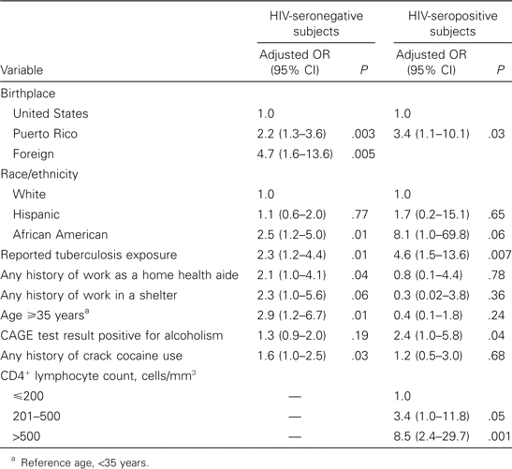
Table 3 Multivariate logistic regression models of factors associated with tuberculin positivity in HIV-seronegative ...
Notes:
Table 3 Multivariate logistic regression models of factors associated with tuberculin positivity in HIV-seronegative and HIV-seropositive drug users.
Unless provided in the caption above, the following copyright applies to the content of this slide: © 2002 Infectious Diseases Society of America

