Slide 1
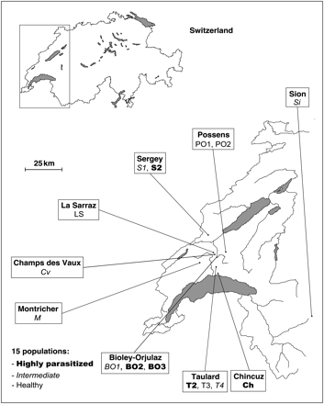
Figure 1. Localities of the 15 sampled populations in western Switzerland. Three groups can be defined according to the ...
Notes:
Figure 1. Localities of the 15 sampled populations in western Switzerland. Three groups can be defined according to the prevalence of the parasite: five highly parasitized populations, six intermediate populations and four healthy populations.
Unless provided in the caption above, the following copyright applies to the content of this slide: © The Author 2009. Published by Oxford University Press on behalf of The Malacological Society of London, all rights reserved

Slide 2
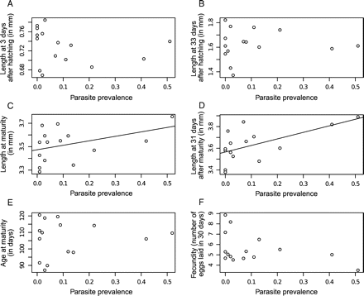
Figure 2. Relationships between parasite prevalence and mean size, age at maturity and fecundity in 15 populations of ...
Notes:
Figure 2. Relationships between parasite prevalence and mean size, age at maturity and fecundity in 15 populations of Galba truncatula. Only significant correlations are represented by a line. A. Length at 3 days after hatching. B. Length at 33 days after hatching. C. Length at maturity. D. Length at 31 days after maturity. E. Age at maturity. F. Fecundity.
Unless provided in the caption above, the following copyright applies to the content of this slide: © The Author 2009. Published by Oxford University Press on behalf of The Malacological Society of London, all rights reserved

Slide 3
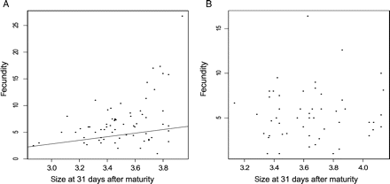
Figure 3. Correlation between size at 31 days after maturity and fecundity. A. The relation analysed at the family ...
Notes:
Figure 3. Correlation between size at 31 days after maturity and fecundity. A. The relation analysed at the family level for healthy populations (four populations, 86 families). B. For highly parasitized populations (five populations, 52 families). The line corresponds to a significant correlation.
Unless provided in the caption above, the following copyright applies to the content of this slide: © The Author 2009. Published by Oxford University Press on behalf of The Malacological Society of London, all rights reserved

