Slide 1
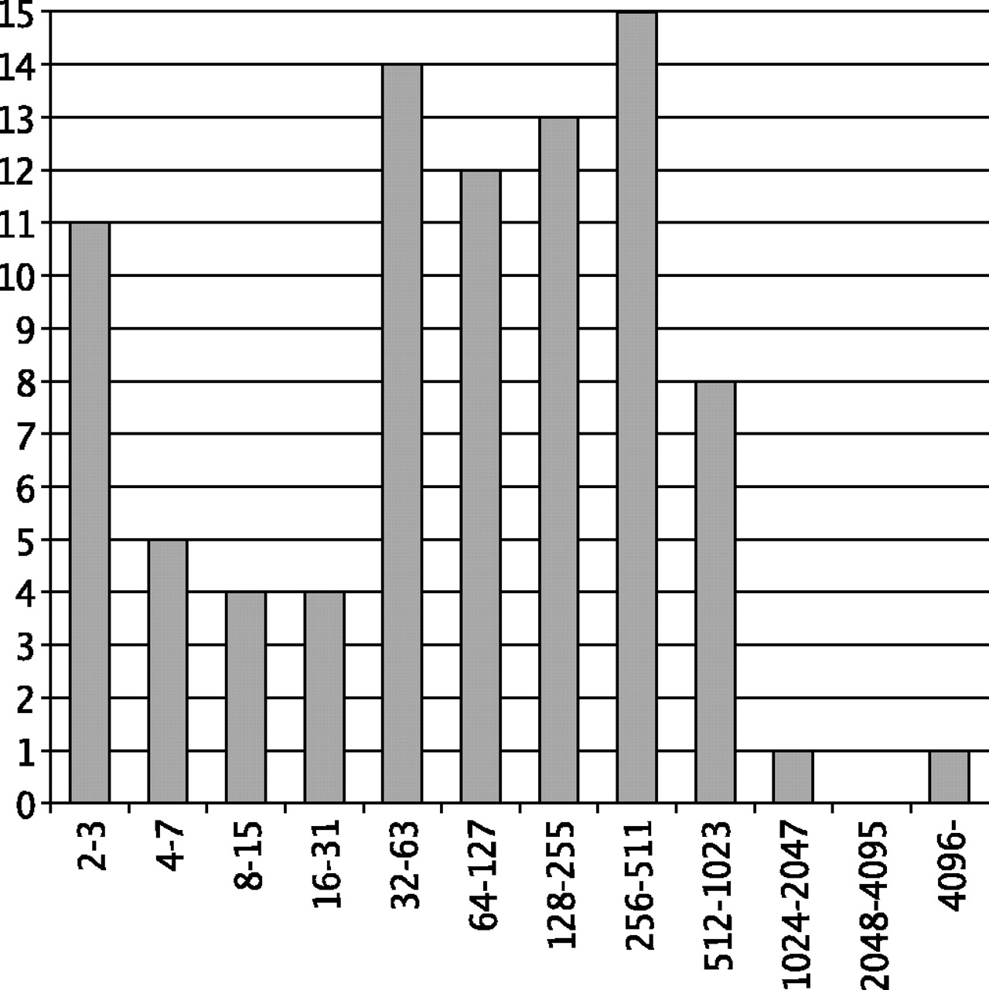
Fig. 1 The distribution of cluster sizes.
Notes:
Fig. 1 The distribution of cluster sizes.
Unless provided in the caption above, the following copyright applies to the content of this slide: © The Author 2004. Published by Oxford University Press. All rights reserved. For Permissions, please email: journals.permissions@oupjournals.org

Slide 2
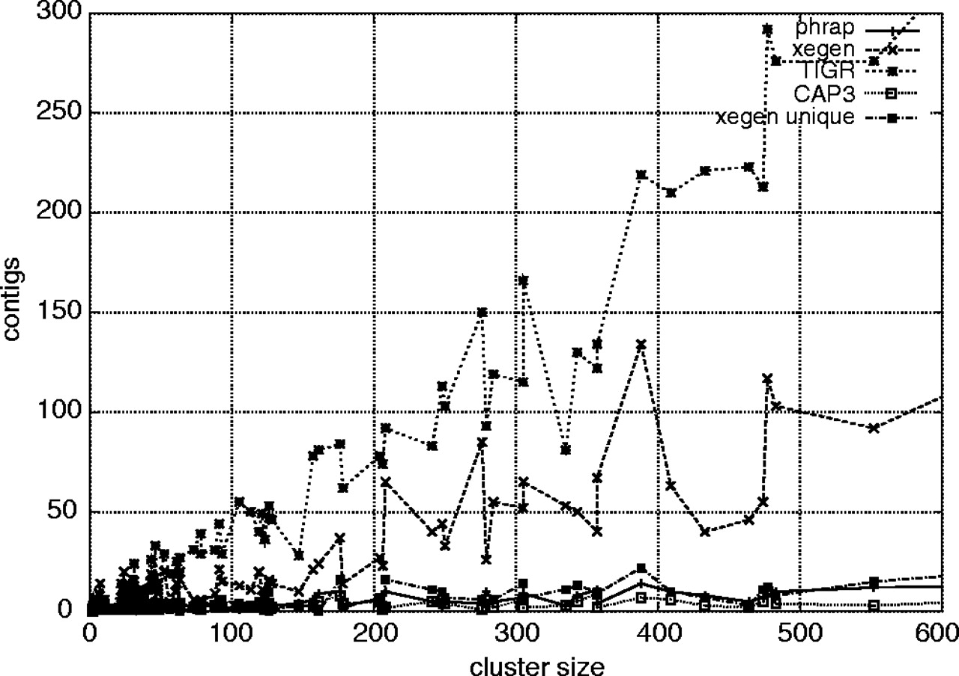
Fig. 2 The number of contigs produced by each sequence assembler plotted against cluster sizes. The line labeled ...
Notes:
Fig. 2 The number of contigs produced by each sequence assembler plotted against cluster sizes. The line labeled unique is the number of sequences after redundancy has been eliminated with cd-hit (see Discussion). The largest clusters are not shown in the diagram due to space constraints.
Unless provided in the caption above, the following copyright applies to the content of this slide: © The Author 2004. Published by Oxford University Press. All rights reserved. For Permissions, please email: journals.permissions@oupjournals.org

Slide 3
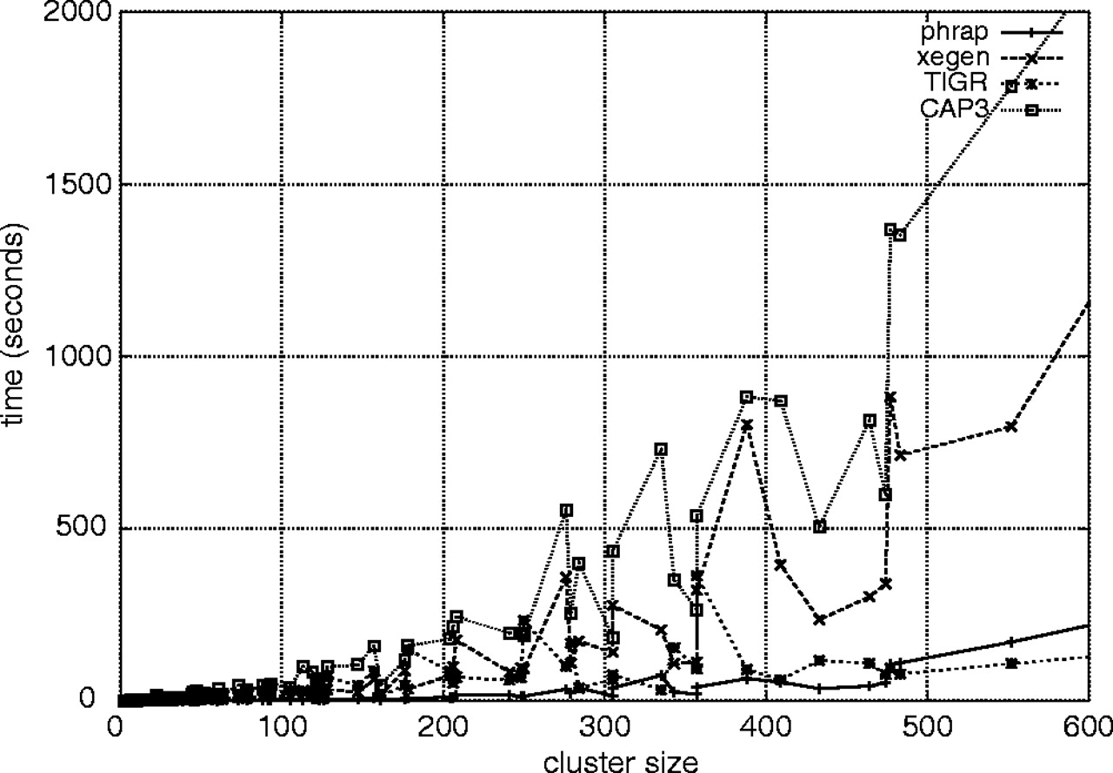
Fig. 3 Running times for each sequence assembler plotted against cluster sizes. The largest clusters are not shown ...
Notes:
Fig. 3 Running times for each sequence assembler plotted against cluster sizes. The largest clusters are not shown due to space constraints.
Unless provided in the caption above, the following copyright applies to the content of this slide: © The Author 2004. Published by Oxford University Press. All rights reserved. For Permissions, please email: journals.permissions@oupjournals.org

Slide 4
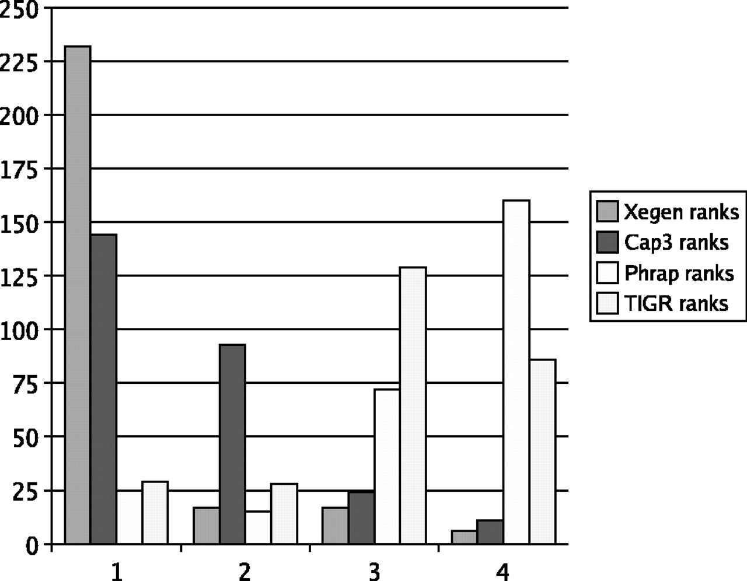
Fig. 4 The ranks of best contig matching each mRNA for each of the sequence assemblers.
Notes:
Fig. 4 The ranks of best contig matching each mRNA for each of the sequence assemblers.
Unless provided in the caption above, the following copyright applies to the content of this slide: © The Author 2004. Published by Oxford University Press. All rights reserved. For Permissions, please email: journals.permissions@oupjournals.org

Slide 5
Fig. 5 Alignment of the best-matching consensus sequences against AL832407. The thick regions indicate matches, ...
Notes:
Fig. 5 Alignment of the best-matching consensus sequences against AL832407. The thick regions indicate matches, solid lines indicate non-matching regions, and stippled lines (in the CAP3 and TIGR outputs) indicate parts of the transcript that are missing from the consensus sequences.
Unless provided in the caption above, the following copyright applies to the content of this slide: © The Author 2004. Published by Oxford University Press. All rights reserved. For Permissions, please email: journals.permissions@oupjournals.org

Slide 6
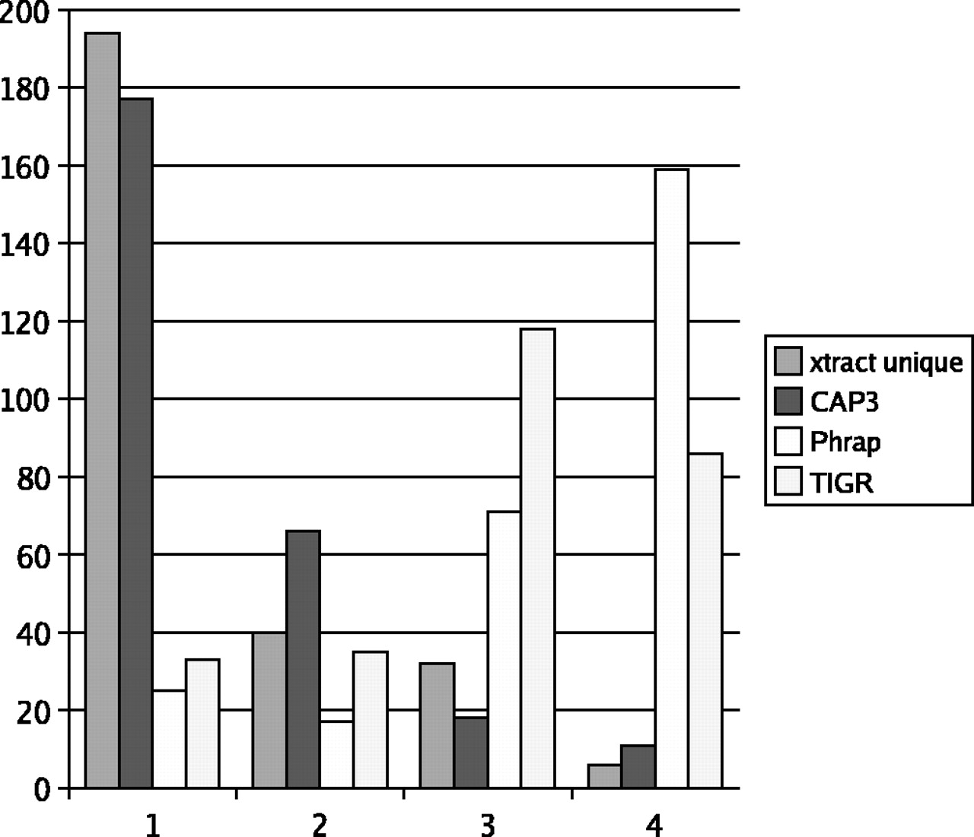
Fig. 6 The ranks of best contig, after processing redundant contigs with cd-hit.
Notes:
Fig. 6 The ranks of best contig, after processing redundant contigs with cd-hit.
Unless provided in the caption above, the following copyright applies to the content of this slide: © The Author 2004. Published by Oxford University Press. All rights reserved. For Permissions, please email: journals.permissions@oupjournals.org

