Slide 1
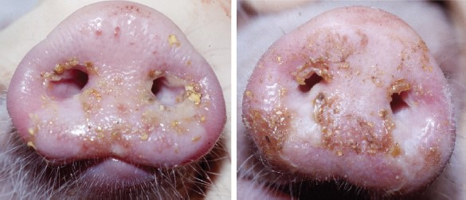
Fig. 1 Lesion on snout of pig 65 in area of black fly bites on PID 2 (left) and PID 5 (right). On PID 2, there is a ...
Notes:
Fig. 1 Lesion on snout of pig 65 in area of black fly bites on PID 2 (left) and PID 5 (right). On PID 2, there is a large pale, raised area of vesiculation ventral to the nostrils. By PID 5, the vesicle had ruptured and the area was eroded.
Unless provided in the caption above, the following copyright applies to the content of this slide: © 2004 Entomological Society of AmericaThis is an Open Access article distributed under the terms of the Creative Commons Attribution Non-Commercial License (http://creativecommons.org/licenses/by-nc/3.0/), which permits non-commercial reuse, distribution, and reproduction in any medium, provided the original work is properly cited. For commercial re-use, please contact journals.permissions@oup.com

