Slide 1
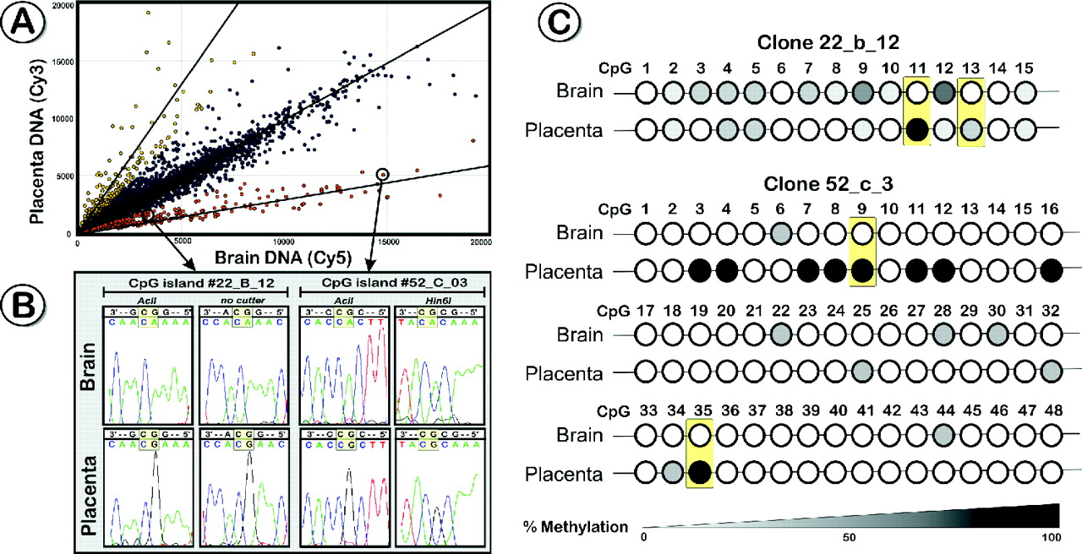
Figure 7 Examples of applications using a CpG island microarray. ( A ) Hybridization of the unmethylated fraction of ...
Notes:
Figure 7 Examples of applications using a CpG island microarray. ( A ) Hybridization of the unmethylated fraction of placenta DNA and post mortem brain DNA to a CpG island array. Two pools of CpG island elements could be identified, which display extensively different methylation levels between these tissues ( Note : some of the identified differences could be due to DNA sequence variation). ( B ) To validate the identified methylation differences, several CpG islands were subjected to bisulfite modification based mapping of methylated cytosines as exemplified for CpG island clones 22_B_12 (promoter region of Galectin-1) and 52_C_03 (promoter region of a brain-specific transcript, CR606704). The top sequence shows the reverse strand (−) of the original restriction sites, the bottom sequence displays the bisulfite-modified DNA. For each bisulfite-modified CpG-island, 8–10 clones were sequenced per tissue. Sequence 52_C_03 revealed several fully methylated CpG's in placenta, which were unmethylated in brain. In contrast, clone 22_B_12 showed subtler methylation differences (15–100%), depending on the position of CpG-dinucleotide. ( C ) Methylation patterns of clones 22B_12 and 52_C_03 derived from bisulfite sequencing of 10–12 clones per tissue. The yellow boxes indicate CpG dinucleotides that are shown in the sequenced graph ( Figure 7B ).
Unless provided in the caption above, the following copyright applies to the content of this slide: © The Author 2006. Published by Oxford University Press. All rights reserved The online version of this article has been published under an open access model. Users are entitled to use, reproduce, disseminate, or display the open access version of this article for non-commercial purposes provided that: the original authorship is properly and fully attributed; the Journal and Oxford University Press are attributed as the original place of publication with the correct citation details given; if an article is subsequently reproduced or disseminated not in its entirety but only in part or as a derivative work this must be clearly indicated. For commercial re-use, please contact journals.permissions@oxfordjournals.org

Slide 2
Figure 6 Applications of the epigenetic profiling technology. ( A ) Changes of methylation profiles at TXNRD2 - ...
Notes:
Figure 6 Applications of the epigenetic profiling technology. ( A ) Changes of methylation profiles at TXNRD2 - COMT-ARVCF in a brain tumour. The data from two different microarrays experiments are superimposed over each other. The analysis of two post mortem brain samples (closed dots) reveals no major difference in methylation levels, whereas the signal intensities vary significantly in the brain tumour (grey dots) when compared with the normal brain. ( B ) The comparison of DNA methylation profiles using the COMT microarray in brain tissue of a healthy control and a schizophrenia patient displays subtle epigenetic differences.
Unless provided in the caption above, the following copyright applies to the content of this slide: © The Author 2006. Published by Oxford University Press. All rights reserved The online version of this article has been published under an open access model. Users are entitled to use, reproduce, disseminate, or display the open access version of this article for non-commercial purposes provided that: the original authorship is properly and fully attributed; the Journal and Oxford University Press are attributed as the original place of publication with the correct citation details given; if an article is subsequently reproduced or disseminated not in its entirety but only in part or as a derivative work this must be clearly indicated. For commercial re-use, please contact journals.permissions@oxfordjournals.org

Slide 3
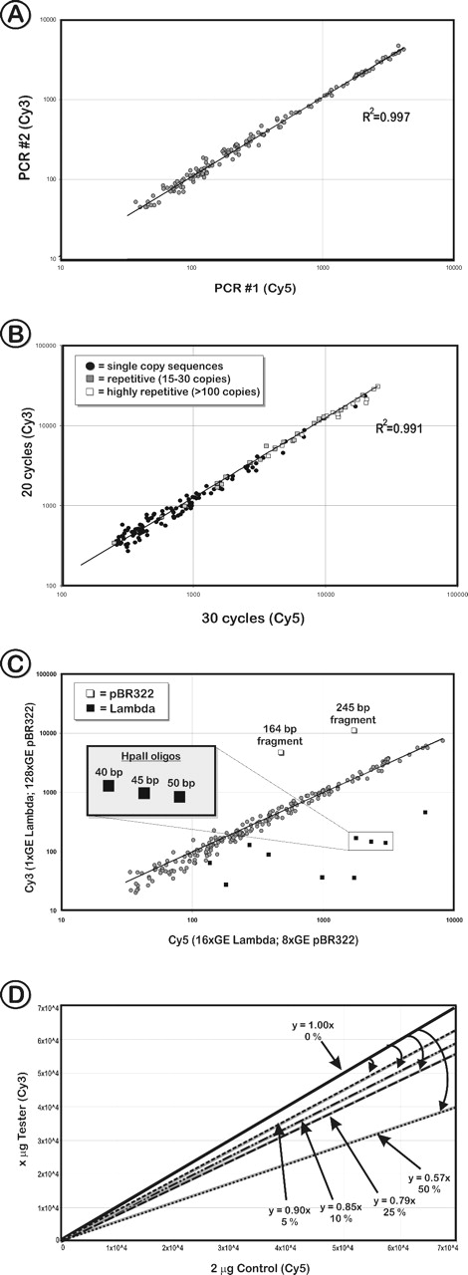
Figure 5 Reproducibility and sensitivity of the method. ( A ) A COMT microarray scatter plot representing two sets of ...
Notes:
Figure 5 Reproducibility and sensitivity of the method. ( A ) A COMT microarray scatter plot representing two sets of amplification products derived from the same DNA source but produced at different time points by different researchers. The high-correlation coefficient of signal intensities demonstrates a high reproducibility of the method. ( B ) Influence of the PCR cycle number. Scatter plot diagrams show hybridization signal intensities of the unmethylated fraction that was amplified using 20 PCR cycles (Cy3 channel) and 30 cycles (Cy5 channel). Amplification products of each PCR were co-hybridized to the COMT microarray that contained oligonucleotides representing single copy sequences (closed circles), partially repetitive sequences (grey squares; 15–99 copies/genome) and highly repetitive DNA fragments (open squares; >100 copies/genome), such as ALU and LINE repeats. ( C ) Scatter plot representing the unmethylated fraction of human gDNA ‘spiked’ with different amounts of control DNA. The test samples were hybridized to the COMT array and contained either a 16-fold excess of λ DNA (16 genome equivalents [GE] versus 1 GE; 10 fragments) or a 16-fold excess of pBR322 (128 GE versus 8 GE; 2 fragments), respectively. The amplicons of the spiked DNA (representing unmethylated DNA) can be easily distinguished as outliers; whereas the signals representing gDNA are located close to the regression line. Median signal intensities of different length oligonucleotides (40–50 bases) that target a specific HpaII restriction fragment in λ DNA reveal that the length of spotted sequences directly influences the spot intensity and therefore the sensitivity of the microarray. ( D ) Sensitivity of the CpG-island microarray hybridization. Control amplicon (2 µg) (post mortem brain, unmethylated fraction) was labelled with Cy5 and co-hybridized with 2 µg (0% difference), 1.9 µg (5% difference), 1.8 µg (10% difference), 1.5 µg (25% difference) or 1.0 µg (50% difference) of Cy3-labelled amplicon. For each hybridization to a COMT array, the regression lines represent the overall intensity that mimics methylation differences over the entire sample. The decrease of amount of DNA is reflected in the angle of the regression lines, which deviated by 5–7% from the expected values.
Unless provided in the caption above, the following copyright applies to the content of this slide: © The Author 2006. Published by Oxford University Press. All rights reserved The online version of this article has been published under an open access model. Users are entitled to use, reproduce, disseminate, or display the open access version of this article for non-commercial purposes provided that: the original authorship is properly and fully attributed; the Journal and Oxford University Press are attributed as the original place of publication with the correct citation details given; if an article is subsequently reproduced or disseminated not in its entirety but only in part or as a derivative work this must be clearly indicated. For commercial re-use, please contact journals.permissions@oxfordjournals.org

Slide 4
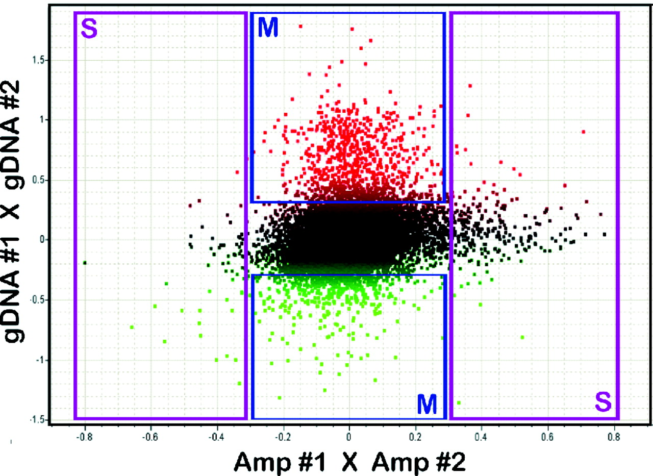
Figure 4 Combined methylation- and SNP-analysis on a CpG island microarray. The data of two separate hybridizations ...
Notes:
Figure 4 Combined methylation- and SNP-analysis on a CpG island microarray. The data of two separate hybridizations of DNA samples derived from post mortem brain of two individuals are plotted against each other. The Y -axis contains the data derived from a methylation analysis (triple-cleavage with HpaII, Hin6I and AciI), whereas the X -axis contains the SNP data derived from the hybridization of the same DNA samples, which were subjected to the entire genome amplification prior to cleavage by the methylation-sensitive restriction enzymes (Materials and Methods). Scale: log (Cy5/Cy3); an increased log-value on the Y -axis is indicated by red versus a decreased log-value represented by green. Significant outliers (log-ratio 0.3, 2-fold difference) can be classified into four clusters (S = SNPs, M = DNA methylation differences), enabling the differentiation of epigenetic differences and nucleotide polymorphisms between the test-samples. Amp = Whole-genome amplified sample.
Unless provided in the caption above, the following copyright applies to the content of this slide: © The Author 2006. Published by Oxford University Press. All rights reserved The online version of this article has been published under an open access model. Users are entitled to use, reproduce, disseminate, or display the open access version of this article for non-commercial purposes provided that: the original authorship is properly and fully attributed; the Journal and Oxford University Press are attributed as the original place of publication with the correct citation details given; if an article is subsequently reproduced or disseminated not in its entirety but only in part or as a derivative work this must be clearly indicated. For commercial re-use, please contact journals.permissions@oxfordjournals.org

Slide 5
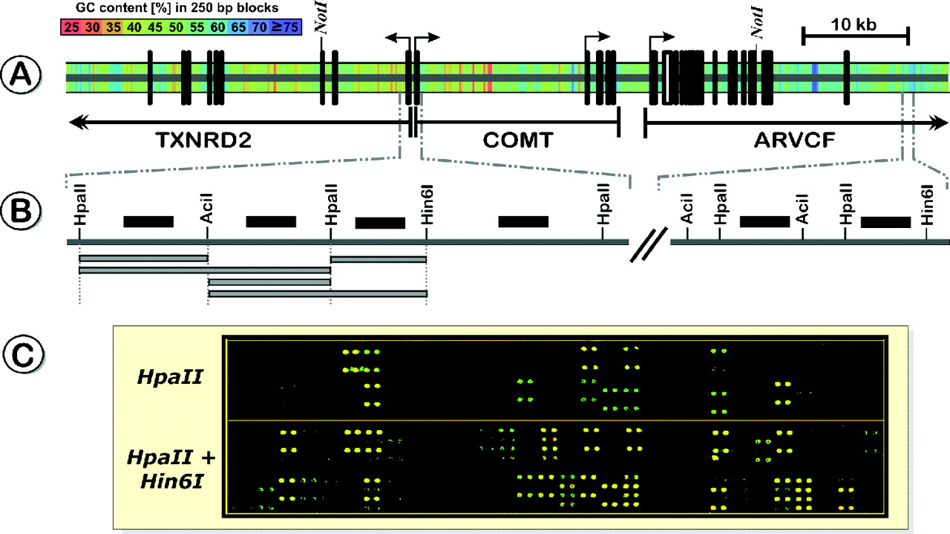
Figure 3 ( A ) Structure and GC-content of the chromosomal region on human chromosome 22q11.2 that spans the ...
Notes:
Figure 3 ( A ) Structure and GC-content of the chromosomal region on human chromosome 22q11.2 that spans the catechol- o -methyltransferase gene ( COMT ), the thioredoxin reductase 2 gene ( TXNRD2 ) and the armadillo repeat gene deleted in VCFS ( ARVCF ). Vertical black bars represent exons. ( B ) To determine the methylation profile of the 100 kb TXNRD2-COMT-ARVCF region, 384 oligonucleotides (50mers, black horizontal bars) were designed based on the restriction sites for the methylation-sensitive endonucleases, HpaII, Hin6I and AciI (additional alternative enzymes are HpyCH4IV or Hin1I). Depending on the methylation status of the CpG-dinucleotides several combinations of amplicons (grey horizontal bars) can potentially hybridize to the oligonucleotides. ( C ) Typical hybridization patterns of the hypomethylated fraction of human gDNA on the COMT oligonucleotide-microarray. As discussed in Results, the complexity and informativeness of the hybridization signals increases with increasing number of methylation-sensitive restriction enzymes.
Unless provided in the caption above, the following copyright applies to the content of this slide: © The Author 2006. Published by Oxford University Press. All rights reserved The online version of this article has been published under an open access model. Users are entitled to use, reproduce, disseminate, or display the open access version of this article for non-commercial purposes provided that: the original authorship is properly and fully attributed; the Journal and Oxford University Press are attributed as the original place of publication with the correct citation details given; if an article is subsequently reproduced or disseminated not in its entirety but only in part or as a derivative work this must be clearly indicated. For commercial re-use, please contact journals.permissions@oxfordjournals.org

Slide 6
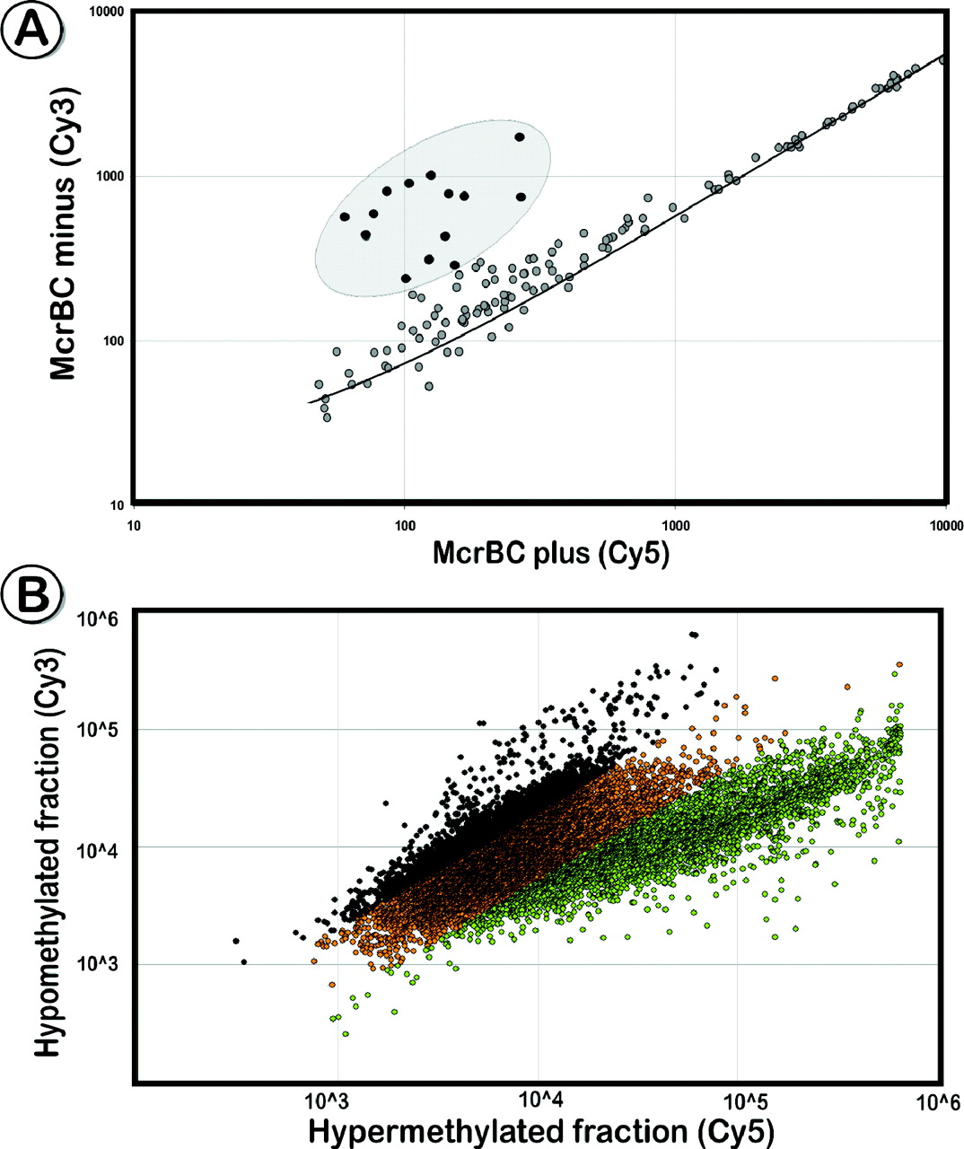
Figure 2 Selective enrichment of restriction fragments with the universal adaptor U-CG1. ( A ) Scatter plot that ...
Notes:
Figure 2 Selective enrichment of restriction fragments with the universal adaptor U-CG1. ( A ) Scatter plot that shows a comparison of ligation products treated with McrBC versus the untreated sample on the COMT array. McrBC treated fragments that contained at least two methylated cytosines were cleaved and could not be amplified in the following adaptor-PCR, resulting in reduced signal intensities in the Cy5 channel. ( B ) Co-hybridization of enriched unmethylated ( Figure 1 , middle panel) and hypermethylated ( Figure 1 , right panel) fragments derived from the same DNA source to a CpG island microarray. A large portion of amplicons is present only in one of the enriched fractions (marked black for log >0.3 black, green for log <−0.3). Although the hypermethylated fraction hybridized to ∼75% of the microarray spots, based on our DNA sequence analysis, only a small fraction of them provide epigenetic information in comparison with the unmethylated fraction.
Unless provided in the caption above, the following copyright applies to the content of this slide: © The Author 2006. Published by Oxford University Press. All rights reserved The online version of this article has been published under an open access model. Users are entitled to use, reproduce, disseminate, or display the open access version of this article for non-commercial purposes provided that: the original authorship is properly and fully attributed; the Journal and Oxford University Press are attributed as the original place of publication with the correct citation details given; if an article is subsequently reproduced or disseminated not in its entirety but only in part or as a derivative work this must be clearly indicated. For commercial re-use, please contact journals.permissions@oxfordjournals.org

Slide 7
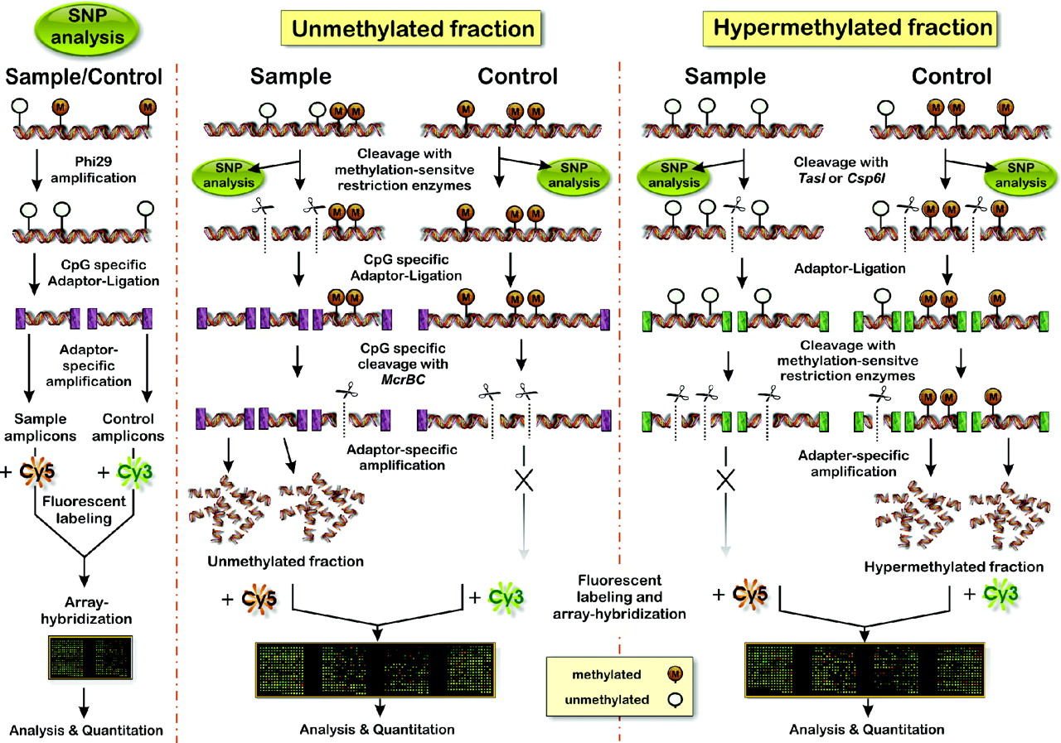
Figure 1 Schematic outline of the microarray-based method for identification of DNA methylation differences and DNA ...
Notes:
Figure 1 Schematic outline of the microarray-based method for identification of DNA methylation differences and DNA polymorphisms in genomic DNA. Left panel: analysis of DNA sequence variation. Middle panel: the main strategy of the method is based on enrichment of unmethylated DNA fragments. DNA samples are cleaved by methylation-sensitive restriction endonucleases, and the resulting DNA fragments are then selectively enriched by adaptor-specific aminoallyl-PCR's, labelled and hybridized to microarrays. Right panel: alternative procedure to enrich the hypermethylated DNA fraction.
Unless provided in the caption above, the following copyright applies to the content of this slide: © The Author 2006. Published by Oxford University Press. All rights reserved The online version of this article has been published under an open access model. Users are entitled to use, reproduce, disseminate, or display the open access version of this article for non-commercial purposes provided that: the original authorship is properly and fully attributed; the Journal and Oxford University Press are attributed as the original place of publication with the correct citation details given; if an article is subsequently reproduced or disseminated not in its entirety but only in part or as a derivative work this must be clearly indicated. For commercial re-use, please contact journals.permissions@oxfordjournals.org

Slide 8
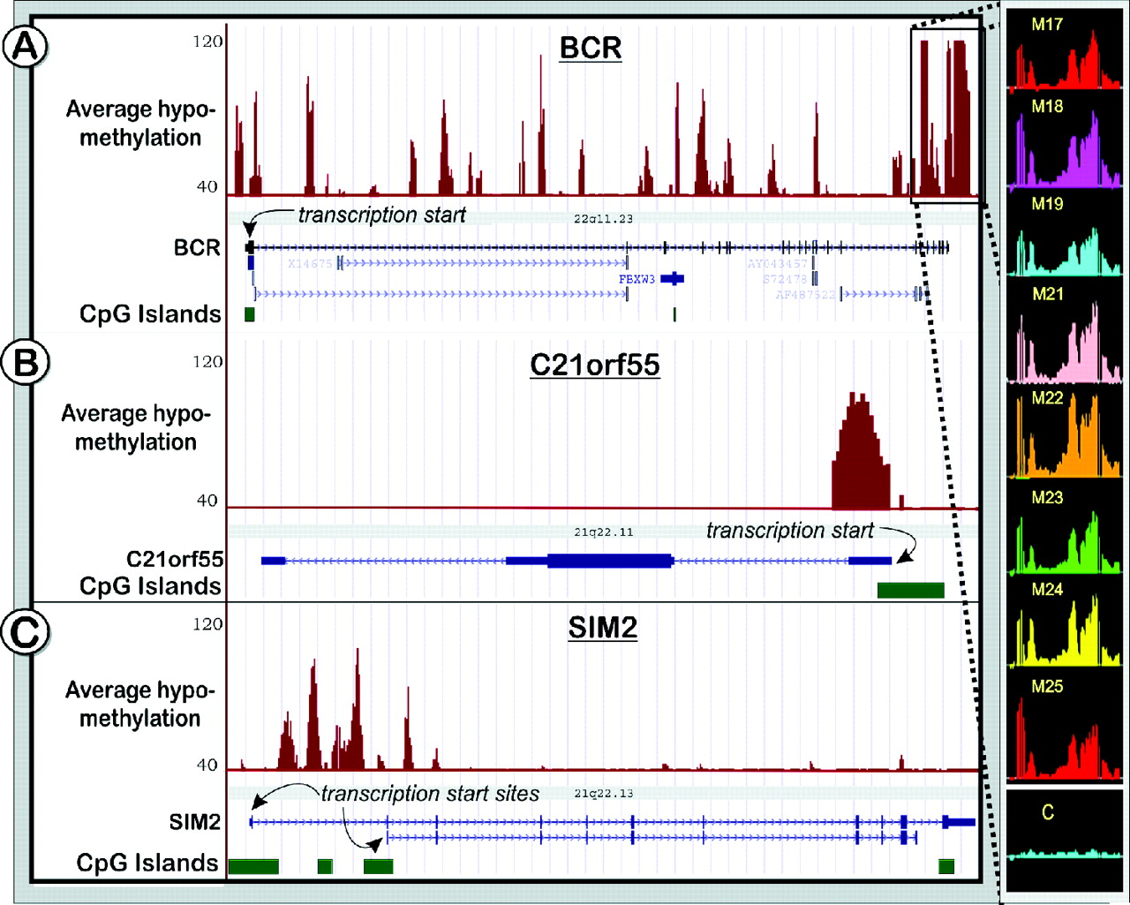
Figure 8 Profiles of unmethylated sites in three loci on human chromosomes 21 and 22 (501 bp window, Materials and ...
Notes:
Figure 8 Profiles of unmethylated sites in three loci on human chromosomes 21 and 22 (501 bp window, Materials and Methods): BCR ( A ), C21ORF55 ( B ) and SIM2 ( C ) for human brain DNA (average of eight individuals, M17-M25). The graphs are based on P -values for each individual interrogation that show the significance of the enrichment in the unmethylated fraction versus total gDNA. The P -values were converted to the (−10 log 10 ) scale, such that, for example, P -value of 10 −4 becomes 40. The vertical axes are adjusted to represent probes in the 40–120 range ( P -values of 10 −4 –10 −12 ), thus only probes that pass P < 10 −4 threshold are shown. Enlarged is a part of the chr 22q11.21 region (181 bp window), spanning breakpoints found in the generation of the two alternative forms of the Philadelphia chromosome translocation. C = gDNA control.
Unless provided in the caption above, the following copyright applies to the content of this slide: © The Author 2006. Published by Oxford University Press. All rights reserved The online version of this article has been published under an open access model. Users are entitled to use, reproduce, disseminate, or display the open access version of this article for non-commercial purposes provided that: the original authorship is properly and fully attributed; the Journal and Oxford University Press are attributed as the original place of publication with the correct citation details given; if an article is subsequently reproduced or disseminated not in its entirety but only in part or as a derivative work this must be clearly indicated. For commercial re-use, please contact journals.permissions@oxfordjournals.org

Slide 9
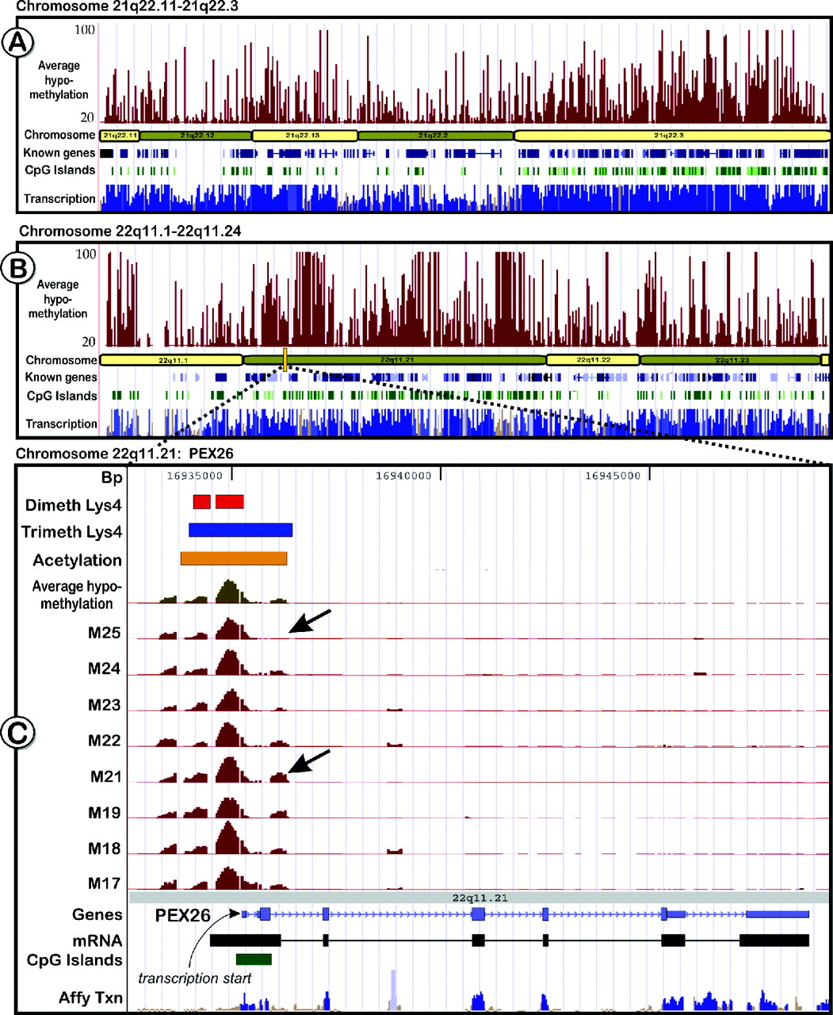
Figure 9 Genomic views showing unmethylated regions on chromosomes 21 and 22. ( A and B ): The top tracks (dark red) ...
Notes:
Figure 9 Genomic views showing unmethylated regions on chromosomes 21 and 22. ( A and B ): The top tracks (dark red) in the two chromosomal graphs shows the average amount of hypomethylation in the brain cortex of eight adult individuals. Also displayed are known genes (dark blue) and CpG islands (green). The bottom tracks display transcriptome data derived from 11 different tissues from the Affymetrix transcriptome phase 2 study ( 36 ). The track is coloured blue in areas that are thought to be transcribed at a statistically significant level. Regions that have a significant homology to other chromosomal regions or that overlap putative pseudogenes are coloured in lighter shades of blue. All other regions of the track are colored brown. ( C ) Enlarged is a part of chromosome 22q11.21, containing the peroxisome biogenesis factor 26 ( PEX26 , MIM 608666) that shows correlation between histone modifications and unmethylated DNA in its promoter region. The top three tracks represent histone modification data for H3 Lys4 dimethylation (orange bar), H3 Lys4 trimethylation (blue bar) and H3 Lys9/14 acetylation (yellow bar) ( 37 ). Underneath are the tracks for the average methylation patterns (unmethylated sites) observed in brain and the individual methylation patterns of all tested individuals (dark red). It is noteworthy that methylation patterns exhibit some interindividual differences (indicated by arrows).
Unless provided in the caption above, the following copyright applies to the content of this slide: © The Author 2006. Published by Oxford University Press. All rights reserved The online version of this article has been published under an open access model. Users are entitled to use, reproduce, disseminate, or display the open access version of this article for non-commercial purposes provided that: the original authorship is properly and fully attributed; the Journal and Oxford University Press are attributed as the original place of publication with the correct citation details given; if an article is subsequently reproduced or disseminated not in its entirety but only in part or as a derivative work this must be clearly indicated. For commercial re-use, please contact journals.permissions@oxfordjournals.org

