Slide 1
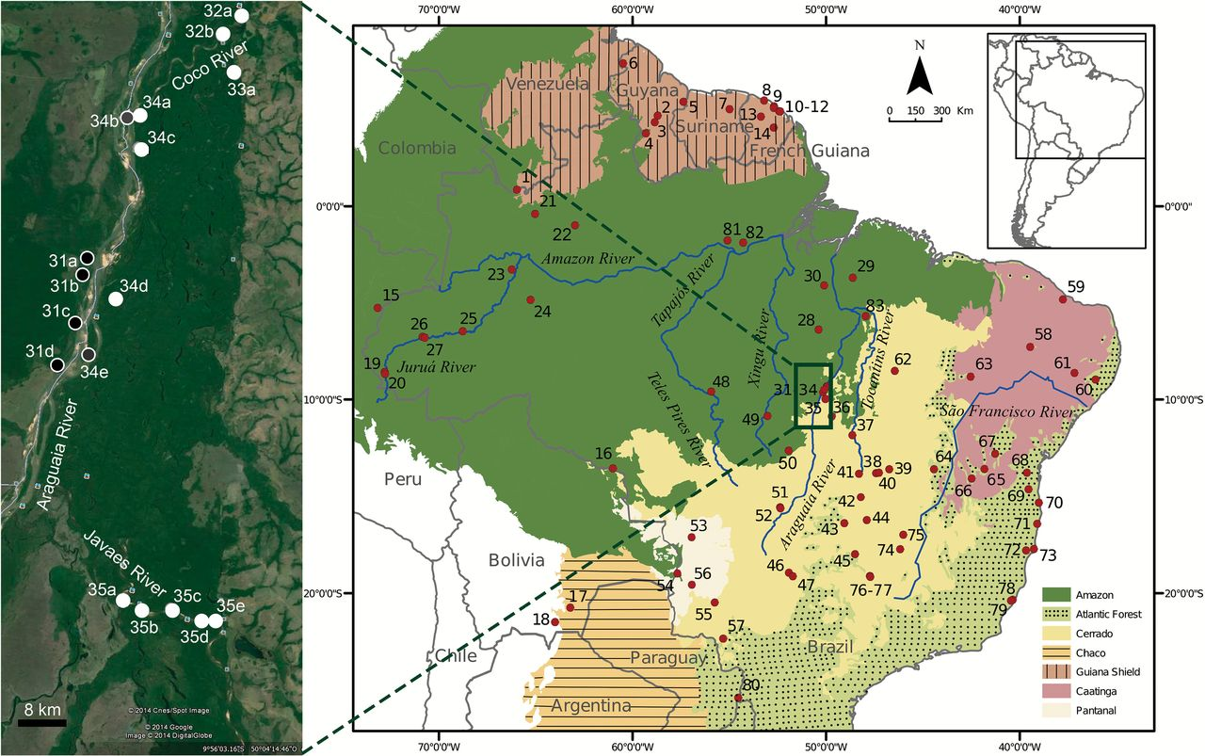
Figure 1. (a) Sampling areas at the mid-Araguaia River and its tributaries (left, source: Google Earth). Sampling ...
Notes:
Figure 1. (a) Sampling areas at the mid-Araguaia River and its tributaries (left, source: Google Earth). Sampling points in white corresponds to the eastern river bank, in black to the western river bank, and in gray to the islands of the Araguaia River. (b) Map including all sampling localities of 6 didelphid marsupials in South America (right). See Gazetteer for detailed information on localities.
Unless provided in the caption above, the following copyright applies to the content of this slide: © The American Genetic Association 2015. All rights reserved. For permissions, please e-mail: journals.permissions@oup.com

Slide 2
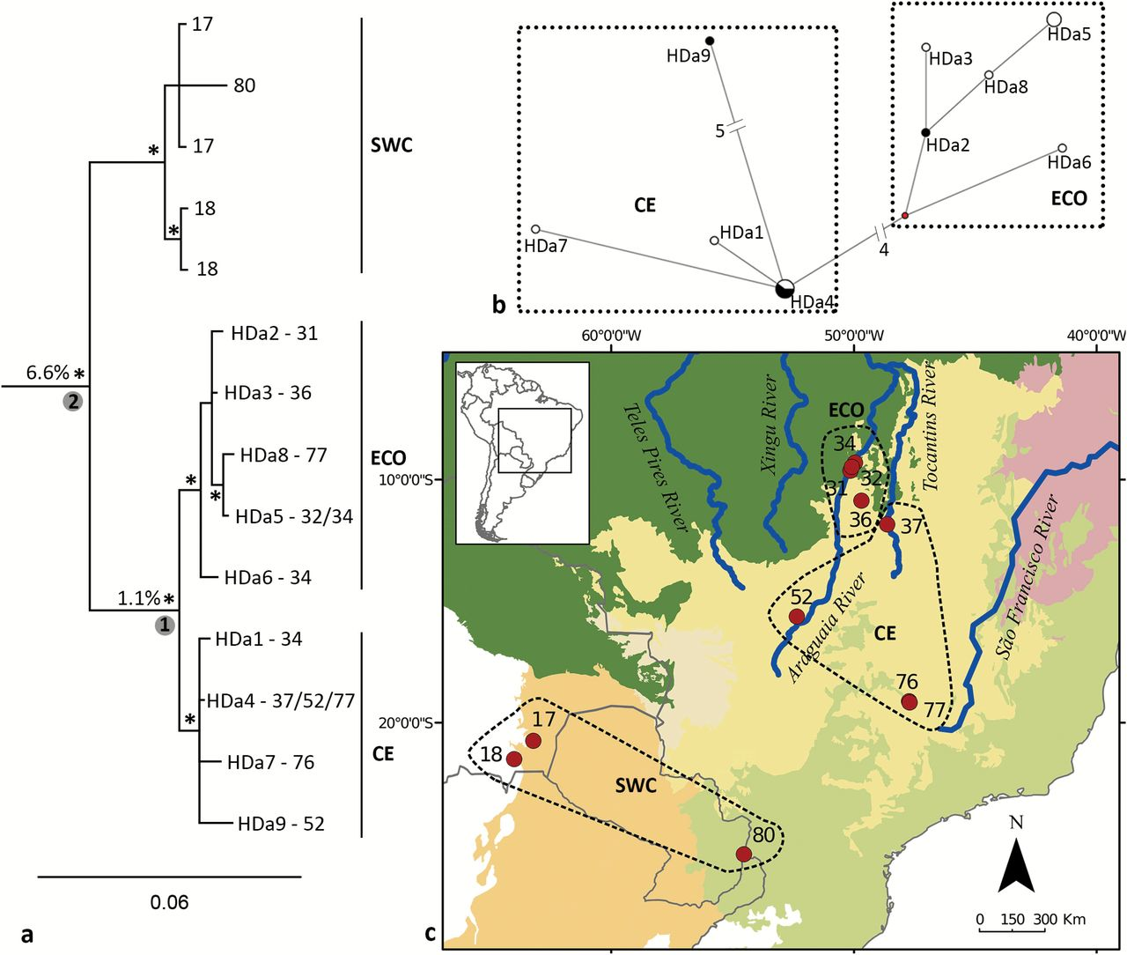
Figure 2. (a) Bayesian phylogenetic reconstruction of mt-Cytb haplotypes of Didelphis albiventris (GTR+I model used). ...
Notes:
Figure 2. (a) Bayesian phylogenetic reconstruction of mt-Cytb haplotypes of Didelphis albiventris (GTR+I model used). Numbers in circles represent nodes for which time to most recent common ancestor are shown in Table 1; percentage values correspond to pairwise genetic distances between clades; and asterisks indicate BPP ≥0.95; numbers in the tip of branches are sampling localities and acronyms are haplotype designations; clades are designated by ECO (Amazonia-Cerrado ecotone clade), CE (Cerrado clade), and SWC (southwest clade). (b) MJ network of D. albiventris of the ECO and CE clades, central Brazil. Length of connecting branches corresponds to the nucleotide substitutions; size of the circles is proportional to the number of individuals sharing each haplotype; white corresponds to the eastern riverbank of the Araguaia River, and black to the western riverbank. (c) Map of sampling localities of D. albiventris, with the representation of the clades.
Unless provided in the caption above, the following copyright applies to the content of this slide: © The American Genetic Association 2015. All rights reserved. For permissions, please e-mail: journals.permissions@oup.com

Slide 3
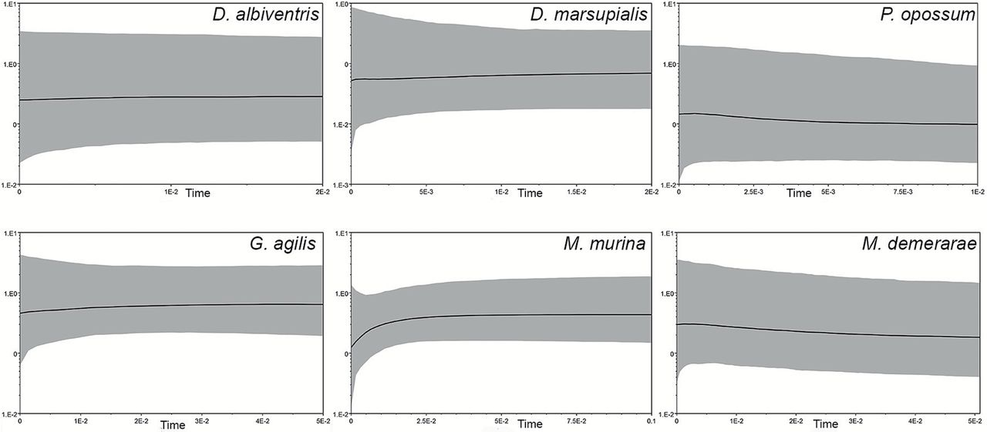
Figure 3. Demographic scenarios of 6 didelphid marsupials from central Brazil reconstructed from mt-Cytb sequences ...
Notes:
Figure 3. Demographic scenarios of 6 didelphid marsupials from central Brazil reconstructed from mt-Cytb sequences using the program BEAST. Black solid curves indicate changes in effective population size and gray shadows indicate upper and lower 95% confidence interval.
Unless provided in the caption above, the following copyright applies to the content of this slide: © The American Genetic Association 2015. All rights reserved. For permissions, please e-mail: journals.permissions@oup.com

Slide 4
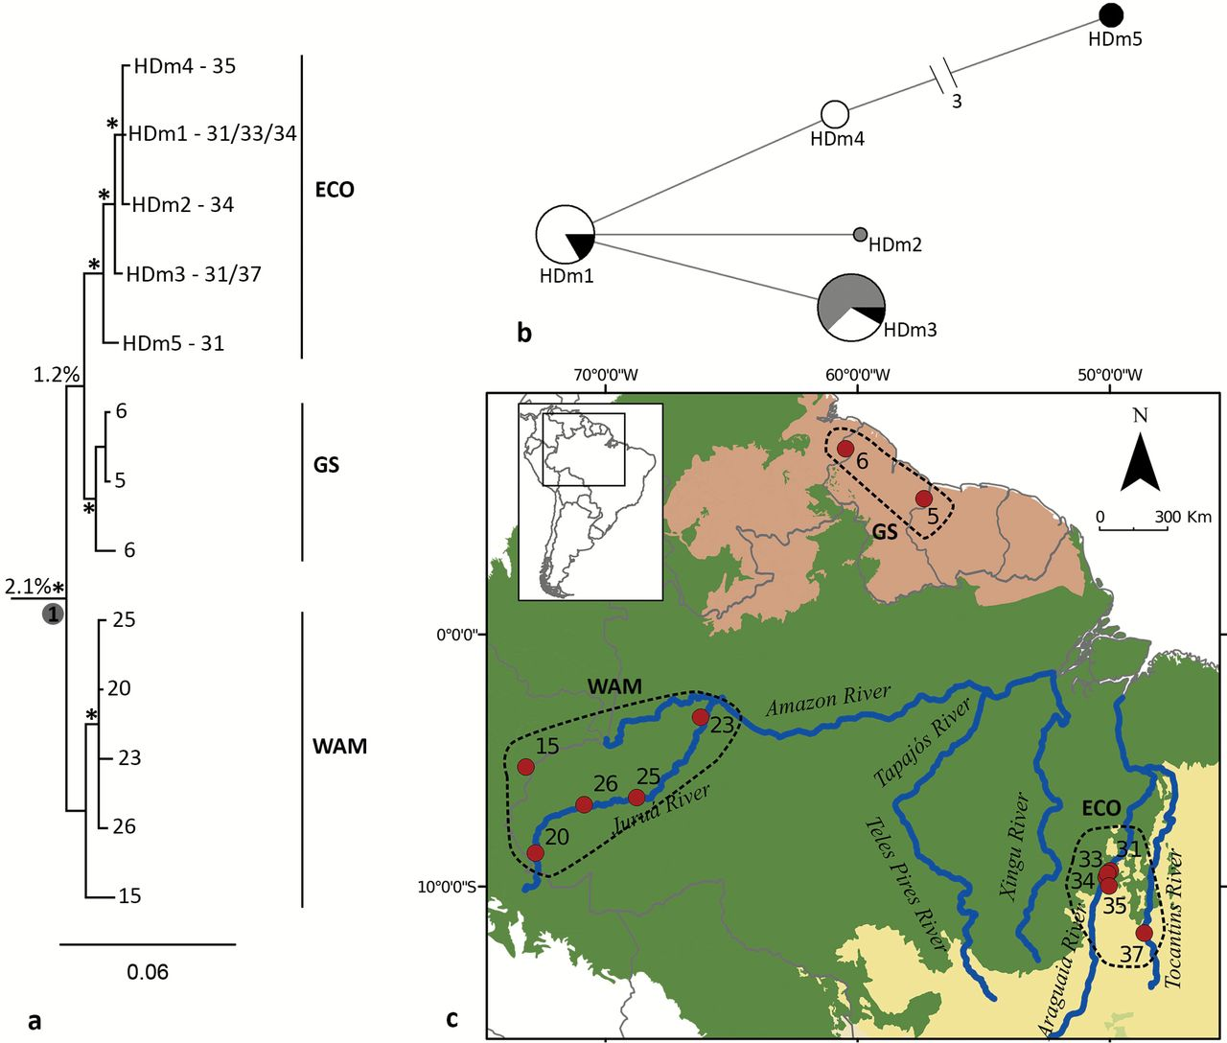
Figure 4. (a) Bayesian phylogenetic reconstruction of mt-Cytb haplotypes of Didelphis marsupialis (GTR+I model used). ...
Notes:
Figure 4. (a) Bayesian phylogenetic reconstruction of mt-Cytb haplotypes of Didelphis marsupialis (GTR+I model used). Numbers in circle represent nodes for which time to most recent common ancestor are shown in Table 1; percentage values correspond to pairwise genetic distances between clades; and asterisks indicate BPP ≥0.95; numbers in the tip of branches are sampling localities and acronyms are haplotype designations; clades are designated by ECO (Amazonia-Cerrado ecotone), GS (Guiana Shield), and WAM (western Amazonia). (b) MJ network of D. marsupialis of the ECO clade, central Brazil. Length of connecting branches corresponds to the nucleotide substitutions; size of the circles is proportional to the number of individuals sharing each haplotype; white corresponds to the eastern riverbank of the Araguaia River, black to the western riverbank, and gray to the islands of the Araguaia River. (c) Map of sampling localities of D. marsupialis, with the representation of the clades.
Unless provided in the caption above, the following copyright applies to the content of this slide: © The American Genetic Association 2015. All rights reserved. For permissions, please e-mail: journals.permissions@oup.com

Slide 5
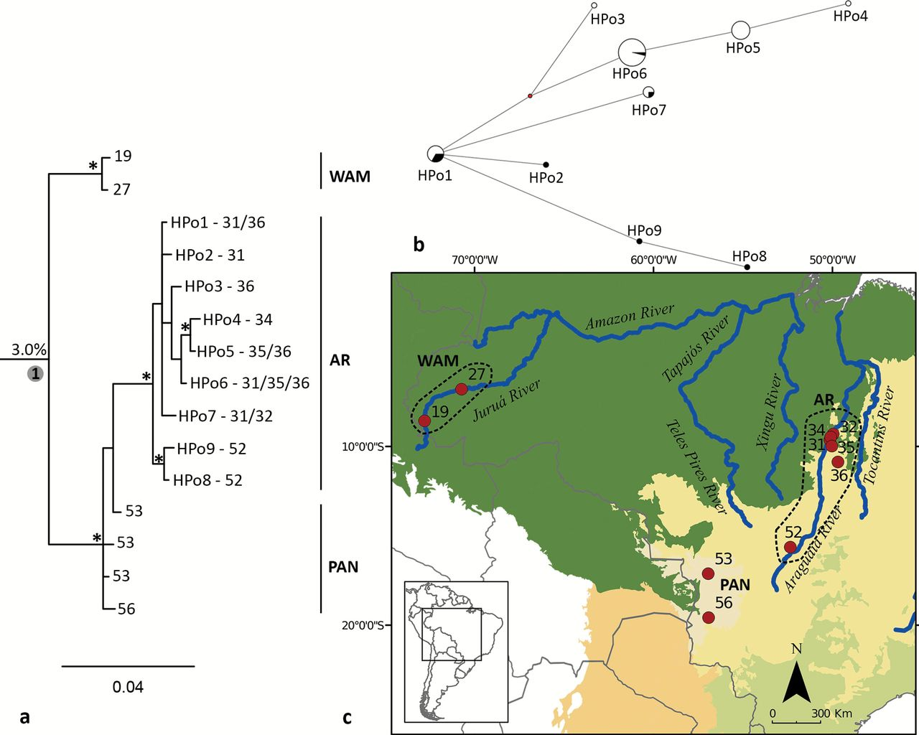
Figure 5. (a) Bayesian phylogenetic reconstruction of mt-Cytb haplotypes of Philander opossum (GTR+G model used). ...
Notes:
Figure 5. (a) Bayesian phylogenetic reconstruction of mt-Cytb haplotypes of Philander opossum (GTR+G model used). Numbers in circle represent nodes for which time to most recent common ancestor are shown in Table 1; percentage values correspond to pairwise genetic distances between clades; and asterisks indicate BPP ≥0.95; numbers in the tip of branches are sampling localities and acronyms are haplotype designations; clades are designated by WAM (western Amazonia), AR (Araguaia River), and PAN (Pantanal). (b) MJ network of P. opossum of the AR clade, central Brazil. Length of connecting branches corresponds to the nucleotide substitutions; size of the circles is proportional to the number of individuals sharing each haplotype; white corresponds to the eastern riverbank of the Araguaia River, and black to the western riverbank. (c) Map of sampling localities of P. opossum, with the representation of the clades.
Unless provided in the caption above, the following copyright applies to the content of this slide: © The American Genetic Association 2015. All rights reserved. For permissions, please e-mail: journals.permissions@oup.com

Slide 6
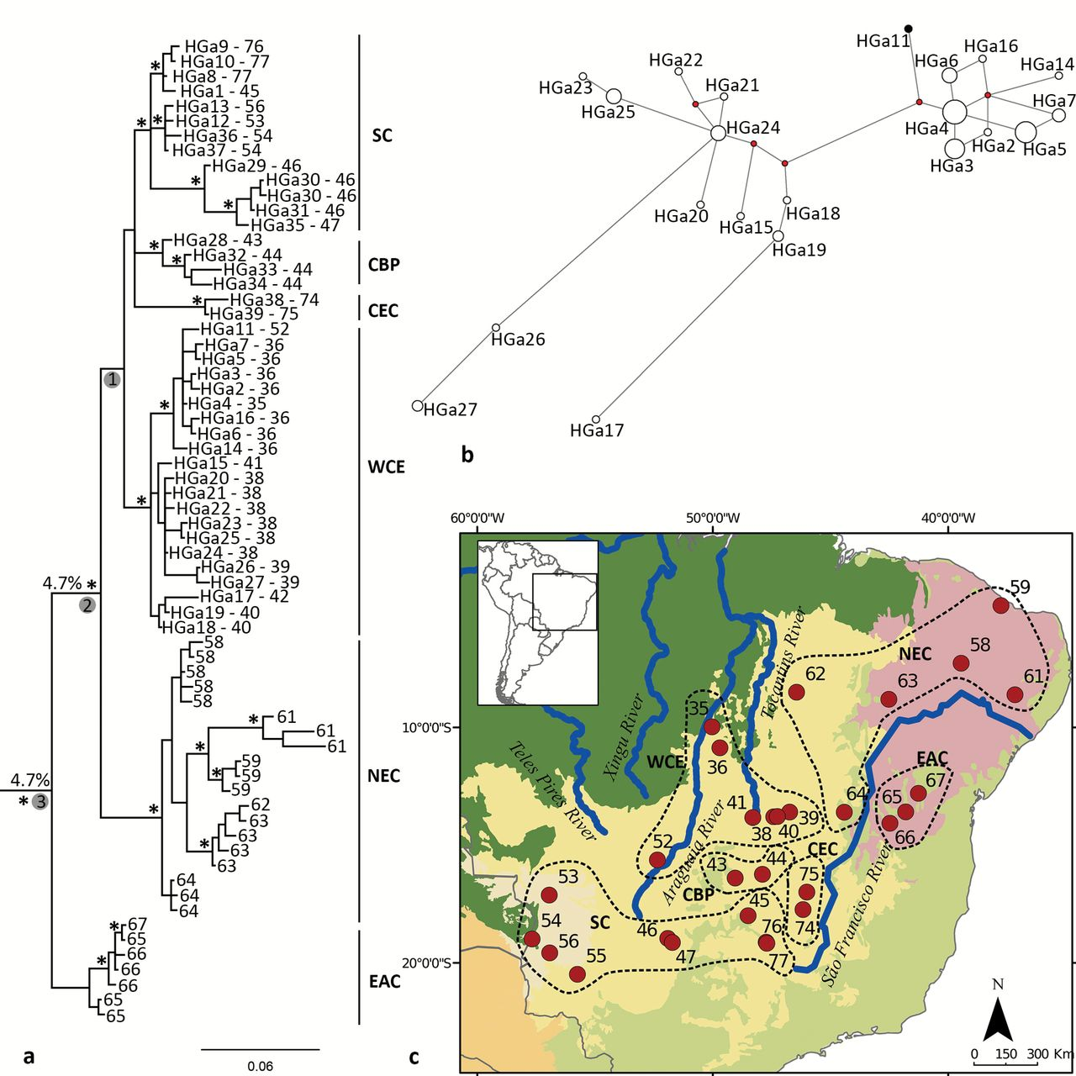
Figure 6. (a) Bayesian phylogenetic reconstruction of mt-Cytb haplotypes of Gracilinanus agilis (GTR+I+G model used). ...
Notes:
Figure 6. (a) Bayesian phylogenetic reconstruction of mt-Cytb haplotypes of Gracilinanus agilis (GTR+I+G model used). Numbers in circle represent nodes for which time to most recent common ancestor are shown in Table 1; percentage values correspond to pairwise genetic distances between clades; and asterisks indicate BPP ≥0.95; numbers in the tip of branches are sampling localities and acronyms are haplotype designations; clades are designated by the SC (southern clade), CBP (central Brazil Plateau clade), CEC (central-east clade), WCE (western clade), NEC (north-eastern clade), and EAC (east clade). (b) MJ network of G. agilis of WCE clade, central Brazil. Length of connecting branches corresponds to the nucleotide substitutions; size of the circles is proportional to the number of individuals sharing each haplotype; white corresponds to the eastern riverbank of the Araguaia River, and black to the western riverbank. (c) Map of sampling localities of G. agilis, with the representation of the clades.
Unless provided in the caption above, the following copyright applies to the content of this slide: © The American Genetic Association 2015. All rights reserved. For permissions, please e-mail: journals.permissions@oup.com

Slide 7
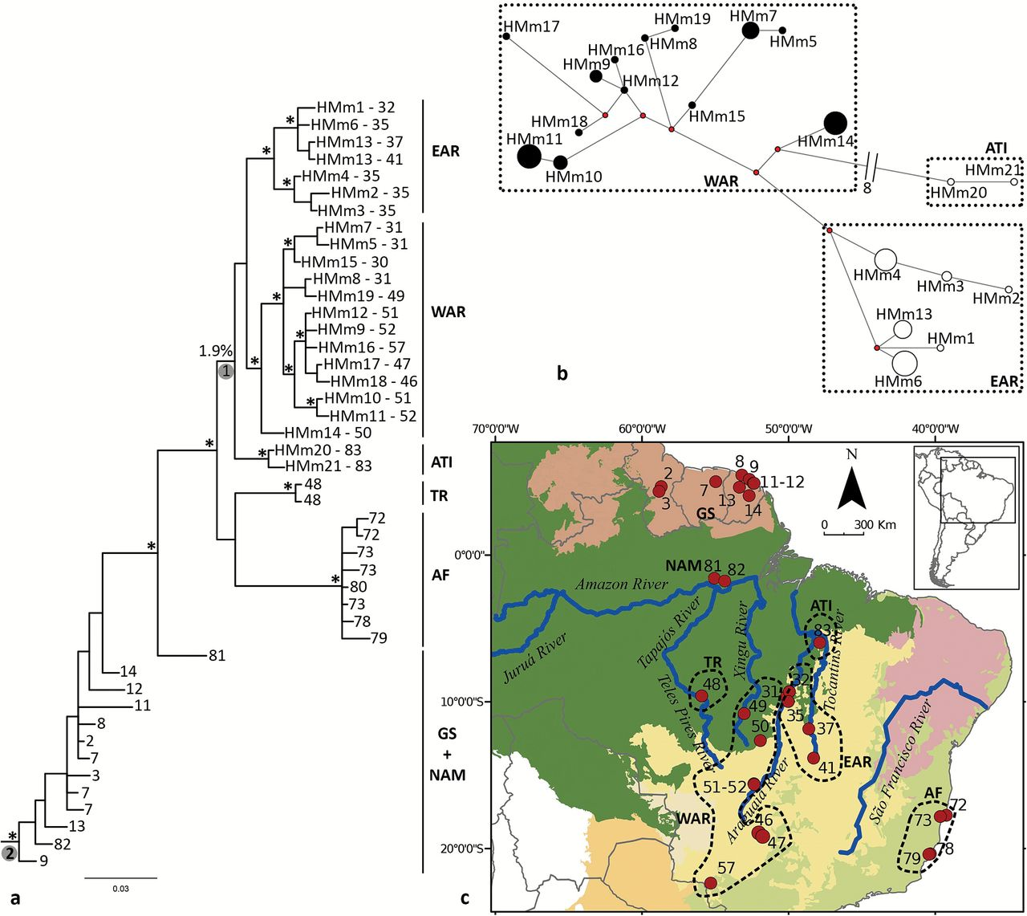
Figure 7. (a) Bayesian phylogenetic reconstruction of mt-Cytb haplotypes of Marmosa murina (HKY+G model used). Numbers ...
Notes:
Figure 7. (a) Bayesian phylogenetic reconstruction of mt-Cytb haplotypes of Marmosa murina (HKY+G model used). Numbers in circle represent nodes for which time to most recent common ancestor are shown in Table 1; percentage values correspond to pairwise genetic distances between clades; and asterisks indicate BPP ≥0.95; numbers in the tip of branches are sampling localities and acronyms are haplotype designations; clades are designated by EAR (eastern Araguaia River), WAR (western Araguaia River), ATI (Araguaia-Tocantins interfluve), TR (Tapajos River), AF (Atlantic Forest), NAM (northern Amazonia), and GS (Guiana Shield). (b) MJ network of M. murina of EAR, WAR, and ATI clades, central Brazil. Length of connecting branches corresponds to the nucleotide substitutions; size of the circles is proportional to the number of individuals sharing each haplotype; white corresponds to the eastern riverbank of the Araguaia River, and black to the western riverbank. (c) Map of sampling localities of M. murina, with the representation of the clades.
Unless provided in the caption above, the following copyright applies to the content of this slide: © The American Genetic Association 2015. All rights reserved. For permissions, please e-mail: journals.permissions@oup.com

Slide 8
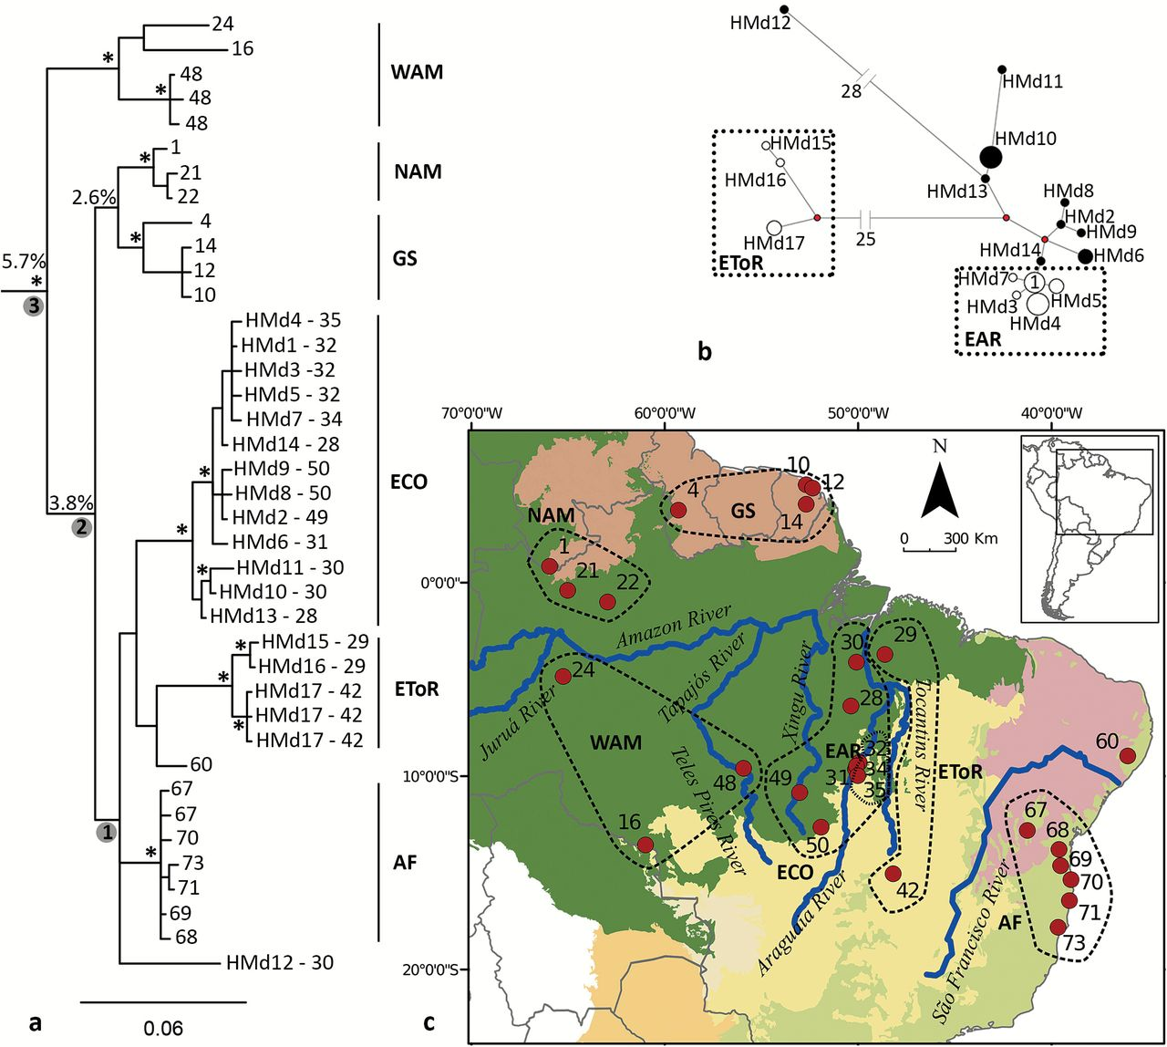
Figure 8. (a) Bayesian phylogenetic reconstruction of mt-Cytb haplotypes of Marmosa demerarae (HKY+I+G model used). ...
Notes:
Figure 8. (a) Bayesian phylogenetic reconstruction of mt-Cytb haplotypes of Marmosa demerarae (HKY+I+G model used). Numbers in circle represent nodes for which time to most recent common ancestor are shown in Table 1; percentage values correspond to pairwise genetic distances between clades; and asterisks indicate BPP ≥0.95; numbers in the tip of branches are sampling localities and acronyms are haplotype designations; clades are designated by WAM (western Amazonia), NAM (northern Amazonia), GS (Guiana Shield), ECO (Amazonia-Cerrado ecotone), EToR (eastern Tocantins River), and AF (Atlantic Forest). (b) MJ network of M. demerarae of the ECO (including samples from eastern Araguaia River, EAR) and EToR clades, central Brazil. Length of connecting branches corresponds to the nucleotide substitutions; size of the circles is proportional to the number of individuals sharing each haplotype; white corresponds to the eastern riverbank of the Araguaia River, and black to the western riverbank. (c) Map of sampling localities of M. demerarae, with the representation of the clades.
Unless provided in the caption above, the following copyright applies to the content of this slide: © The American Genetic Association 2015. All rights reserved. For permissions, please e-mail: journals.permissions@oup.com

