Slide 1
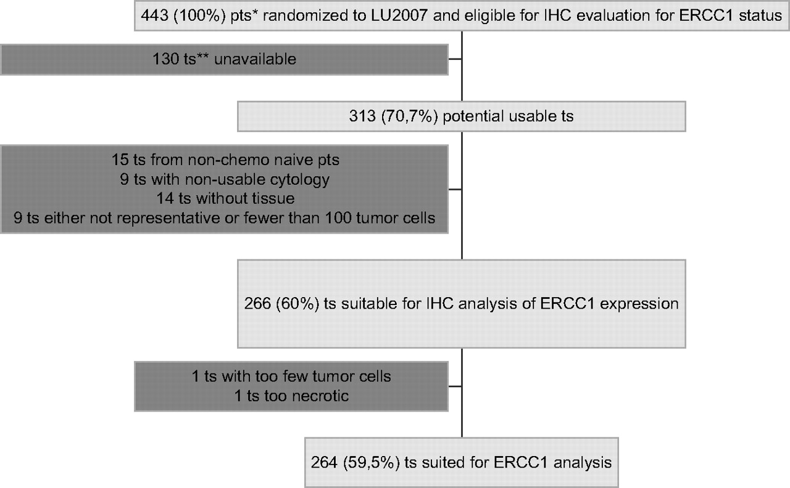
Figure 1. Flow chart of the patients’ tissue samples through the excision repair cross-complementation group 1 (ERCC1) ...
Notes:
Figure 1. Flow chart of the patients’ tissue samples through the excision repair cross-complementation group 1 (ERCC1) tumor marker study. *Patients. **Tissue samples.
Unless provided in the caption above, the following copyright applies to the content of this slide: © The Author 2010. Published by Oxford University Press on behalf of the European Society for Medical Oncology. All rights reserved. For permissions, please email: journals.permissions@oxfordjournals.org

Slide 2
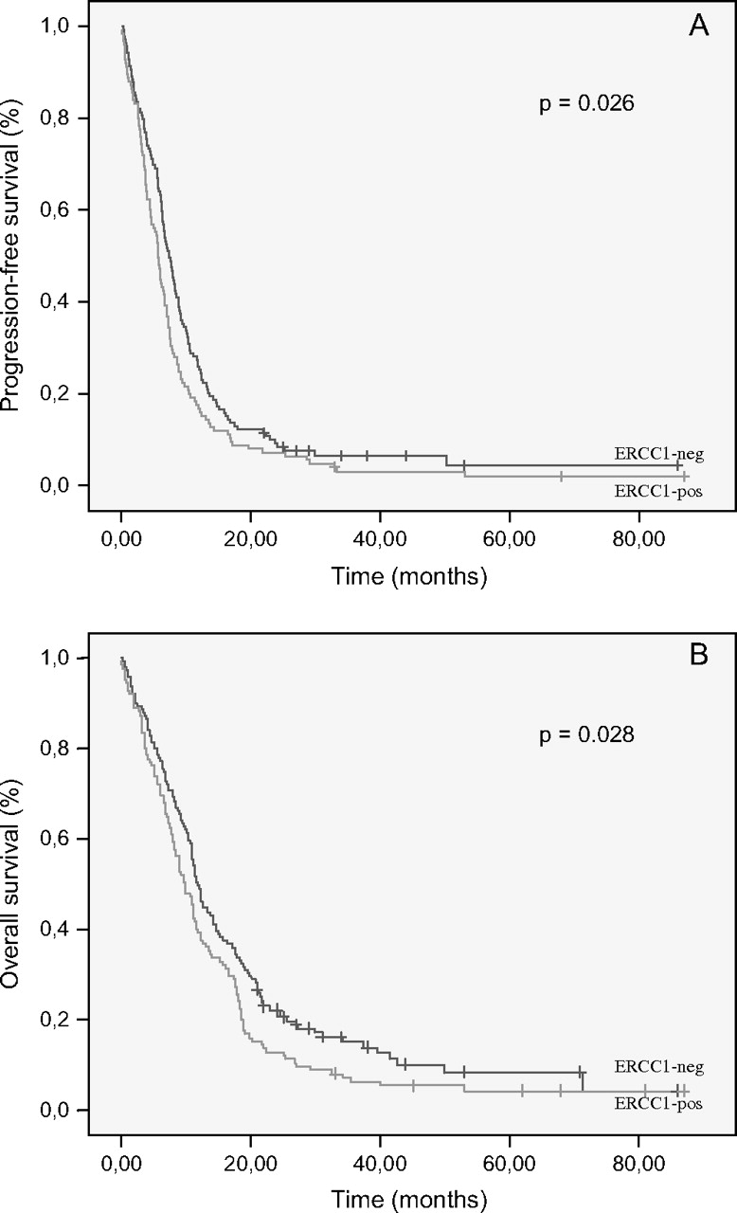
Figure 2. (A and B) Progression-free survival and overall survival in months for 264 patients with advanced ...
Notes:
Figure 2. (A and B) Progression-free survival and overall survival in months for 264 patients with advanced non-small-cell lung cancer stratified according to the excision repair cross-complementation group 1 (ERCC1) tumor marker status.
Unless provided in the caption above, the following copyright applies to the content of this slide: © The Author 2010. Published by Oxford University Press on behalf of the European Society for Medical Oncology. All rights reserved. For permissions, please email: journals.permissions@oxfordjournals.org

Slide 3
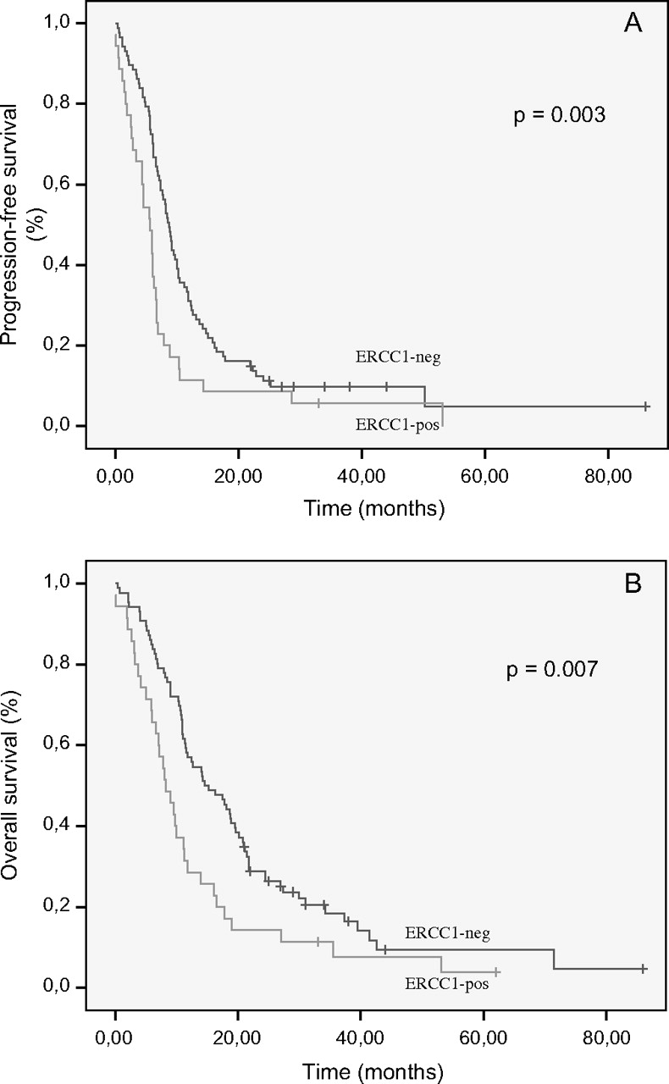
Figure 3. (A and B) Progression-free survival and overall survival in months for 122 patients with advanced ...
Notes:
Figure 3. (A and B) Progression-free survival and overall survival in months for 122 patients with advanced non-small-cell lung cancer (adenocarcinoma subtype) stratified according to the excision repair cross-complementation group 1 (ERCC1) tumor marker status.
Unless provided in the caption above, the following copyright applies to the content of this slide: © The Author 2010. Published by Oxford University Press on behalf of the European Society for Medical Oncology. All rights reserved. For permissions, please email: journals.permissions@oxfordjournals.org

Slide 4
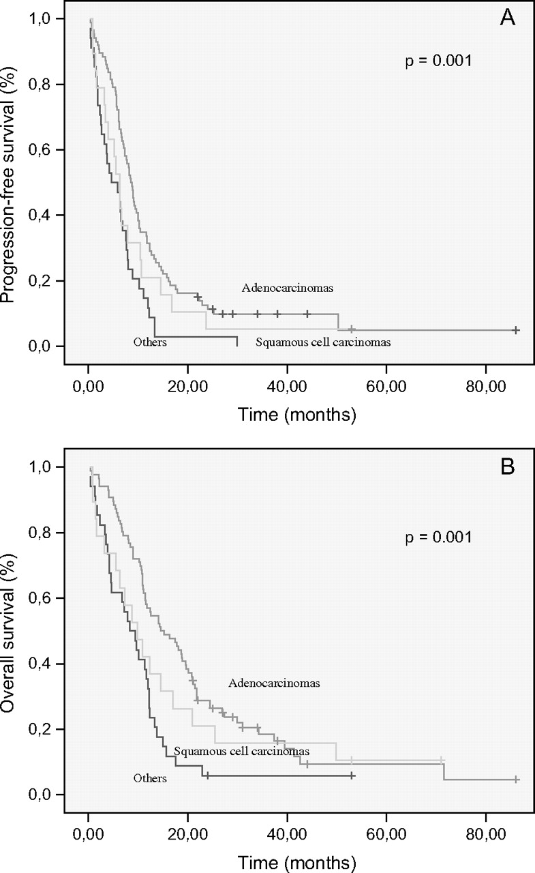
Figure 4. (A and B) Progression-free survival and overall survival in months for 139 patients with advanced ...
Notes:
Figure 4. (A and B) Progression-free survival and overall survival in months for 139 patients with advanced non-small-cell lung cancer, excision repair cross-complementation group 1 tumor marker negative and stratified according to the three main histological subtypes (adenocarcinomas, squamous cell carcinomas and others).
Unless provided in the caption above, the following copyright applies to the content of this slide: © The Author 2010. Published by Oxford University Press on behalf of the European Society for Medical Oncology. All rights reserved. For permissions, please email: journals.permissions@oxfordjournals.org

