Slide 1
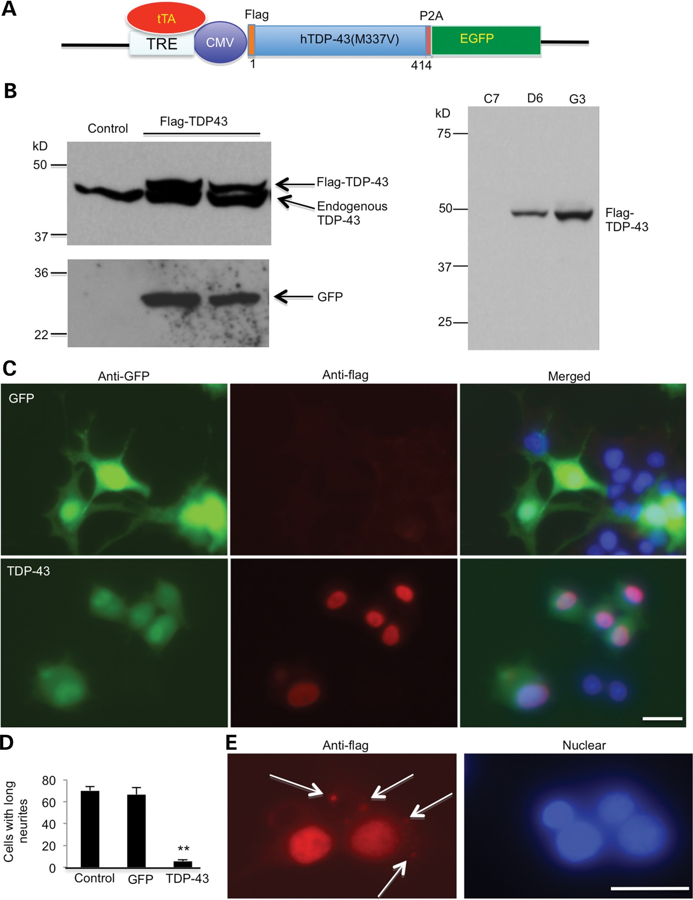
Figure 1. Expression of mutant TDP-43 suppresses neurite outgrowth of PC12 cells. (A) Schematic drawing of the TDP-43 ...
Notes:
Figure 1. Expression of mutant TDP-43 suppresses neurite outgrowth of PC12 cells. (A) Schematic drawing of the TDP-43 (M337V) in the Tet-Off vector. Mutant human TDP-43 (M337V) is tagged with Flag and linked to EGFP via 2A oligopeptides (P2A), which are self-cleaved to separate TDP-43 from EGFP when expressed in cells. Flag-TDP-43 is expressed in the absence of doxycycline. CMV, cytomegalovirus promoter. (B) Western blotting with anti-TDP-43 or anti-GFP antibodies revealing the expression of transfected Flag-TDP-43 and GFP in stably transfected PC12 cell lines (D6, G3) (left panel). Anti-flag antibody also verified the expression of transfected TDP-43 (right panel). Cells were examined after removing doxycycline for 6 days. (C) Double fluorescent immunostaining of PC12 cells (G3 clone) showing neurites in GFP control, but not in flag-TDP-43-transfected cells in response to NGF treatment. Scale bar: 10 μm. (D) Quantification of PC12 cells containing neurites longer than two cell body diameters (n = 300 each group). *P < 0.05. (E) In some flag-TDP-43-transfected cells under metabolic stress without glucose in culture medium for 2 days, cytoplasmic aggregates (arrows) are seen.
Unless provided in the caption above, the following copyright applies to the content of this slide: © The Author 2013. Published by Oxford University Press. All rights reserved. For Permissions, please email: journals.permissions@oup.com

Slide 2
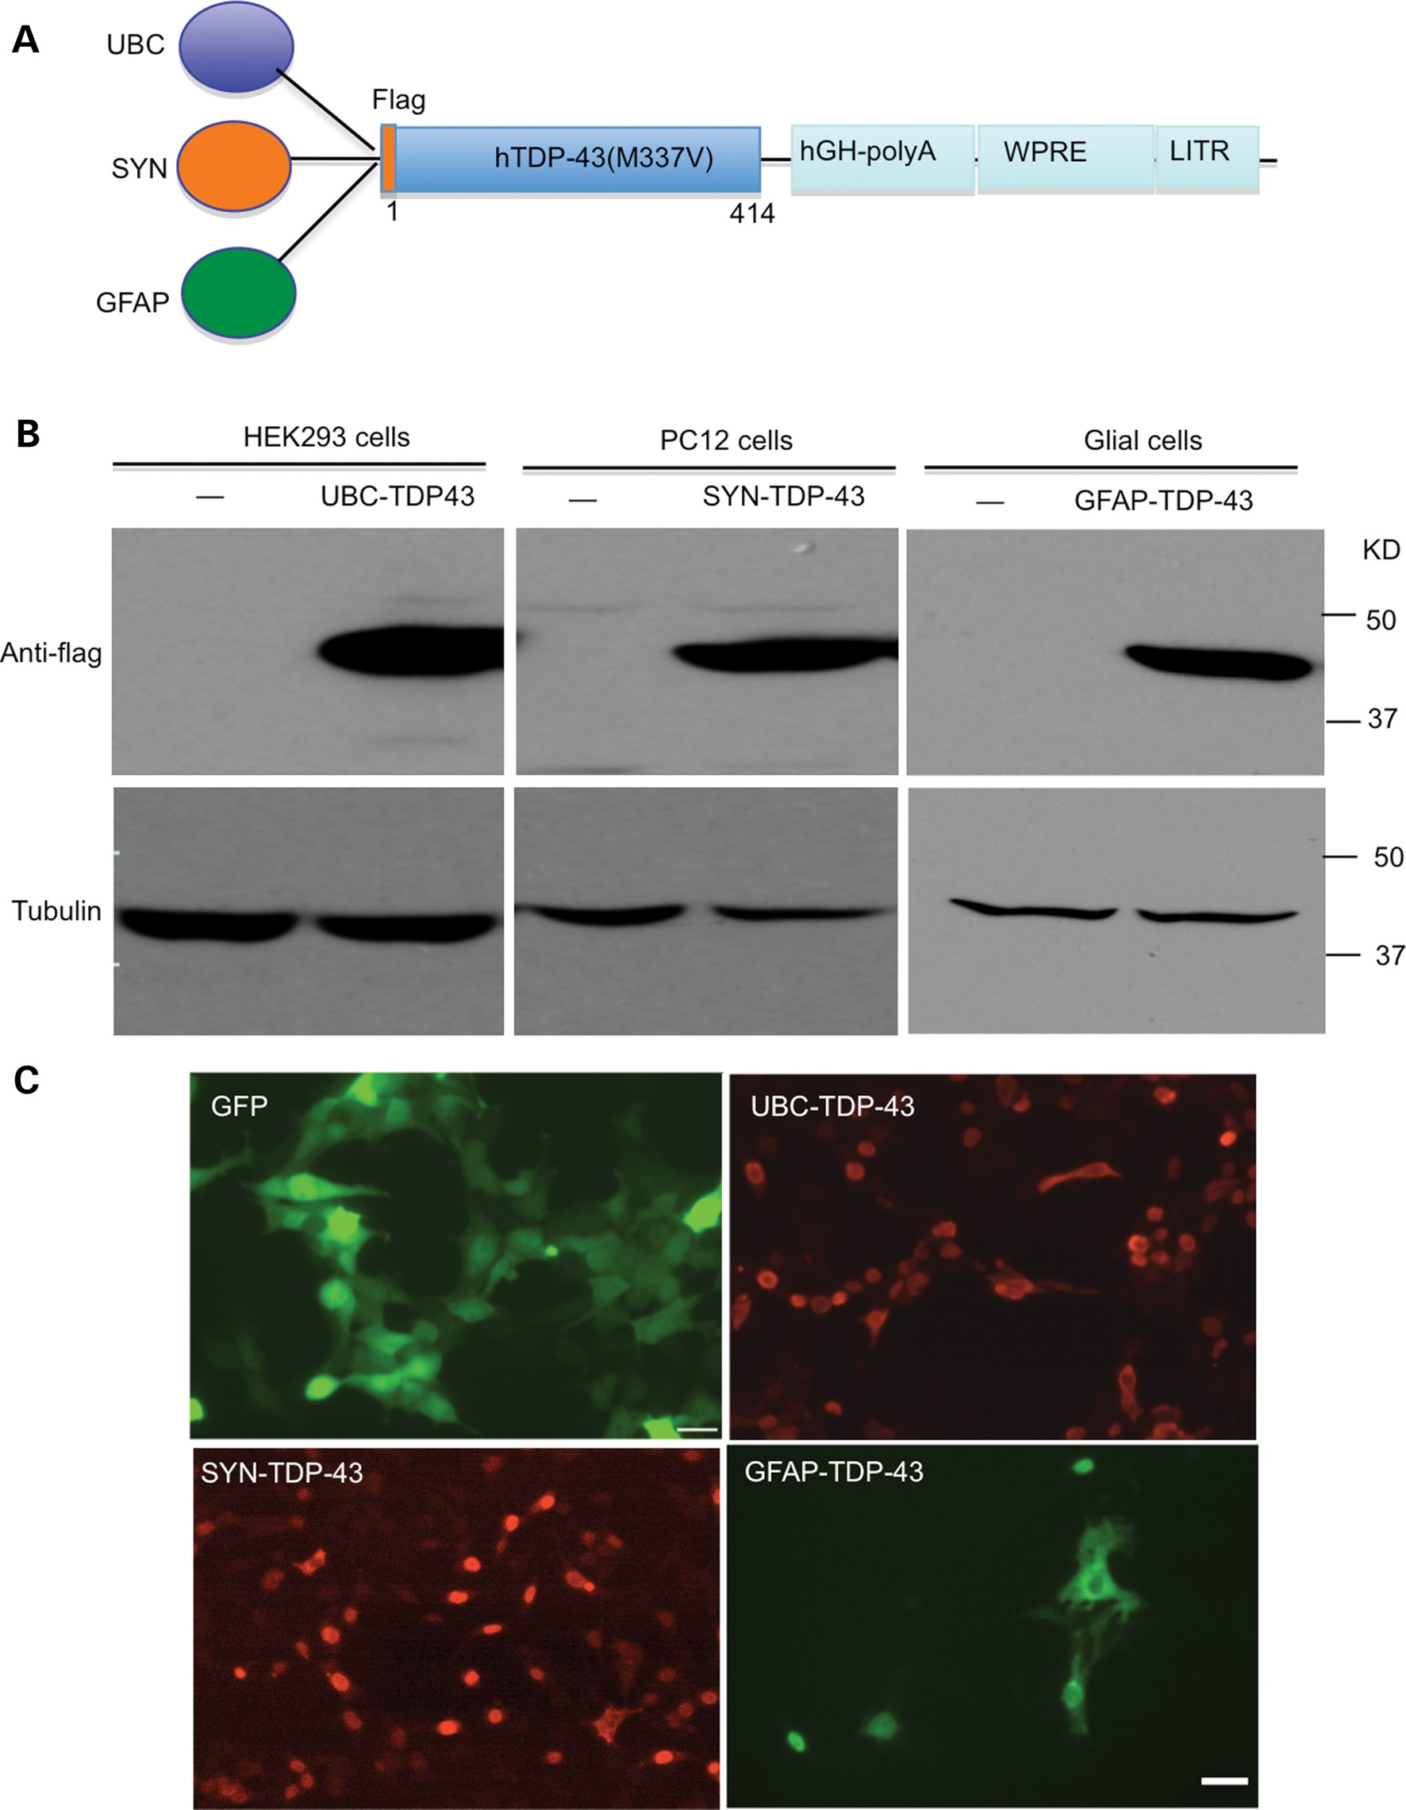
Figure 2. Expression of mutant TDP-43 in neuronal and glial cell lines. (A) Schematic diagrams of AAV9 viral vectors ...
Notes:
Figure 2. Expression of mutant TDP-43 in neuronal and glial cell lines. (A) Schematic diagrams of AAV9 viral vectors that contain human ubiquitin promoter (UBC), human synapsin-1 promoter (SYN) or human GFAP promoter. WPRE, woodchuck hepatitis virus post-transcriptional control element. (B) Western blotting with anti-flag detecting the expression of TDP-43 in HEK293, PC12 and cultured primary astrocyte cells. (–): non-infected cells. (C) Anti-GFP and anti-flag immunostaining also verified the expression of UBC-GFP control, UBC-TDP-43, SYN-TDP-43 and GFAP-TDP-43 viruses in different cell types. Scale bar: 10 μm.
Unless provided in the caption above, the following copyright applies to the content of this slide: © The Author 2013. Published by Oxford University Press. All rights reserved. For Permissions, please email: journals.permissions@oup.com

Slide 3
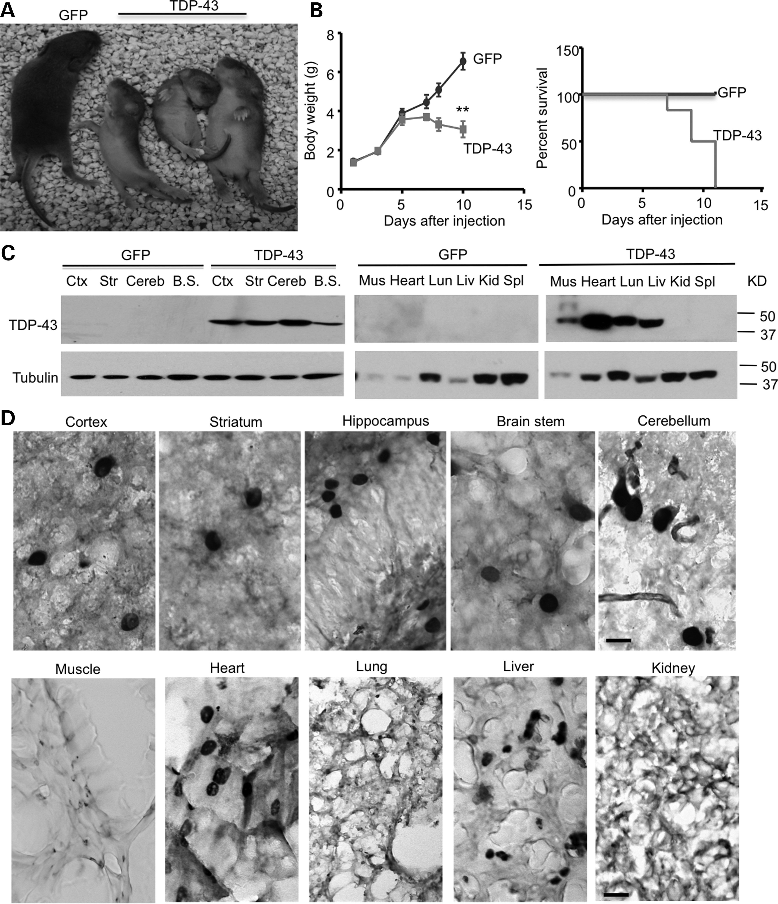
Figure 3. Expression of UBC-TDP-43 in postnatal-day-12 mice injected with AAV-UBC-TDP-43 at postnatal day 1. (A) The ...
Notes:
Figure 3. Expression of UBC-TDP-43 in postnatal-day-12 mice injected with AAV-UBC-TDP-43 at postnatal day 1. (A) The neonatal P1 mouse pups were intravenously (i.v) injected with 1.2 × 1010 vg of AAV9-UBC-GFP or UBC-TDP-43. At P12, mutant TDP-43 expression reduced the size of mice compared with UBC-GFP-injected mice. (B) Body weight (left panel) and survival rate (Kaplan–Meier plot, right panel) assays showing that mutant TDP-43 reduced body weight gain and caused early death of mice (n = 6 for each group). **P < 0.01. (C) Western blotting with anti-flag showing that the intravenous injection of AAV9-UBC-TDP-43 at P1 leads to the widespread expression of UBC-TDP-43 in the brain and peripheral tissues in mice at P12. Ctx, cortex; Str, striatum; Cereb, cerebellum; B.S., brain stem; Mus, muscle; Lun, lung; Liv, liver; Kid, kidney; Spl, spleen. (D) TDP-43 immunostaining of the brain and peripheral tissues of UBC-TDP-43-injected mice at P12. Note that mutant TDP-43 is enriched in neuronal cells in the brain and also in the nuclei of cells in heart and liver. Scale bar: 10 μm.
Unless provided in the caption above, the following copyright applies to the content of this slide: © The Author 2013. Published by Oxford University Press. All rights reserved. For Permissions, please email: journals.permissions@oup.com

Slide 4
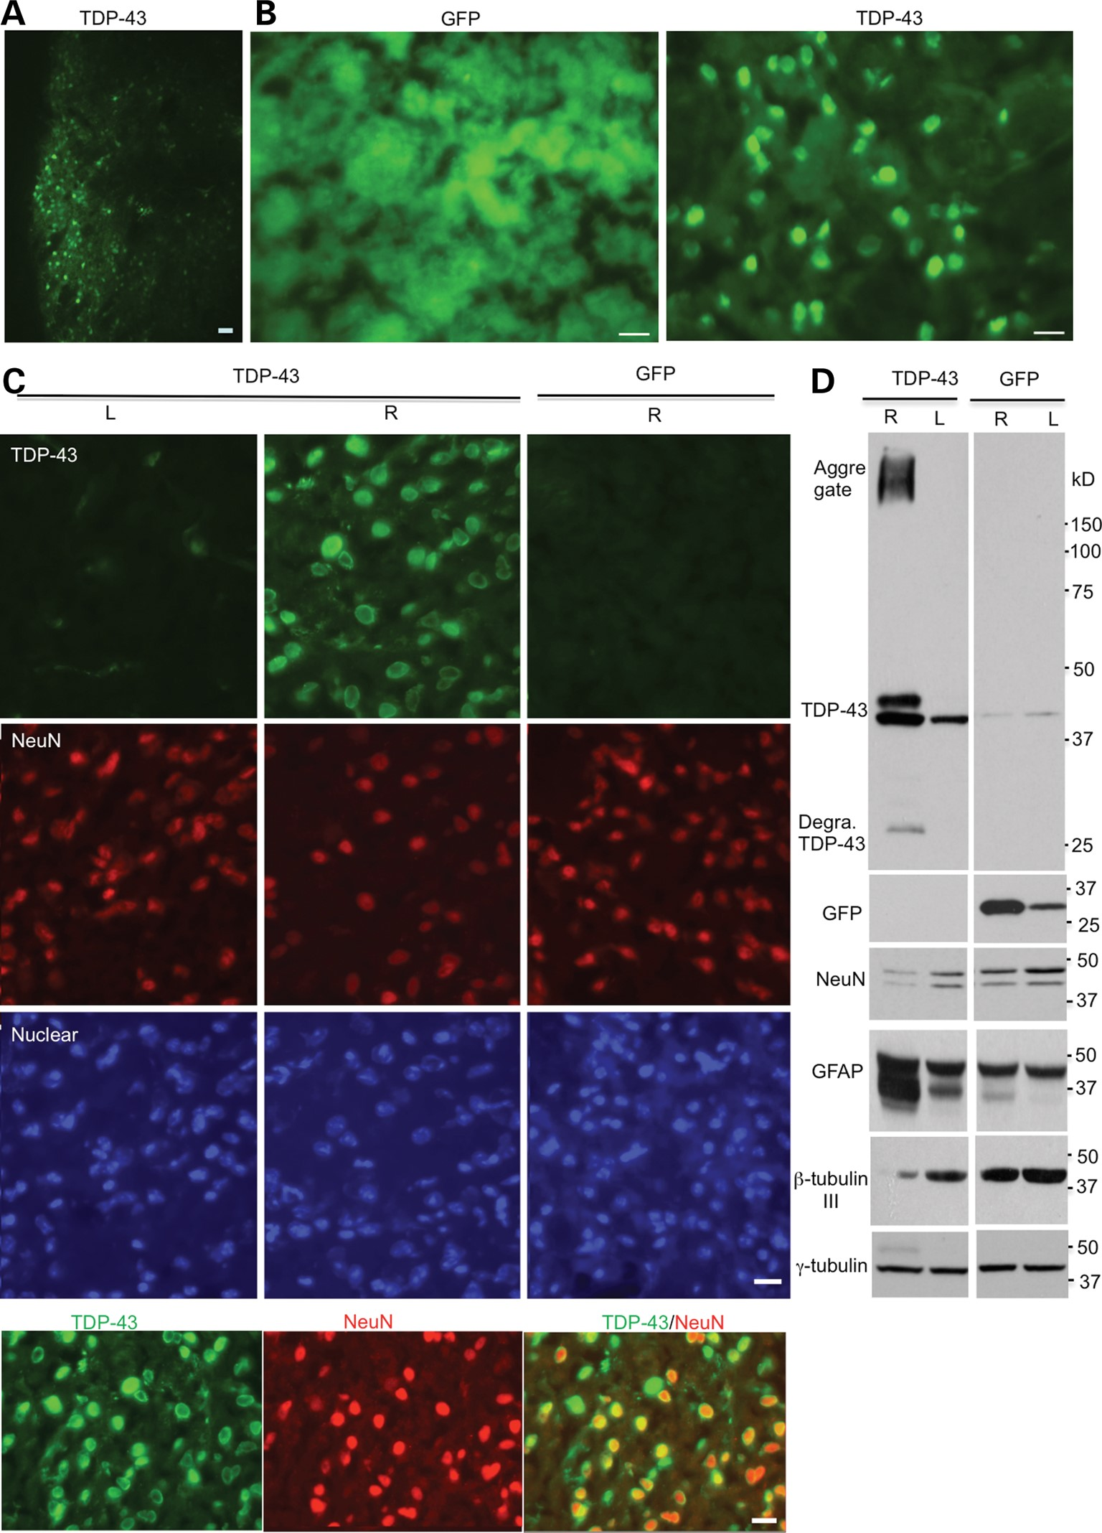
Figure 4. Stereotaxic injection of AAV-UBC-TDP-43 viruses into the striatum of mice. (A, B) Mice at 3 months of age ...
Notes:
Figure 4. Stereotaxic injection of AAV-UBC-TDP-43 viruses into the striatum of mice. (A, B) Mice at 3 months of age were injected with UBC-GFP or UBC-TDP-43 (2.5 × 1010 vg) into the right side of their striatum. After 15 days, immunofluorescent staining showed the expression of GFP or TDP-43 in the injected striatum. Scale bars: 10 μm. (C) High-magnification (40×) micrographs showing the expression of TDP-43 in neuronal nuclei with a reduced number of NeuN-positive cells in the right striatum (R), but not in the non-injected striatum (L) or UBC-GFP-injected right (R) side of the striatum. Colocalization of NeuN and TDP-43 is seen in the merged image (low panel). Scale bars: 10 μm. (D) Western blotting confirming the expression of UBC-TDP-43 or UBC-GFP in the injected right (R) side of the striatum in 18-month-old mice. Degra, degraded. Note that there are decreased levels of NeuN as well as β-tubulin-III and an increased level of GFAP in the presence of TDP-43 compared with the non-injected or UBC-GFP-injected striatum.
Unless provided in the caption above, the following copyright applies to the content of this slide: © The Author 2013. Published by Oxford University Press. All rights reserved. For Permissions, please email: journals.permissions@oup.com

Slide 5
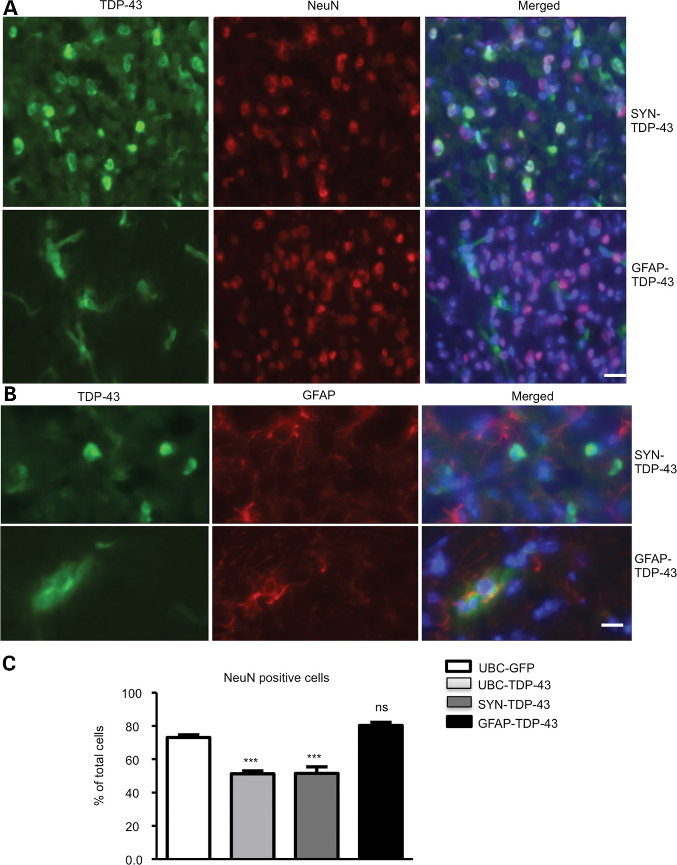
Figure 5. Stereotaxic injection of SYN-TDP-43 and GFAP-TDP-43 viruses into the striatum of mice. (A) Double ...
Notes:
Figure 5. Stereotaxic injection of SYN-TDP-43 and GFAP-TDP-43 viruses into the striatum of mice. (A) Double immunofluorescent staining showing the expression of SYN-TDP-43 and GFAP-TDP-43 in the striatum of mice at 3 months of age after being injected for 15 days. Scale bar: 10 μm. (B) High-magnification micrographs showing the selective expression of SYN-TDP-43 and GFAP-TDP-43 in NeuN-positive neurons and GFAP-positive astrocytes, respectively. Scale bar: 10 μm. (C) Counting NeuN-positive and GFAP-positive cells showing that UBC-TDP-43 and SYN-TDP-43 reduced the number of NeuN-positive cells. Expression of GFAP-TDP-43 in astrocytes did not significantly alter the numbers of NeuN-positive cells. ***P < 0.001 compared with UBC-GFP-injected striatum.
Unless provided in the caption above, the following copyright applies to the content of this slide: © The Author 2013. Published by Oxford University Press. All rights reserved. For Permissions, please email: journals.permissions@oup.com

Slide 6
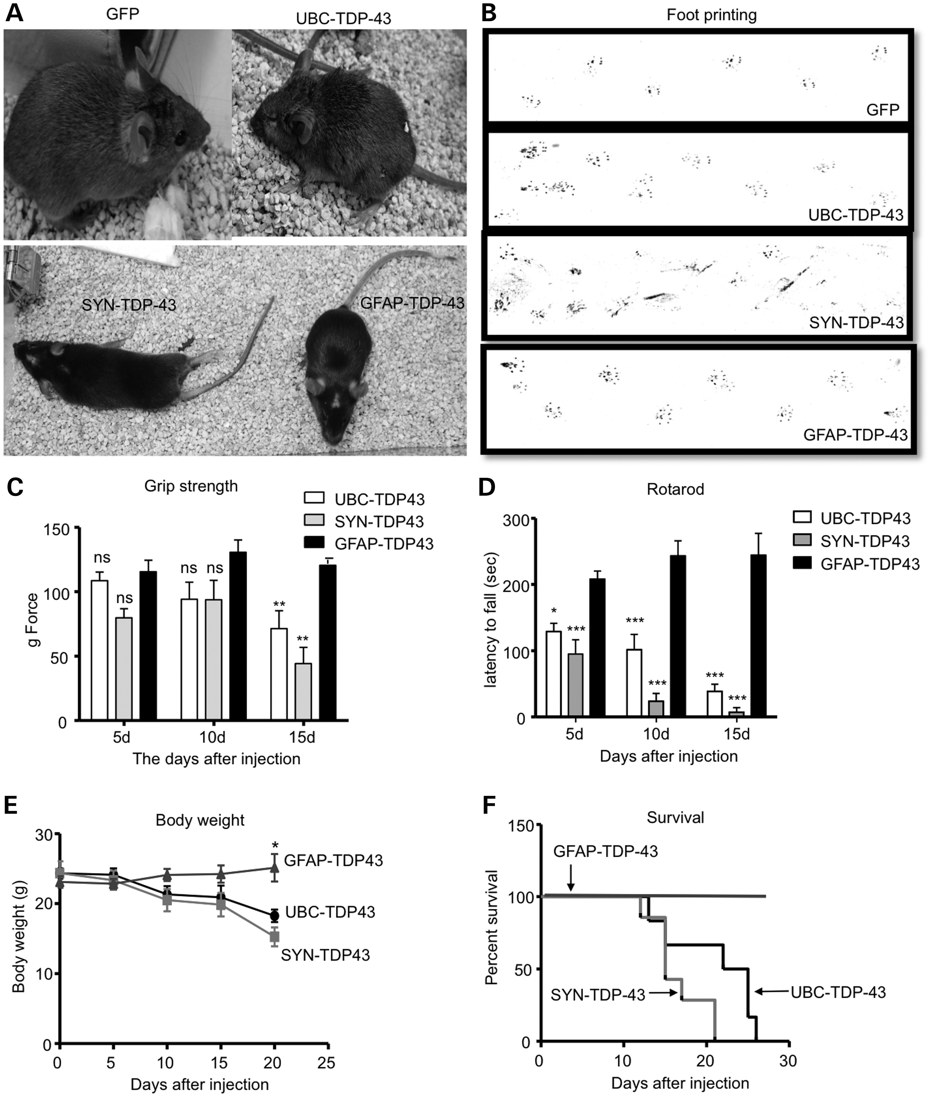
Figure 6. Expression of mutant TDP-43 in neuronal cells in the striatum of mice causes more severe phenotypes than ...
Notes:
Figure 6. Expression of mutant TDP-43 in neuronal cells in the striatum of mice causes more severe phenotypes than those in glial cells. (A) Mice that were injected with UBC-TDP-43 or SYN-TDP-43 into their striatum for 15 days are smaller in size and show paralysis compared with UBC-GFP- or GFAP-TDP-43-injected mice. (B) The foot-printing assay (front paws in red and hind paws in blue) revealing gait abnormalities in UBC-TDP-43- and SYN-TDP-43-injected mice compared with UBC-GFP- and GFAP-TDP-43-injected mice. (C, D) Motor function impairment of UBC-TDP-43- and SYN-TDP-43-injected mice, which was revealed by hind limb grip strength (C) and rotarod performance (D) assays. Two-way (genotype × time) ANOVA revealed statistic significance (**P < 0.01, ***P < 0.001). (E, F) Body weight (E) and survival (F) assays showing that expression of mutant TDP-43 in neuronal cells caused a greater reduction in body weight and survival in UBC-TDP-43- or SYN-TDP-43-injected mice compared with GFAP-TDP-43-injected mice (n = 6 per group). In C–F, *P < 0.05, **P < 0.01, ***P < 0.001 compared with GFAP-TDP-43 group.
Unless provided in the caption above, the following copyright applies to the content of this slide: © The Author 2013. Published by Oxford University Press. All rights reserved. For Permissions, please email: journals.permissions@oup.com

Slide 7
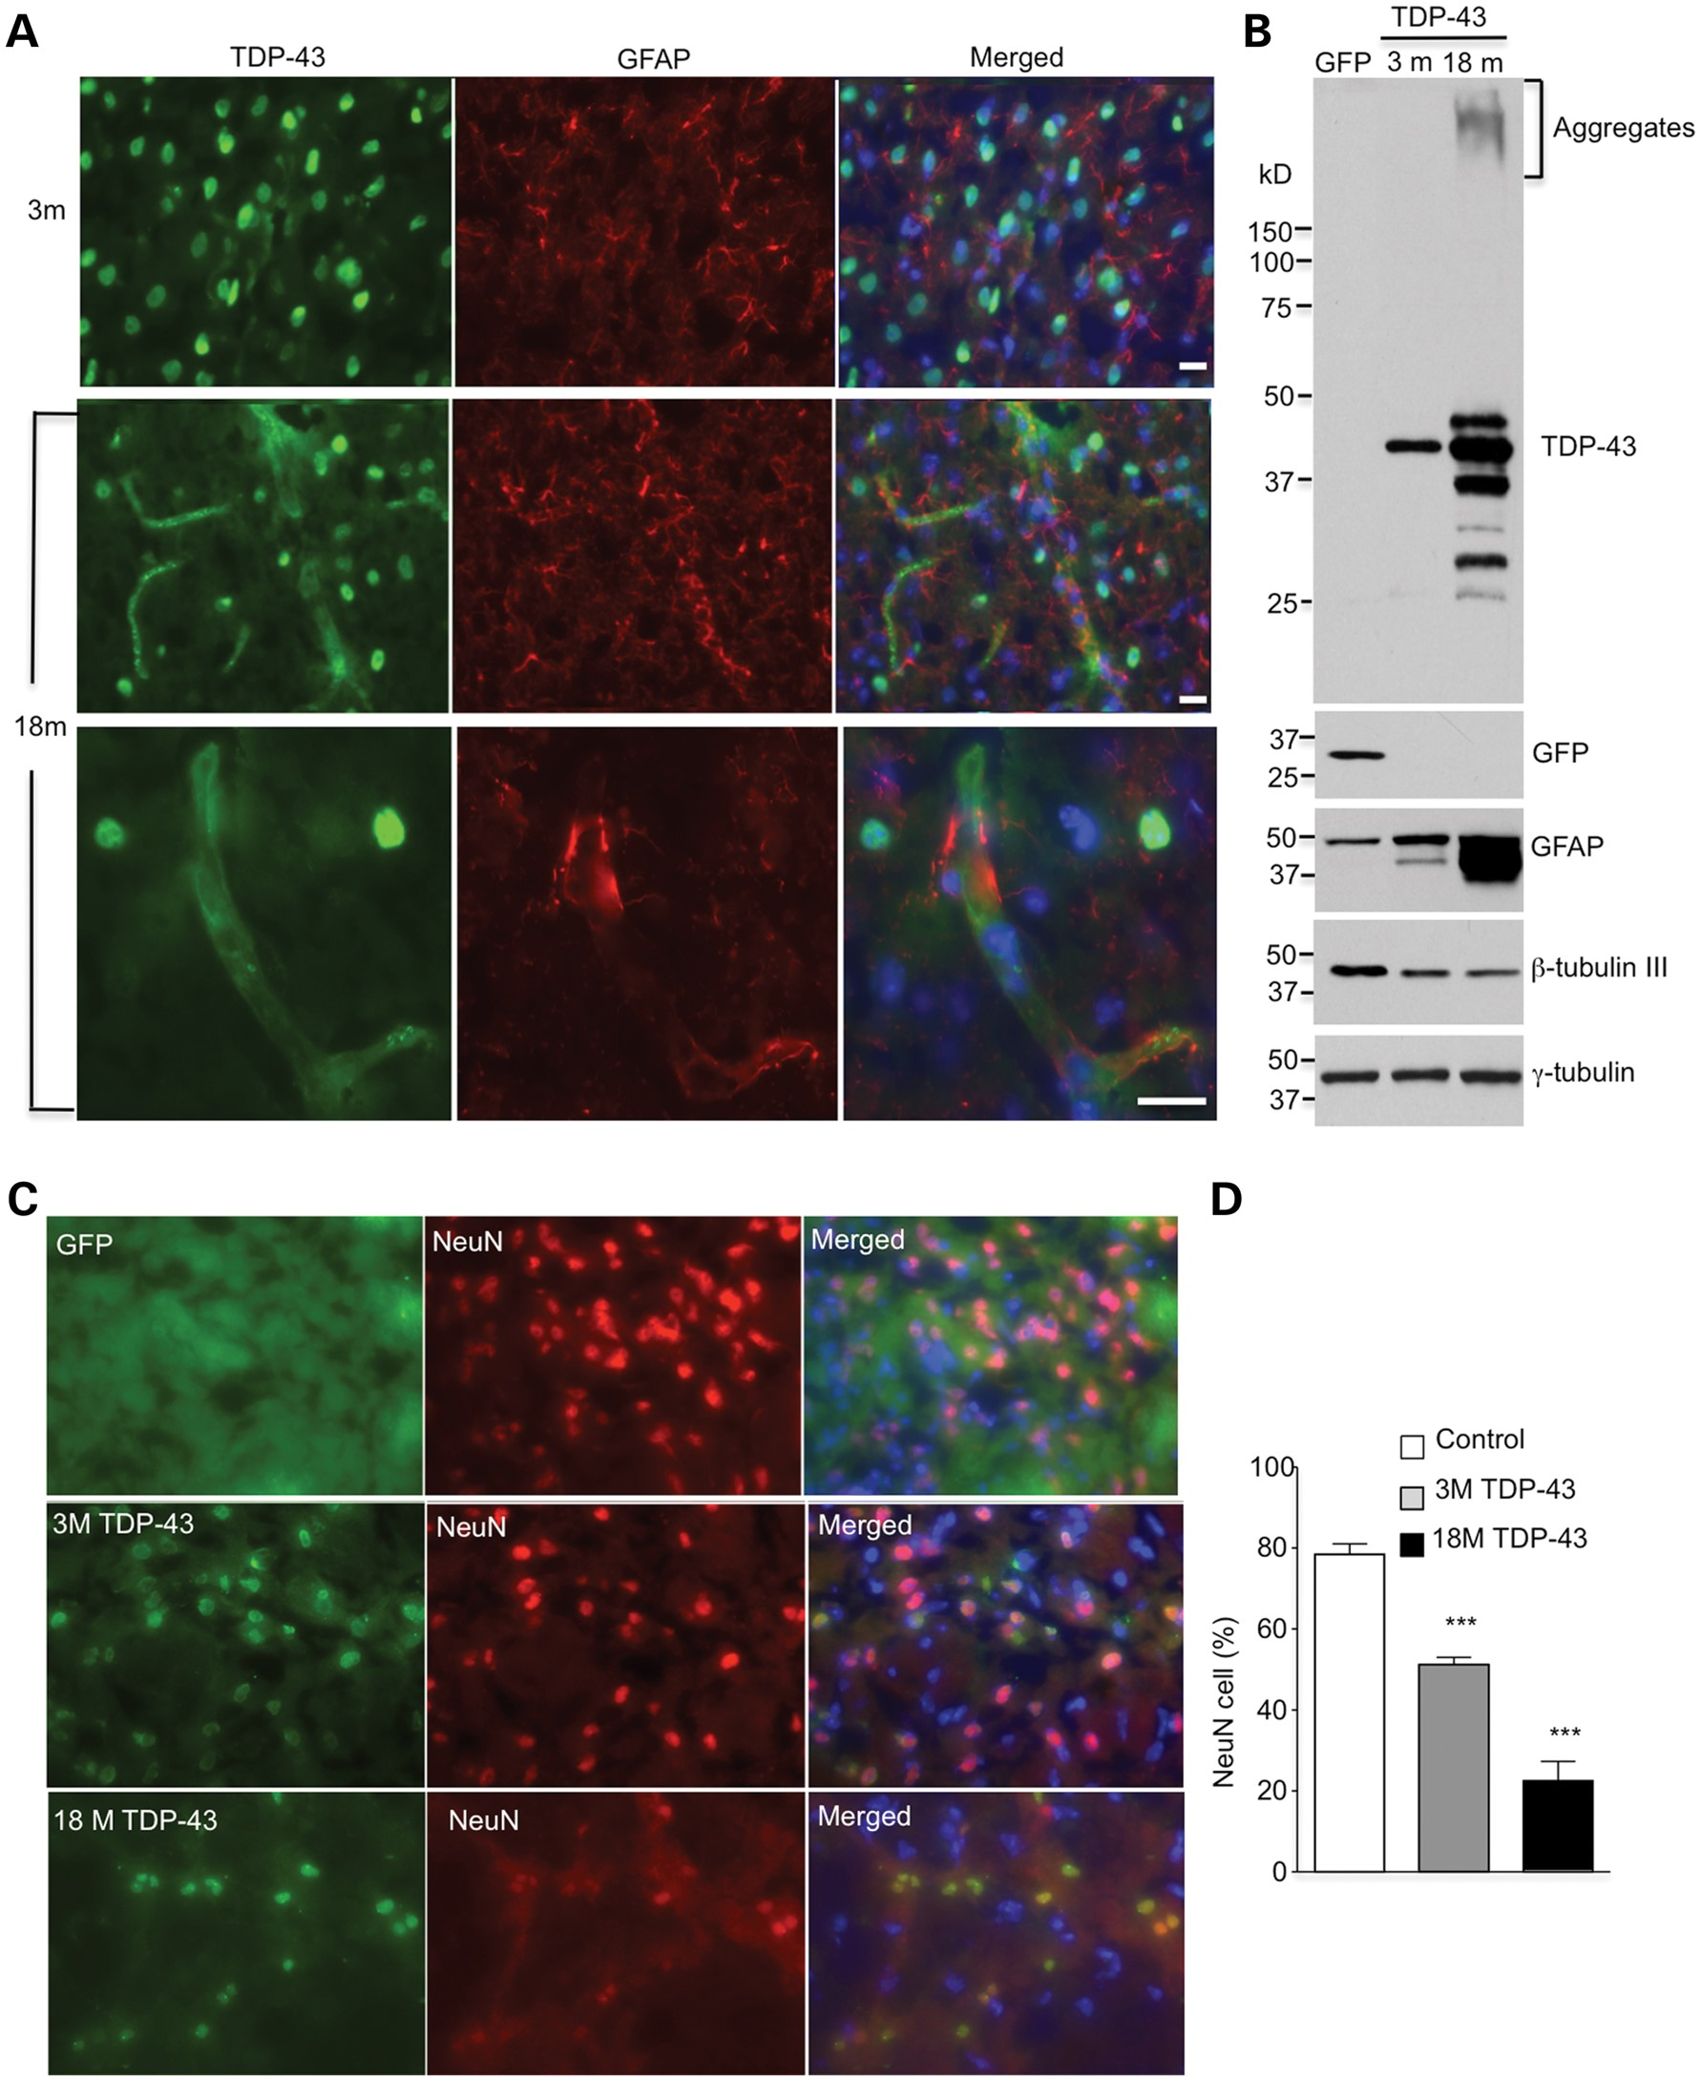
Figure 7. Aging promotes the expression of UBC-TDP-43 in glial cells and exacerbates neuronal degeneration. (A) Double ...
Notes:
Figure 7. Aging promotes the expression of UBC-TDP-43 in glial cells and exacerbates neuronal degeneration. (A) Double immunostaining of the striatum of mice at 3 and 18 months of age showing that more GFAP-positive cells express TDP-43 in 18-month-old mice after injection of AAV9-UBC-TDP-43 for 15 days. The bottom panel shows high-magnification graphs in which TDP-43 is expressed in GFAP-positive astrocytes. Scale bar: 10 μm. (B) Western blotting also revealing the increased levels of TDP-43 and GFAP in the injected striatum of an 18-month-old mouse compared with that in a 3-month-old mouse. Neuronal marker protein, β-tubulin-III, is also decreased. (C) Double immunostaining of the striatum of mice at 3 and 18 months of age showing a decrease in NeuN-positive cells (% of total cells) after UBC-TDP-43 had been injected for 15 days. Scale bar: 10 μm. (D) Quantitative assessment of NeuN-positive cells showing fewer NeuN cells in 18-month-old mice than in 3-month-old mice (n = 600 cells each group). ***P < 0.001 compared with the non-injected control striatum.
Unless provided in the caption above, the following copyright applies to the content of this slide: © The Author 2013. Published by Oxford University Press. All rights reserved. For Permissions, please email: journals.permissions@oup.com

Slide 8
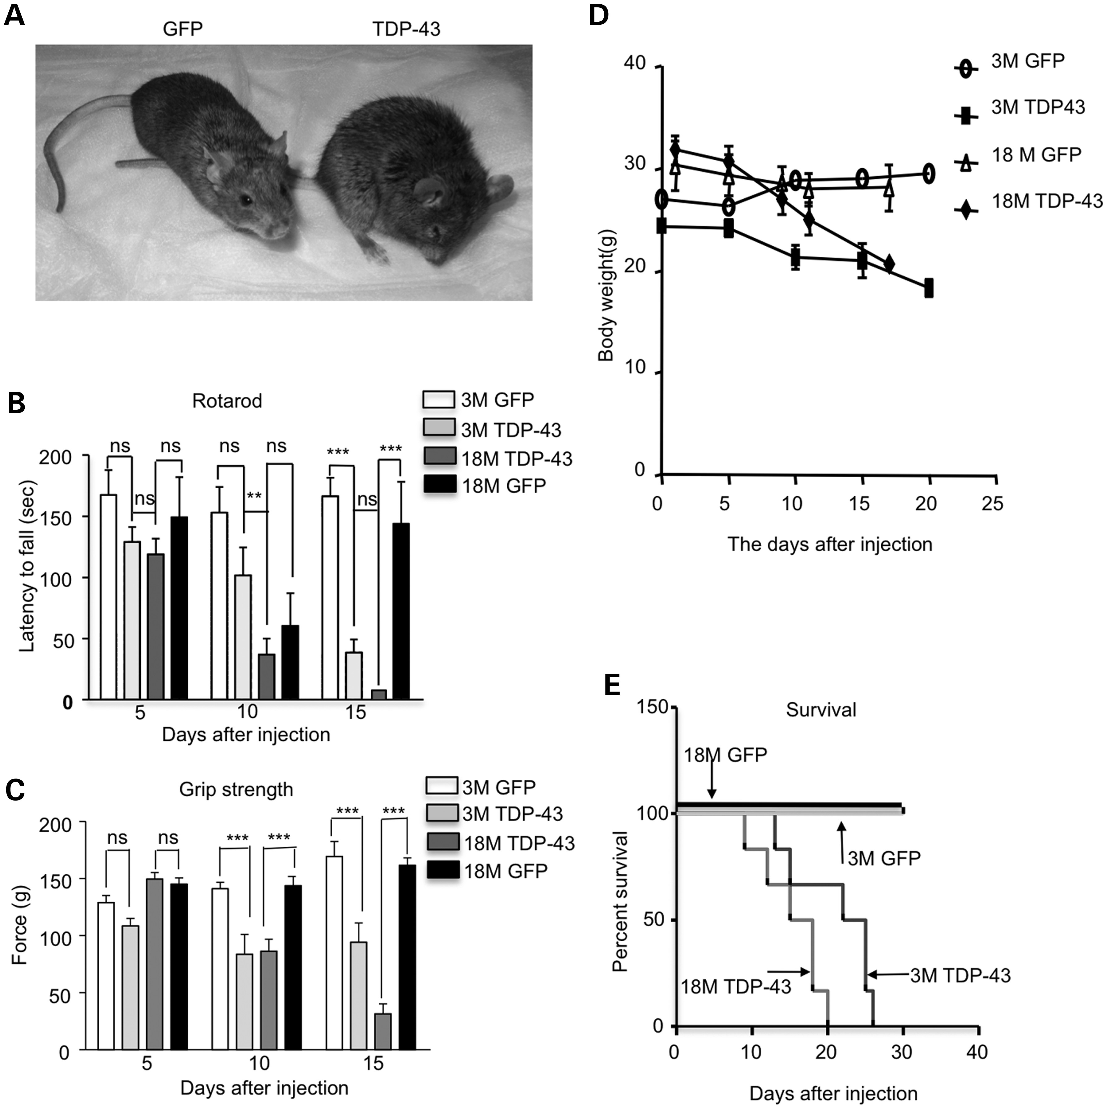
Figure 8. Aging increases the severity of phenotypes of UBC-TDP-43-injected mice. (A) Pictures of 18-month-old mice ...
Notes:
Figure 8. Aging increases the severity of phenotypes of UBC-TDP-43-injected mice. (A) Pictures of 18-month-old mice that were injected with UBC-GFP or UBC-TDP-43. (B, C) Rotarod performance (B) and hind limb grip strength (C) tests showing more severe motor impairment in 18-month-old mice than 3-month-old mice at 10 days after stereotaxic injection of AAV-UBC-TDP-43 (n = 6 per group). Two-way (genotype × time) ANOVA revealed statistic significance (**P < 0.01, ***P < 0.001). (D, E) Mice at 18 months of age also showed reduced body weight (D) and earlier death (E) than 3-month-old mice after their striata were injected with AAV-UBC-TDP-43 virus. The control is AAV-UBC-GFP-injected mice (n = 6 per group).
Unless provided in the caption above, the following copyright applies to the content of this slide: © The Author 2013. Published by Oxford University Press. All rights reserved. For Permissions, please email: journals.permissions@oup.com

Slide 9
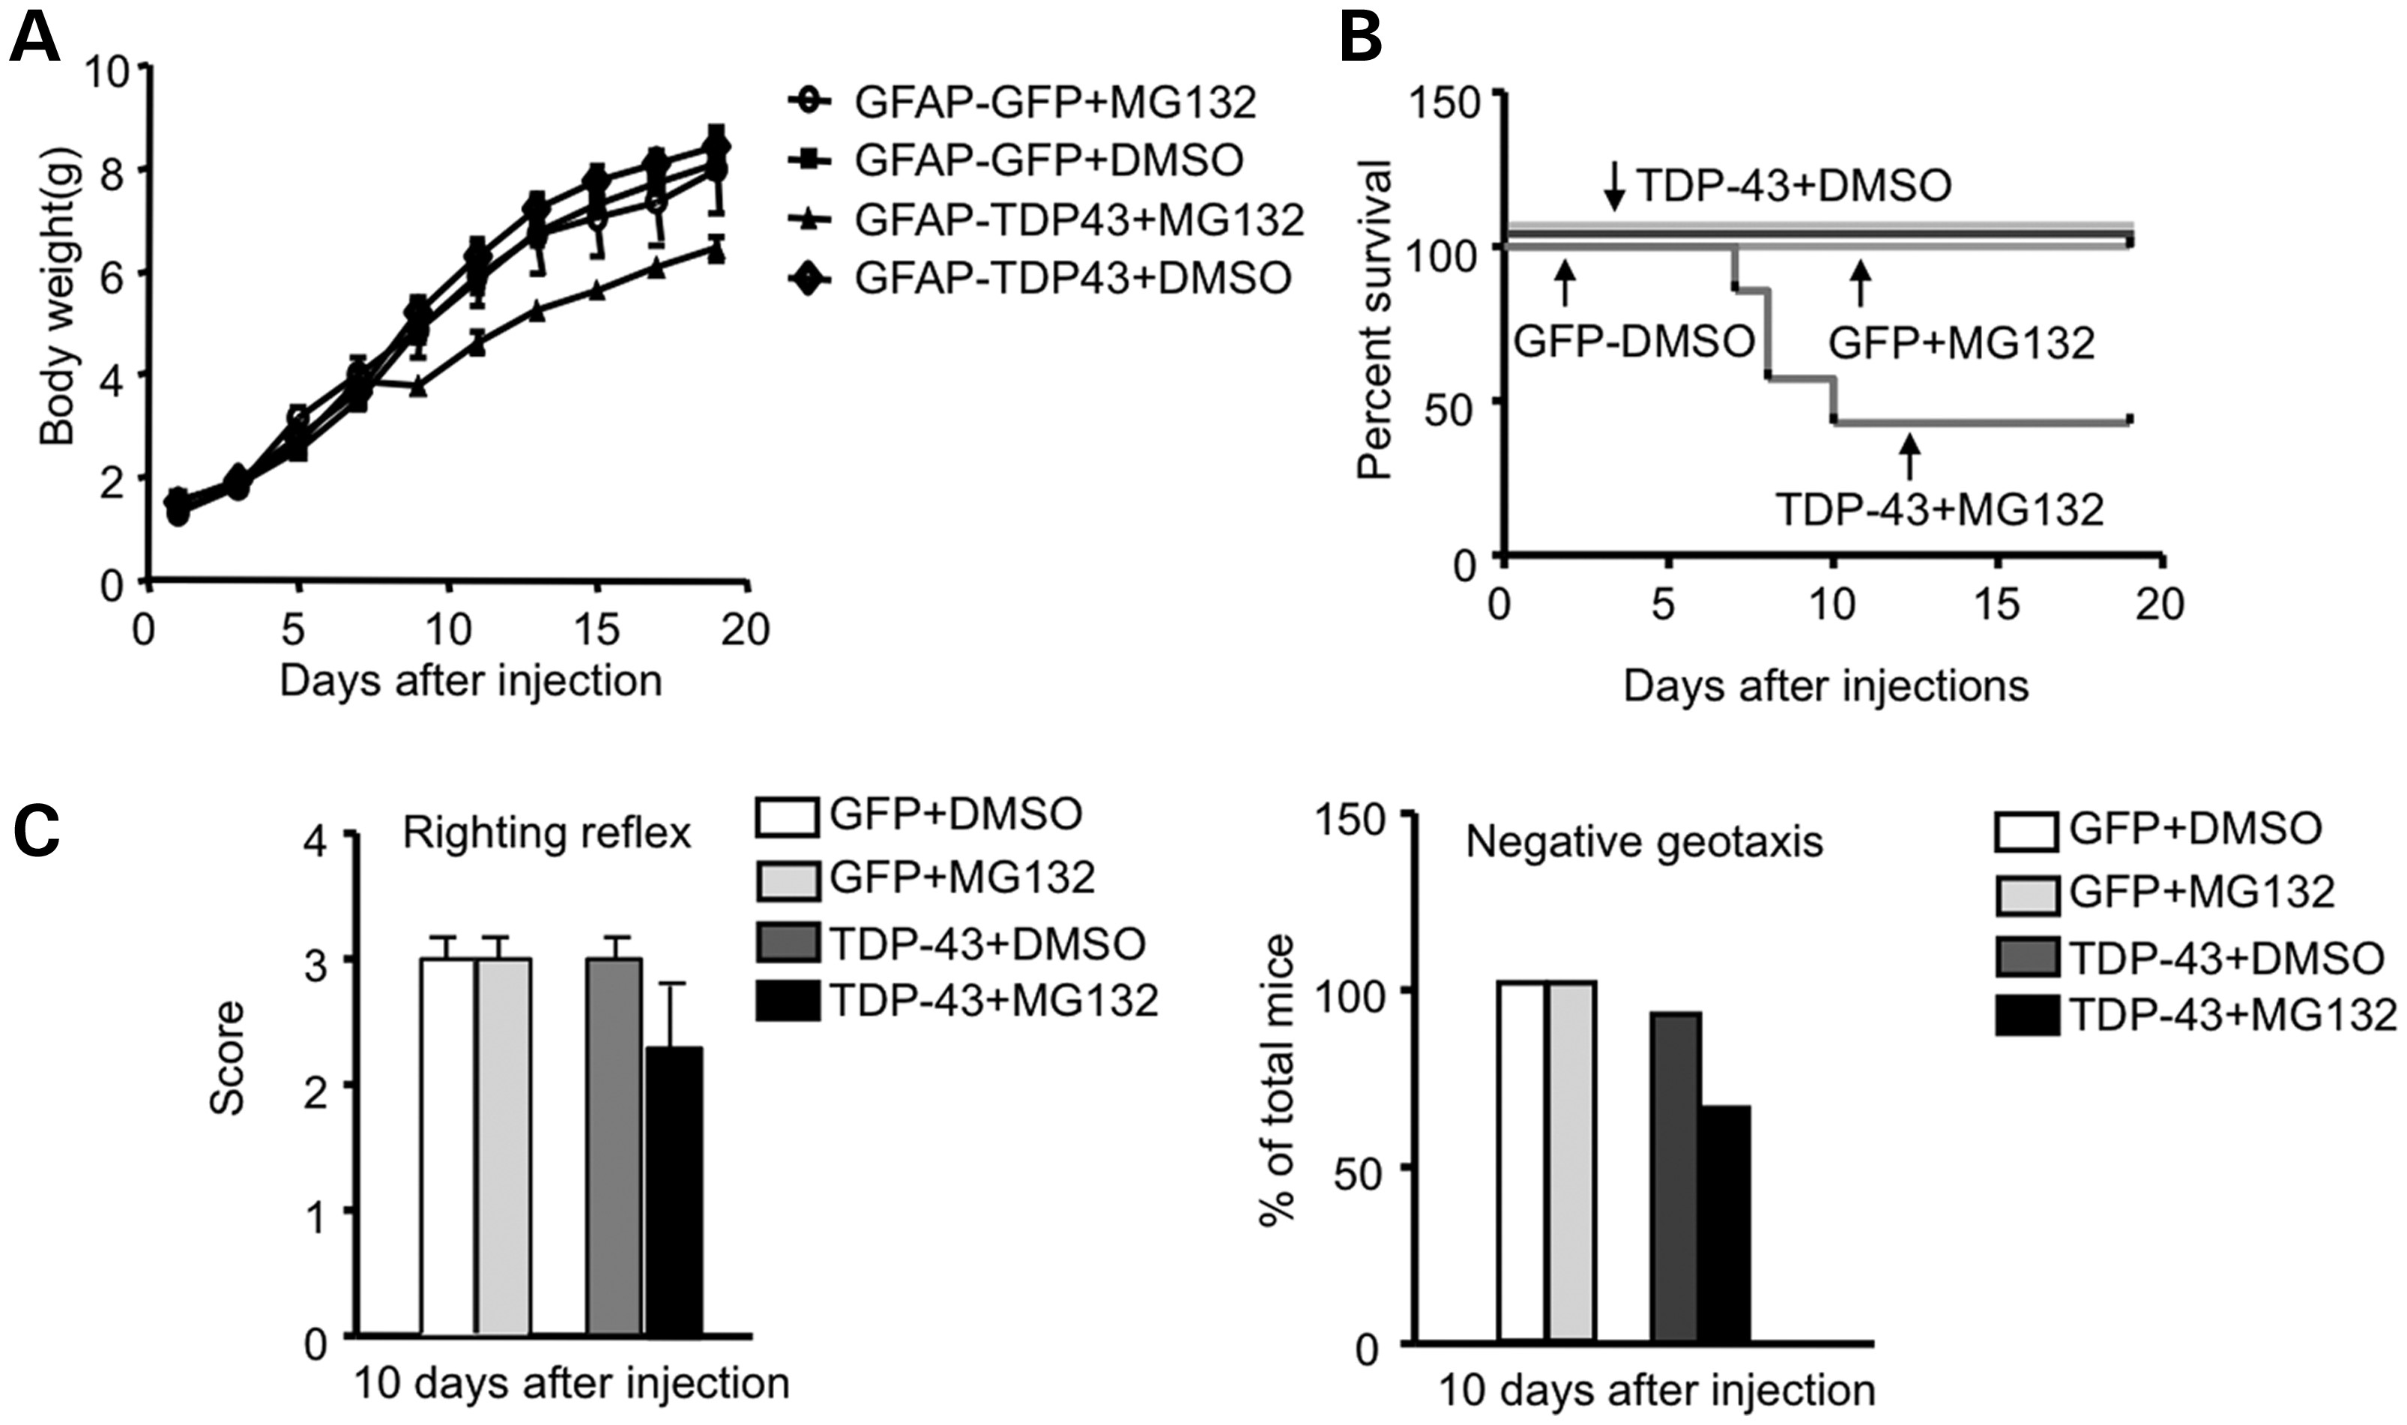
Figure 9. Inhibition of proteasome activity of postnatal mice enhances glial expression of TDP-43 and toxicity. (A) ...
Notes:
Figure 9. Inhibition of proteasome activity of postnatal mice enhances glial expression of TDP-43 and toxicity. (A) Changes in body weight of mice injected with AAV GFAP-TDP-43 or GFAP-GFP at P1, which was expressed under the control of GFAP promoter. The mice were then subcutaneously injected with MG132 (5 mg/kg/day) for 10 days (n = 6 each group). (B) About 50% of GFAP-TDP-43-injected mice treated with MG132 die during postnatal days 7–10. (C) MG132 treatment reduced the righting reflex and negative geotaxis behavior of GFAP-TDP-43 virus-injected pups as compared with AAV GFAP-GFP-injected mouse pups.
Unless provided in the caption above, the following copyright applies to the content of this slide: © The Author 2013. Published by Oxford University Press. All rights reserved. For Permissions, please email: journals.permissions@oup.com

Slide 10
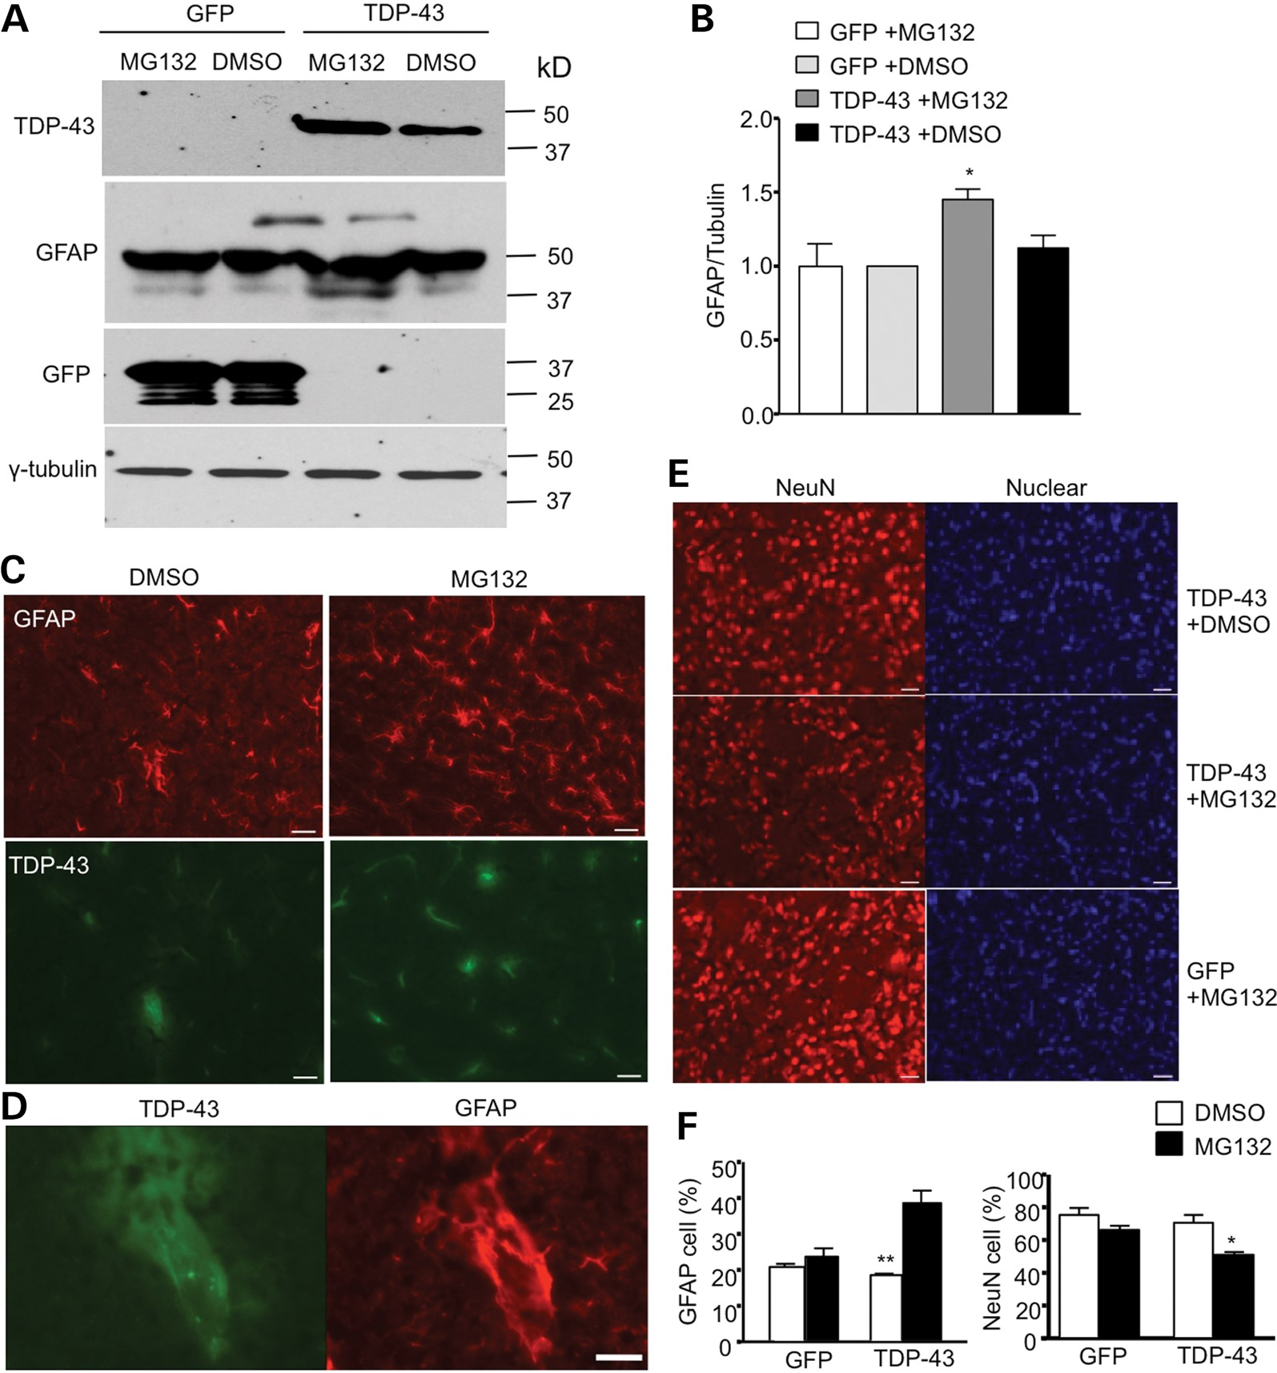
Figure 10. Inhibition of proteasome activity increases the expression of TDP-43 in astrocytes and neuronal toxicity. (A) ...
Notes:
Figure 10. Inhibition of proteasome activity increases the expression of TDP-43 in astrocytes and neuronal toxicity. (A) Western blotting showing that MG132 treatment increased the level of TDP-43 and GFAP in the brain of mouse pups that were injected with AAV GFAP-TDP-43. AAV GFAP-GFP injection served as a control. (B) Quantitative analysis of the relative levels of TDP-43 and GFAP (ratio to tubulin relative to GFP with DMSO group) on western blots. (C–D) Double immunostaining of P20-day-old mouse pups that were intraventricularly injected with AAV GFAP-TDP-43 at P1 and then subcutaneously injected with DMSO or MG132 (5 mg/kg) daily. The brain sections were stained with anti-flag for TDP-43 (green) and anti-GFAP (red) for astrocytes. (E) Immunofluroescent staining with anti-NeuN (red) for neuronal cells and Hoechst dye for the nucleus. Scale bar: 10 μm. (F) The percentage of NeuN- and GFAP-positive cells of total cells in AAV GFAP-TDP-43-injected-mouse pup brains after MG132 treatment.
Unless provided in the caption above, the following copyright applies to the content of this slide: © The Author 2013. Published by Oxford University Press. All rights reserved. For Permissions, please email: journals.permissions@oup.com

